Slide 1
SCHOLARSHIPS
LOCAL / SCHOOL BASED SCHOLARSHIPS
&
DISTRICT / AUTHORITY AWARD

Slide 2
Things you must have to complete your scholarship package
PEN – located on your report cards (not your school student number – 9 digit pen)
Photo of yourself – nothing formal, just a quick snap, can be B&W, printed on regular paper
Social insurance Number (required by some district scholarships)
A teacher nominator – you just require their signature verifying they support your application
A reference letter from anyone except a hwss teacher or family member
Personal statement – tell us about yourself and your goals
Copy of your bceid transcript
Financial need form if you are applying for any that require it – must be completed correctly or will not be eligible (do not declare family income as $0)
print legibly and put your name on the bottom of each page
HAND IN ELECTRONICALLY OR IN PERSON TO MS. BUTLER dbutler@sd43.bc.ca

Slide 3
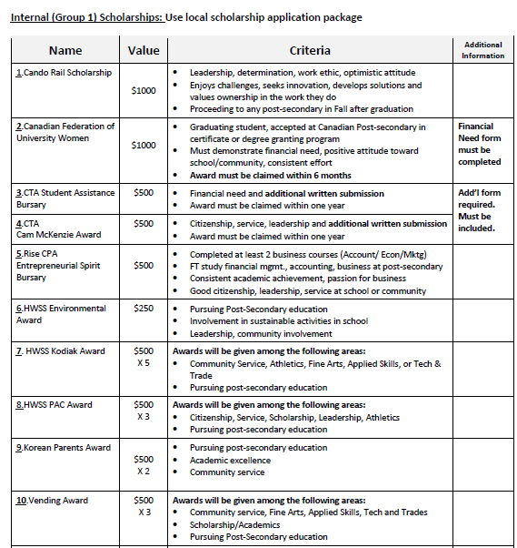
Notice that each scholarship has a number beside it? Apply for them in numerical order. If not applying for some, begin with the first number you are applying for.
Notice that each scholarship has criteria?
Indicate how you meet that criteria.

Slide 4
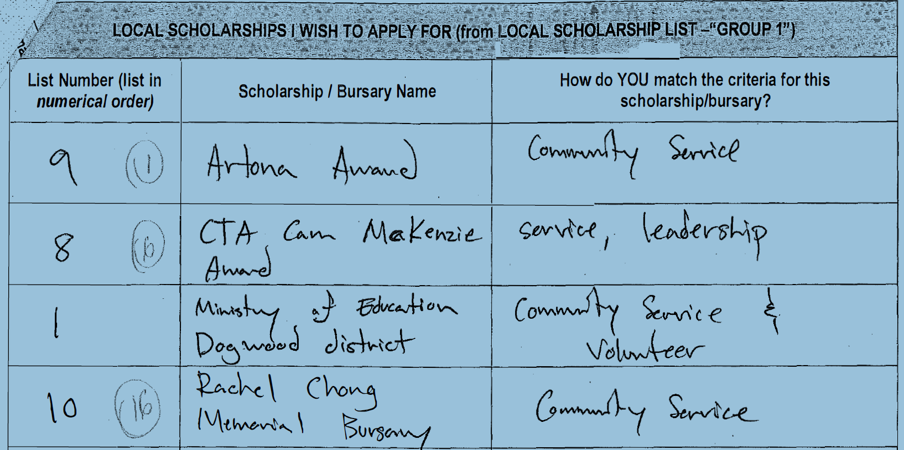
WHAT NOT TO DO

Slide 5
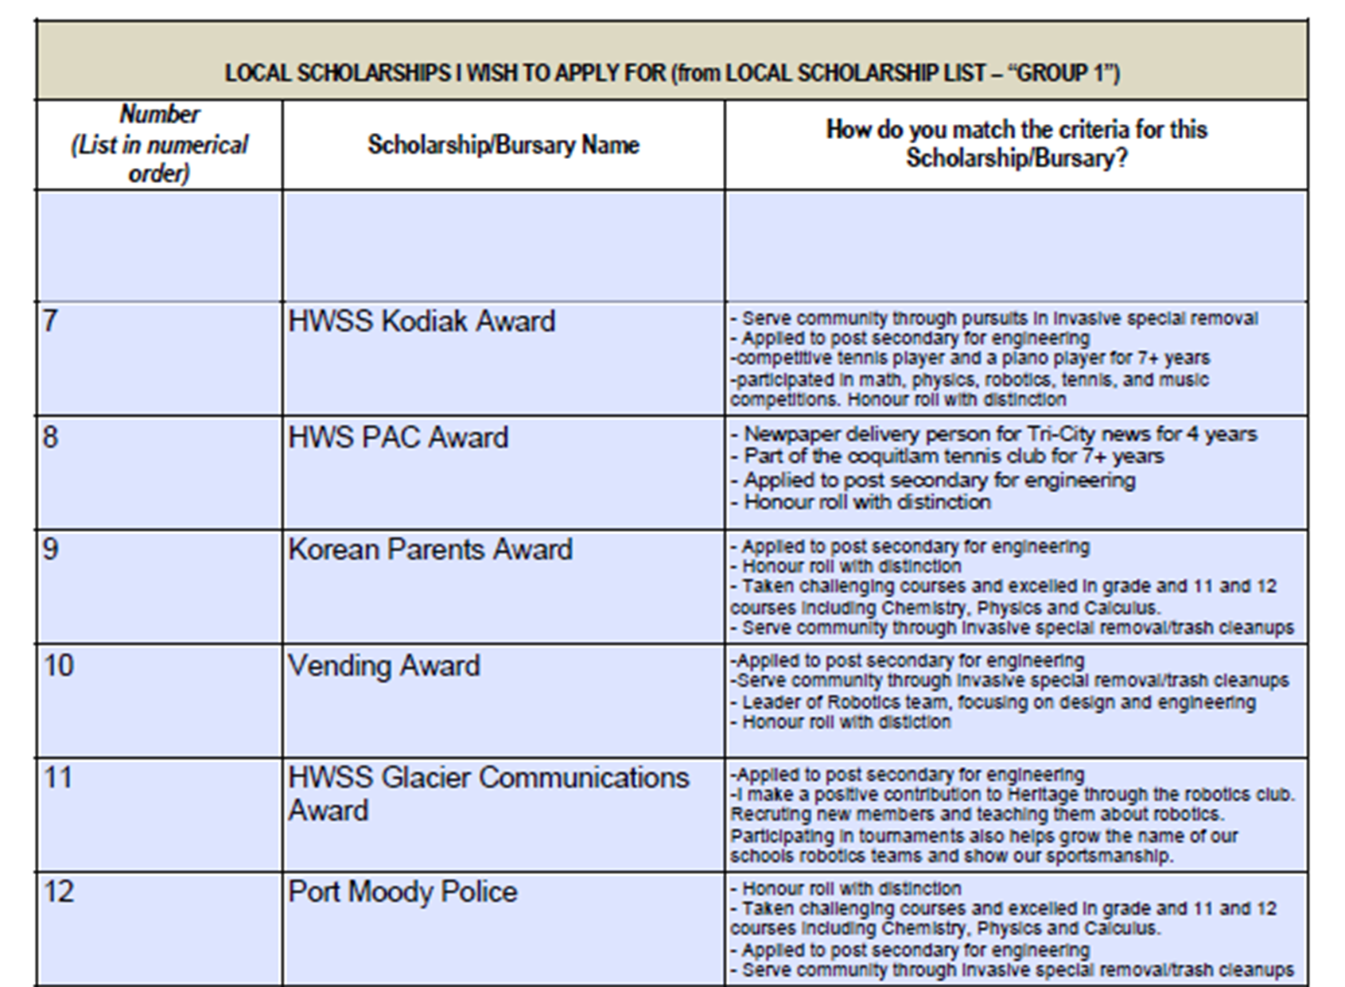
DO THIS!!!!!

Slide 6
APPLICATION ARE DUE:
FRIDAY, APRIL 12, 2024
NO LATER THAN 12:00 PM
Late or Incomplete Packages will not be accepted!

Slide 7
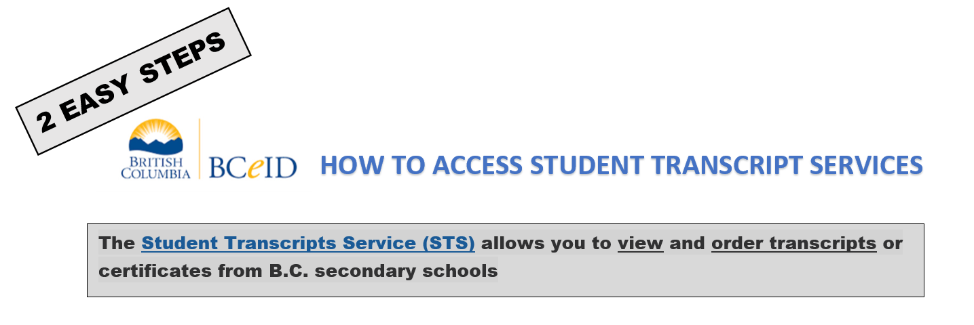
WHY?

Slide 8
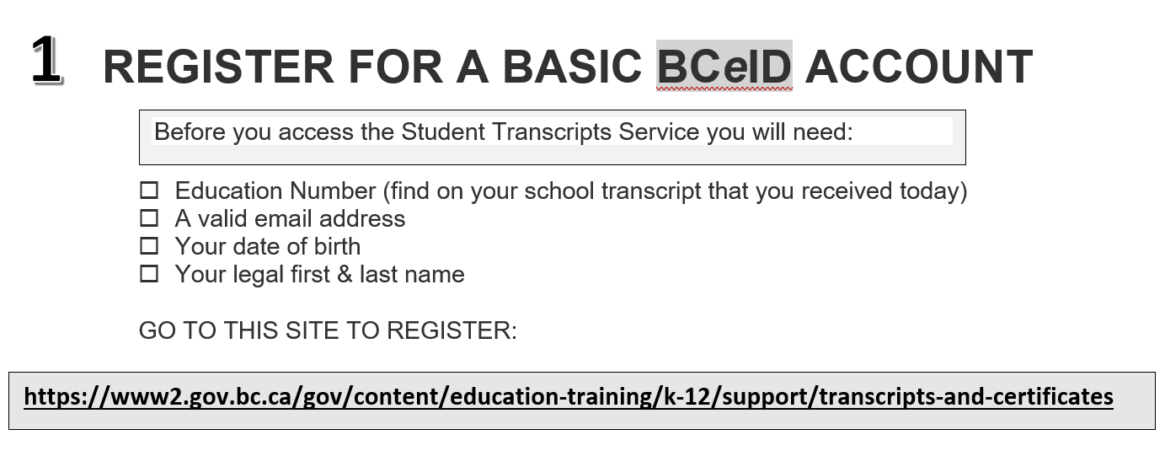

Slide 10
Where to find scholarships on my website
Financial Aid - Heritage Woods Secondary School (sd43.bc.ca)
Scholarships are listed by due date
Click on each scholarship to see criteria. Most applications will be attached or in the link

