Slide 1
War of the Worlds
Orson Welles

Slide 2
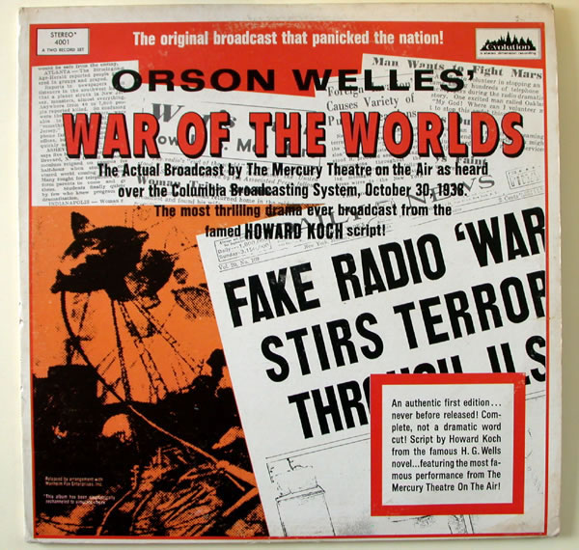

Slide 3
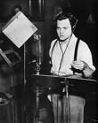

Slide 4
