Slide 1
Cozy up with a good book
Top Picks for Middle School Readers
With Jessica, Maria, Paul, Emma, Heather and John

Slide 2
Today’s Presentation
Windows and Mirrors
Middle School Favorites from Summit Students
Links to websites
New reads to consider

Slide 3
https://www.youtube.com/watch?v=_wQ8wiV3FVo
Notes:
https://www.youtube.com/watch?v=_wQ8wiV3FVo

Slide 4
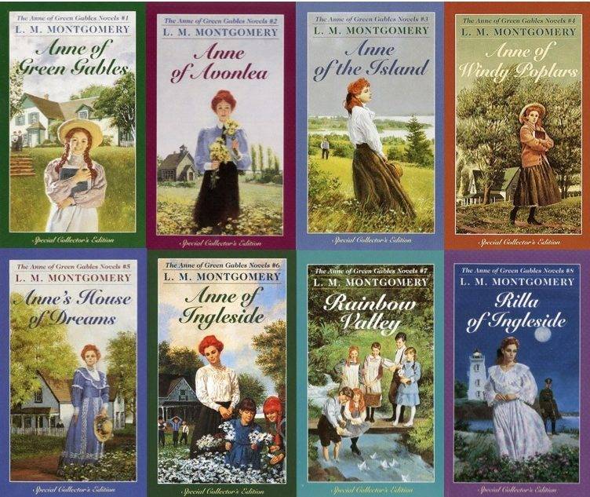
Maria’s picks
Anne of Green Gables
Notes:
Consider talking about:
Universities

Slide 5
Jessica’s Picks
Anything by Roald Dahl
Anything by David Williams
Notes:
Consider talking about:
Universities

Slide 6
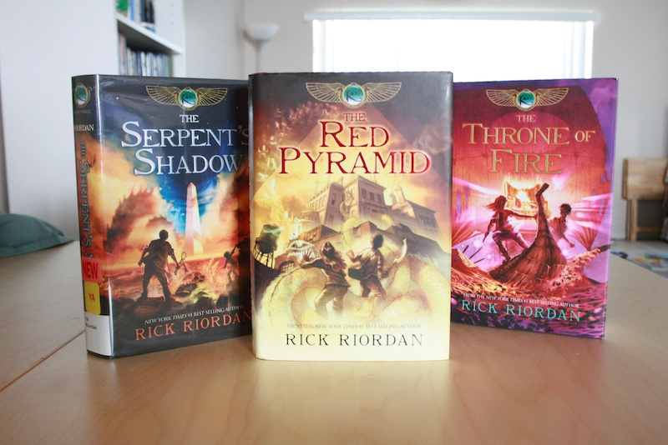
Jonathan and Paul’s picks
Red Pyramid Series
The Hatchet
Wonder
Holes
Masterminds
Notes:
Consider talking about:
Universities

Slide 7
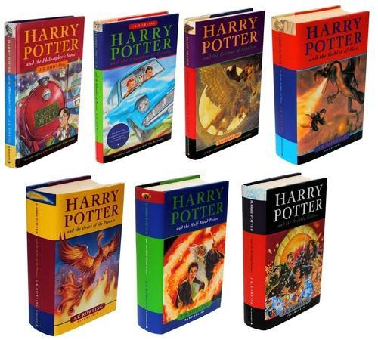
Emma’s Picks
The Hate U Give
When Breathe Becomes Air
Beyond Infinity
Harry Potter
Notes:
Consider talking about:
Universities

Slide 8
Heather’s Picks
The Haters
Me Earl and the Dying Girl
Butter
The Last Message
Notes:
Consider talking about:
Universities

Slide 9
Ms. Dziwak’s Picks
The Track Series: Ghost, Patina, Sunny, Lu
Refugee
Out of My Mind
Lumberjanes
Notes:
Consider talking about:
Universities

Slide 10
Websites with more information on Literature as Mirrors and Windows
http://www.scholastic.com/bookfairs/readerleader/windows-and-mirrors-why-we-need-diverse-books
https://www.weareteachers.com/mirrors-and-windows/
https://crawlingoutoftheclassroom.wordpress.com/2017/09/26/stories-as-mirrors-and-windows-part-1-stories-as-mirrors/
https://www.tolerance.org/classroom-resources/teaching-strategies/close-and-critical-reading/window-or-mirror
https://scenicregional.org/wp-content/uploads/2017/08/Mirrors-Windows-and-Sliding-Glass-Doors.pdf
Notes:
Consider talking about:
Universities

