Slide 1
Books that middle school students love to read
With Anjali, Marianne, Amy, Amanda, Daniel, Dylan and Sydney

Slide 2
Today’s Presentation
Windows and Mirrors
Middle School Favorites from Summit Students
Links to websites
New reads to consider

Slide 3
https://www.youtube.com/watch?v=_wQ8wiV3FVo
Notes:
https://www.youtube.com/watch?v=_wQ8wiV3FVo

Slide 4
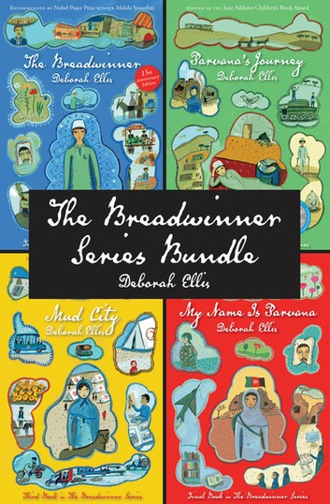
Anjali's Picks
Breadwinner Series
The Selection
Notes:
Consider talking about:
Universities

Slide 5
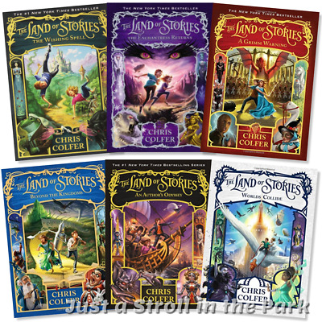
Amanda’s Pick
Land of Stories
Notes:
Consider talking about:
Universities

Slide 6
Marianne's Pick
Uglies
Notes:
Consider talking about:
Universities

Slide 7
Amy's Picks
Refugee
Ungifted
Projekt 1065
Notes:
Consider talking about:
Universities

Slide 8
Daniel’s Picks
House of the Scorpion
Scythe
Notes:
Consider talking about:
Universities

Slide 9
Dylan's Pick
Touching Spirit Bear
Notes:
Consider talking about:
Universities

Slide 10
Sydney's pick
A List of Cages
Notes:
Consider talking about:
Universities

Slide 11
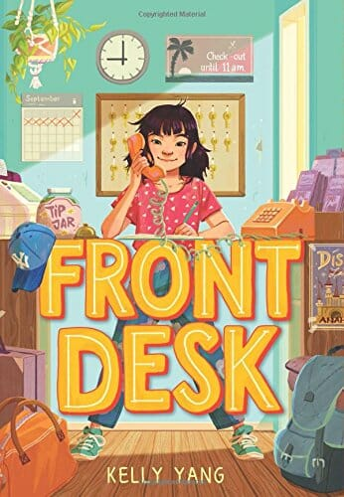
Ms. Dziwak’s Picks

Slide 12
Novelist​
Website that allows you to find more books that your child may enjoy based on what they have read and like
http://web.b.ebscohost.com/novpk8/search/novbasic?vid=0&sid=f5f83ad5-5f17-4c74-b79e-d385214a20f4%40sessionmgr101
Hoopla
App from Coquitlam Public Library
Great for ebooks and audiobbook
Free with a Coquitlam Public Library Card
https://www.hoopladigital.com/
Book of the Year
Books that middle school in Coquitlam have selected for students to read and vote for their favorite
https://www.sd43.bc.ca/LibraryServices/Pages/BookoftheYear.aspx#/=

Slide 13
Websites with more information on Literature as Mirrors and Windows
http://www.scholastic.com/bookfairs/readerleader/windows-and-mirrors-why-we-need-diverse-books
https://www.weareteachers.com/mirrors-and-windows/
https://crawlingoutoftheclassroom.wordpress.com/2017/09/26/stories-as-mirrors-and-windows-part-1-stories-as-mirrors/
https://www.tolerance.org/classroom-resources/teaching-strategies/close-and-critical-reading/window-or-mirror
https://scenicregional.org/wp-content/uploads/2017/08/Mirrors-Windows-and-Sliding-Glass-Doors.pdf
Notes:
Consider talking about:
Universities

