Slide 1
fishing in Canada
Jereme, jack and Eric

Slide 2
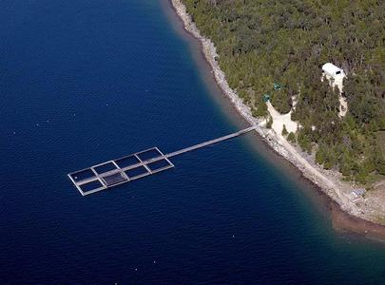
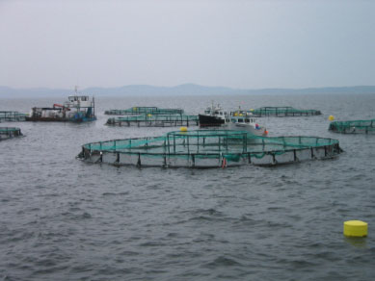
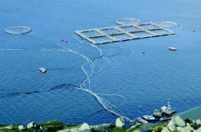
Today’s methods of fishing http://www.greenpeace.org/international/seafood/understanding-the-problem/fisheries-problems-today
Notes:
Now a days we have different methods of fishing, for instance we have more fish farms (pictures above) which makes it a lot more easier to produce and get more fish in the country, this also allows us not to ever sacrum to a shortage of fish, but it is a lot more unhealthy to eat fish farm fish then to eat wild fish. http://www.greenpeace.org/international/seafood/understanding-the-problem/fisheries-problems-today

Slide 3
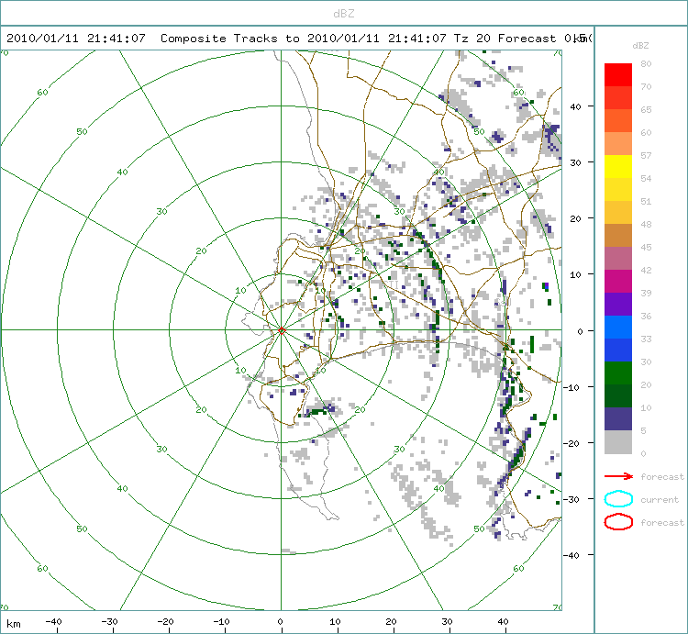
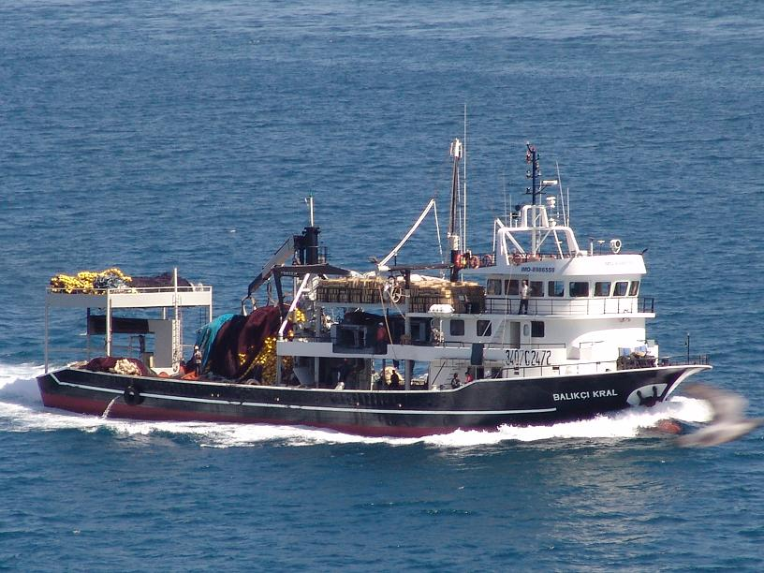
Existing technology
Notes:
Today we use lots of technology to catch fish like GPS(fish finders), radars and better built boats for catching more fish.
Also we have more knowledge about where the fish move to, lay their eggs and weather their good to eat or not.

Slide 4
Economic value of the fishing industry
Salmon farming is a big economic booster. Aquaculture has contributed 3,500 direct jobs to the British Columbian economy. 90% of these jobs are in coastal communities all around Canada. The most the fishing industry makes in production is over 1 billion a year boosting our economy amazingly and helping more jobs then ever.

Slide 5
http://www.grinningplanet.com/2004/02-26/farmed-salmon-pollution-gmo-eco.htm
Fish farming is a huge industry in B.C. But is it really a good thing? Most scientists say that fish farming is really not that good for the fish’s health and for our health as consumers. Because of over fishing in Canada and even all around the world we have had to come up with a way to help bring the numbers of these fish back up and fish farms were the answer. Since we began using fish farms are actually causing more sickness in fish and are even wiping out the wild fish. So the commercial fishing industry is effected by the decrease in wild salmon to.

