Slide 1
B.C. Forestry
By: Mwai , Matt , Ryan ……and Derek

Slide 2
History

Slide 3
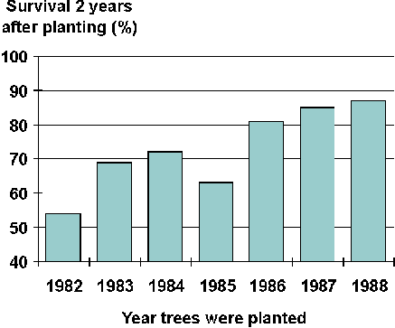
Present day.
This present day forestry has improved by %80.
In order to do that they have found ways to improve it as in placing seeds further apart or placing highly developt seeds.

Slide 4
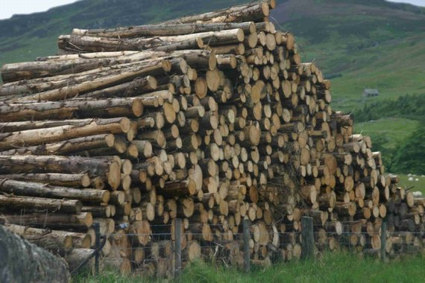
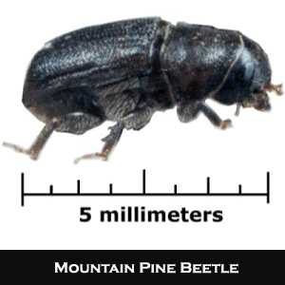
Impact on Environment
Forestry has had a huge impact on our environment. Our current tree population is still depleting because more trees are cut down then being replanted.
The pine beetle has been a big problem for our forestry industry. The pine beetle has killed over 80,000,000 trees and infected over 450,000 hectors.

Slide 5
Economic Value

