Slide 1
Agriculture
By: Kristen, Farnaz, & David

Slide 2
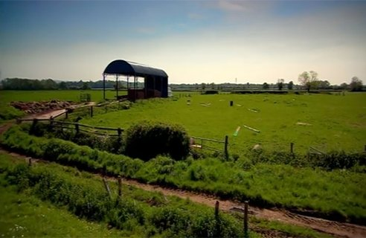
History of Agriculture
Agriculture today came with the influx of Europeans who came in search of furs and later gold
Aboriginal peoples hunted, gathered, and processed natural products much earlier
1981: 22% of the population were located on 6,500 farms, mostly on Vancouver Island, the lower mainland, and the Okanagan and Kootenay valleys

Slide 3
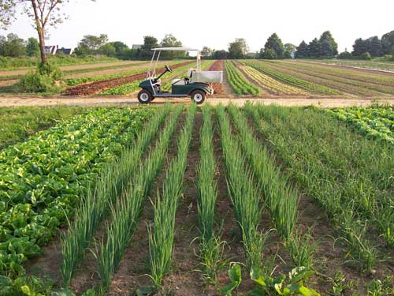
History
Tractors first appeared in the early 20th century (numbered at 332 by 1922)
To produce 1 acre (20 bushels) of wheat in 1890 with a gang plow, a seeder, a harrow, a binder, a thresher, and wagons and horses, took 8 to 10 man hours of labor
The total number of farms increased to 19,225 in 1991

Slide 4
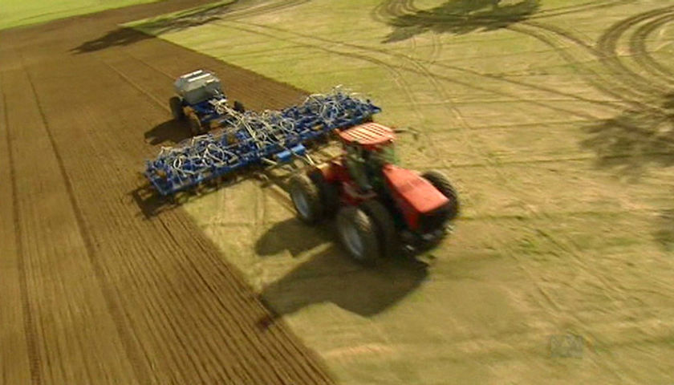
The Present of Agriculture
- June 2009: Canadian Food Inspection Agency confirmed Canada achieved a national disease-free status for avian influenza
- Average farmer is now more dependent upon the manufactures of fertilizers, chemical sprays, and feeding, compared to 30 years ago
- Environmental Farm Planning and Beneficial Management Practices received $3.23 million and $6.7 million, giving B.C.’s farmers the opportunity to assess their operational strengths and risks, determine their environmental footprint, and develop an action plan
- Farming has been improved in many ways from new farming machinery to new farming techniques

Slide 5
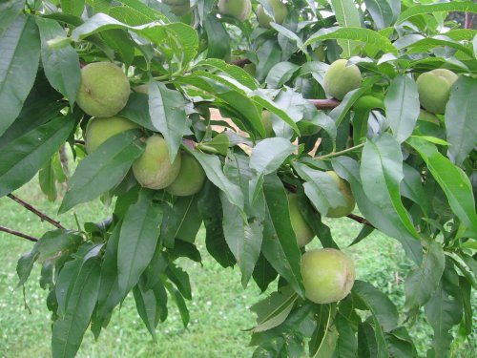
Good Impacts of Agriculture on the Environment
-
Agriculture is the key success to the rise of human civilization
-The majority of human population labored in Agriculture
-
Agriculture also provided jobs and people had a chance to make money

Slide 6
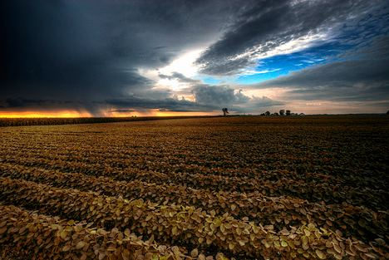
Bad Impacts of Agriculture on the
Environment
-There are three environmental challenges with Agriculture
1. Biodiversity:
Agriculture expansion and over use has destroyed biodiversity and habitants.
Wild species are going extinct slowly.
2. Climate Change
Global temps will rise if green house gas emissions are not reduced climate change will take place.
Climate change will impact food production, health and the environment.
Food will be hard to produce with change in farming seasons leading to more disease and pests.

Slide 7
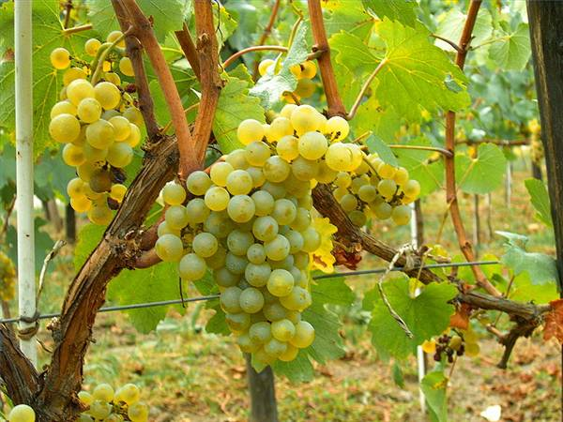
3. Bioenergy
-intensified biofuel operations could have significant negative impacts on water and soil, natural habitats and biodiversity.
Also farmers today are growing crops that are making them the most money
for example in the Okanagan their are many wine factories which grapes
Majority of farmers are growing grapes so they could make money from them and leaving other crops out.
http://www.okanaganwines.ca/wineries/

Slide 8
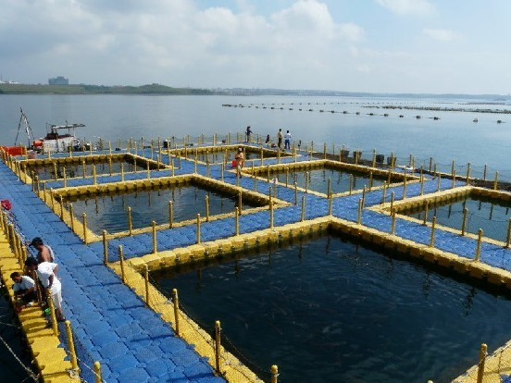
Economic value of Agriculture
Agriculture is still the main point of making money
- but now we have fish farms and greenhouses that are catching up with Agriculture
- Fish farms for example are making good money for the economy because there is still a high demand for fish.

