Slide 1


Welcome to
Port Moody Secondary School
“A Tradition of Excellence”
Future IB Grade 11
Parent Session
Wednesday, December 11, 2024
IB Coordinators:
Sean Lenihan slenihan@sd43.bc.ca
Aliisa Sarte asarte@sd43.bc.ca
Joni Tsui jtsui@sd43.bc.ca

Slide 2
Agenda
Introductions
Course Selection and Considerations
  Gr 10 to 11
Graduation Requirements: BC Dogwood Diploma
IB Diploma Requirements
Post-secondary planning
Questions?

Slide 3
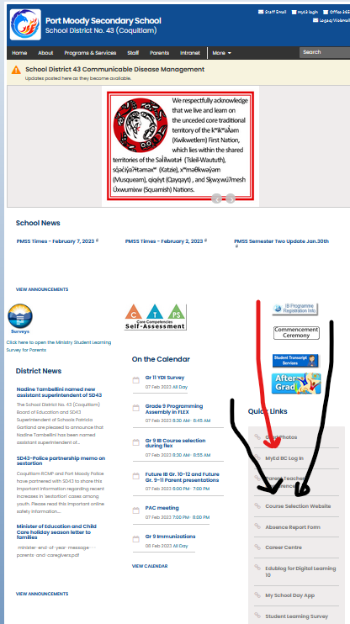
Programming Process
Read the information on the Course Selection website linked on our school website in the quick links section
Complete course selection on MyEd- either student or parent can do this! Instructions on the Course Selection website.

Slide 4
Programming Process
Try to complete selections by December 19th
We start building a timetable for the school based on student requests.

Slide 5

course Selection
Students must take at least 8 courses
6 IB Subject courses + TOK 11(Theory of Knowledge) + Core 11 (includes CAS 11, EE 11 and CLC 11)

Slide 6
B.C. Dogwood Diploma Graduation Requirements
Our IB students are dual-track, meaning they meet BC graduation requirements mainly through the IB diploma courses.
80 credits over grades 10,11, and 12 consisting of………

Slide 7
B.C. Dogwood Diploma Graduation Requirements
52 Required Credits
English (10,11 &12)
Social Studies (10 & 11 or 12)
Science (10 & 11 or 12)
Math (10 & 11 or 12)
Physical and Health Education 10
Arts Education or Applied Design, Skills and Technologies (10 or 11 or 12)
Careers Life Education 10
Careers Life Connections 12
Indigenous Graduation Requirement (4 credits)

Slide 8
B.C. Dogwood Diploma Graduation Requirements
28 elective credits (10,11, or 12)
At least 16 credits at the grade 12 level including English12.
IB Diploma students typically do not worry about most of this. They will earn more than enough credits in the appropriate areas by completing their IB Diploma.

Slide 9
Graduation Program Assessments
Numeracy Assessment
  Grade 10
Literacy Assessment
  Grade 10
  Grade 12
  The goal is to be proficient.

Slide 10
Changing Language Courses
Former French Immersion or strong heritage language students wanting to change language for grade 11 must complete a form which is available from the office
This form must be submitted to the correct teacher who will approved by the language teacher who will recommend placement
IB Language is a SECOND LANGUAGE course
Risk takers? Principled? Open minded?

Slide 11
IB Diploma Programme
Grades 9 and 10 are our foundation programme (now called Pre DP)– preparing for the Diploma.
Grade 11 and 12 are the IB Diploma years.
Description of groups by grade on course planning website.

Slide 12
Course Selection Grade 11 IB Diploma
Group | Course Choices
Group 1 | IB English A: Literature 11 HL
Group 2 | IB Modern Language 11 SL (French, Spanish, Mandarin, Japanese)
Group 3 | IB History 11 HL or IB Geography 11 HL or IB Economics 11 SL
Group 4 | IB Biology 11 HL or IB Chemistry 11 SL or IB Physics HL
Group 5 | IB Mathematics: Analysis and Approaches 11 SL or HL IB Mathematics: Applications and Interpretation 11 SL or HL
Group 6 | IB Visual Arts 11 HL/SL, IB Film SL or a second choice from group 2-4.
Core | IB Theory of Knowledge 11 IB CAS 11, IB Extended Essay 11 and CLC 11
Minimum of 3 HL courses, maximum of 4 HL course for Diploma.
Limit of 8 Courses
Music, Agility Training or Musical Theatre may be a 9th option

Slide 13
What is HL and SL?
HL refers to Higher Level. This means that the school is expected to provide 240 hours of instruction.
SL refers to Standard Level. This means that the school is expected to provide 150 hours of instruction.
Many courses will have the same core at HL and SL, with extensions or options or additional topics for HL.
HL is not ‘harder’, it is just more…

Slide 14
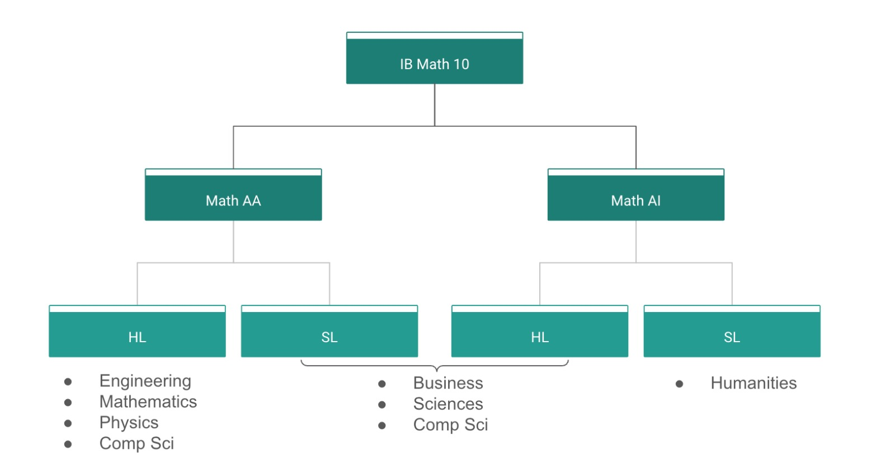
IB Mathematics Curriculum
Notes:
AA: Analysis and Approaches
AI: Applications and Interpretation

Slide 15
IB Mathematics Curriculum
Considerations:
Post-Secondary Plans
You should look at Post-Secondary admission requirements to various programs before making your decision.
AA and AI are different courses, not different levels.
Cannot change streams part way through.
But within AA or AI, it may be possible to move from HL to SL for grade 12.
Interest and Strength in Mathematics
AA – more depth, fewer topics. More pure math, much of the course does not allow calculators.
AI – more breadth, not as much depth. Applying the math. Can use calculators throughout the whole course.
Both still have calculus and statistics, and prepare you for post-secondary
Notes:
AA: Analysis and Approaches
AI: Applications and Interpretation

Slide 16
What is TOK?
The Theory of Knowledge course encourages critical thinking about knowledge itself, to try to help young people make sense of what they encounter in their studies and in the world around them.
Core requirement of the IB Diploma programme.
Requires the completion of an essay on a prescribed title and the completion of an exhibition on how knowledge manifests in the real world.
4 graduation credits per year for the BC Dogwood Diploma

Slide 17
What is the Extended Essay?
4000-word research paper
Can be written in any of the curricular areas of IB but should be chosen as a function of personal interest and teacher expertise.
Students must complete the paper in stages and are required to have a member of the school staff as supervisor.
4 Graduation credits from Ministry of Education in both years.

Slide 18

What is C.A.S. (Creativity, Activity, Service)?
Creativity: arts, and other experiences that involve creative thinking
Activity: physical exertion contributing to a healthy lifestyle
Service: an unpaid and voluntary exchange that has a learning benefit for the student.
About 3 hours per week plus reflection recorded on ManageBAC.
4 graduation credits per year from Ministry of Education

Slide 19
When choosing courses:
Group 1: All English (easy ☺)
Group 2: Choose your Language Acquisition Course (easy)
Group 3: Choose one of History, Geography or Economics
Group 4: Choose one of Biology, Chemistry or Physics
Group 5: Choose one of AA HL, AA SL, AI Hl or AI SL
Group 6: Choose one of IB Art, IB Film or
Economics, Geography, History, Biology,
Chemistry, Physics or another Language class

Slide 20
Timetabling is tricky so…
Students need to also choose alternates for their Group 3 and Group 4 courses.
May also choose a 9th class: Music, Total Athlete, Musical Theatre… (will be in block 5)

Slide 21
Timetabling
HL classes will be 90 minutes long
SL classes, TOK and Core blocks will be 76 minutes long
Classes will alternate Day 1 and Day 2 through the year.
All IB students will start in block 1 at 7:36 a.m.
HL classes will continue during the week of January 26-30 in some form
HL classes in Grade 11 will continue through to the last day of school in June.

Slide 22
Considerations
Grade 11 is a step up in academic demand from Grade 10
IB Grade 11 is a bigger step up from IB Grade 10.
Time management is crucial!
Communication with teachers is crucial!
Notes:
5 academic courses- balanced approach– master timeline for IB assignments- key to success is time management– get help when/if needed- talk to me, teachers, Ms. Sarte, parents, friends– you are not alone in what the year holds- know what you want out of the next year

Slide 23
Post Secondary Requirements
  Admission requirements are different for each post secondary school and program
    Science faculties often require 2 sciences
      UBC & SFU- Chem 11 and Physics 11 traditionally but changes happen …
    Math requirements may vary

Slide 24
Post Secondary Considerations
Decide what you want to study.
Make a list of universities you may want to attend.
Go to their websites and search for IB admission requirements.
Canadian universities will typically have faculty specific requirements.
Go where you are wanted!
Don’t listen to the rumour mill– do your own research and think for yourself.

Slide 25
Post Secondary Information
Career Resource Centre provides students with :
Post Secondary Information
Resume workshops/support
Scholarships and Bursary Information

Slide 26
IB Fees
Fees are charged in grade 9 and 10 on a cost recovery to support the additional expenses of the program
  $500 dollars in grade 9 and in grade 10
IB exam fees are charged in grade 12 on a per subject basis
  6 subjects x $123US= $738US ($1032 at Nov exchange rate)
  We complete exam registration in October and will invoice families at that time, including GST, in Canadian dollars
  Exam fees are paid directly to the IBO for their costs

Slide 27
Parent Communication
  Teachers, Counsellors, and Administrators are accessible through parent-teacher interviews, orientation days, and appointments.
  Visit the school web-site to find out about policies, dates, phone numbers, and e-mail addresses.
  http://www.sd43.bc.ca/School/portmoody/Pages/default.aspx

Slide 28










Port Moody Secondary
Questions
& Answers…

