Slide 1

Port Moody Secondary
Graduating Class of 2025
March Assembly
Notes:
NOTE:
To change the image on this slide, select the picture and delete it. Then click the Pictures icon in the placeholder to insert your own image.

Slide 2
Before We Begin…
Information shared today is a general preview. More to come!
A grad planning newsletter will be sent to all Gr. 12 students & families. No need to take pictures of the slides.
There will be additional assemblies and informational updates sent home over the coming weeks and months.

Slide 3
Graduation Expectations
Meeting all Graduation Requirements
If short requirements or key courses: You will need a Grad Plan coordinated through your counsellor
General expectations of students:
Now to June
Grad Activities
Dinner/Dance & After Grad

Slide 4
Have you…
Paid any outstanding fees (e.g. lost/damaged books, activity fee, graduation fee) and completed your policy form (on SchoolCashOnline)
Completed all assignments for CLC 12 (Career Life Connections). You must have done your exit interview
Returned any Sem 1 textbooks/library books that you still have
Returned any team/athletic uniforms

Slide 5
DINNER/DANCE and aftergrad

Slide 6
Meet your 2025 Grad Committee!!
Miranda Gonzales
Bella Rigietti
Katherine Xu
Andrea Nechita
Mckenzie Davis
Leah Worsley
Julin Chai
Tovah Popowitz
Kieren Fergusen
Claudia Yoon
Ariya Ghag
Laya Hong
Jia Bains
Miguel Briones
Adele Ku
Zoe Deller
Katy Hansen
Michelle Yoon
Madi McMeiken

Slide 7
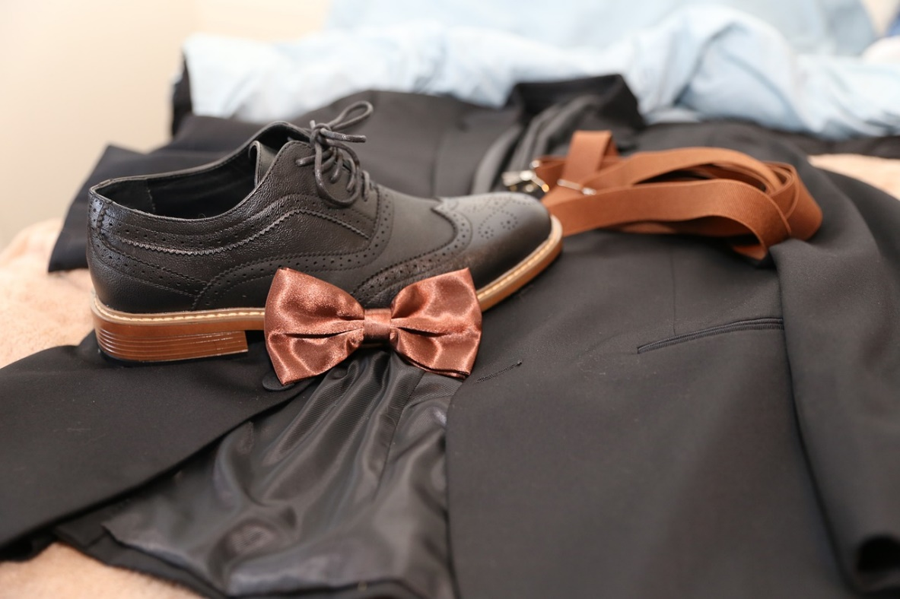
DINNER DANCE
Saturday, June 21, 2025, 5:30-11 pm
Pinnacle Hotel Vancouver Harbourfront
Theme to be Determined (voting will happen after the assembly)!!
Ticket price is TBD
Students may bring 1 (preapproved) guest to the event.
Tickets on sale beginning April 8, seating choices begin April 15*.
*All fees, CLC, uniforms, etc. must be dealt with to buy a ticket.

Slide 8

GUESTS
A guest is considered anyone who is not part of the PMSS Grade 12 graduating class.
All guests must be age appropriate (e.g. one year out of school).
All guests must be approved by school administration prior to purchasing a ticket.
Guest approval forms will be available online beginning March 31st, and are due by 3:30 April 9. No late or incomplete applications will be considered.
Any approved guest tickets will be attached to the graduating student’s SchoolCashOnline account

Slide 9
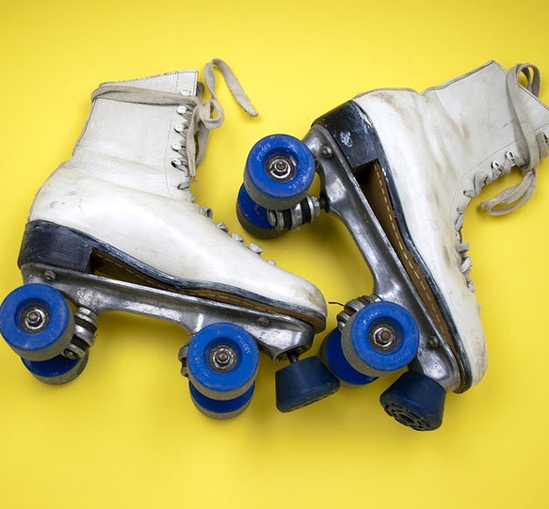
AFTER GRAD
Will be at Science World !
More information coming shortly...

Slide 10
COMMENCEMENT AND CO-VALEDICTORIAN NOMINATIONS

Slide 11
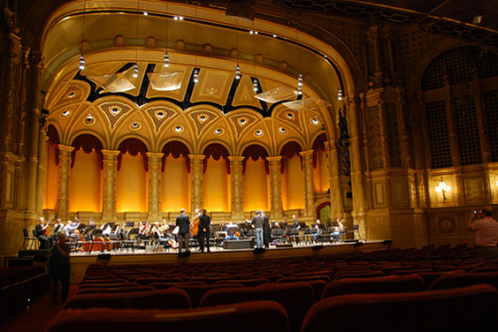
Commencement
Wednesday, June 25th, 2025
Orpheum Theatre
Start at 7 pm, arrive by 6 pm
You will be able to purchase tickets for your family to attend
Students will collect their Caps and Gowns during a mandatory commencement rehearsal/assembly June 18th. These are for students to keep after the ceremony.
Commencement comment/write-ups need to be submitted on Forms now—they were due Feb 20th.

Slide 12
Names on Certificate
The name on your official graduation certificate from the Ministry of Education will be your legal name.
We will use your usual name in the composite, program, the certificate in your portfolio, and for awards
See Mr. Cameron if you need changes to your usual name

Slide 13
Co-Valedictorian Nominations—avail March 31st on Forms
All students nominated must meet the following criteria:
Be in high academic standing – typically placing on the honour roll for each formal report in grade 11 and 12 (though not always)
Be in a position to graduate in June
Be respected by peers and staff
Have demonstrated service and leadership in the Port Moody Secondary learning community
Be a positive, ethical role model who demonstrates integrity and exemplary behaviour
Be able to deliver a positive and authentic valedictorian speech, on behalf of all grade 12 students
Have strong verbal communication skills
Be willing to commit the time to work closely with co-valedictorian and administration in the crafting/editing and revising of their speech

Slide 14
POST SECONDARY ADMISSION AND SCHOLARSHIPS
Complete online Post Secondary Institution process (PSI), even if not sure about attending college or university
  https://www2.gov.bc.ca/gov/content/education-training/k-12/support/transcripts-and-certificates
  All the latest scholarship information is found in the PMSS Times, as well as the PMSS Post Secondary Tab on our website, and the Post-Secondary Teams page.

Slide 15
Congratulations—you’re almost there!
What questions do you have for us?

