Slide 1

September 2020

Slide 2


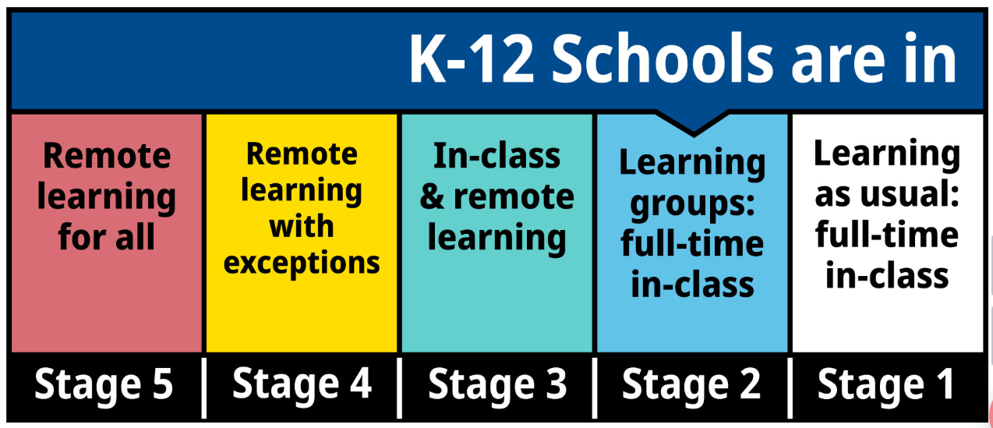

Slide 3
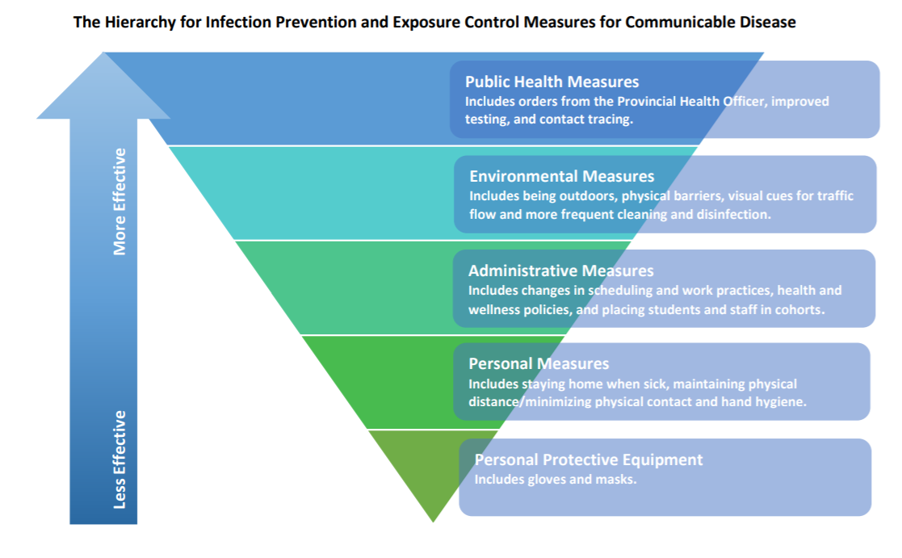
Notes:
This information is taken directly from the CDC Public Health Guidance for K-12 Schools.
Paste in the chat during the meeting
http://www.bccdc.ca/Health-Info-Site/Documents/COVID_public_guidance/Guidance-k-12-schools.pdf

Slide 4
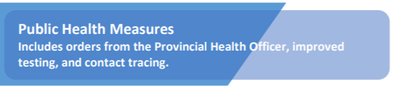
Schools are considered a “controlled environment” by Public health
Schools have a consistent grouping of people
Schools can have robust illness policies for staff and students
Schools can implement systems for personal practices, like hand washing, sanitizing and respiratory etiquette
Schools can implement many health and safety features like extra cleaning, use of outdoor space, and limits on personal interactions

Slide 5
Most effective method of infection prevention
Schools have an important role in contact tracing
Tracking what staff have worked with cohorts
Tracking School visitors, including TTOCS and changes in schedules

Slide 6
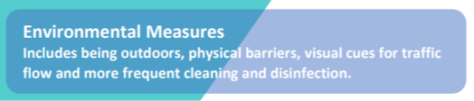
We will try and be outdoors more
Be aware of, and follow all signage
Pay attention to traffic flow arrows and markings
  Stairs, hallways, doors (entrance/ exit)
  Bathroom assignments
Keep our areas clean
  Caretakers, teachers, admin and students all have a role-desks, toys equipment etc
  Soap dispensers have been added over the summer

Slide 7
Refer to student handbook

Slide 8
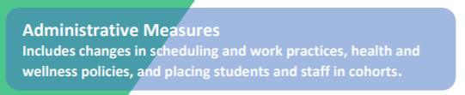
Examples: Adjusted start and end times, Lunch/recess in shifts, Learning Groups, visitor limitation and check-in
Refer to student handbook

Slide 9


A learning group or cohort is a group of students and staff who remain together throughout the school quarter, semester or year and who primarily interact with each other. In SD43 this will mean the Learning Group will be a student’s or teacher’s main class in elementary and middle schools, and one school dedicated class per quarter at secondary

Slide 10

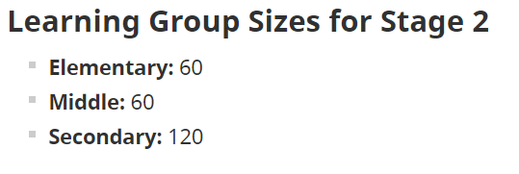

Remain physically distant when outdoors with persons outside your Learning Group
Refrain from touching others at all times

Slide 11
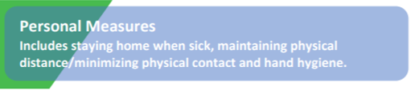







The Basics
Stay home if you are sick
Frequent hand washing/sanitizing
Avoid touching your face
Avoid sharing belongings (pens, food, etc.)
Stay within and respect learning groups (cohorts)
Keep safe distance (2 metres)
Masks should be worn by students in Grades 6 to 12 when outside their learning group, and in common areas like hallways , learning commons etc, due to the unpredictability of being able to a maintain physical distance indoors.
Wash/sanitize your hands
2 metres
Keep your distance
Cover coughs and sneezes
Feel sick? Stay home
KEY:
Be able to recognize the signs and symptoms of COVID-19
Wear a face mask where/when required

Slide 12
Illness
Students are expected to perform a daily health check before coming to school, and are expected to remain at home if they are sick.
If you become ill while at work/ school, they will be moved to an isolation space and parents contacted for immediate pick up.
Hand hygiene
Hand washing/hand sanitizing routines will need to be established and strictly followed. (insert school specific details)
Respiratory Etiquette
Cough sneeze into sleeve etc

Slide 13
If you become sick at school…
Let your teacher/principal know
You will be asked to self-isolate, wear a mask, and someone will be called to pick you up or give permission for you to go home
For COVID-19 like symptoms it is recommended to contact 811 and speak to your health-care provider-follow their advice
You are to stay home until COVID-19 has been excluded AND your symptoms have resolved.

Slide 14
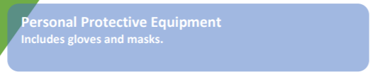
Least effective but most talked about infection intervention
Ministry of Education is providing all staff and students with a mask.
Intended for times when physical distancing cannot be maintained.
The use of PPE is not recommended for elementary aged students
PPE should be worn by students in Grades 6 to 12 when outside their learning group, and in common areas like hallways , learning commons etc, due to the unpredictability of being able to a maintain physical distance indoors.
PPE should be worn by staff when outside their learning group, and in common areas like hallways , learning commons etc, due to the unpredictability of being able to a maintain physical distance indoors

