Slide 1
Core competencies
What should we know before we complete our self-assessments?
What questions might we have?

Slide 2
Core Competencies
a set of intellectual, personal, and social competencies
strengths-based and student-centered – what the student can do
can be demonstrated in many different ways as you learn both in and outside of school
developed over the course of a student’s schooling and into adulthood
Notes:
The addition to our curriculum of the Core competencies might be the biggest shift in the entire re-design
As we become preoccupied by changes to individual curriculum areas Yet it also feels like they are easily pushed aside to the margins as especially
Recognition that our children’s success is in large part determined by abilities that span across subject areas and that a central purpose of school is to develop those competencies in our kids
Harp

Slide 3
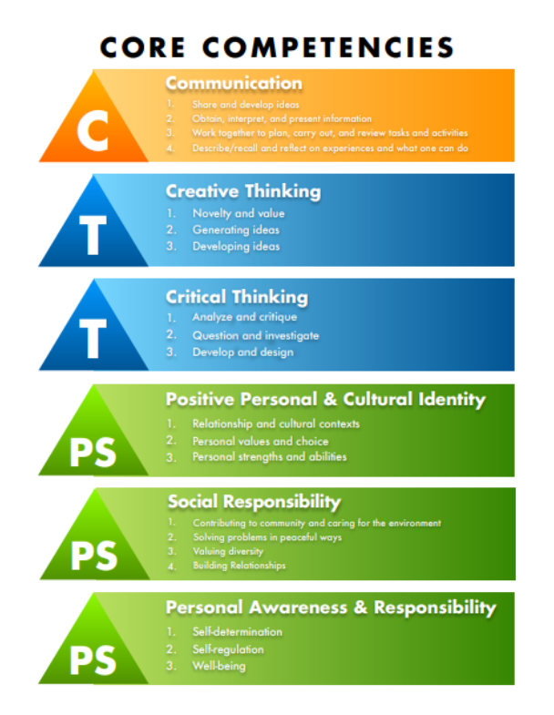

Slide 4
Why has this been added to the BC curriculum?
Research shows that it is important for students to be able to self-reflect and self-assess as we are learning.
How am I doing?
What are my strengths?
How can I improve?
Where to next?

Slide 5
Here are some questions to help you start thinking about the core competencies:
Communication
What are some ways you like to use to show your learning?
Critical Thinking
What strategies do you use to decide whether to believe something you read or hear on the news? What advice would you give a younger student about figuring out what is true?
Creative Thinking
What helps you get new ideas?
What makes you want to get new ideas or try something new?

Slide 6
Here are some questions to help you start thinking about the core competencies:
Positive and Personal Cultural Identity
What are some aspects that you value about your culture?
What are some things about your culture that you would like other people to know?
Personal Awareness and Responsibility
What do you do to help yourself when you are feeling a bit discouraged about your work / performance?
Social Responsibility
How do you use words and actions to encourage other students who might be feeling a bit sad or discouraged?
What contribution(s) have you made to your school/community/team that you feel good about?

Slide 7
Examples of ways to self-assess and share your learning using the core competencies. You may have used a few of these this year to reflect on a learning experience or event.
Photo essays or vlogs
Blog posts
Illustrations and art work
Interviews (written or oral)
Mind maps or other graphic organizers
Word cloud

Slide 8
Before we ask you to self-assess on core competencies of your choosing, let’s review some frequently asked questions
1. Do I need to talk specifically about my learning at school?
No! You may choose something that you do in the community (e.g. sports, work, volunteering)
2. Do I need to give myself a mark? Is my teacher going to give me a mark?
No! Self-assessments are not supposed to be graded.

Slide 9
Self-assessment
Please complete the digital self-assessment using the link shared via the school app/on the school website:
https://bit.ly/2WOZcnj
Alternately, you can complete a written version

