Slide 1
Post Secondary
in Canada

Slide 2

FACT:
All public universities and colleges in Canada are good!
Which university or college is the right one for your son or daughter?

Slide 3

Understanding the Post Secondary Landscape
different types of post Secondary
Public
Private
Colleges
Universities
Institutes

Slide 4

The COLLEGE Landscape
Colleges typically offer a combination of
trades, apprenticeship, career, technical,
university transfer programs.
Colleges offer credentials such as citations,
certificates, diplomas, associate degrees
and applied bachelor degrees.
Programs fall into two categories: limited
enrollment and open enrollment programs.

Slide 5
Transfer from College to University
FACT: students who start at college and transfer to university end up doing as well or better at university!
Why College? Cheaper, small class sizes, closer to home, great transition to university
College Transfer: complete a min. of 24 credits (8 courses) to a maximum of 60
credits (half of your degree) and meet a min. university GPA.

Slide 6
Institutes
BCIT
Offers trades/apprenticeship, technical and technology education (certificates/diplomas/degrees) in Applied & Natural Sciences, Business & Media, Computing & IT, Engineering, Health Sciences and Trades & Apprenticeships. Diplomas can ladder into degree programs.
Entrance requirements is competitive entry or on a first qualified/first applied basis.
One program choice – choose options, not courses. Students take 6 to 8 courses per semester.
BCIT programs are taught by industry professionals and offers networking, applied learning, and the latest in tool technology.
Programs offer ‘Work Integrated Learning’ (WIL):
Apprenticeships
Co-op
Industry projects
Internships
Practicums
Field placements
Clinical preceptorships (for Health Science programs)
New micro-credential for graduating students to explore architecture, structure and engineering.

Slide 7
Institutes
Justice Institute of BC:
Offers programs and courses in public safety (firefighting, emergency response, law enforcement etc.) – (certificates/diplomas/degrees)
Nicola Valley Institute of Technology:
Indigenous public post-secondary. Offers trades, health and human services, justice studies, environmental studies and business programs.
(certificates/diplomas/associate of arts and a Bachelor of Social Work)

Slide 8
The UNIVERSITY Landscape in BC
Research-intensive universities: SFU, UBC, UNBC and UVic: Degree granting - competitive admission. Undergraduate and graduate degrees and certificates.
Teaching-intensive universities: CapU, KPU, UFV, TRU, and VIU: Offers open enrollment and limited enrollment programs. Offers citations, certificates, diplomas, associate degrees and degrees.

Slide 9
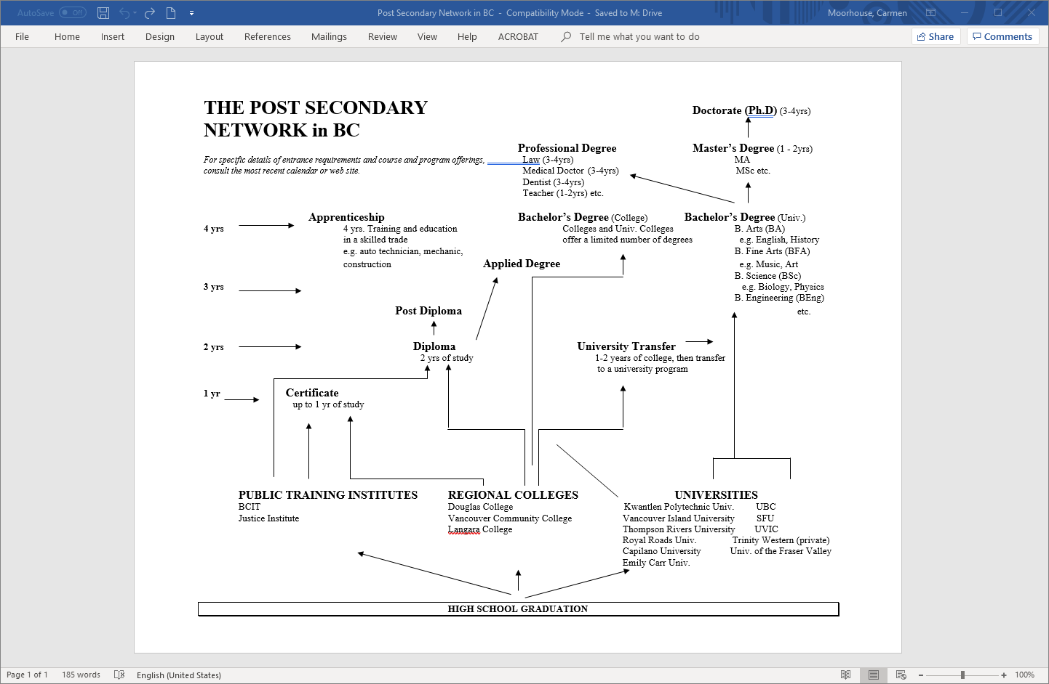


Slide 10
Deciding Where to Go!
Academic Program: Does the university offer the program your son or daughter wants? Many students are unsure what program they want and roughly 80% will change their area of study during their university career. Students should look for a good selection of academic programs and the flexibility to try out different areas of study.
Admission: Have you taken required/approved courses? Do you meet the admission average. It is based on grades only or is a supplementary application required?
Location: Move away from home or stay close by? Rural or urban area? Large university or small? Weather issue? A campus tour is a helpful step.

Slide 11
What to consider…
Experiential Opportunities: Does the university offer leadership, mentorship, volunteer, international exchange programs, internships or co-op?
Cost: College or university? Live at home or away from home?
Scholarships: What scholarships are offered? Automatic and Application based. Some universities offer many scholarships, bursaries and awards.
US: Are you applying to the US? Different admission process: holistic.

Slide 12
Cost of going to UBC V for 1st Year ‘Arts’ for Domestic Students
(Canadian Citizen) – Total Cost not including cost of laptop/cell phone: $26,498

Slide 13

Admission Requirements
Canadian citizen/permanent resident, or protected persons (non-claimant?), International student (funding eligible?).
General admission requirements vs program admission requirements.
Required/approved courses.
English language requirement.
English proficiency requirement.
Admission averages and min. course grades.
Some programs require supplemental applications.
Policy on repeated courses and challenge exams.
Policy regarding taking courses that are not included in the school’s timetable (online/summer school).
Literacy assessment policy.

Slide 14
Application Process
Application portals.
Application fee (domestic and international fee)
Most universities and colleges urge early applications.
Application timeline, processes and deadlines vary.
Early admission, regular admission, and rolling application process.
Submitting supplemental applications.
Document deadlines: reporting marks (gr. 11 /12), TOEFL/IELTS scores, permanent residency card etc.
Official and unofficial grade reporting.
Timing of offers of admission.
Entrance scholarships: automatic and application-based.
Deadline to accept offer of admission. Tuition deposit may be required.
Policy on admission deferrals.
Registration for classes typically begins in June or July.

Slide 15
What you need to know before you apply!
When should I apply for admission?
How do I apply?
How much is the application fee? (domestic vs international fee)
Does my program require a supplemental application?
When do I submit this?
What are the deadlines to apply?
Is there an early admission process?
Is there a rolling admission process?
When should I apply for entrance scholarships and other types of scholarships?
What are the document deadlines? (reporting marks (gr. 11 /12), TOEFL/IELTS scores, permanent residency card etc.)
How do I report my grades? (Official vs. unofficial grade reporting.)
When would I receive offers of admission?
Are offers conditional? What are the conditions?
When do I accept an offer of admission? (Tuition deposit may be required.)
If I want to defer my offer of admission and take a gap year, how is this done?
When do I register for classes?

Slide 16
Admission Timeline for Grade 12s
Apply
for admissionin the fall
Apply for
Scholarships starting in the fall
Send transcripts and other documents
Apply for on- campus housing
Accept offer April/May/June
Register for courses June/July
Final offer confirmed July/Aug

Slide 17
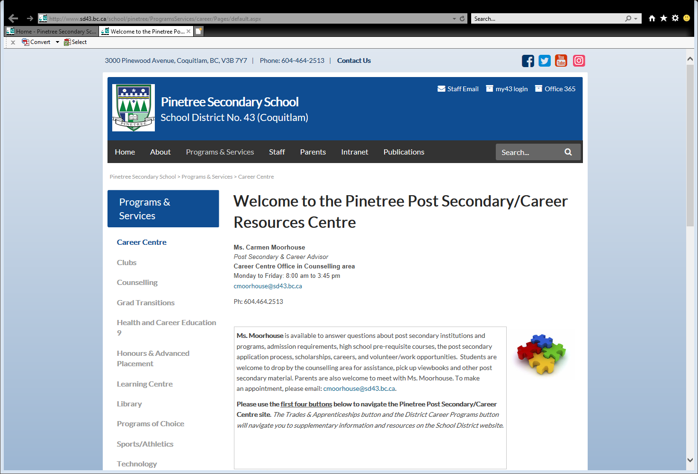

Slide 18
