Slide 1
Post Secondary
in Canada

Slide 2

FACT:
All public universities and colleges in Canada are good!
Which university or college is the right one for your son or daughter?

Slide 3

Understanding the Post Secondary Landscape
different types of post Secondary
Public
Private
Colleges
Universities
Institutes

Slide 4

The COLLEGE Landscape
Colleges typically offer a combination of
trades, apprenticeship, career, technical,
university transfer programs.
Colleges offer credentials such as citations,
certificates, diplomas, associate degrees
and applied bachelor degrees.
Programs fall into two categories: limited
enrollment and open enrollment programs.

Slide 5
Transfer from College to University
FACT: students who start at college and transfer to university end up doing as well or better at university!
Why College? Cheaper, small class sizes, closer to home, great transition to university
College Transfer: complete a min. of 24 credits (8 courses) to a maximum of 60
credits (half of your degree) and meet a min. university GPA.

Slide 6
Institutes
BCIT:
Offers trades/apprenticeship, technical and technology education (certificates/diplomas/degrees).
All programs offer ‘applied’ education - job ready
training and taught by industry professionals.
Diplomas ladder into degree programs.
Justice Institute of BC:
Offers programs and courses in public safety (firefighting, emergency response, law enforcement etc.) – (certificates/diplomas/degrees)
Nicola Valley Institute of Technology:
Indigenous public post secondary. Offers trades, health and human services, justice studies, environmental studies and business programs.
(certificates/diplomas/associate of arts and a Bachelor of Social Work)

Slide 7
The UNIVERSITY Landscape in BC
Research-intensive universities: SFU, UBC, UNBC and UVic: Degree granting - competitive admission. Undergraduate and graduate degrees and certificates.
Teaching-intensive universities: CapU, KPU, UFV, TRU, and VIU: Offers open enrollment and limited enrollment programs. Offers citations, certificates, diplomas, associate degrees and degrees.

Slide 8
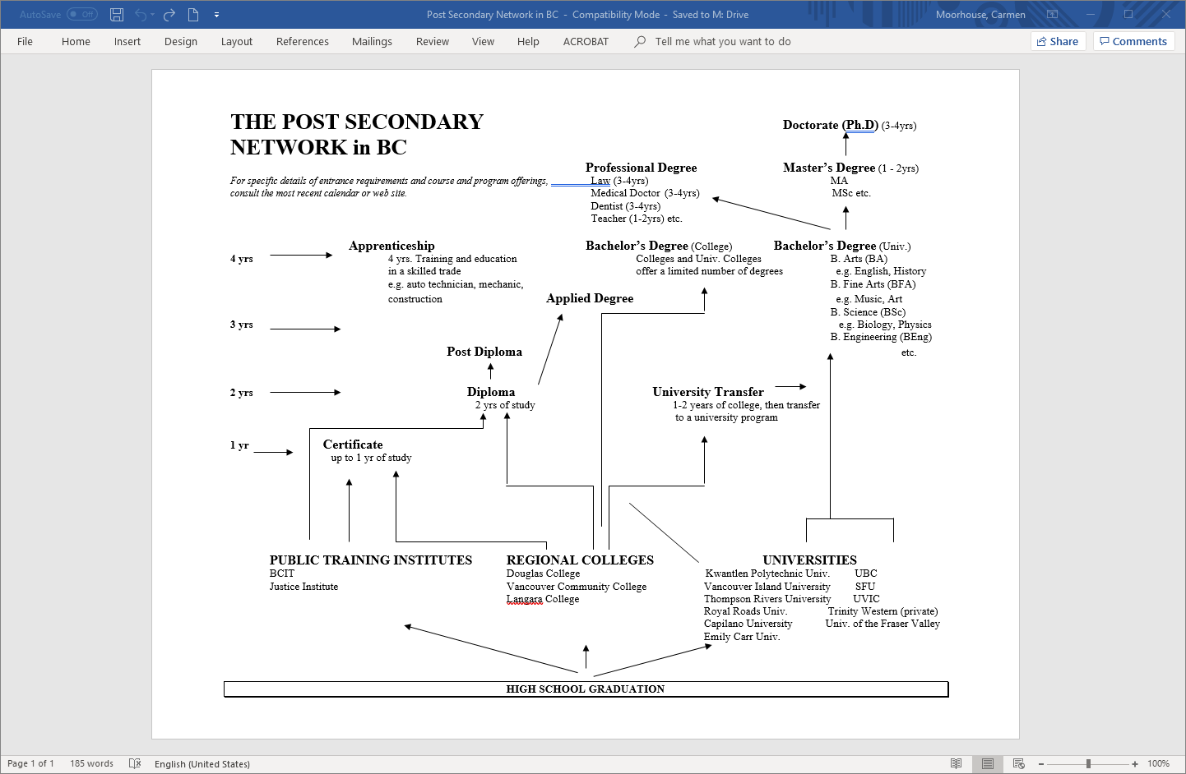
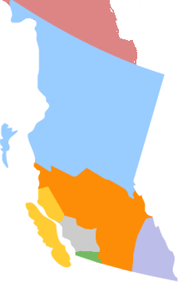

Slide 9
Deciding Where to Go!
Academic Program: Does the university offer the program your son or daughter wants? Many students are unsure what program they want and roughly 80% will change their area of study during their university career. Students should look for a good selection of academic programs and the flexibility to try out different areas of study.
Admission: Have you taken required/approved courses? Do you meet the admission average. It is based on grades only or is a supplementary application required?
Location: Move away from home or stay close by? Rural or urban area? Large university or small? Weather issue? A campus tour is a helpful step.

Slide 10
What to consider…
Experiential Opportunities: Does the university offer leadership, mentorship, volunteer, international exchange programs, internships or co-op?
Cost: College or university? Live at home or away from home?
Scholarships: What scholarships are offered? Automatic and Application based. Some universities offer many scholarships, bursaries and awards.
US: Are you applying to the US? Different admission process: holistic.

Slide 11
Cost of going to UBC for 1st Year ‘Arts’ for Domestic Students
(Canadian Citizen) – Total Cost not including cost of laptop/cel phone: $22,927

Slide 12

Admission
Canadian citizen/permanent resident, or protected persons (non-claimant? International student (funding eligible)?
General admission requirements and program admission requirements.
Required/approved courses.
English language requirement and English proficiency requirement.
Admission averages and min. course grades.
Some programs require supplemental applications.
Policy on repeated courses and challenge exams.
Policy regarding taking courses that are not included in the school’s timetable (online/summer school).
Literacy assessment policy.

Slide 13
Application Process
Application portals.
Application fee (domestic and international fee)
Some programs require supplemental applications.
Most universities and colleges urge early applications.
Application timeline, processes and deadlines vary.
Early admission, regular admission, and rolling application process.
Document deadlines: reporting marks (gr. 11 /12), TOEFL/IELTS scores, permanent residency card etc.
Official and unofficial grade reporting.
Timing of offers of admission.
Entrance scholarships: automatic and application-based.
Deadline to accept offer of admission. Tuition deposit may be required.
Policy on admission deferrals.
Registration for classes typically begins in June or July.

Slide 14
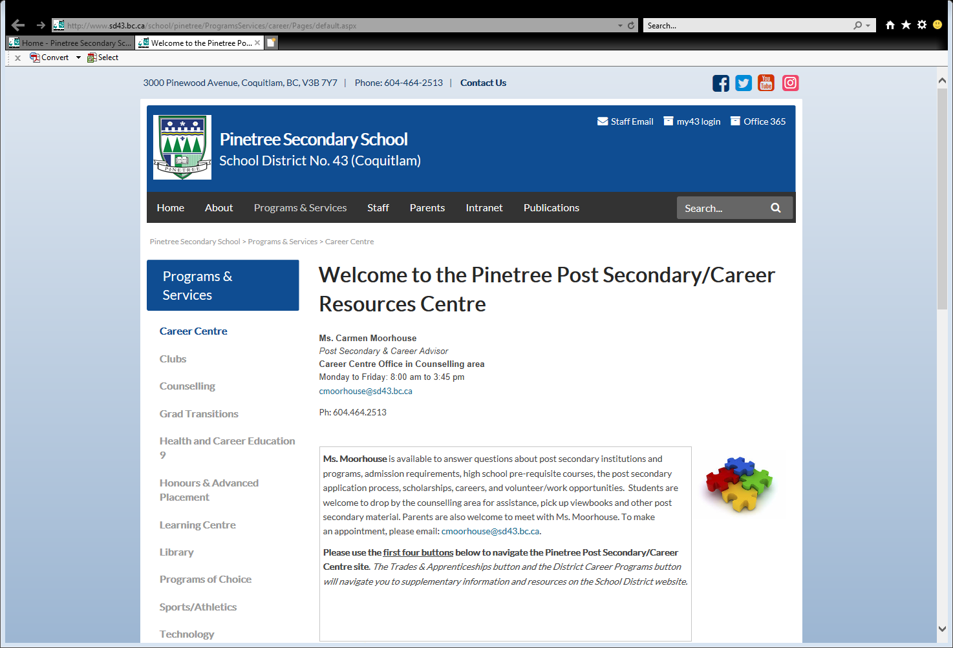

Slide 15
Welcome to the Pinetree Post Secondary/Career Resources Centre - Pinetree Secondary School (sd43.bc.ca)

