Slide 1
Conscription in World War I

Slide 2
Why did it happen?
By late 1916 the terrible casualties at the front in France and Flanders were beginning to cause reinforcement problems for the Canadian commanders overseas. Recruitment at home was slowing, and the manpower and enlistment system was disorganized. For PM Sir Robert BORDEN, the first necessity was to assist the men in the trenches, and by May 1917, when he returned to Canada from the Imperial War Conference in London and from visits to the trenches, he had decided that compulsory service was necessary.

Slide 3
(To summarize)
Take out material that is not important or that repeats information
Break the information into chunks
Simplify the language for your presentation
Add images where possible

Slide 4
By late 1916 the terrible casualties at the front in France and Flanders were beginning to cause reinforcement problems for the Canadian commanders overseas.
↓
By late 1916, there were many deaths and injuries in France and Flanders with not enough soldiers to replace them

Slide 5
By late 1916, there were many deaths and injuries in France and Flanders with not enough soldiers to replace them

Slide 6
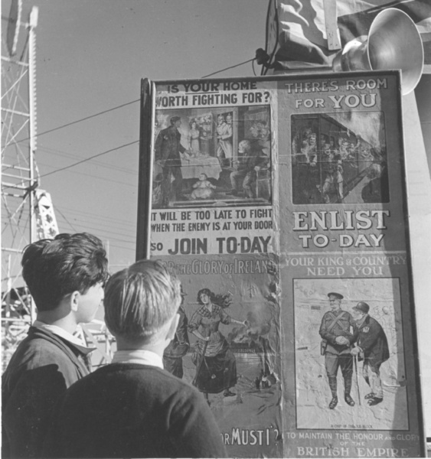
Recruitment at home was slowing, and the manpower and enlistment system was disorganized.
↓
Recruitment was slowing (fewer men were enlisting) and the system was disorganized.

Slide 7
Works Cited
Keep track of your sources as you go along
Use Citation Machine to generate your citations in MLA format
(found on the Pinetree Library webpage)

Slide 9
Click on MLA on the left side

Slide 10
Copy and paste the URL of the site you used and a citation should be generated.
JONES, RICHARD. "Conscription." The Canadian Encyclopedia. N.p., n.d. Web. 29 Feb 2012. <http://www.thecanadianencyclopedia.com/articles/conscription>.

Slide 11
Click on the type of resource used if you used a book OR if a citation is NOT generated when you put in the URL

Slide 12
Fill in the blanks as much as you can

Slide 13
Arrange your entries alphabetically
with all lines after the first indented

Slide 14
Works Cited
Jones, Richard. "Conscription." The Canadian Encyclopedia. N.p., n.d. Web. 29 Feb 2012. <http://www.thecanadianencyclopedia.com/articles/conscription>.
Santor, Donald M. Canadians at War 1914-1918. Scarborough: Prentice-Hall of Canada, 1978. Print.
Wikipedia contributors. "Conscription Crisis of 1917." Wikipedia, The Free Encyclopedia. Wikipedia, The Free Encyclopedia, 9 Jan. 2012. Web. 29 Feb. 2012.

