Slide 1
Cell phones and brain cancer

Slide 2
Quick facts
By the end of 2009, the number of mobile cellular subscriptions worldwide reached approximately 4.6 billion
(THIS IS TOO WORDY)
versus
4.6 billion cell phones in use in 2009

Slide 3
Researchers do not agree

Slide 4
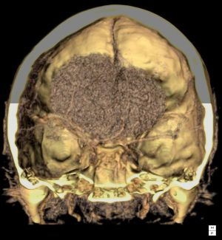
Risk of brain cancer
There is growing evidence – exclusively reported in the IoS in October – that using handsets for 10 years or more can double the risk of brain cancer. Cancers take at least a decade to develop, invalidating official safety assurances based on earlier studies which included few, if any, people who had used the phones for that long.

Slide 5
One study’s warning
A study in the IoS found using handsets for 10 years or more can double the risk of brain cancer.
Earlier studies reporting no effect had been for shorter periods
Cancers take at least a decade to develop

Slide 6
Some say it is safe
A Swedish study - mobile phone users have no greater chance of developing the disease than the general population
The study followed 420,000 Danish mobile phone users for up to 21 years

Slide 7
This information in the last slide was okay.
What would have strengthened it?

Slide 8
My recommendation
Cell phones could be safe but I would be careful
Limit your use of cell phones
Don’t sleep with your cell phone near your head at night
- Buy a proper headset

Slide 9
Works Cited
"Cancer risk 'not raised by mobile phone use'." Northern Echo. 07 Dec. 2006: 03. eLibrary.
Web. 11 May. 2010.
Lean, David. “Mobile phones 'more
dangerous than smoking.” The Independent.
independent.co.uk., 30 March 2008,
Web. 11 May 2010.
Wikipedia contributors. "Mobile phone."
Wikipedia, The Free Encyclopedia.
Wikipedia, The Free Encyclopedia, 10 May.
2010. Web. 11 May. 2010.

