Slide 1
Scholarship & post secondary Update 2024/2025 Wednesday, Oct. 2 Ms. Moorhouse & Mr. Nelson

Slide 2
DIFFERENT SOURCES OF FINANCIAL AID
SCHOLARSHIPS
Although many scholarships are based heavily on academic achievement, many have other criteria, which play a large role as well. A combination of the following is also considered: community activities, leadership qualities, athletic ability, a commendable character, ethnic background, special needs, specific area of study, career plan, parents’ union affiliation.
BURSARIES
Bursaries are a non-repayable sum of money that is given based primarily on financial need, but also considers academic achievement and other criteria. Usually, official documentation affirming your financial situation is required.
GRANTS
Grants are a non-repayable sum of money that is given based primarily on financial need. Government grants are available. www.studentaidbc.ca
LOANS
Money borrowed by student demonstrating financial need, which must be repaid. A full financial statement is a necessary part of the application form. Student may get a loan from the government or a bank. BC/Canada Student Loan: www.studentaidbc.ca
AWARDS
Monetary awards made in recognition of achievement and significant individual contributions to the school, cultural and athletic development of school/community.

Slide 3
Where to find information?
The GRAD 2025 Team will have Scholarship/bursary application information
Not on the Team? Email Ms. Moorhouse with Grad 2025 in the subject Line and you will be added
The Career resource Website also lists scholarships available on the Financial Aid page and it includes scholarship search links and other relevant documents

Slide 4
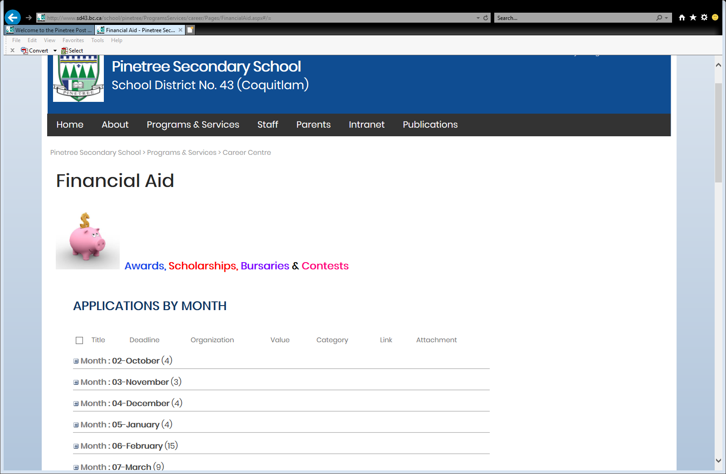

Slide 5
No One Source
Hundreds of Scholarships, Bursaries & Grants Available (non-repayable)
Local/District Scholarships/Bursaries (application process in spring at Pinetree)
External/affiliation Scholarships/Bursaries (applications available throughout the year)
University Entrance Scholarships/Bursaries (apply in the Fall)
BC Government Scholarships (feb deadlines)
BC Government loans/Grants (apply in early June)
You are responsible for researching, applying, and sending your applications with all required documents.

Slide 6
Local Scholarships & Bursaries
Online Pinetree local Scholarship Application available in March/April 2025 for Canadian Citizens & Permanent residents only
Scholarships/bursaries for Pinetree Graduating Students
$ donated by Local Community organizations
Includes District Authority award application process
Mr. Nelson & Ms. Moorhouse will support students throughout the application process
Online application
Stay tuned for details in the spring!

Slide 7
External Scholarships & Bursaries
Sponsored by Private organizations (businesses, societies, unions etc.) Example: Loran awards
Check with parents to see if their employer, union, club etc. offers scholarships or bursaries!
Different criteria for each scholarship
Deadlines throughout the year
National, regional and provincial awards

Slide 8
Entrance Scholarships
Awarded by colleges and universities
Automatic Entrance Scholarships: no application required. Based on GPA of Grade 12 courses used for admission.
Major entrance Scholarships: application required. Based on GPA of grade 11 & 12 courses (transcript), essay, letters of reference. Awarded to high academic students who have been involved in their school and/or community.
Scholarships available for international students.
Check with each university/college you are applying to!

Slide 9
Entrance Bursaries
Awarded by colleges & universities
Based on Financial need
Must also apply to Government student aid
Meets unmet need of government aid (top up)
Check with university/college you are applying to!

Slide 10
BC Government scholarships (must be a Canadian citizen or permanent resident)
$1,250 BC achievement scholarships – no application required (8000 graduates will receive this award)
$1,250 District Authority Scholarships – apply in the spring at Pinetree
$5,000 BC excellence Scholarships – Pinetree can nominate one student – Nominee must Apply by Feb. 15 (55 students awarded)
$5,000 Pathway to teacher education scholarships – apply online by Feb. 15
* For application details visit: BC Government Scholarships

Slide 11
BC/Canada Government Student loans & grants
Grants, Loans, targeted financial assistance (government care, low income and permanent disabilities) for Canadian Citizens/Permanent residents who are BC residents with financial need.
BC Access Grant. B.C. Access Grant (Full-Time) | StudentAidBC
Step 1: Students should have a BC Services Card & SIN# www.gov.bc.ca/bcservicescard
Check your school dEsignation: Apply | StudentAidBC
Step 2: Apply for loan at www.studentaidbc.ca (apply to see if you are eligible)
Early June – application will become available and students should apply at that time.
Can apply up to 6 weeks before program ends, receive notice of assessment, sign loan agreement and receive loans and grants. (takes 4 to 6 weeks to receive assistance)
How much you get is Calculated on education and living costs, tuition, books, rent etc. and available financial resources, scholarships etc.
Weekly/monthly/annual BC and Canada grant and loan limits.
Loan to supplement, not replace funds available to students.
Budget worksheet at studentaidbc.ca
Yearly application.

Slide 12
Some scholarships require a student to be NOMINATED by their school.
U of T book Award/National Scholarship Program (Domestic Students) & U of T Lester B. Pearson Scholarship (for international students) – Brag Sheet due to Mr. Nelson on Fri, Oct. 4.
Queen’s University Entrance – Brag sheet Due to Mr. Nelson on Fri., Nov. 8. can nominate two students.
Schulich Leaders Scholarships (January) Can nominate one student.
BC Excellence Awards (January) can nominate one student.
Western university national scholarship (February) can nominate four students plus one if they are an international student.
Details posted are on teams and Pinetree career resources site

Slide 13
National scholarship program for Domestic students
Value: The National Scholarship covers tuition, incidental and residence fees for up to four years of study.
Eligibility: Nominees must submit an online application form in order to be considered for the National Scholarship. Nominees will receive an email containing the link to the national scholarship application form.
Eligibility Criteria:
an original and creative thinker
committed to school and community
a high achiever in academic and creative pursuits
enthusiastic about learning and intellectual exploration
a Canadian citizen, permanent resident or protected person
currently in your final year of Canadian secondary school or first-year CEGEP
intending to begin university the following academic year
a National Book Award nominee
Nomination process: submit Brag Sheet to Mr. Nelson at kEnelson@SD43.BC.CA by oct. 4, 2024.
Scholarship Deadline:
Deadline for Nominee to apply for the 2024 National Scholarship: Oct. 17, (11:59 EDT)
For more information: About the National Scholarships - Future Students. University of Toronto | University of Toronto (utoronto.ca)

Slide 14
Lester B. Pearson Scholarship for International Students
Value: Aprox. 37 scholarships: full tuition, books, incidental fees and full residence support for four years.
Must be an international student who have demonstrated exceptional academic achievement and creativity, who is accepted as a leader with their school, and who have the potential to contribute to the global community in the future.
Pearson Scholarship Deadlines:
Nomination process: submit Brag Sheet to Mr. Nelson at kEnelson@SD43.BC.CA by oct. 4, 2024.
OUAC Admission Deadline: Oct. 18, 2024
Student scholarship application & documentation deadline: Nov. 8, 2024.
For more information and to apply online visit: https://future.utoronto.ca/pearson/about/

Slide 15
Major Admission Awards
Pinetree can nominate up to two students.
Criteria: Superior academic ability, creative and original thinking, proven leadership qualities.
Nomination process. Please submit a brag sheet to Mr. Nelson at KeNelson@sd43.bc.ca no later than Fri., Nov. 8, 2024.
If nominated you Must apply to Queen’s Univ. VIA OUAC no later than Nov. 20, 2024
Deadline for Nominee to apply for MAA: Dec. 8, 2024
Go to Future Students Major Admission Awards | Registrar & Financial Aid Services (queensu.ca) for more info.

Slide 16
Pinetree Student Information Brag Sheet
Student Information Brag Sheet Fillable pdf is available on Financial Aid webpage on the post secondary & Career resources website. Pinetree Brag Sheet.pdf (sd43.bc.ca)
The purpose of the Brag Sheet is to procure a letter of reference from a teacher or for scholarship nomination consideration.
Please fill out the form and email it to your teacher referee or Mr. Nelson. It should be updated throughout the year if volunteer information changes.

Slide 17
Entrance Scholarships (not requiring nominations)
Colleges and Universities offer entrance scholarships and bursaries.
Based on courses used for admission.
Visit the Financial Aid page of college and university websites for information and deadlines.
Now is the time to do your research!
To apply for an entrance scholarship, you must first apply to the college or university.

Slide 18
UBC Major Entrance Scholarships
UBC Presidential Scholars Award (academic/leadership) for Domestic STudents
Students will be considered for this award if they apply to UBC through the online application by December 1, 2024, and check the box on the online UBC application.
Centennial Scholars Entrance Award for domestic students (based on financial need, be a strong academic student and meet all UBC’s admission requirements)
Scholarship application is required and due December 1, 2024.
Awards for indigenous students: must self-identify on UBC application. Some awards require a separate application.
Beyond tomorrow scholars program & award for Black Canadian students: Must Self-Identify on UBC application and complete a separate application.
Scholarships for international students
UBC Financial planning

Slide 19
SFU undergraduate Entrance scholarships
The value range is $20,000 to $140,000.
You must have grades in the 90% range, excellence in extra-curricular. Very competitive.
Deadline to apply for this scholarship is Dec. 15, 2024.
Available for both domestic and international students.
References are VERY important. Must know you well and be able to speak about your extra-curricular. Leadership, involvement in community/service, over a long period of time. Be specific in describing involvement and what you accomplished/learned
Essay questions
References should be able to describe/speak to your involvement not just your academics.
High School Applicants - Scholarships - Financial Aid and Awards - Simon Fraser University (sfu.ca)

Slide 20
Other SFU Scholarships
UGGla Family Entrance Scholarship (requires application)
Uggla Family Scholarship - Undergraduate Admission - Simon Fraser University (sfu.ca)
The are other scholarships listed on the SFU website: High School Applicants - Scholarships - Financial Aid and Awards - Simon Fraser University (sfu.ca)
Awards & Bursaries & indigenous awards (High School Applicants - Awards & Bursaries - Financial Aid and Awards - Simon Fraser University (sfu.ca)

Slide 21
Steps to apply for scholarships
Complete a Pinetree student information brag sheet
Research scholarships
Decide which scholarships you want to apply for where you fit the criteria and follow instructions carefully!
Make note of requirements: essay, transcript, letters of reference
Ask teachers, community members, counselors for reference letters
Most Pinetree scholarships require Canadian Citizenship or Permanent Residency. Know your status and check the requirements of the specific scholarships.
Apply by due dates. Check whether it is ‘apply by’ or ‘received by’ for the application date.
Submit scholarship application (most are online applications).

Slide 22
Reference letters
If you are asking your teachers for a reference letter:
Give adequate time (at least two weeks)
Choose someone who knows you well so you can receive the strongest letter
Make sure you give a copy of your pinetree student information Brag Sheet Pinetree Brag Sheet.pdf (sd43.bc.ca)
If possible, include a copy of your application
Some letters may be included in your application; some may need to be submitted directly by your teacher

Slide 23
ESSAYS
Edit! Edit! Edit!
Read the topic carefully
Scholarship providers get to know you through your essays so be specific
Use examples
Only provide information that you are comfortable being shared with others. Many essays are published along with winner’s profiles.

Slide 24
Post Secondary FAQ
All applications are now open!
Check deadlines for each post secondary
You will need your pEN# & credit card
For most BC Post secondary apply at educationplannerbc.ca
You do not need to have completed courses to apply
It doesn’t matter which semester you are taking courses
After you apply, most institutions will require you to submit a transcript, and some programs require supplementary applications

Slide 25
Post Secondary applications
Douglas College: Application is now open. Apply early.
BCIT: Applications are open until program fills for most technology programs (check program). Some programs have competitive entry and are accepted until posted deadline. Applications accepted throughout the year for trades programs.
Capilano University: Application is open. Apply early! Deadlines published on website for each program.
Emily carr univ. of Art & Design: Application is open. Deadline is January 15, 2025.
KPU: Applications accepted Oct. 1 – March 1, 2025, for limited intake programs and early application for open intake programs. The final deadline for open intake programs is Jul. 1, 2025.
SFU: Applications accepted until Jan. 31, 2025
UBC: Early application deadline Dec. 1, 2024. The final application deadline is Jan. 15, 2025.
UVic: Applications accepted Oct. 1 – Jan. 31, 2025.
Ontario Universities – OUAC is open. It is recommended that students apply in the Fall. Each Ontario university has a different application deadline. * U of Toronto: Early consideration and recommended deadline to apply: Nov. 7, 2024.. Final deadline for most programs is in January.
U of Alberta – Applications accepted until March 1, 2025
McGill: Applications accepted until Feb. 1, 2025
BC applications: EducationPlannerBC
Ontario applications: Undergraduate Application Guide | Ontario Universities' Application Centre (ouac.on.ca)
Alberta applications (except U of A): ApplyAlberta | ApplyAlberta
For all other Canadian universities, visit institution website.

Slide 26
Post secondary visit dates
Oct. 9 (Wed) – lunch hour – U of Alberta (A200)
Oct. 10 (Thurs) – lunch hour - U of Calgary (a200)
Oct. 10 (Thurs) – 4:30-5:30pm – U of T (online)
Oct. 24 (Thurs) – lunch hour - Western U (a200)
Oct. 24 (Thurs) – after school – BC Post-SEcondary Mini Fair (community Room 7, 8 & 9)
Oct. 29 (Tues) – lunch time– SFU Beedie school of Business (a200)
Nov. 7 (THURS) – lunch hour – UBC Sauder School of Business (A200)
Nov. 13 (Wed) – Lunch hour – SFU (Library)
Nov. 14 (Thurs) – lunch hour - UVic Gustavson school of business (A200)
Nov. 14 (Thurs) – Virtual Session at 5pm - SFU Criminology
Nov. 19 (Tues) – lunch hour – U of waterloo (A200)
Nov. 21 (thurs) – lunch hour – U of Guelph (foyer)
Nov. 29 (Fri) – lunch hour – UVic Engineering/computer Science (A200)

Slide 27
Transcripts
You will need to complete the Student Transcript Service (STS) Form
Students intending on pursuing a post-secondary program beginning Sept. 2025 must create a BC Government account (BCeID) to Register and then access the (STS). Students must order transcripts for post-secondary institutions. This process ensures that official transcripts are sent to post-secondary institutions. The online link to complete their STS Form is Order a High School Transcript or Certificate as a Current Student - Province of British Columbia (gov.bc.ca)
In addition, Students may also be required to upload or self-report grades in their University student account (most universities) or at the time of application (Capilano Univ., U of Alberta, BCIT).

Slide 28
Student transcript service

Slide 29
Questions?
Contact Mr. Nelson at kenelson@sd43.bc.ca
or Ms. Moorhouse at cmoorhouse@sd43.bc.ca

