Slide 1
StudentTranscripts Service PSI Transcript Ordering/Sending

Slide 2
VISIT
http://www.studenttranscripts.gov.bc.ca

Slide 3
Click on ‘Current Student’

Slide 4
Click on ‘Order’

Slide 5
Click on ‘Register for a Basic BCeID’

Slide 6
Register for Basic BCeID

Slide 7
Once you register for a Basic BCEID you will be sent an email to confirm your registration.
The email will contain an Activation Link.

Slide 8
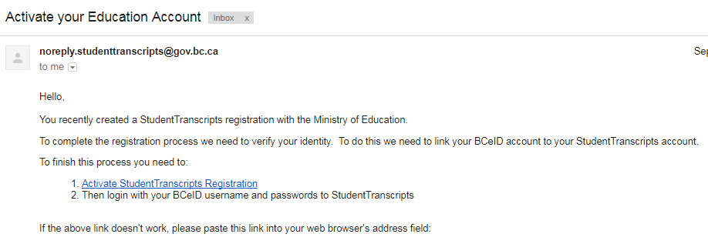
Email Verification
An email confirmation will be sent to activate registration.
Click on link from the email confirmation to link the newly created BCeID to the student’s STS account. Must activate within 24 hours!
Notes:
The system will display a registration confirmation message advising an email has been sent; to activate the registration and link a BCeID to a student’s STS Account you need to click a link in the email.
**Students must click on this link within 24 hours or the registration process must be completed again.
After you click the link the system will prompt you to enter your BCeID user name and password to finalize the process.

Slide 9
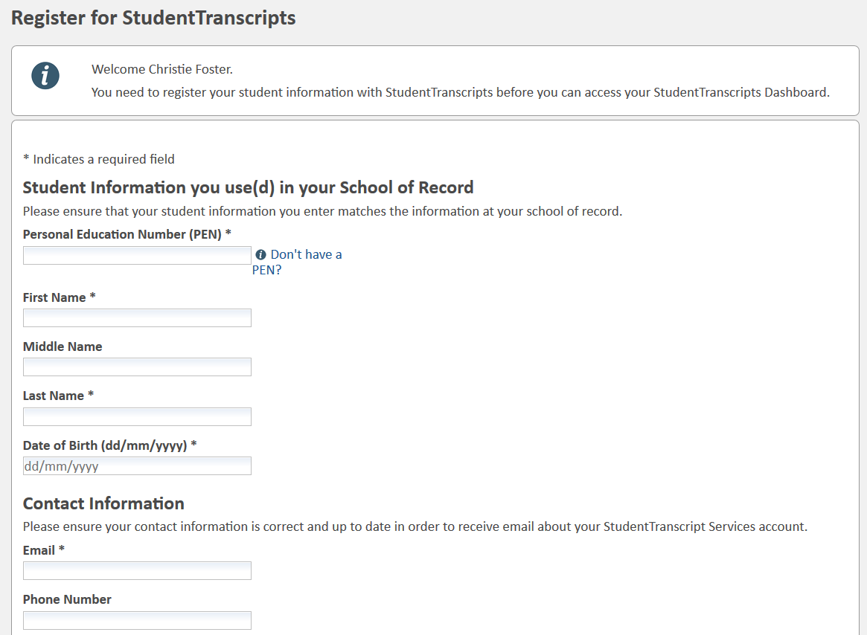
Register for StudentTranscripts
Register for the StudentTranscripts Service
Tip: PEN, First Name, Last Name and DOB are mandatory fields and must match Pinetree record.
Three incorrect attempts will lock you out of the system!
Notes:
Students must provide their PEN, legal name and birthdate to obtain access to their records.
**This information should match what the school of record has on file for the student.
Challenges that students often encounter when trying to register is:
Using nick names or anglicized names that do not match their name in their school of record
Hyphenated names
After 3 attempts, they will be locked out of the system, STS will need to go into system and unlock, then an email will get sent to students to try again.

Slide 10
LOG in with BCeID

Slide 11
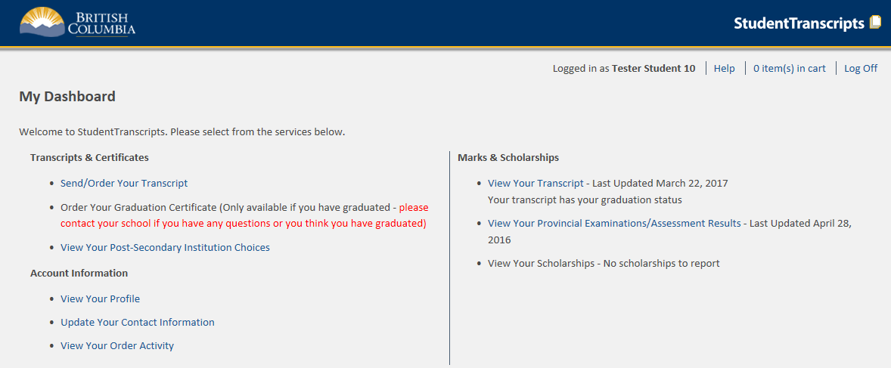
Student Dashboard: Click on Send/Order Transcript
Main Student Dashboard following authentication and authorization
Notes:
The Student Dashboard provides access to the functions available to students once they have:
1. authenticated using a Basic BCeID, and
2. successfully been authorized to access their transcript records.

Slide 12
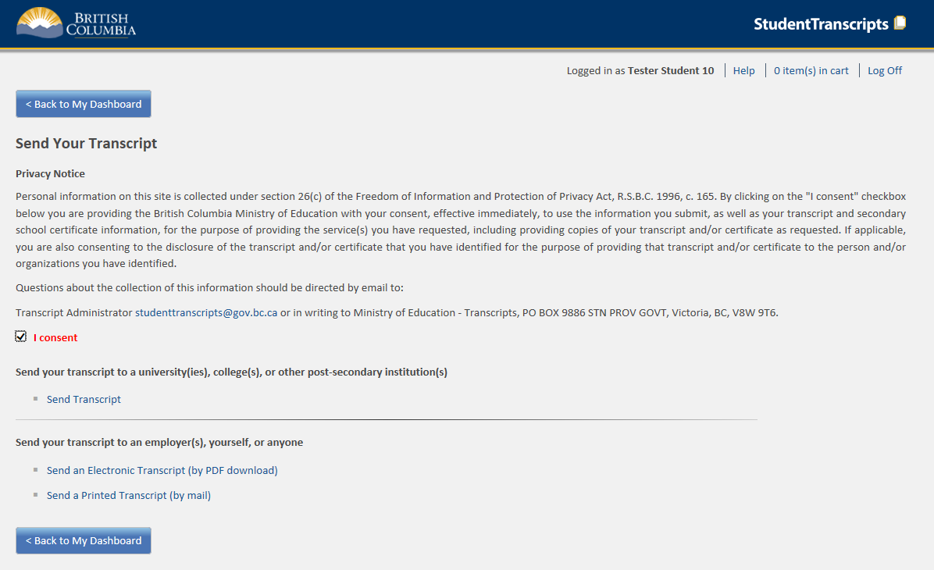
Send/Order your Transcript
Privacy consent activates links below
Send Transcript to PSI
Notes:
Privacy consent box (once checked) enables the other links for:
Sending transcripts to PSIs; or,
Sending transcripts to other third parties.
Electronic Transcript (by PDF download) will operate much like an electronic bank transfer transaction requiring the email address of the receiver and a shared security question and answer. **Important to use exact password as they are case sensitive and if password is incorrectly entered 3X, it will be locked out.
Printed Transcripts will now also be automated through direct PDF transcript printing at BCMail for subsequent mailing to the specified destination.
** Printed transcript is ordered, BC Mail receives order from STS, transcript is printed, posted through Canada Post and is not tracked

Slide 13
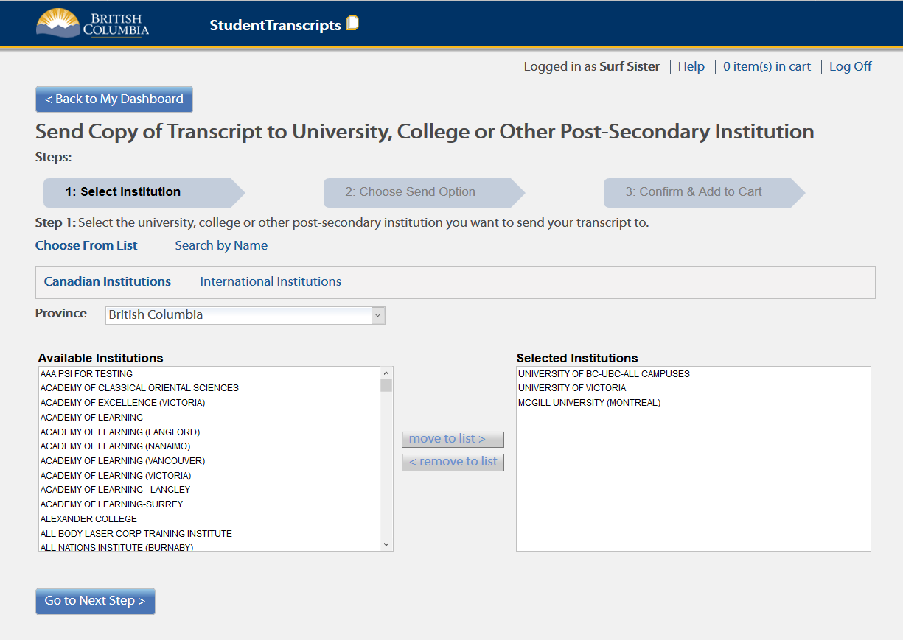
Step 1 – Search for PSI and move to list
Notes:
**This slide shows three different PSIs and the options on how to send a transcript to each on the following slide

Slide 14
Information to go to PSIs
SEND OPTION PRE-SELECTED FOR GRADUATING STUDENTS!
DO NOT CHANGE!
.
Notes:
**Send my transcript now and allow this Post-Secondary Institution to request transcript updates until the date specified below. – NEW online XML Transcript
**Send interim and final marks when they are available - electronic batch process (May and July)
**Send final marks when they are available - printed copies only of transcript
If the student wants to ‘send my printed transcript now”, then they will need to change their selection from the current default button

Slide 15
Step 3 – Confirm and Add to Cart and review transcript
Notes:
**Informational message can provide students with important information on exam or assessment information.
**Students must check their information on the transcript of grades for accuracy before proceeding.

Slide 16
Confirmation of Order
New – order has not yet been sent for batch process and final transcripts
Notes:
**Order details show which institutions were selected and when the transcripts will be available.
**Status of each transcript with “new” order has not yet been sent and “processing” is being sent

Slide 17
Final Step – Submit Order
Last screen – submit order

Slide 18
QUESTIONS?
QUESTIONS about the STUDENT TRANSCRIPT SERVICE and/or SENDING TRANSCRIPTS directly to universities and colleges?
Email Ms. Moorhouse at cmoorhouse@sd43.bc.ca

