Slide 1

Class of 2025
The Road to Graduation

Slide 2

Make sure you are on Track to Graduate!
Review your Diploma Verification:- this is posted in MYED BC for you to download and review _____________

Slide 3
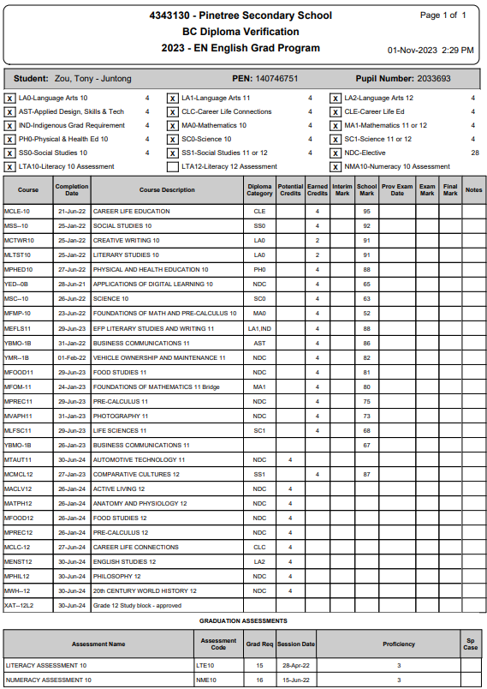


Sample Diploma Verification
Checklist:
All the boxes at the top should be checked with an X (exception for now Literacy 12 Assessment)
Assessments – Literacy 10 and Numeracy 10 must be completed
  If you are missing one of these grade 10 assessments expect an email from Mr. Rao.
  you will need to write in January
Total number of credits will be at the very bottom. Total should be = or > than 80. Top row indicates total # of Grade 12 credits. You need 16 minimum.
Check to see if Summer School marks/ Online marks are there if this applies to you.

Slide 4
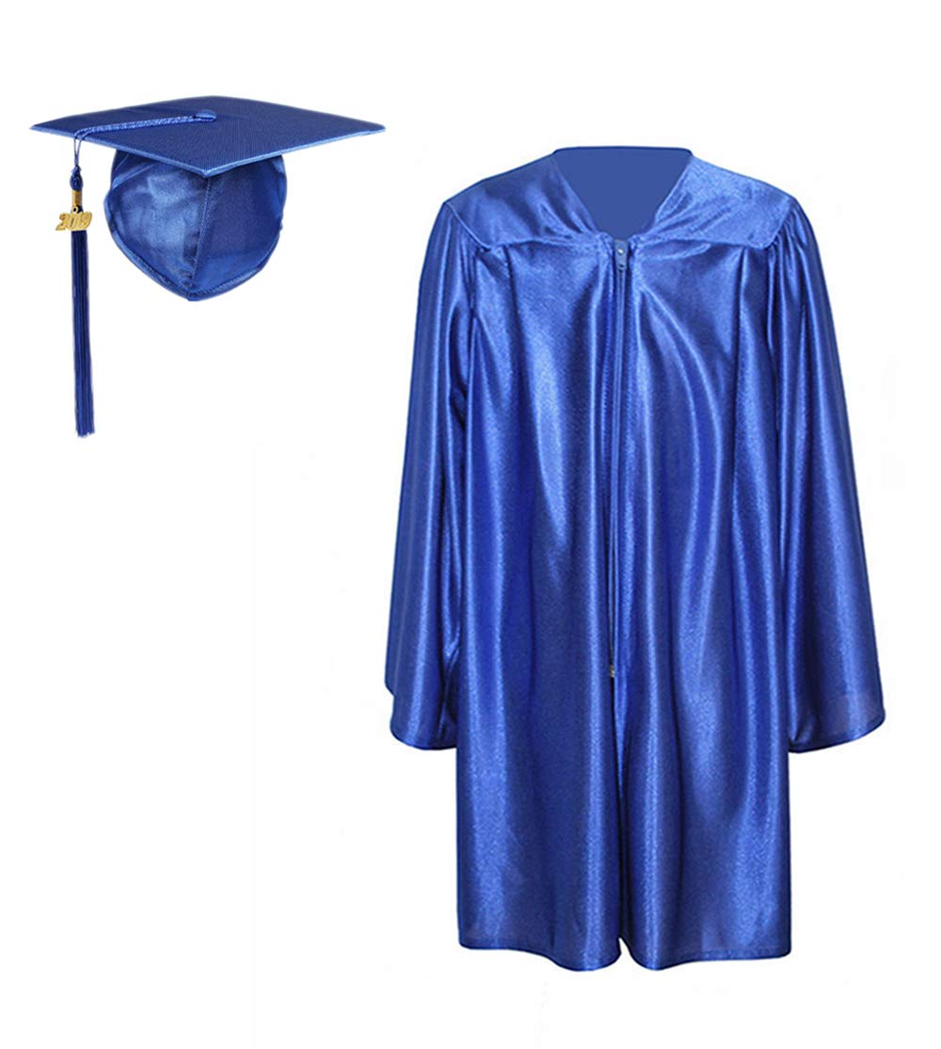
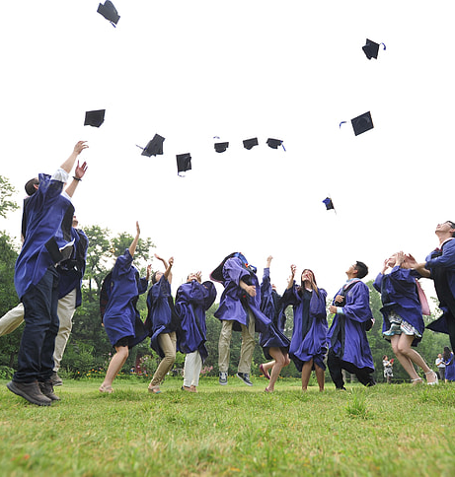
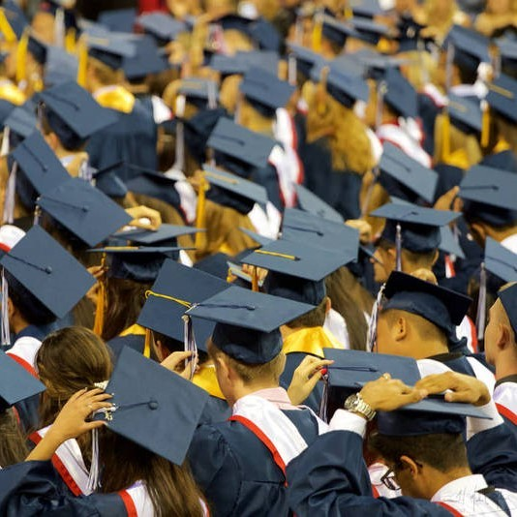
Cap & Gown Size!
Go to this link (Sent to your school email/Grad channel )and complete the form Today!
Your size is needed for us to order your gown.
Deadline December 6th, 2024.

Slide 5

Pinetree my school Day app – Grade 12 channel
All important relevant information for grade 12’s will be posted on this Channel. Make sure you have downloaded the APP so that you don’t miss out on important information and DEADLINES!

Slide 6
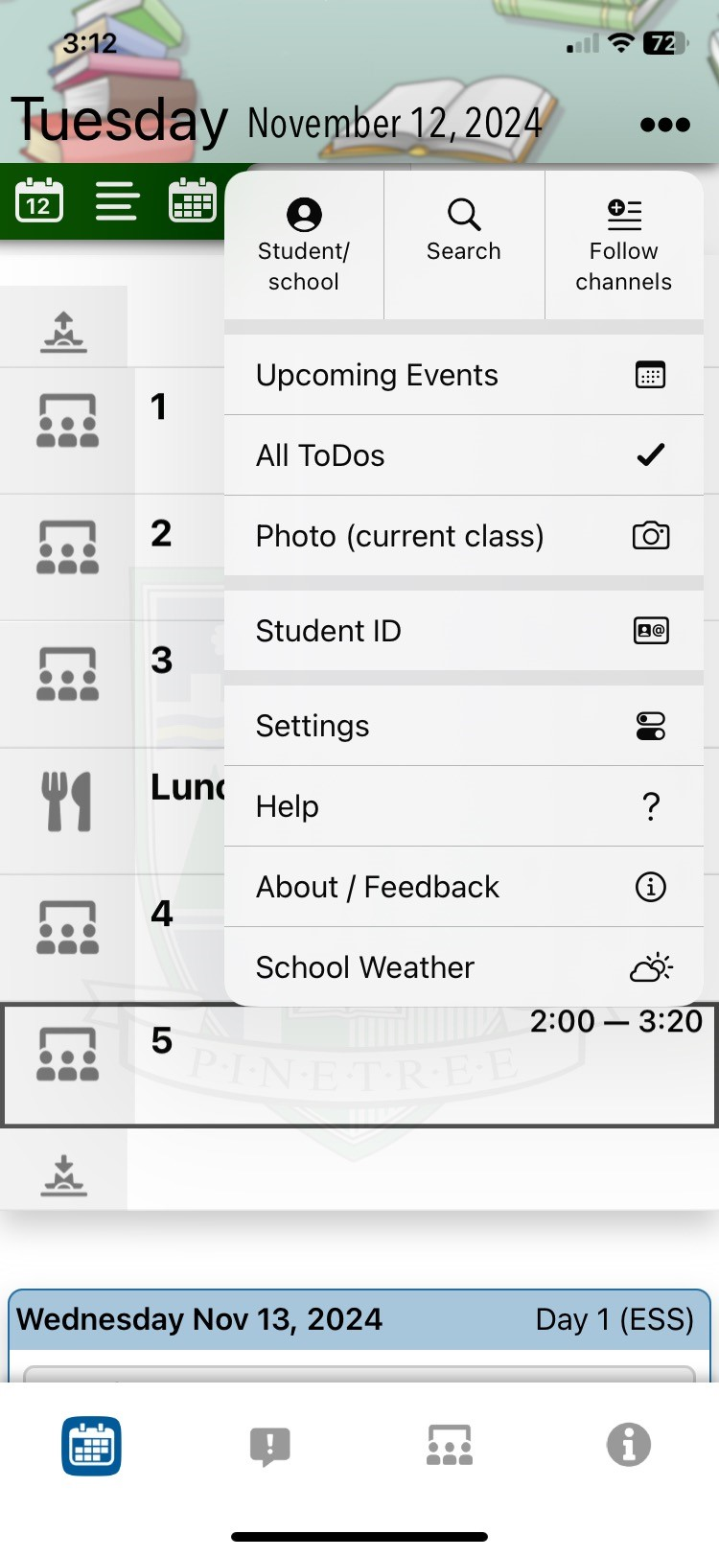
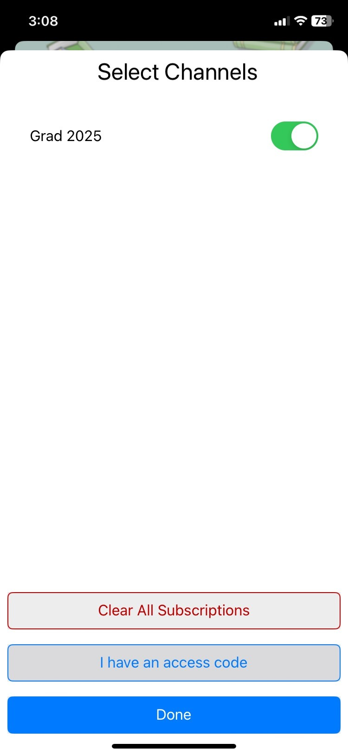
Go to My school Day APP now

Slide 7
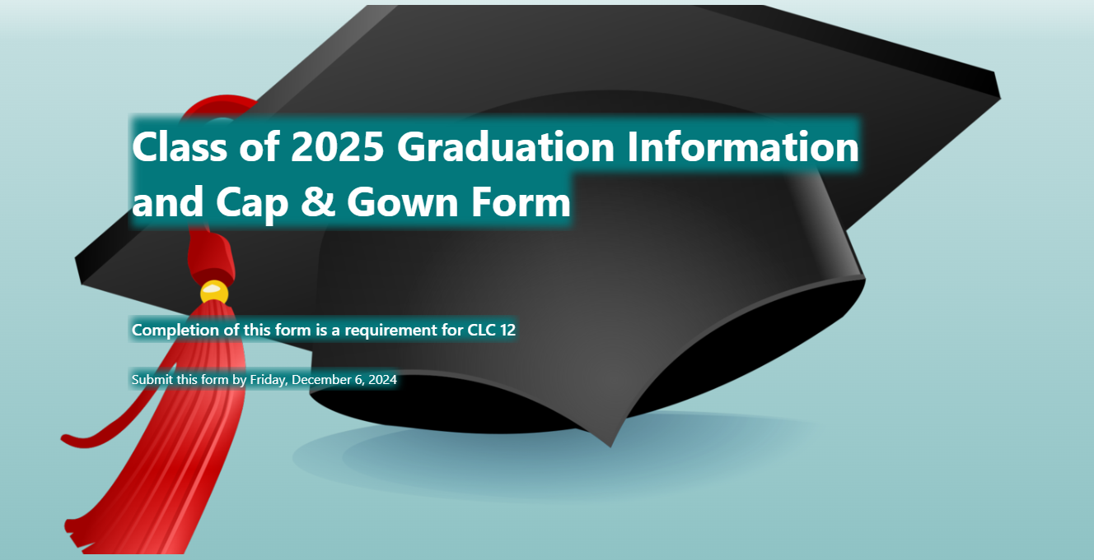
Link for the form will be emailed to students!
And put on the Grad 2025 Channel in the my school day app
Complete by December 6th.
REQUIRED ASSIGNMENT FOR CLC12

Slide 8
POST SECONDARY APPLICATIONS
APPLICATIONS ARE OPEN
YOU NEED YOUR PEN# AND A CREDIT CARD
CHECK DEADLINE DATES (EARLY AND/OR FINAL)
REGISTER FOR STS
YOU DO NOT NEED FINAL GRADE 12 MARKS TO APPLY
YOU DO NOT NEED PAPER TRANSCRIPTS
IT IS OK TO HAVE REQUIRED COURSES IN SECOND SEMESTER
FOR BC UNIVERSITIES: EDUCATIONPLANNEBC
FOR ONTARIO UNIVERSITIES: OUAC (105 APPLICATION)
FOR ALBERTA: APPLYALBERTA (EXCEPT U OF ALBERTA)
FOR ALL OTHER CANADIAN UNIVERSITIES, GO DIRECTLY TO THEIR WEBSITE

Slide 9
STUDENT TRANSCRIPT SERVICE
WWW.STUDENTTRANSCRIPTS.GOV.BC.CA
REGISTER FOR A BASIC BCEID
IT WILL GIVE YOU ACCESS TO THE STUDENT TRANSCRIPT SERVICE

Slide 10
access student transcript service
StudentTranscripts Service Help Resources - Province of British Columbia (gov.bc.ca)
Using your bceid, you can register for the sts and you will be prompted to enter student information.
An email will be sent to the email address you provided, and it must be activated within 24 hours.
Once activated, you will be able to log onto sts using your bceid and password.
From your sts dashboard, you can choose up to 25 free (psi) selections, so that colleges and universities you are applying to will receive your official transcript. Do not change the pre-selected send options!

Slide 11
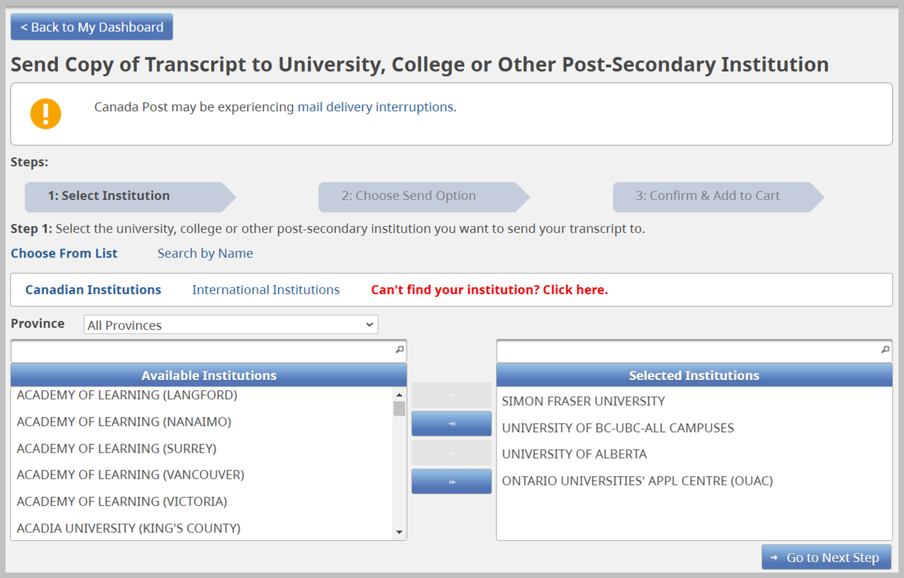

Slide 12
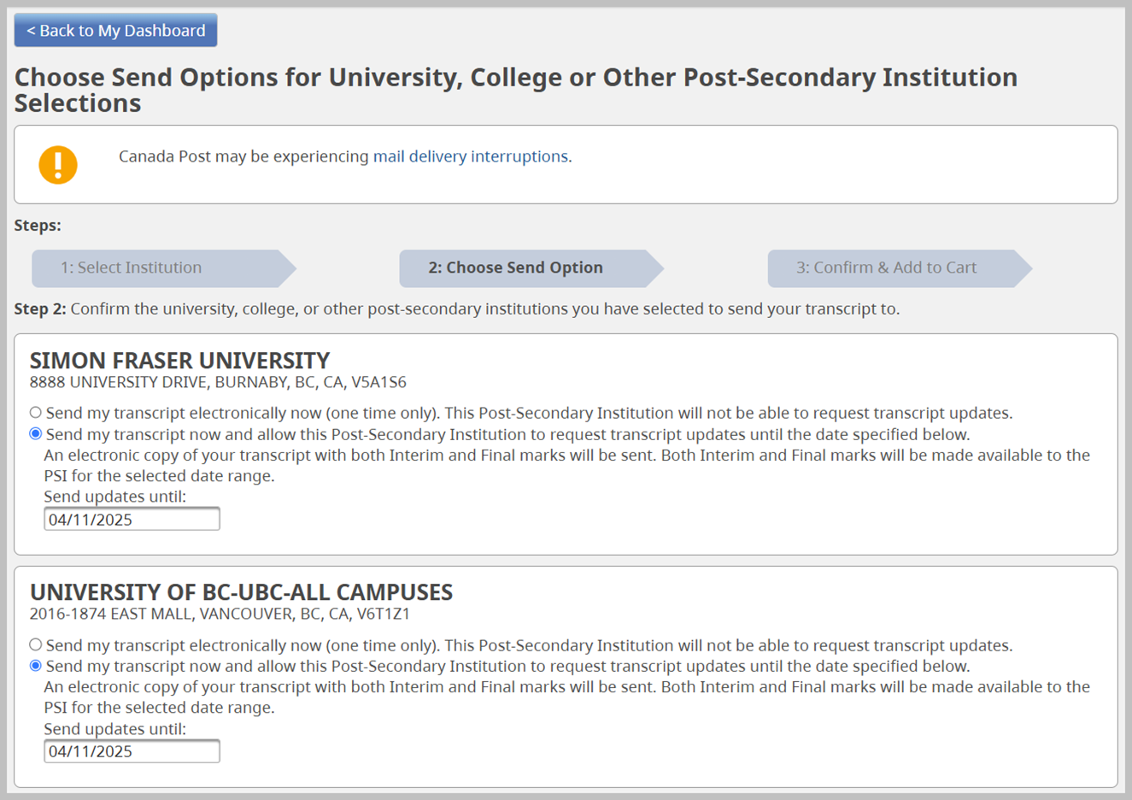

Slide 13
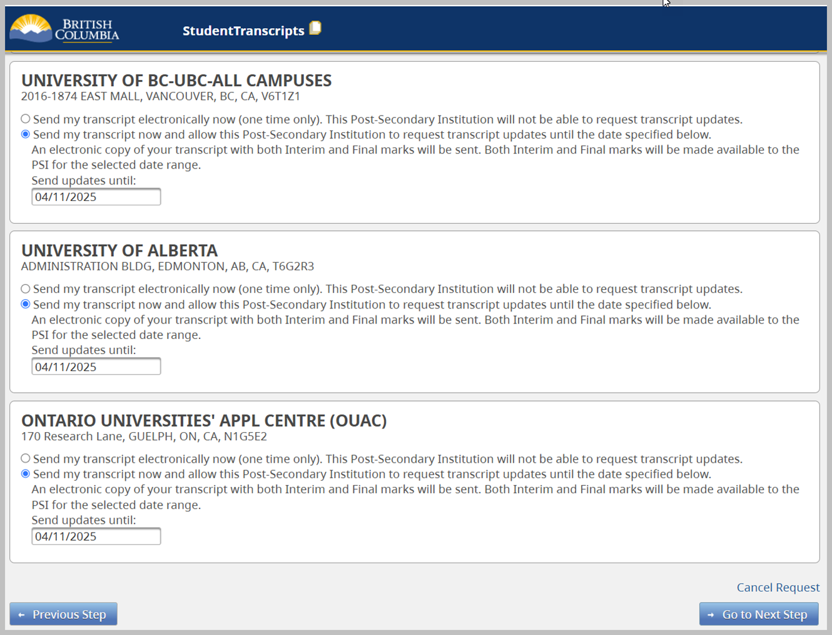

Slide 14
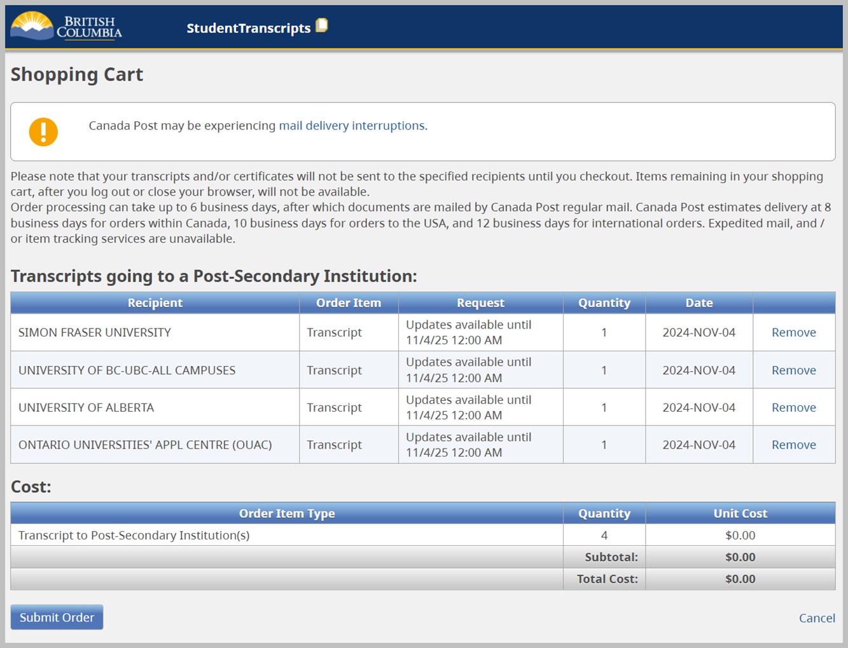

Slide 15
Grad wear website extended
You now have time until tonight 11:59 pm to order grad wear if you haven’t already!
Online store is still open!!!!
LAST CHANCE!

Slide 16
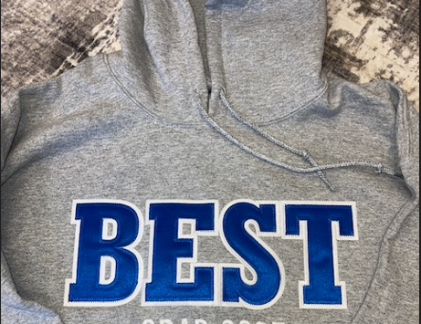
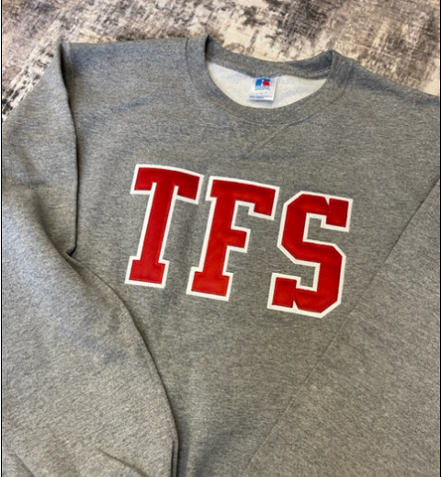

Slide 17
Grad Council Presents: Winter formal
December 12th 2024
Drum roll…….

Slide 18
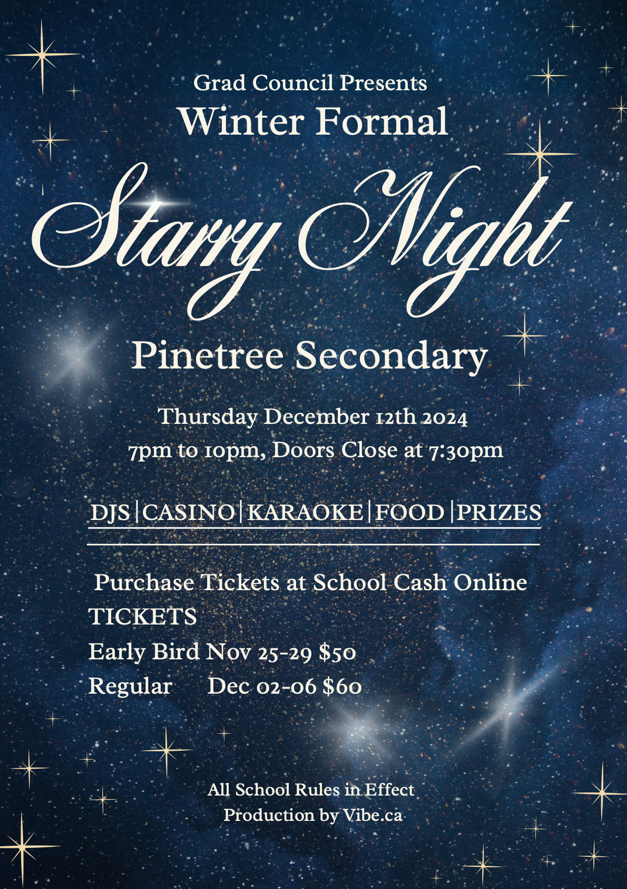

Slide 19
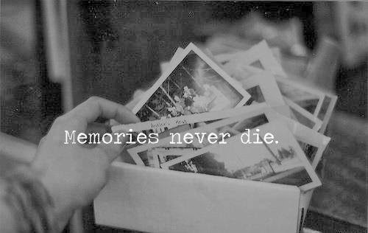
Slide show of memories!
Submit photos to:
Photos will be put into a slide show to view at the dinner dance celebration this year!
Photos must be appropriate!
For example:
  Photos of you and your friend group hanging out at school.
  Activities and extra curricular events outside and during school!.
LAVANYA K. AND AIDA S.
SEND PHOTOS TO THESE NUMBERS:
672-515-1007
604-729-4911

