Slide 1
PRESENTATION TOPICS Grade 9 to 10 Programming
Graduation Program Requirements
Student Success at Pinetree
Pinetree Programs
Number of Courses
Choosing Courses in myed bc
Timeline Information

Slide 2
Counselling Department
Ms. Bishop A-I
Mr. Nelson J-O
Ms. Dhillon P-Z
Mr. Sharma International Students
Emails on school website!

Slide 3
CHOOSING COURSES Important Decisions…
Grad requirements
Interests/exploration/electives
Awareness of Career Plans and Post Secondary Plans
How do I get information?
Family
Counsellor
Post-Secondary & Career Advisor
Research
Course Calendar/Booklet

Slide 4
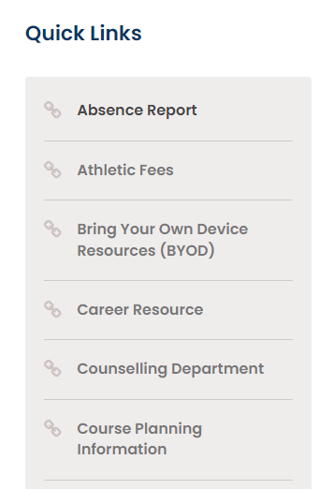
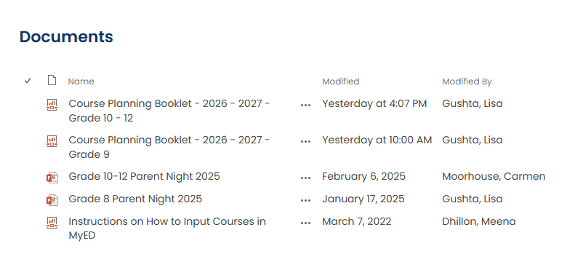
Where to find the course calendar!

Slide 5
GRADUATION PROGRAM 80 Credits
1. Required 52 credits:
English Language Arts 10, 11 and English Studies 12 12 credits
Social Studies 10 4 credits
Social Studies 11 or 12 4 credits
Science 10 4 credits
Science 11 or 12 (Ch, Ph, Bi, Earth Science, Sc for Citizens) 4 credits
A Mathematics 10 4 credits
A Mathematics 11 or 12 4 credits
Physical and Health Education 10 4 credits
Fine Arts or Applied Skills 10, 11 or 12 4 credits
Career Life Education 10 4 credits
Indigenous Focused Coursework
2. Career Life Connections 12 (not a structured class) 4 credits
3. Electives (Grade 10, 11 and 12 - depends on focus studies) 28 credits
4. Assessments:
Numeracy 10 ,Literacy 10, Literacy 12
TOTAL 80 credits
Must have credit for three grade 12 courses plus English Studies 12, includes CLC 12 (16 grade 12 credits total)

Slide 6
Languages
A second Language is not required for graduation
A second Language is no longer required for admission to SFU or UBC
No other University or College in Canada requires a second language
Benefits of a Second Language
Learning a second language helps students build and strengthen skills for their future
Improves communication skills
Ability to interact with others
Public speaking skills
Fosters cultural awareness and global perspectives
Builds confidence through interactive and engaging activities
Prepares students for real-life language use

Slide 7
FNA (Fine Art) or ASK (Applied Skill) 10, 11 or 12
Students are required to complete 4 credits in either:
Fine Arts ( any Drama, Dance, Music or Visual Art course) OR
Applied Skills (any Business Ed. , Home Ec, Info Tech and Tech Ed. Course)
Must completed at the Grade 10, 11 or 12 level
When choosing electives there are no grade 10 numbered electives other than second language courses or Band and Choir courses
All electives you choose will be numbered 11 other than your core required courses.

Slide 8
FINE ARTS / APPLIED SKILLS
SOME EXAMPLES INCLUDE:
Drafting 11 (AS) Graphic Arts 11 (FA)
Marketing & Promotion 11 (AS) Drama 11(FA)
Textiles 11(AS) Art Studio 11 (FA)
Foods Studies 11(AS) Auto Tech 11(AS)
Composition & Production 11(FA) Choral Music 11(FA)
Automotive Tech 11(AS) Any Info Tech 11(AS)
Instrumental Music (Band) 11 (FA)
see the course booklet for more details:

Slide 9
NUMBER OF COURSES
GRADE 10 students
8 Courses
You must have 8 classes in your schedule. This does not include extra courses or online courses.
Extra Courses:
Jazz Band 10, Choir 10, Vocal Jazz 10, Graphic Production11 (Yearbook 11), Athletic Leadership 11, Leadership 11, Red Cross Leadership 11 (note: priority given to grade 11’s and 12’s)
These courses are in addition to your 8 courses if you choose to take one or more of them

Slide 10
Our English 10 Courses at Pinetree
There are 4 options for English 10.
Your 4 choices include:
Composition 10
Creative Writing 10
New Media 10
Composition 10 HONOURS
You will notice your schedule has Literary Studies 10 along with your English 10 choice. All English courses are rooted in reading, so this section is attached to your English selection.

Slide 11
Pinetree Mathematics
Grade 10 Year​
Workplace Mathematics 10
Foundations of Math & Pre-Calculus 10​
Pre-Calculus 10 Honours and 11 Honours (year-long)​
Pre-Calc 10 Honours (Sem 1) Pre-Calc 11 Honours (Sem 2)
Pre-Calculus 11 would take up one elective spots if approved
Most likely these classes will be in period 1 (7:45am start)

Slide 12
Lifeguarding Fitness/Learn to Swim(new)
Learn to Swim Fitness 11/12 (Grades 10-12)
Whether students are brand-new swimmers or looking to strengthen their technique, the class emphasizes skill progression, teamwork, and personal fitness in group lessons. Held at the City Centre Aquatic Complex during block 5,
this course provides a fun, inclusive, and active experience that supports lifelong comfort and safety in and around the water. Cost: $250
Lifeguarding Fitness 12 (Grades 10-12) (Year Long – 8 credits)
Lifeguarding Fitness 11/12 is a full-year program that trains you to become a certified lifeguard and swim instructor.
Students will earn the Bronze Medallion and Bronze Cross in Semester 1, then advance to the National Lifeguard (NL) and Swim Instructor (SI) certifications in Semester 2.
All classes run at City Centre Aquatics Complex, during Block 5, through the entire school year.
Attendance is mandatory as this program is offered in partnership with the City of Coquitlam.
$350 (Sem. 1 -Medallion and Cross) + $900 (Sem. 2 – NL (National Lifeguard) and SI (Swim Instructor)

Slide 13
PINETREE SPECIAL PROGRAMS
HONOURS & AP – self select, but admission requires teacher recommendation
HONOURS courses will be more rigorous. Make sure you are prepared for this. Once you are selected, we will not be able to change the class, and you will not be able to drop the class part way through the semester.
Think about why you want to take Honours and if it’s a good fit for you based on your interests, passion, work ethic.
Students should be certain they want the Honours course and that they are able to meet the rigors of the course.
ELL: Prepare Students for English 10, 11 & 12 Courses
There are 4 levels of ELL classes. You are placed based on an assessment.
(Your ELL teacher will recommend a plan for next year)

Slide 14
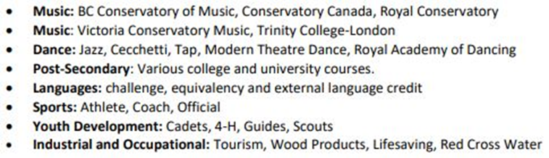
SPECIAL PROGRAMS….Continued
COURSE EQUIVALENCY
If you completed courses in another Country– we can give you credit for courses that meet BC ministry outcomes.
Note: 80% match of curriculum is needed.
EXTERNAL COURSES
Certain Courses taken outside school system; i.e.: Music, Languages, Sports, Cadets, Industrial Programs, Drivers Training, First Aid, Life Saving

Slide 15
CHOOSE WISELY!
It will be very difficult if not impossible to make changes to your courses in September; therefore, please choose your classes carefully.
There will be a verification of your selected courses in late May/Early June. This will be your opportunity to make sure your choices are correct.
If you selected Honours you know at this time if you were accepted. It will be on the draft version of your timetable

Slide 16
STUDENT SUCCESS
Strive to do your best
Course failure may result in:
Remedial summer school (mark between 40%-49%), Summer School
OR
Repeating the course next year

Slide 17
Summer School or Online
If you are planning to take a summer school course or an online course, you must indicate this on your course planning sheet and in the NOTES to Counsellor section in MYED BC when you select your courses.
If you complete a course (summer school, or online) without telling us, we will not be able to change your schedule to a preferred elective in September. You will be placed in a class that has space.
You cannot drop courses you are enrolled in at Pinetree and then take that course online once the semester has started. This planning must occur now.

Slide 18
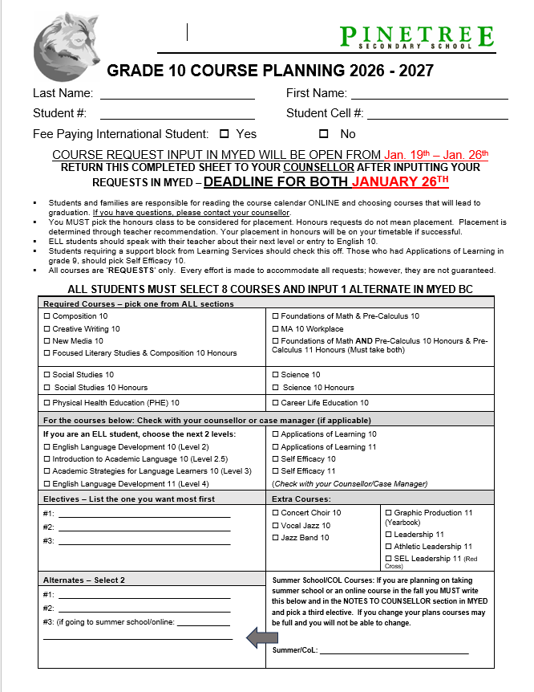
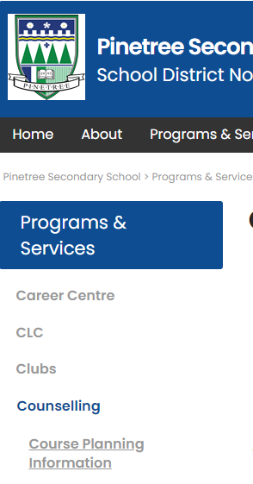
Grade 10 Course Planning sheet
Go to the Course Planning page on the website to download a copy.

Slide 19
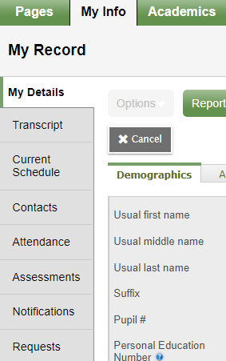
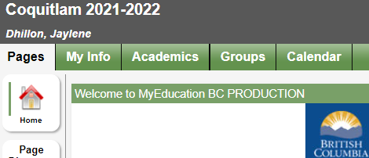
Inputting your Course Selection in MyEd BC
1. Log into your student MyED BC account
You will see the heading as shown below. Click on the green tab title “My Info”.
2. Click on the tab in the left column that reads “Requests”.

Slide 20
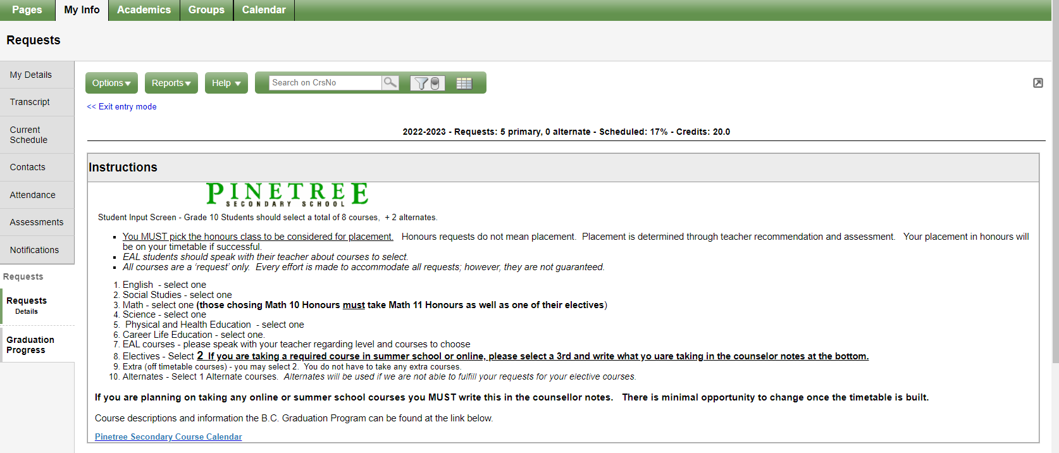
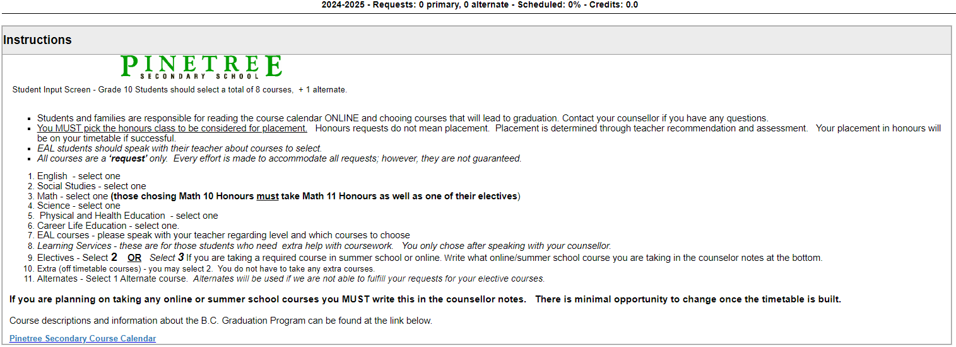
3. You will then see this page. Read the instructions carefully!

Slide 21
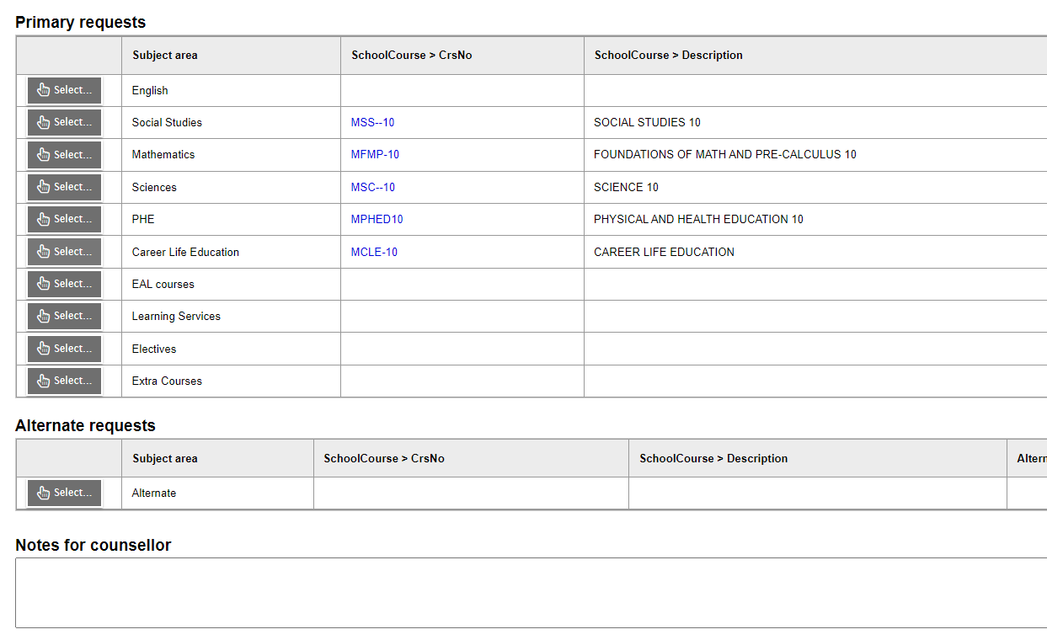
4. Primary request, Alternate selection, Notes
Write any information you want your counsellor to have in this section: summer school, online etc.

Slide 22
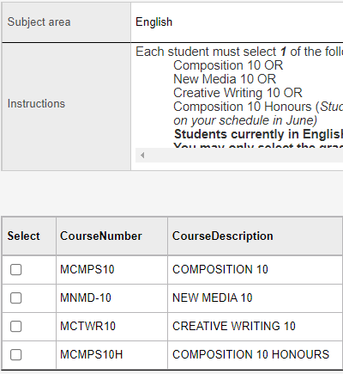
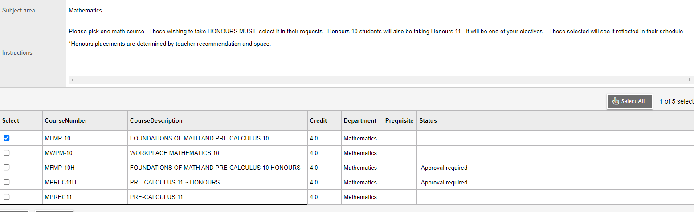
5. English- choose one
6. Mathematics-choose one unless you are self-selecting Math 10/11 Honours. If you choose this Math 11 becomes one of your 8 courses.

Slide 23
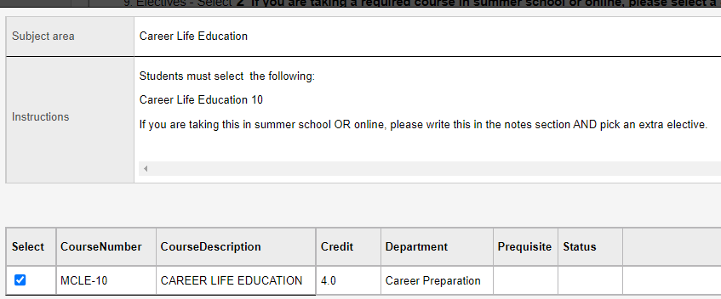
7. Be sure to read the instructions in each category of your primary requests.

Slide 24
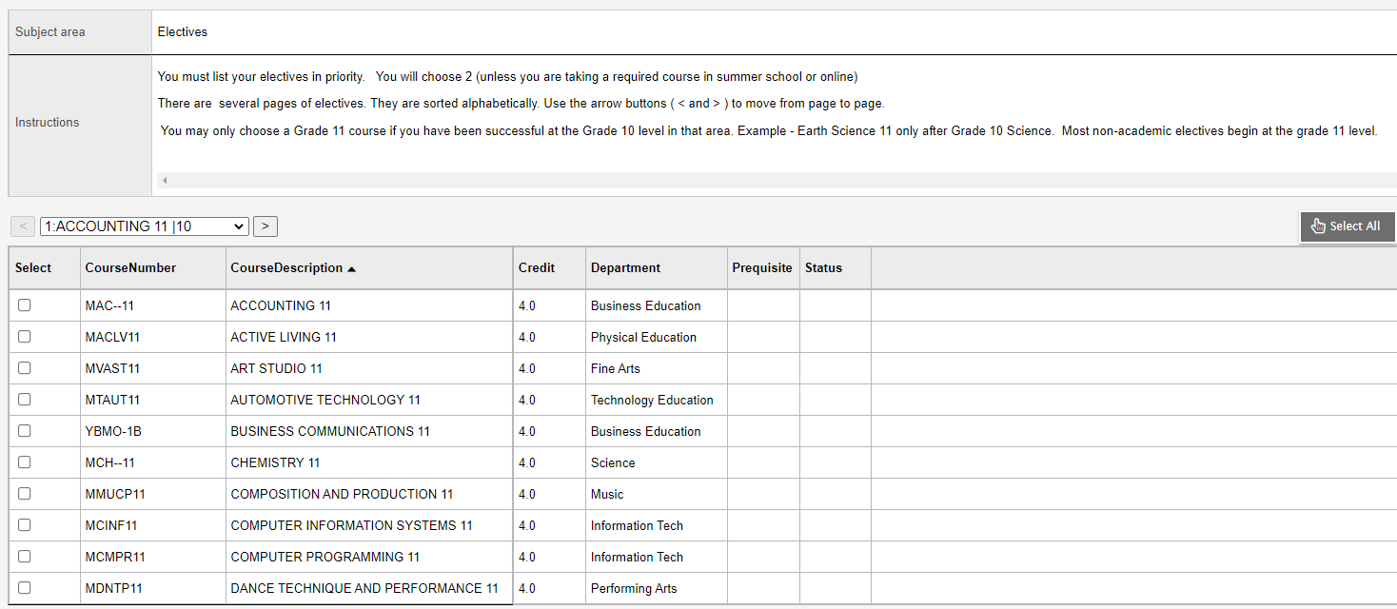
8. Electives: most will choose 2 electives unless you choose to take a course at summer school you will choose 3
NOTE: you must select a total of 8 course ( not more or less)

Slide 25
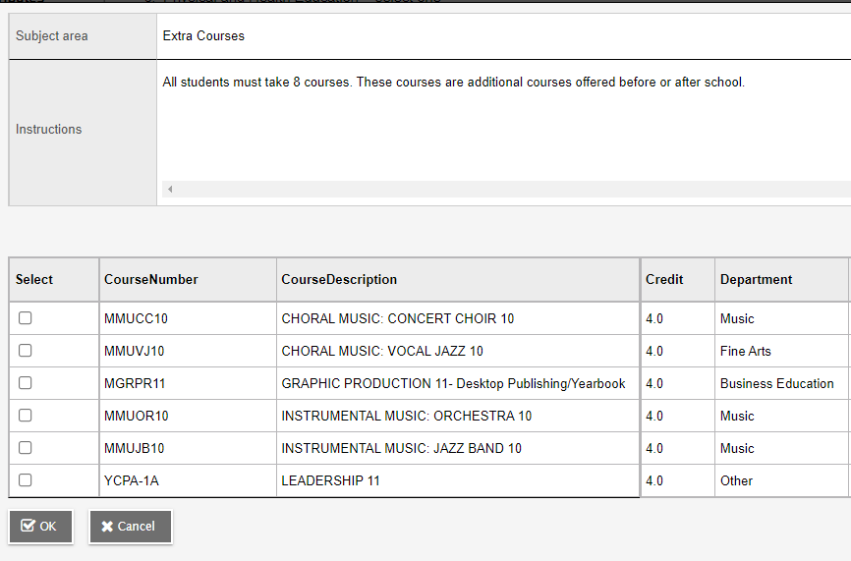
9. Extra Courses-only these courses can be taken as additional courses beyond the 8.

Slide 26
TIMELINE
PLAN CAREFULLY, TALK TO YOUR PARENTS AND IF YOU HAVE QUESTIONS SEE YOUR COUNSELLOR.
FINAL DUE DATE TO ENTER YOUR COURSE SELECTION ONLINE IN MYED BC and TO RETURN YOUR COMPLETED COURSE PLANNING SHEET TO YOUR COUNSELLOR IS – JANUARY 26TH, 2026
If you have problems accessing your student Myed BC portal and need your password reset- please email your Vice-Principal. Counsellors are not able to do this.

