Slide 1
to Pinetree Secondary!
Getting Ready for Grade 9
“Accepting Challenges Together”

Slide 2
Success=Getting Involved (Leadership and Volunteering, Fine & Performing Arts)
Clubs
Dance club
Crochet club
Debate club
Board games club
Badminton club
Adopt a trail club
Film club
Investment club
Magic trick club
Model United Nations
Philosophy club
School of Rock
STEM club
Business Club
Video Game Design club
……and many more!
Sports/Athletics
Cross Country
Soccer (Girls/Boys)
Volleyball (Girls/Boys)
Basketball (Girls Jr, Boys 9/Jr./Sr.)
Ski and Snowboard
Swimming
Badminton
Tennis
Ultimate Frisbee
Track & Field
Golf
Mountain biking

Slide 3
FALL
Swimming – boys/girls, all ages (number dependent)
Volleyball-9/10/sr. girls/boys
Soccer-boys
Cross Country - boys/girls, all grades
Cheer & Dance Team – open to all grades
Wrestling- open to all grades
Highlights
Senior Boys' Volleyball – came 5th at Provincial Championships
Swim Team- four students made Provincials
Cross Country- 3 team members made Provincials in Victoria

Slide 4
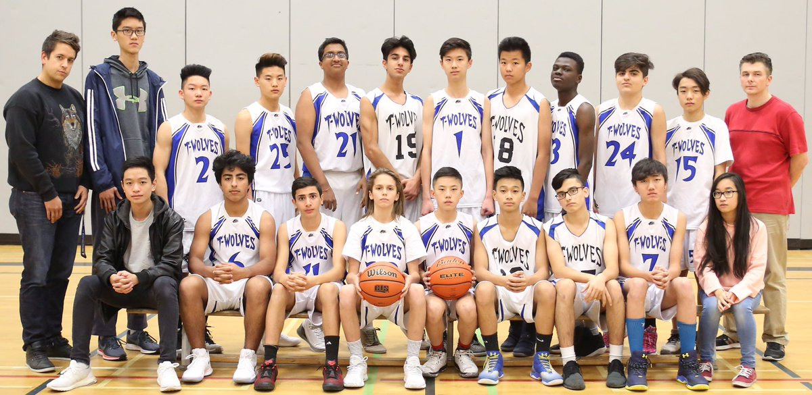
WINTER
Basketball - 9/10/sr. boys
Jr/Sr. Girls' Basketball
Ski and Snowboard Team – boys/girls, all grades

Slide 5
SPRING
Tennis – boys/girls, all ages
Badminton – boys/girls, all ages
Track and Field – boys/girls, all ages
Basketball – Spring league, all ages
Soccer – girls all grades
Mountain Biking – boys/girls, all ages
Golf- boys/girls, all ages

Slide 6
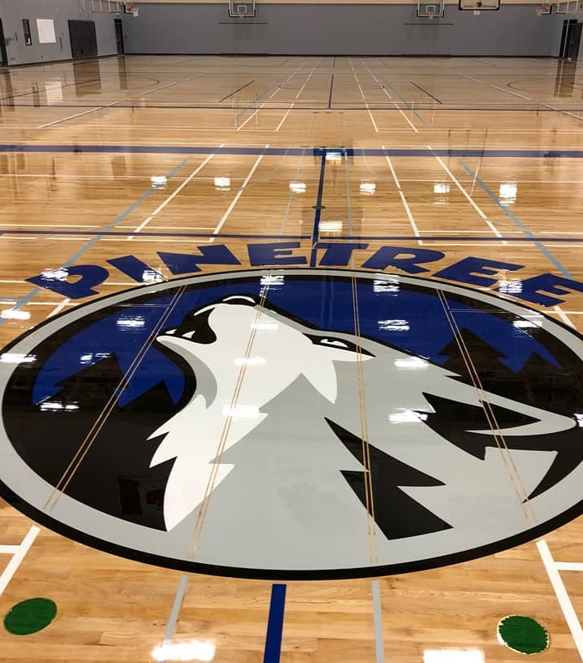
INTRAMURALS
All year long at lunch
Co-ed
Emphasis on sportsmanship
T-shirts for sportsmanship
Handball, Basketball, Floor Hockey, Dodgeball, Soccer, Badminton, Volleyball, drop in activities

Slide 7
People to Know!
Administration at Pinetree
PRINCIPAL:
MS. JANINE CLOSE
VICE PRINCIPALS:
MS. CIOLFITTO A-J
MS. MEHAI K-P
MR. RAO Q-Z
Counsellors at Pinetree Youth Workers
MS. STARR/ MS.HAMILTON A-I Ms. Khaira
MR. NELSON J-0 Mr. Conedera (New Immigrant Y. Worker)
MS. DHILLON P-Z Ms. Xie & Ms. Jeoung (International Y. Workers)
MR. SHARMA All International Students
Notes:
Include new counsellor

Slide 8
Counsellor Role at Pinetree
NEED HELP? LET US GIVE YOU A HAND!
Course planning
Career planning and Career Center
Post secondary information, admissions, and financial aid
Help with academic, personal, social, and family problems
Prevention and awareness education
Crisis intervention and referral to community services

Slide 9
Supporting Pinetree Students
ENGLISH LANGUAGE LEARNERS
ELL Program for students learning the English language
Assessment and placement to develop English language skills
TEACHER SUPPORT
Teachers provide tutorials outside class time
Arranged independently with students as needed
LEARNING SERVICES– LEARNING CENTER
Academic support for grades 9 – 12
Work with teachers, students, and parents to facilitate student success
LIBRARY
Print materials, audio-visual resources, and computer lab – online access for students
ESS (Enrichment and Support)
Wednesday mornings from 10:05-11:20
Opportunity to get support from teachers and catch up on missing work
TUTORING
Tutoring lists available from your counsellors early in the FALL (Paid Student Tutors)
Homework club (A100) is after school from 3:15-4:15. Student tutors available. (Free service)

Slide 10
The Transition from Grade 8 to 9
Our goal is to help grade 8’s make a smooth transition to high school. To help ease the transition, we provide the following information/events:
Grade 8 Walkabout: January 24th, 2025
Visits to Middle Schools: Early March to program and make course selections
Articulation meetings: With teachers at the middle schools in mid- April
First day of School in September: Grade 9’s come in for ½ the day for a mini- orientation, to learn about Digital Literacy, get their pictures taken, Office 365 password and enjoy a lunch!
Notes:
Date needed

Slide 11
Choosing Courses: The Programming Process
Read the course calendar descriptions carefully. Calendar is available online.
Don’t worry about what your friends are taking; instead, focus on your skills and abilities.
Discuss your choices with your parents.
Contact your counsellor if you have questions.
Grade 9 is a year for exploration. These are not pre-requisite courses (other than languages and core academics)

Slide 12
Course Programming
Grade 9 students are required to take 8 courses:
5 are mandatory:
English 9 (or EAL)
Socials 9 (or EAL)
Science 9
Math 9
PE 9
3 Electives
* Applications of Digital Learning 10

Slide 13
Applications of Digital Learning 10
Although categorized as a grade 10 credit, the course will be taken by all grade 9 students. Instruction is delivered through a combination of online assignments and learning activities during ESS block.
Goal of the course:
In this course, students will be required to navigate the technology required to accomplish the competencies of our curriculum and beyond.
Students will be able to
understand and define a task
choose the correct digital tool for the purpose
deliver a finished product ethically and responsibly
learn to protect the personal security and privacy of themselves and others

Slide 14
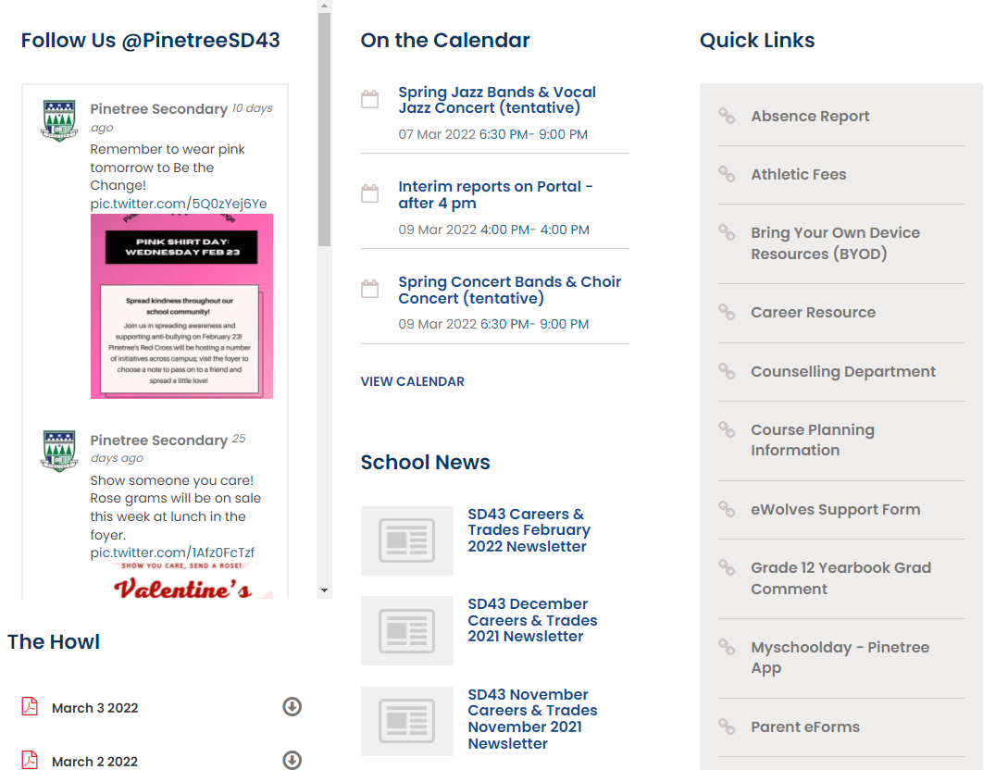
READ THE GRADE 9 Course Calendar

Slide 15
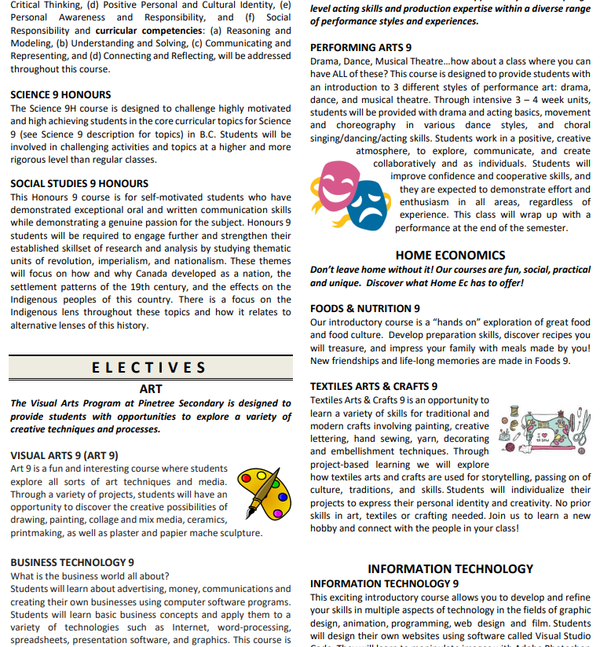
Detailed description of all courses.

Slide 16
Elective Choices
VISUAL ART 9- learn skills in drawing, painting, collage, mixed media, printmaking, paper mâché, and photography
BUSINESS TECHNOLOGY 9- Students will learn about advertising, money, communications and creating their own businesses using computer software programs. This course is an excellent foundation of business knowledge and skills and introduces students to the senior business education curriculum
PERFORMING ARTS 9- drama, Dance, and Musical Theatre
FOODS & NUTRITION 9- Explore great food and food culture. A “hands – on course”
TEXTILES ARTS & CRAFTS 9- An opportunity to learn a variety of skills for traditional and modern crafts involving painting, creative lettering, hand sewing, yarn, decorating and embellishment techniques
FITNESS 9- designed for students looking to improve their performance as well as their fitness levels. Includes core muscle training, cardio workouts, advanced weight training. Note: This is an elective in addition to PE 9

Slide 17
Elective Choices Cont.
INFORMATION TECHNOLOGY 9- develop and refine your skills in every aspect of technology from graphic design and animation to programming and web design and film.
WOODWORK 9- learn to safely use tools and equipment to design, create, and finish your own projects. We learn and practice skills, so we can build cool things to make us proud. Be active, productive and have fun!
POWER TECHNOLOGY 9- get challenged to solve problems and design solutions that you can build or test! In the past, students have built C02 dragsters, Rube Goldberg (engineer/inventor) machines, mobiles, balances and more!

Slide 18
Elective Choices cont’d…
MUSIC PROGRAM:
Concert Band 9 (linear- all year course)
Band 9 will be one of your 8 courses
Jazz Band 9 (linear - extra course)
Choir 9 (linear - extra course)
Vocal Jazz 9 (linear - extra course)

Slide 19
Second Languages
French 9
Japanese 9
Mandarin 9
Spanish 9
Note: Grade 9 Language courses are beginner classes. These courses are not intended for Native speakers or for students coming out of Immersion programs. Please discuss with counsellor regarding appropriate placement if necessary.

Slide 20
Benefits of a Second Language
Learning a second language helps students build and strengthen skills for their future
Improves communication skills
Ability to interact with others
Public speaking skills
Fosters cultural awareness and global perspectives
Builds confidence through interactive and engaging activities
Prepares students for real-life language use

Slide 21
Language Considerations
Good at French? Keep French 9.
Good at Languages? Take French 9, Spanish 9, Mandarin 9, or Japanese 9.
Good student but want a change? Switch to a different language.
Not strong in languages? Don’t take one.
Want a break? Wait until grade 11 and take a beginner language in grade 11 ( i.e. Beginner Spanish 11 or Beginner Japanese 11).
IMPORTANT NOTICE: Grade 11 second languages are no longer required for admission into UBC or SFU.

Slide 22
Pinetree Honours Program
What type of student is the Honours/AP program designed for?
Gifted students, extremely talented and motivated students.
Students who are passionate about the subject material
Students who enjoy hard work and being challenged in class.
What are the advantages of an Honours class?
Students of similar abilities and interests work together in an enriched environment.
Students develop their higher-level thinking skills.
Students participate in the subject areas that match their talents.
What if I don’t get into Honours class in grade 9?
Do not worry. You will still be able to apply and enter the honours program in grade 10+

Slide 23
Honours
Honours Courses:
English Language Arts 9 Honours
Mathematics 9 Honours
Science 9 Honours
Social Studies 9 Honours
How are students selected for the grade 9 Honours classes?
All interested students must self-select honours classes in the Student MyEd Portal
Middle Schools will then provide feedback
A lottery system will determine which students will have a seat in Honours
If selected for Honours, students will not be able to drop the course and switch to a regular class

Slide 24
Timetable Features
TWO SEMESTERS PER YEAR
September to January and February to June
Semester courses last for 5 months (Science, Socials, English, Math, PE, Electives)
LINEAR COURSES AT THE GRADE 9 LEVEL
Band, Choir
September to June
STUDENTS IN GRADE 9 ARE REQUIRED TO TAKE 8 COURSES PER YEAR
COMMON MEETING TIMES FOR STUDENTS
Lunch
PACK/ESS
COMMON LUNCH FOR ALL STUDENTS
Activities –intramural program
Clubs, Meetings, Activities

Slide 25
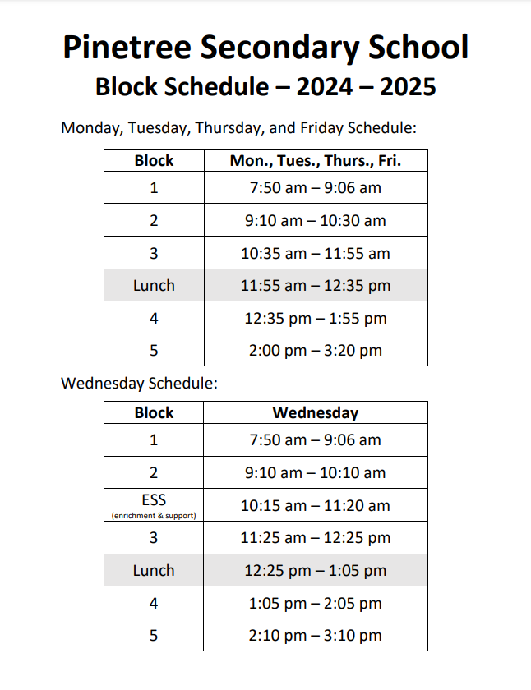

Slide 26
Timeline Grade 8’s
Cross Catchment :
Coss catchment applications open at 9 am on February 7th
Cross catchment applications close at 4 pm on February 12th
Pinetree Honours:
Qualified candidates will be admitted based on consult with their middle school and lottery system
Notes:
Dates needed

Slide 27
Timeline Cont.
Programming at Middle Schools: March 2025
Maple Creek: March 11th
Scott Creek: March 12th (morning)
Summit Middle: March 12th (afternoon)
Courses must be inputted online in Student MyEd Portal by March 14th. Portal will close on March 31st.

Slide 28
COUNSELLOR CONTACTS:
Please call or email your counsellor if you have questions:
Ms. Starr : sstarr@sd43.bc.ca A-I
Ms. Hamilton: lhamilton@sd43.bc.ca A-I
Mr. Nelson: kenelson@sd43.bc.ca J-0
Ms. Dhillon: mdhillon@sd43.bc.ca P-Z
Mr. Sharma: vsharma@sd43.bc.ca International Student Contact
Pinetree phone #: 604-464-2513
Notes:
Include new counsellor

