Slide 1
Pinetree Secondary Grade 10-12 Parent Night
Graduation Program Requirements
Pinetree special programs
Number of courses
Choosing courses
Post Secondary options
Timeline information
Notes:
Meena

Slide 2
People to know!
Administration at Pinetree
Principal: Ms. Janine Close
Vice Principals:
Ms. Ciolfitto A-J
Ms. Mehai K-P
Mr. Rao Q-Z
Counsellors at Pinetree
Ms. Starr/ Ms. Hamilton A-I
Mr. Nelson J-0
Ms. Dhillon P-Z
Mr. Sharma All International Students
Post Secondary & Career Advisor
Ms. Moorhouse
Youth Workers
Ms. Khaira
Mr. Conedera (New Immigrant Youth Worker)
Ms. Xie & Ms. Jeoung (International Youth Workers)

Slide 3
GRADUATION PROGRAM (Grades 10-12) 80 Credits
Required 52 credits:
English Language Arts 10, 11, and English Studies 12 12 credits
Social Studies 10 4 credits
A Social Studies 11 or 1 4 credits
Science 10 4 credits
A Science 11 4 credits
A Mathematics 10 4 credits
A Mathematics 11 4 credits
Physical and Health Education 10 4 credits
Fine Arts or Applied Skills 10, 11, or 12 4 credits
Career Life Education 10 4 credits
Indigenous focused coursework
Career Life Connections 4 credits
Electives (Grade 10, 11, and 12) 28 credits
Numeracy 10 Assessment
Literacy 10 Assessment
Literacy 12 Assessment
TOTAL - 80 credits
*16 of your credits (4 classes) must be grade 12 level*
Notes:
Meena

Slide 4
Graduation Assessments
Numeracy 10 Assessment:
All students will be required to complete the Numeracy 10 assessment as a graduation requirement.
Literacy 10 Assessment:
All students will be required to complete the Literacy 10 assessment as a graduation requirement
Literacy 12 Assessment:
All students will be required to complete the Literacy 12 assessment as a graduation requirement
All grade 12 students will be registered to write the assessment in January. They may re-take the assessment in June, should they choose to
See the Ministry website for more info:
https://curriculum.gov.bc.ca/provincial/grade-10-numeracy-assessment
https://curriculum.gov.bc.ca/provincial/grade-10-literacy-assessment
https://curriculum.gov.bc.ca/provincial/grade-12-literacy-assessment
Notes:
Gio

Slide 5
Arts Education 10, 11, or 12 --Applied Design, Skills, and Technologies 10, 11 or 12
Students are required to complete 4 credits in Arts Education or Applied Design, Skills, and Technologies:
SOME EXAMPLES INCLUDE:
Drafting 11 (AS)
Graphic Arts 11 (FA)
Marketing & Promotion 11 (AS)
Drama 11 (FA)
Textiles 11 (AS)
Art Studio 11 (FA)
Food Studies 11 (AS)
Auto Tech 11 (AS)
Composition & Production 11 (FA)
Choral Music 11 (FA)
Automotive Tech 11(AS)
Any Info Tech 11 (AS)
Instrumental Music (Band) 11 (FA)
Notes:
Gio

Slide 6
English
English 10 Course Offerings:
Each of the grade 10 English classes will be paired with Literary Studies 10. Your choices include:
Creative Writing 10
Composition 10
New Media 10
Composition and Literary Studies 10 HONOURS
English 11 Course Offerings:
Each of the grade 11 English classes will have an English First Peoples component. This will meet their Indigenous Focuses Coursework, graduation requirement
EFP Literary Studies and Writing 11
EFP Literary Studies and New Media 11
EFP Literary Studies and Writing 11 HONOURS
Notes:
Gio

Slide 7
English
Year 12 English Language Arts:
Students must complete one of the following “Year 12” English courses for Graduation:
English Studies 12
English Studies 12 Honours
English First Peoples 12
The following course can be taken as an English 12 elective:
Literary Studies 12 (this alone will not meet English 12 requirement)
Notes:
Gio

Slide 8
Mathematics
Math 10 Options (Grad Requirement)
Workplace Mathematics 10
Foundations of Math & Pre-Calculus 10
Pre-Calculus 10/11 Honours (full year program)
Math 11 Options (Grad Requirement)
Workplace Mathematics 11
Pre-Calculus 11
Foundations of Math 11 (Bridge )
Notes:
Meena

Slide 9
Mathematics
Math 12 Options
Pre-Calculus 12
Calculus 12
Pre-Calculus 12 Honours/Calculus 12 Honours
Independent Directed Studies (IDS) Mathematics
Grade 12 Math is not required for Graduation but check post-secondary program requirements
Notes:
Meena

Slide 10
Math Honours Program:
Grade 9:
Math 9 Honours or Math 9
Grade 10:
Pre-Calc 10 Honours (sem 1) Pre-Calc 11 Honours (sem 2)
Grade 11:
Pre-Calc 12 Honours (sem 1) Calculus 12 Honours (sem 2)
Grade 12:
Independent Directed Studies (IDS) Math 12

Slide 11
Social Studies
Social Studies 12:
NO Social Studies 11 courses at Pinetree (11’s can take a Social Studies 12 for their grad requirement)
Comparative Cultures 12 Social Justice 12
20th Century History 12 Physical Geography 12
Law Studies 12 BC First Peoples 12
Philosophy 12
Psychology 12 – note this is an elective course, and does not satisfy the social studies grad requirement
Notes:
Gio

Slide 12
Course Equivalency/External Credits
Students may also obtain credits towards graduation through:
Equivalency: Course equivalency is the process of receiving credit based on documentation indicating that the student has achieved the learning outcomes for an approved grade 10, 11 or 12 course at an institution outside of BC or Canada. Course must be an 80% match with BC curriculum.
External Credits: credit for courses completed outside Pinetree (see your counsellor)
Notes:
Meena

Slide 13
PINETREE Programs
Advanced Placement
Advanced placement offers academic challenge in senior courses.
It can provide advanced credit or standing in first year university courses in some post-secondary institutions.
Students may choose the following:
AP Anatomy & Physiology, AP Chemistry, AP Physics
No other AP exams are offered at Pinetree Secondary
Notes:
Gio

Slide 14
PINETREE Programs
Honours Courses
Focused Literary Studies and Composition 10 Honours
English First Peoples and Writing 11 Honours
English Studies 12 Honours
Socials 10 Honours
Pre-Calculus 10 Honours/11 Honours (year-long/2 semesters)
Precalculus 12 Honours/Calculus 12 Honours (year-long/2 semesters)
Science 10 Honours
Life Science 11 Honours and Anatomy and Physiology 12 Honours (AP)
Physics 11 Honours and Physics 12 Honours (AP)
Chemistry 11 Honours and Chemistry 12 Honours (AP)
IDS 12 for Science and IDS 12 for Mathematics
Notes:
Gio

Slide 15
Honours Courses
Students should only select if they are prepared for the rigors of an Honours Program
You can move between non-honours courses and honours courses (example- you can apply for Chem 12 honours/AP without having taken Chem 11 Honours)
Departments have established a process to select candidates
Successful candidates will know in late June when draft schedules are available
Once you are admitted into an Honours class, you WILL NOT be able to change this course. Be certain you want the course.
Notes:
Gio

Slide 16
Notes:
Doug

Slide 17
Notes:
Doug

Slide 18
Notes:
Doug

Slide 19
Notes:
Doug

Slide 20
TRADES program contact information:
Train In Trades Contact:
Ben King
phone number: 778-984-1354
email: bking@sd43.bc.ca
Work in Trades Contact:
Joanna Horvath
phone number: 604-312-7739
email: jhorvath@sd43.bc.ca

Slide 21
SD43 Trades Program Open House

Slide 22
Post Secondary Applications and Admission
It is YOUR responsibility to research post-secondary admission requirements and to be aware of the application process & deadlines.
Be aware that in most instances, post-secondary institutions will also be looking at your grade 11 marks.
Counsellors and Ms. Moorhouse (Post Secondary & Career Advisor) are available to assist you.
Ms. Moorhouse can be reached at: cmoorhouse@sd43.bc.ca
Notes:
Meena

Slide 23
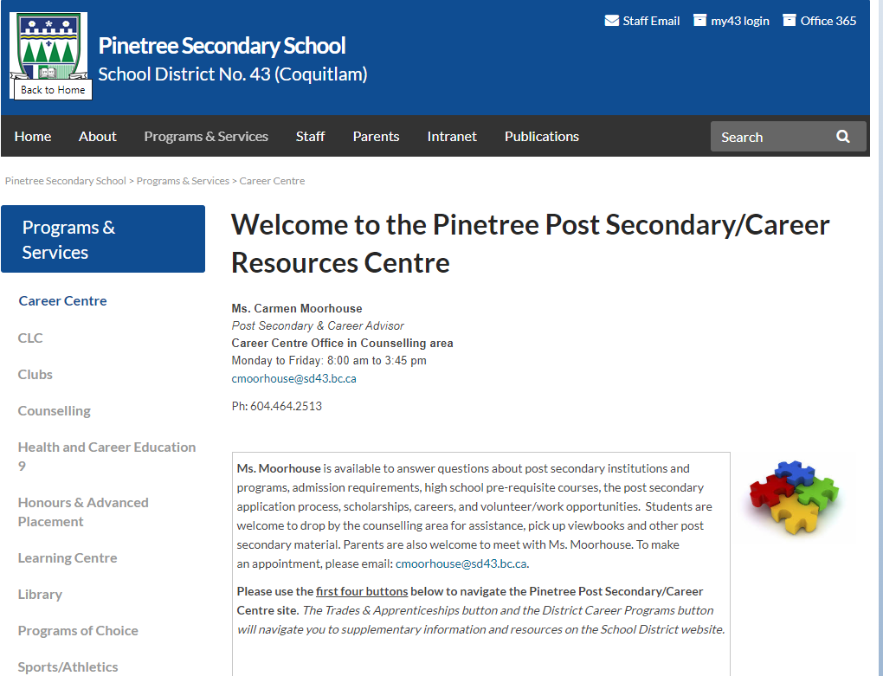
Notes:
Meena

Slide 24
University & College Options in BC
UBC, SFU, UVIC, UNBC
Capilano University
Kwantlen Polytechnic University
Trinity Western University
Emily Carr University of Art and Design
BCIT
Thompson Rivers University
University of the Fraser Valley
Vancouver Island University
Douglas College
Langara College
Vancouver Community College
Some universities and/or programs are competitive entry
Check required courses, % grade, English and Math and OTHER requirements for each university and program
Notes:
Carmen

Slide 25
Language Courses
**NEW** UBC no longer requires a second language 11
**NEW** SFU no longer requires a second language 11
Language Challenge exams:
If you are fluent in a second language, you can register to write a language challenge exam
UBC will not accept a Language 12 challenge towards the admission average.
SFU will accept a Language 12 challenge towards the admission average.
Language Challenge Exam registration opens in October. Exam writes are in January

Slide 26
Benefits of a Second Language
Learning a second language helps students build and strengthen skills for their future
Improves communication skills
Ability to interact with others
Public speaking skills
Fosters cultural awareness and global perspectives
Builds confidence through interactive and engaging activities
Prepares students for real-life language use

Slide 27
Post Secondary Education: SFU Admission Requirements
Admission based on Grade 11 & 12 courses (SFU approved course list)
General Required Grade 11 courses:
English 11 (All English 11 options are approved)
Math 11 Min 60% (Pre-Calculus 11 or Foundations 11)
Science 11 (chemistry, physics, life science, or earth science) Physics 11 & Chem 11 required for science-based courses
Socials 11 or 12
Required Grade 12 courses:
English Studies 12 minimum final grade of 70%
Minimum of 5 grade 12 courses, including English Studies 12, from SFU’s approved course list – much different than in the past
Program-specific approved courses and minimum course grades
The admission evaluation will be based on all approved grade 11 & 12 courses, with greater emphasis on ‘List A’ Grade 12 courses
Notes:
Carmen

Slide 28
UBC Holistic Admission Evaluation
Secondary School Grades
It is recommended you have a least 6 grade 12 courses (academic/non- academic)
UBC may consider all your academic Grade 11 and Grade 12 course grades Applied design, skills, technologies courses; career ed; and physical education course grades will not be used
UBC will look closely at all academic grade 11 and grade 12 courses related to your degree
Personal Profile
2-5 short essay questions depending on the program to which you apply
Evaluated based on breadth and depth of your experiences
Additional requirements for some programs: video interview, test, resume, audition etc.
Literacy 12 Assessment
UBC requires a 3 out of 4 for admission. No other school requires a minimum grade
Notes:
Carmen

Slide 29
University of Victoria
General Admission Requirements
Admission Averages are based on:
English 12 and 3 additional approved academic grade 12 courses
Grade 11 requirements
English 11, Social Studies 11, Pre-Calculus 11 or Foundations of Math 11 (depending on the faculty), an Academic Science 11 (Life Sc 11, Chem 11, Earth Sc 11, Ph 11)
Check the website for approved grade 12 courses for each faculty!
https://www.uvic.ca/future-students/undergraduate/admissions/high-school/bc-yt/index.php
NOTE: Supplemental application needed for some programs including Business.
Notes:
Carmen

Slide 30
Douglas College
www.douglas.bc.ca
Eligible for admission if you:
Completed BC secondary school and minimum mark in English 12 (C)
Different deadlines and entrance requirements for each program
**Check carefully!
If you are applying to a university transfer program, your registration date for courses depends on your GPA! Check with an academic advisor at Douglas College or Mrs. Moorhouse for more information.
Notes:
Carmen

Slide 31
CHOOSING COURSES Important Decisions…
Ensure you meet Graduation requirements
Check post-secondary requirements
(See Ms. Moorhouse or your counsellor)
Seek out the advice of family members, mentors, and/or your counsellor
Read the Course Calendar Online
Be aware that we will not be able to change classes once the school year starts
Notes:
Meena

Slide 32
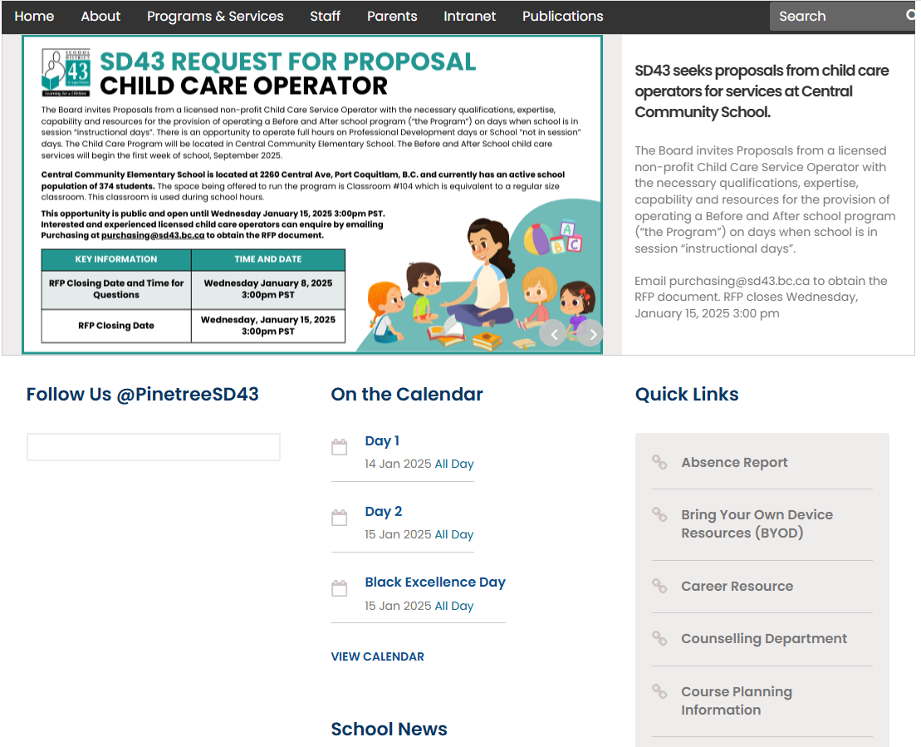
Course Calendar Online

Slide 33
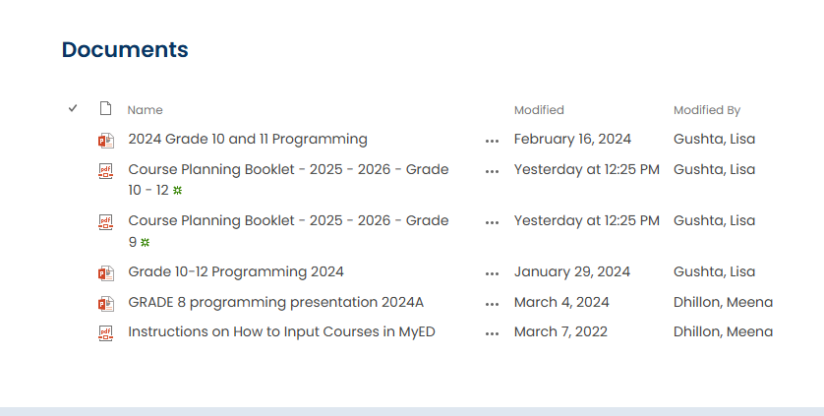

Slide 34
Detailed Description of all courses!

Slide 35
Required Courses
Grade 10
(8 classes)
English Lang. Arts 10
Social Studies 10
Career Life Educ. 10
Science 10
A Mathematics 10
Physical Education 10
Two (2)Electives
Grade 11
(8 classes)
One of Lang Arts 11 Options
Any Science 11
Any Mathematics 11
Social Studies 12 (can be done
Grade 12 year)
Four (4) additional courses
Grade 12
(8 classes)
English Studies 12 1.___________12
2.___________12
3.___________12
Four (4) additional courses
Career Life Connections
Consider whether you need grade 11 pre-requisite courses to set you up for grade 12.
Grade 11 courses count! Treat it like grade 12. Universities take grade 11 marks into consideration for admission.
Grade 12 is about setting yourself up for life after high school. If you are planning to attend post-secondary, make sure you have the required courses for your program.
Notes:
Meena

Slide 36
When Choosing Courses:
For all core academics, you must have completed the prerequisite course for all grades 9 through 12
i.e. for Chemistry 11 you must have successfully passed Science 10
i.e. for French 11 you must have successfully passed French 10
For all gr 12 electives you must have the grade 11 prerequisite as well
i.e. you cannot take Auto 12 without having completed Auto 11
i.e. you cannot take Physics 12 without having completed Physics 11
Notes:
Meena

Slide 37
Extra and Online Classes
Extra Courses: Jazz Band, Choir , and Vocal Jazz, Musical Orchestra, Leadership, Athletic Leadership, Graphic Production 11 (yearbook), any online courses (these would be in addition to your 8 courses)
Grade 9-11 students must have 8 classes in their Pinetree timetable (extra courses not included, online courses not included)
Grade 12 students may apply to have 7 classes in their timetable (and receive an off block)
Grade 12 students can go down to 6 classes (3 in each semester)– but students who choose this will not qualify for academic distinction awards (gold cord, gold stole) at the commencement ceremonies.
Most students will graduate with more than 80 credits
If you wish to Grad earlier in January of your grade 12 year, please see your Counsellor to discuss further
Notes:
Meena

Slide 38
Summer School
Summer School info available April/May Visit www.summerlearningcoquitlam.ca for more info about programs.
Secondary Remedial (counsellors will have referral forms in April)
for grade 9 and 10 students who were unsuccessful (emerging/40-49%) during the school year and are being given the opportunity to receive credit (passing grade) for the course.
Summer School Credit (Grade 10-12, registration dates TBA)
In-person schooling
5 –6 weeks (3 hours/day)
Notes:
Meena

Slide 39
Questions?
If you have any questions, please contact the appropriate counsellor, based on your child’s last name:
A-I: Ms. Starr sstarr@sd43.bc.ca
A-I: Ms. Hamilton lhamilton@sd43.bc.ca
J-O: Mr. Nelson kenelson@sd43.bc.ca
P-Z: Ms. Dhillon mdhillon@sd43.bc.ca
International: Mr. Sharma vsharma@sd43.bc.ca
School phone #: 604 464 2513

