Slide 1












  Maple Creek Club Days
January 15
January 22
January 29

Slide 2



  About Club Days
  You will be asked to select three choices for clubs. We will do our best to ensure that one of your three choices has been selected.
  You will be participating in the same club each week.
  The intention of Club Days is to pursue a personal interest, meet other students and teachers with similar interests, and maybe make a new connection.
  Please base your club selections on your personal interests only, there is no guarantee that you will be in the same club as a friend.
  Club days will occur on Thursday afternoons.
  Please take note of any costs and/or supplies associated with your club and speak with your family about your choices.
  Confirmation of clubs will be communicated by December 12th. Clubs requiring costs will be sent via Cash Online at that time.
  If you are in the SSNO Club, you do not have to complete the form.

Slide 3

  Summary of clubs
  Art Club*
  Ball Games
  Board Games
  Book Club
  Chunky Blanket Finger Knitting*
  Crochet*
  Engineering and Design
  Facepainting & Theatre Makeup
  Jazz Band*
  Jigsaw Puzzles and Hot Cocoa
  Lunch Club*
  Minecraft Co-op Adventure
  Movement Club
  Odyssey of the Mind
  Poetry Club
  Science in Action
  Skating*
  Soccer Club
  Swimming*
  Tissue Paper Collage Club
  Video Game (Coding) Development
  Wild Education*
(*) means there is a cost to the activity

Slide 4



  1
  art club
Location: Maple Creek
Cost: $5
Max # of Students: 50
Do you spend half your daydreaming up your next masterpiece? Then stop doodling in the margins and come join Art Club!
We’ll be crafting adorable oven-baked clay trinkets, painting our very own tote bags (or a T-shirt if you want to bring one) and experimenting with multimedia designs using a Cricut machine. Plus, you get to hang out with a whole crew of fellow art-lovers.
Whether you’re an experienced artist or just love to create, this club is all about imagination, fun, and trying new things. Come get messy and make cool stuff with us! 🎨

Slide 5



  2
  ball games
Location: Maple Creek
Cost: None
Max # of Students: 25
Love to move, play, and have fun? Join the Ball Games Club! We’ll explore exciting new games using different types of balls and equipment—think beyond the usual sports! From fast-paced challenges to creative team activities, you’ll stay active, build skills, and make new friends. Whether you’re competitive or just want to try something new, this is your chance to get in the game!

Slide 6

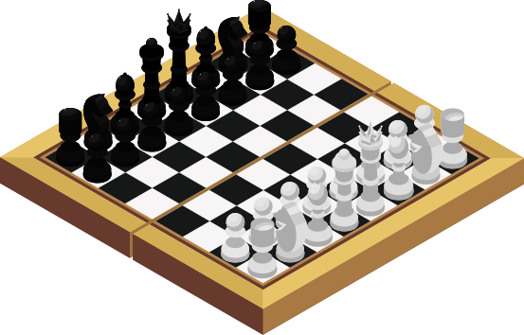

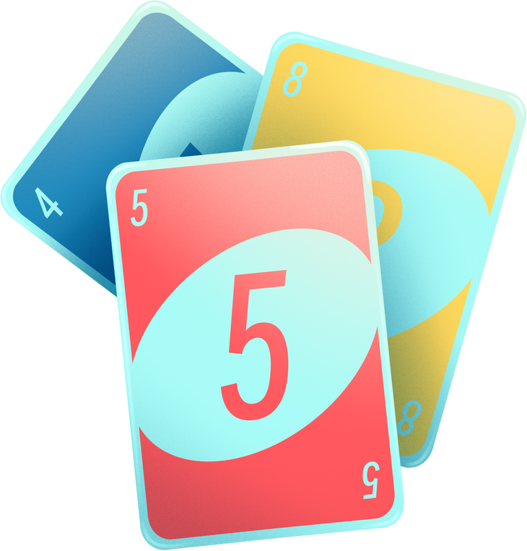
  3
  board games
Location: Maple Creek
Cost: None
Max # of Students: 50
Do you want to get together with some other people that enjoy board and card games? Come to these sessions and play some favourites (you can bring your own game) or try something new! Lots of games will be introduced and shared! No experience necessary - just a willingness to have some fun!!!

Slide 7


  4
  book club
Location: Maple Creek
Cost: None
Max # of Students: 30
Looking for a calm escape from the hustle and bustle? Join the Book Club! Spend time in a cozy, quiet space in the library, dive into great books, and share ideas with fellow readers. Whether you love novels, graphic stories, or just want a peaceful place to read, this club is perfect for you. Relax, recharge, and let your imagination soar!

Slide 8
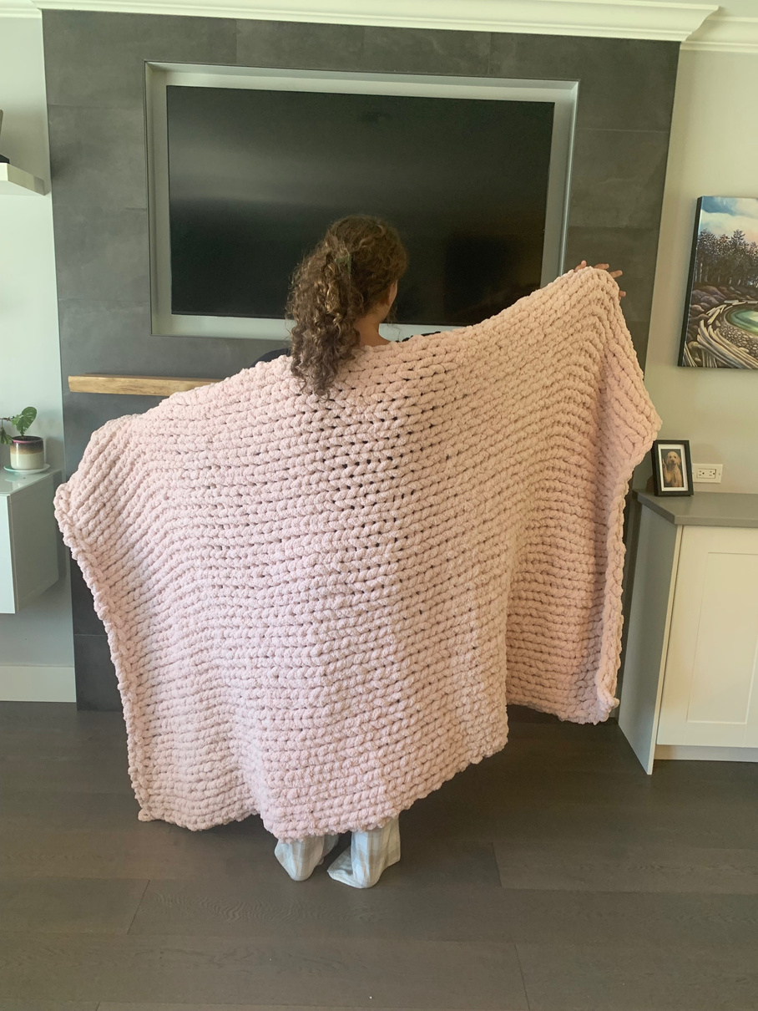
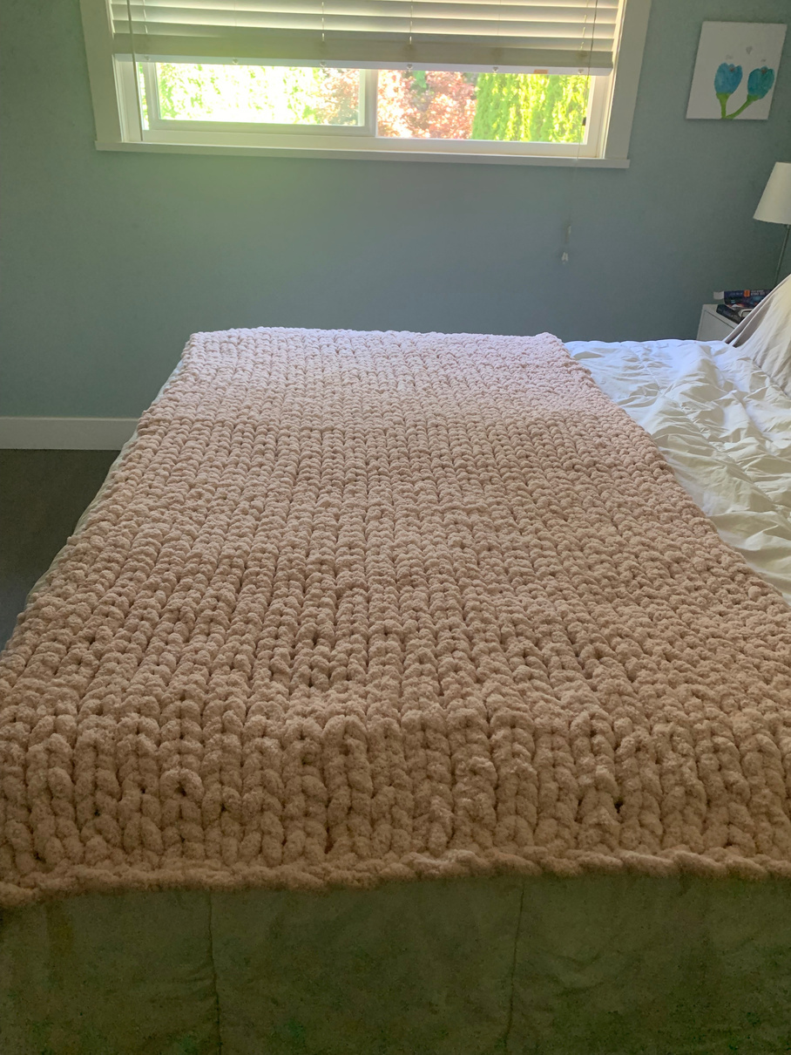
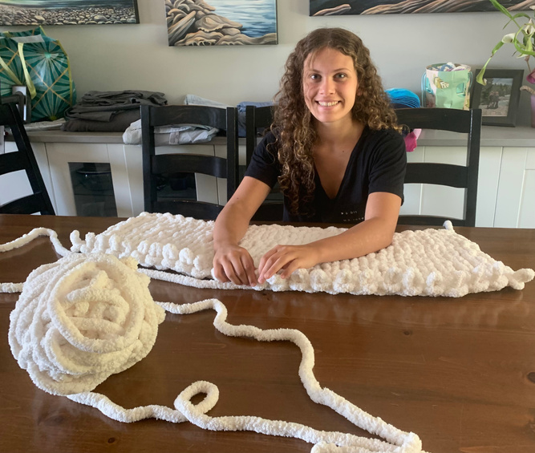
  5
  chunk blanket finger knitting
Location: Maple Creek
Cost: $40
Max # of Students: 25
Do you like to cozy up with a warm blanket on an cold day? Come learn how to make a hand-knitted chunky blanket that will be the envy of all your friends and family. Make one for yourself or as a special gift for someone special. No experince or knitting needles required.

Slide 9

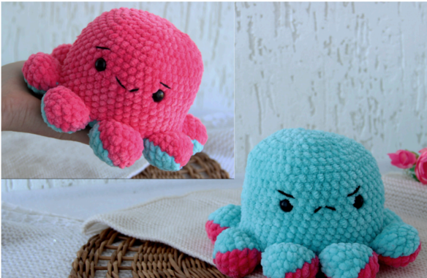
  6
  crochet
Location: Maple Creek
Cost: $5
Max # of Students: 20
Come join Crochet Club to connect with friends who share crochet as a common hobby! Beginner to Intermediate crocheters all welcome! We'll be making Reversible Octopuses with some fluffy yarn. No previous experience needed and crochet tools/materials are included in the cost.

Slide 10


  7
  engineering and design
Location: Maple Creek
Cost: None
Max # of Students: 24
Create a design, put your art skills to work, and engineer a moving vehicle that actually works! Test your creation against gravity and explore basic physics as you add elastic power to boost your machine. This club is all about hands-on fun and will challenge your creativity, problem-solving, and building skills.

Slide 11
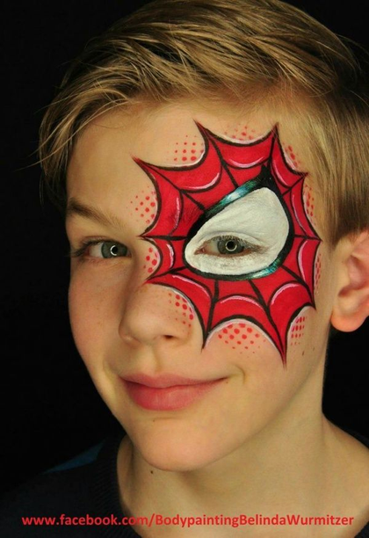
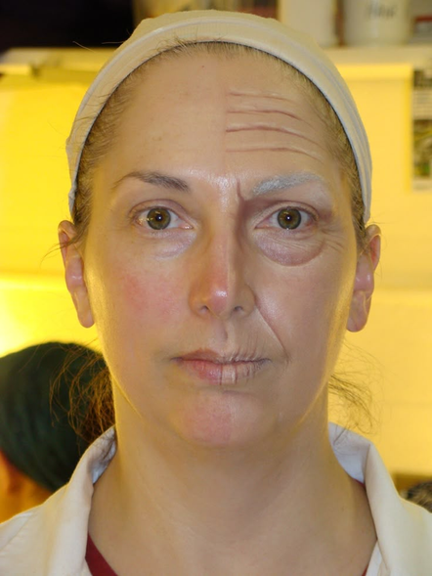
  8
  facepainting & theatre makeup
Location: Maple Creek
Cost: None
Max # of Students: 25
Do you love doing makeup? Do you want to learn how to face paint and create realistic makeup effects? Then choose a partner and sign up for Theater Makeup! This club will focus on facepainting techniques, how to "age" someone with makeup, and how to create realistic-looking wounds! You will need to sign up with a friend, as each person will be doing makeup on their partner during every session. Please let us know of any skin or allergy sensitivities prior to signing up.

Slide 12

  9
  Jazz band
Location: Maple Creek
Cost: $10
Max # of Students: 30
Pre-requisites: Must be in Band (beginner or advanced) or approved by Mr. Morgan
Love music and want to explore the smooth sounds of jazz? Join the Jazz Band! We’ll dive into swing, blues, and improvisation while creating an exciting ensemble experience. Open to all band students—beginner or advanced—and musicians outside of band (with approval from Mr. Morgan). Bring your instrument, your creativity, and get ready to groove!

Slide 13


  10
  jigsaw puzzles and hot cocoa
Location: Maple Creek
Cost: None
Max # of Students: 50
Do you like the idea of a quiet afternoon sipping hot chocolate, listening to cozy music, and working on jigsaw puzzles? Then this club is for you! This is a great opportunity to meet new people in our school in a relaxed environment. Some of the completed puzzles will be glued and displayed in the school.

Slide 14

  11
  lunch club
Location: Maple Creek
Cost: $15
Max # of Students: 24
Love cooking? Hungry for something fun?
Join the Lunch Club, where each session, experienced student chefs team up to prepare a full meal from scratch. This includes a main dish, side dish, and dessert. It’s your chance to try exciting new recipes and share delicious food with friends.
If you already know your way around the kitchen and can follow a recipe without help or a demonstration, you’re exactly who this club is for!

Slide 15
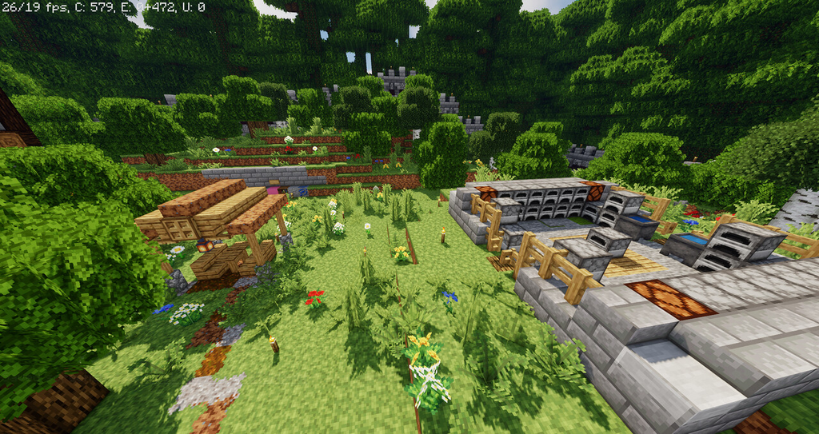
  12
  minecraft co-op adventure
Location: Maple Creek
Cost: None
Max # of Students: 23
Join with new friends to play survivor and go on a Co-Op quest to kill the Ender Dragon! We will spend 2 days getting as geared up as possible, then will attack the Ender Dragon on the last day! Students must have a device with the latest version of Minecraft Education loaded and operational.

Slide 16



  13
  Movement club
Location: Maple Creek
Cost: None
Max # of Students: 24
A fun, no-pressure space to move, play, and express yourself.
We’ll explore different ways of moving—stretching, balancing, flowing, and more—to boost energy, confidence, and creativity.
Movement helps us focus, feel good, and manage stress. In this club, you’ll learn simple strategies for self-regulation while having fun, trying new things, and exploring musicality.
No experience needed. Everyone welcome!

Slide 17


  14
  odyssey of the mind
Location: Maple Creek
Cost: None
Max # of Students: 25
Join Odyssey of the Mind and work together to solve creative challenges! This club focuses on teamwork, verbal problem-solving, and hands-on building tasks. You’ll collaborate to think critically, design innovative solutions, and present your ideas in fun and engaging ways. If you enjoy working with others and tackling unique problems, this is the club for you!

Slide 18


  15
  poetry club
Location: Maple Creek
Cost: None
Max # of Students: 25
Together we will explore reading and writing different types of poems, share our favourite poems, and discover new ones. Bring a notebook, a pencil and your creativity!

Slide 19



  16
  Science in Action
Location: Maple Creek
Cost: None
Max # of Students: 25
Love experimenting and building? Join Hands-On Science! Get creative with fun projects like the Egg Drop Challenge, making slime, and designing race cars. This club is all about exploring science through teamwork and hands-on activities. If you enjoy testing ideas and seeing how things work, come and make science come alive!

Slide 20


  17
Location: Poco Rec Rink
Cost: $15
Transportation: Walking
Max # of Students: 100
  skating
Come spend the afternoon skating! Bring your skates if you have them, a hockey stick if you please. Don't have the gear? No worries! Rentals of skates and helmets are included in this club fee. All levels of experience and ability welcome!

Slide 21

  18
  soccer club
Location: Maple Creek
Cost: None
Max # of Students: 40
Join Mr. Shepherd as he slide tackles right into the beautiful game of soccer like never before. At our club, we don’t just play—we study the strategies, watch the legends, follow the leagues, and train for fun!
Whether you’re a beginner or a seasoned player, this is your space to learn, grow, and share the love of the game.
⚽ What to expect:
  Study sessions: Explore tactics, formations, and the history of soccer.
  Watch parties: Enjoy classic matches and live games together.
  Training drills: Build skills, fitness, and teamwork.
  Friendly games: Put it all into practice (limited physical contact )

Slide 22

  19
  swimming
Location: City Centre Aquatic Complex
Cost: $12 (Free with Gr. 6 Get Active Card)
Transportation: Walking
Max # of Students: 50
Catch some waves with us at the CCAC pool! If you like to swim or just want to play in water, this is the activity for you. There's a minimal cost, or it's free if you have a Gr. 6 Get Active Card.

Slide 23
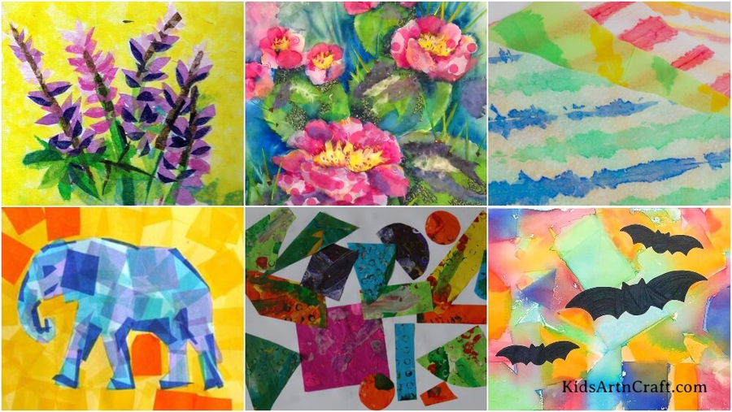
  20
  Tissue Paper Collage Club
Location: Maple Creek
Cost: None
Max # of Students: 26
Unleash your creativity with bright colors and interesting textures! In this fun, hands-on class, you explore the art of tissue paper collage, layering, blending, and creating unique artwork. No experience needed, just bring your imagination and enjoy a relaxing, artistic break with friends. (Bring any recycled colored paper, magazines, and fabric with you if you can.)

Slide 24

  21
  video game (CODING) development
Location: Maple Creek
Cost: None
Max # of Students: 20
Whether you’re a beginner or already experimenting with code, this club is all about creativity, problem-solving, and building something you can be proud of. Members will design, code, test, and polish their very own games.
Important Requirements:
Own laptop - school laptops will not allow Game Maker Studio 2 to be installed without permissions.

Slide 25
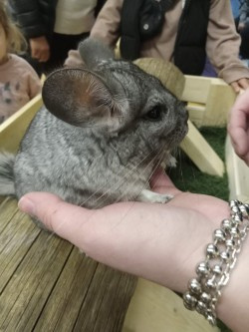
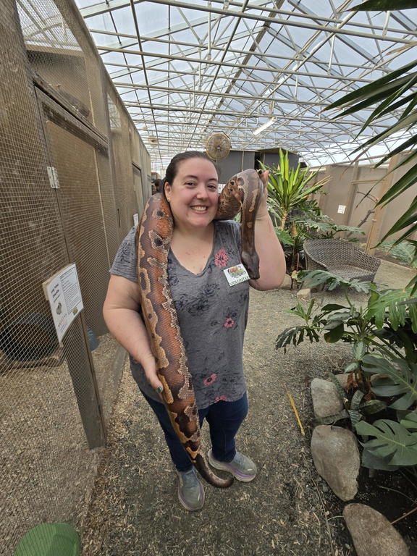
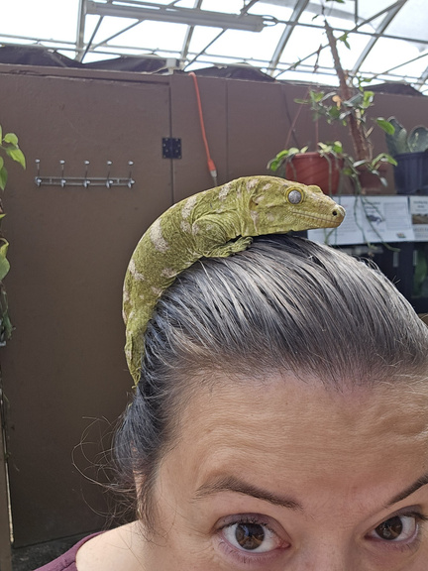
  22
  wild education
Location: Maple Creek
Cost: $15
Max # of Students: 25
Have you ever seen, held, or pet a chinchilla or ferret, a
scorpion or tarantula, a 100 lb tortoise, a gecko, or rhino
iguana? Wild Education is Western Canada's LARGEST exotic
animal rescue, with nearly 200 rescued or surrendered
animals in their care. Come and meet a few of their animals that are a part of their education program and learn about the
importance of the rescue. You may even meet a celebrity
animal.

