Slide 1

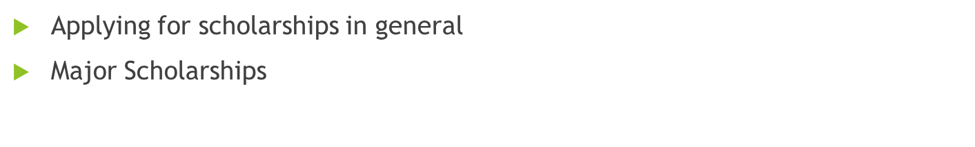
September 2024 Scholarship Meeting
Today:
Heritage Woods Secondary 2024-2025

Slide 2

For all scholarship opportunities…
You should create a BCeID account to access your transcripts as well as to give permission for transcripts to be sent to universities. Save your User ID and Password – you will need them later in your grade 12 year.
If you have questions about the scholarship process, PLEASE DO NOT WAIT UNTIL THE LAST MOMENT TO ASK FOR HELP. Email Ms. Butler dbutler@sd43.bc.ca and she can help you with your questions.

Slide 3
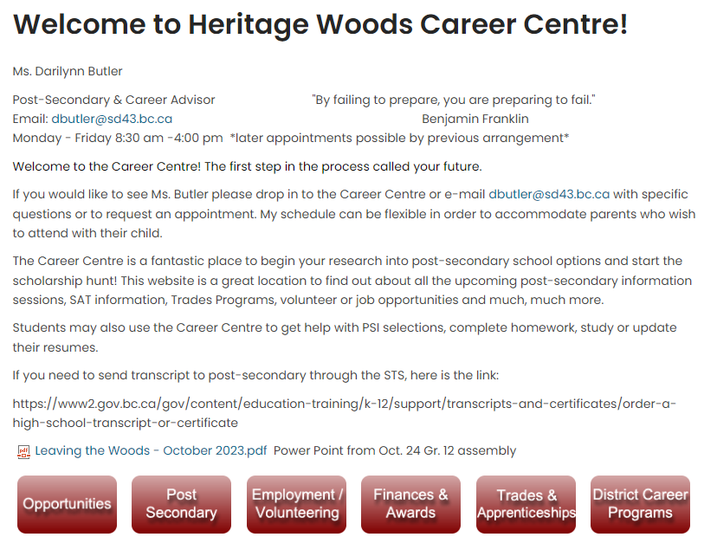

Slide 4
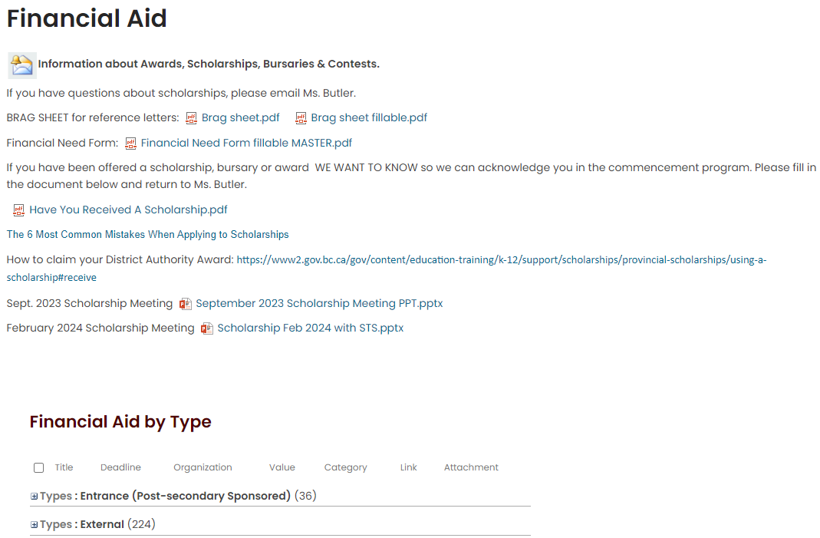

Slide 5
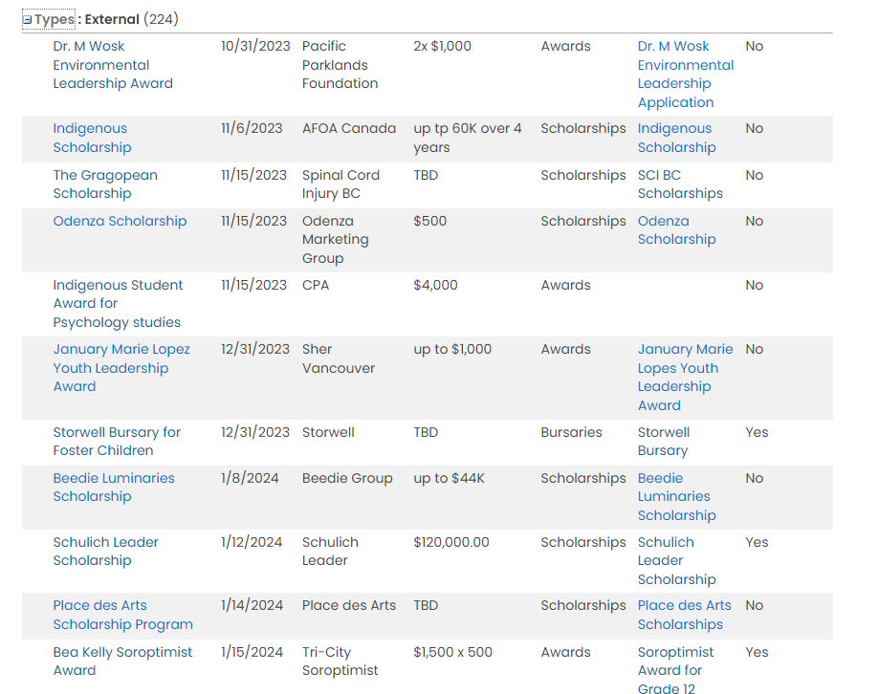

Slide 6
Student Transcript Service
There is a link on the career centre website under the post-secondary tab.
http://www.sd43.bc.ca/school/heritagewoods/ProgramsServices/career/Pages/Post-secondary.aspx#/=
You are creating a BASIC BCeID account
Keep your user ID and password as you will need it throughout grade 12
If you have already created an account to see your grades/transcripts, this is the same account – you cannot create another one
This is where you give permission for post-secondaries to receive your transcripts. Select all schools you plan to apply to. For Ontario schools select OUAC and then the individual schools. Can select US/International schools.
If you are having trouble, please email Ms. Butler dbutler@sd43.bc.ca

Slide 7

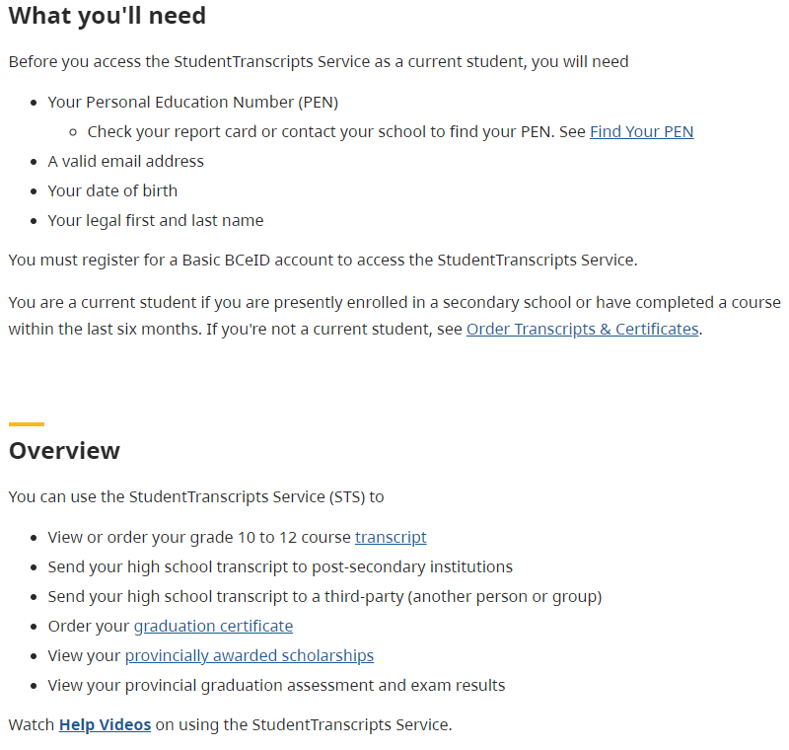
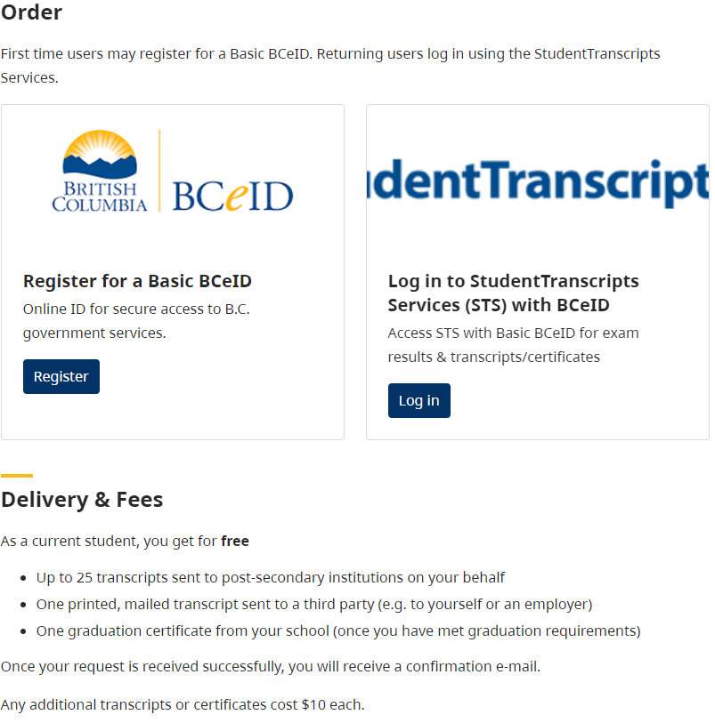

Slide 8

Things To Do Before Applying!
Reference Letters: Not a Relative. Choose wisely and ask in advance!
Check that you are Eligible – read criteria carefully!!
Access your on-line transcript
Confirm your application is complete… incomplete = not accepted
Due Dates…. Hand it in early! Check time deadline too!
Keep track of all the scholarships to which you apply
PRINT CLEARLY ON ALL APPLICATIONS

Slide 9
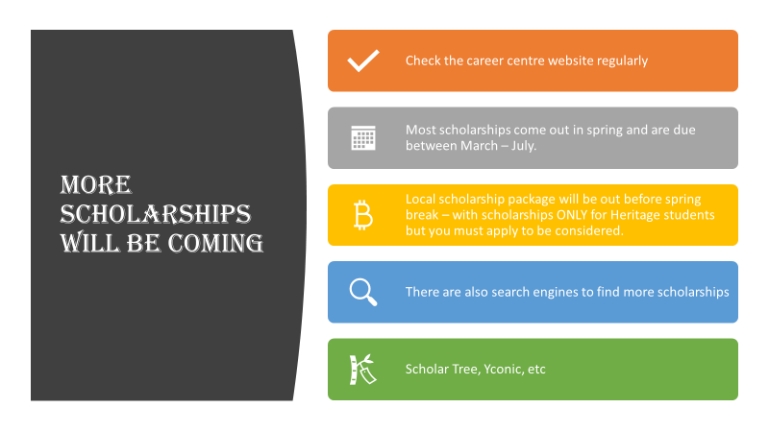

Slide 10

Major Scholarship Opportunities
Please see the following slides for information on the upcoming MAJOR scholarship opportunities.
Some will require a school nomination on a school-based application.
Remember to read the scholarship criteria carefully. Excellence is required for these major awards.
Our internal deadlines will not be the same as the actual scholarship deadlines as we require time to select nominees and winners.
All applications will be available on the career centre website LISTED BY DUE DATE.

Slide 11

Sept. 28, 2024
Application deadline

Slide 12
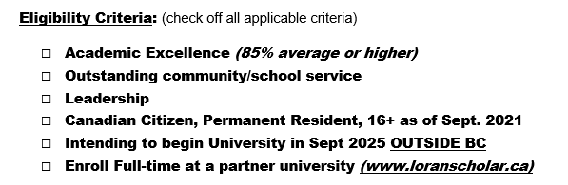
Loran Scholar’s Foundation
Application deadline Oct 15, 2024 8PM ET
Becoming a Loran Scholar will launch you on an inspiring, life-long journey to create positive change. It is a transformational opportunity to grow by challenging your limits, and to develop your ability to lead with integrity, in order to build a brighter future for all.
The Loran Award offers a four-year leadership-enrichment program, financial support for undergrad, diverse opportunities for experiential learning, and a long-term supportive community of peers and mentors—people who will inspire and motivate you in your pursuit to make a difference.
No school nomination required

Slide 13
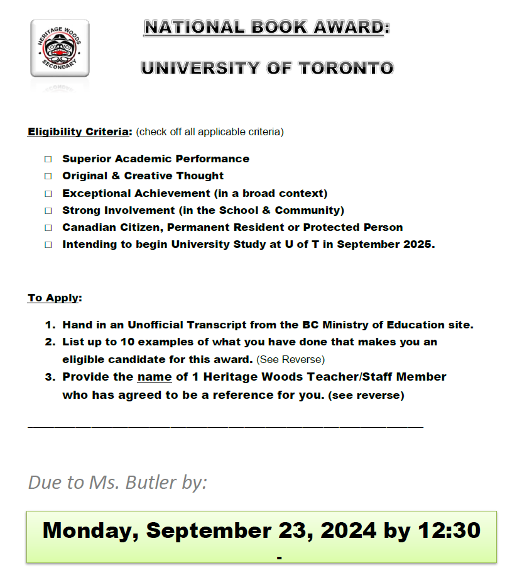
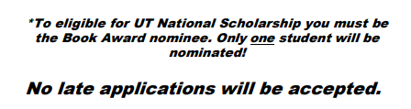

Slide 14
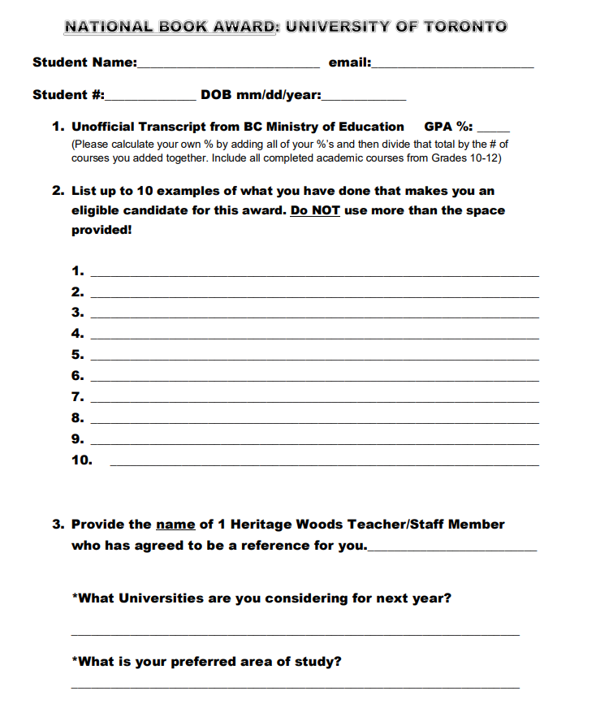

Slide 15
Lester B Pearson International Scholarship (at University of Toronto)
Eligibility Criteria: (must meet all criteria)
Academic excellence
Outstanding impact on school and community life
Creativity and leadership within school
International student in your final year of high school
Beginning university study at University of Toronto in September 2025
To Apply:
1.Hand in an Unofficial Transcript from the BC Ministry of Education site
2.Write a 1 page; double spaced, 12 font size, single sided paragraph stating why you meet the criteria for this award and why you should be selected
3.Provide the name of 1 Heritage Woods Teacher/Staff Member who has agreed to be a reference for you
Due to Ms. Butler by:
Friday Sept. 27, 2024 by 12:30!
No late applications will be accepted.

Slide 16
QUEEN’S UNIVERSITY:
Chancellor’s Scholarship
Eligibility Criteria: (check off all applicable criteria)
Superior Academic Ability
Demonstrated Leadership, Original & Creative Thinking
Exceptional Achievement (in a broad context)
Strong Involvement (in the School & Community)
Canadian Citizen or Permanent Resident of Canada
Intending to attend Queen’s University in full-time undergraduate program in September 2025.
To Apply:
Hand in an Unofficial Transcript from the BC Ministry of Education site.
Write a 1 page; double spaced, 12 font size, single sided paragraph stating why you meet the criteria for this award and why you should be selected.
Provide a reference letter from a community member (not a teacher or staff member from Heritage Woods Secondary School).
Provide the name of 1 Heritage Woods Teacher/Staff Member who has agreed to be a reference for you.
Due to Ms. Butler by:
Thursday Nov 07 2024 by 12:30pm
No late applications will be accepted.

Slide 17
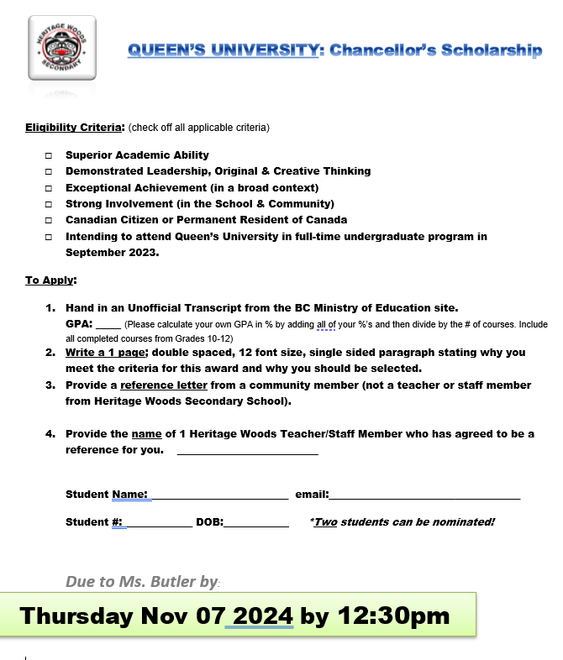
NO LATE APPLICATIONS WILL BE ACCEPTED

Slide 18
TD Scholarship for
Community Leaders
Since 1995, TD has awarded millions in scholarships to recognize students who have demonstrated an outstanding commitment to community leadership. TD Scholarship for Community Leadership recipients receive up to $70,000 for tuition and living expenses as well as opportunities for paid summer employment, peer networking and mentorship.
Have you shown exceptional leadership in helping to make a meaningful and lasting difference in your community? We’d love to hear about your community leadership efforts and what inspired you to get involved. We’re more interested in the mark you’re making in the world than the marks you’re getting in the classroom. The program is open to students with an average of 75% and up who are supporting positive change in their communities.
What is community leadership?
We’re interested in hearing from students who have demonstrated consistent and outstanding dedication to solving a community problem or making their community a better place. For example, you may be helping to clean up the environment, promote social justice, or fight child poverty.
Application deadline: November 13, 2024
**NO SCHOOL NOMINATION REQUIRED**

Slide 19
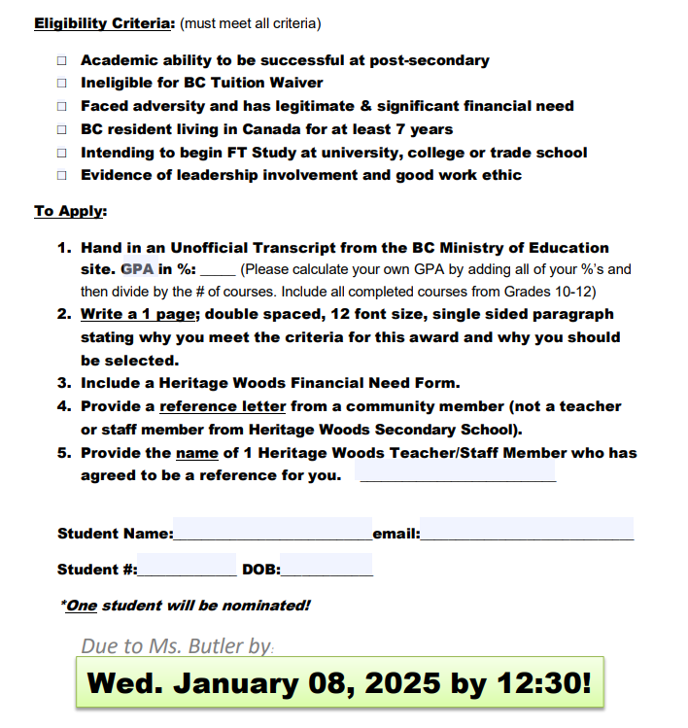

Cmolik Foundation Scholarship

Slide 20
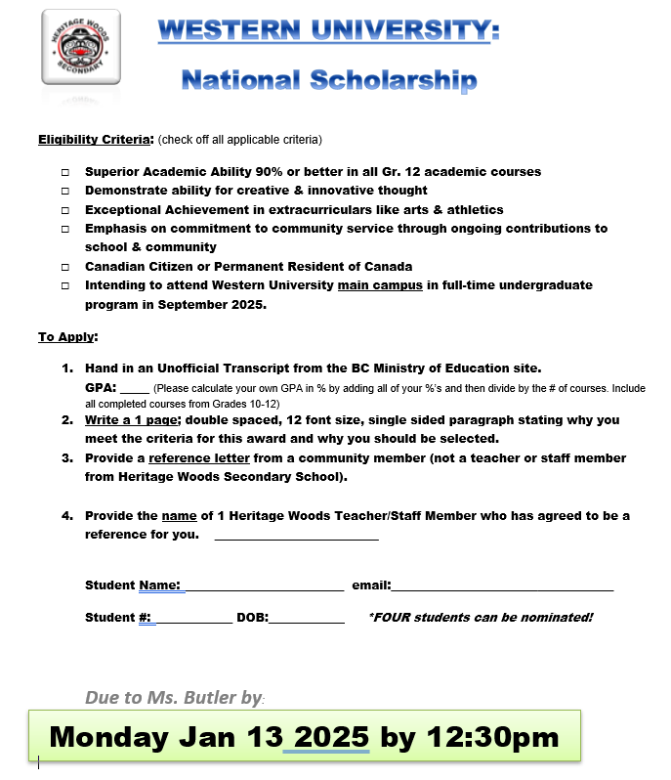

Slide 21
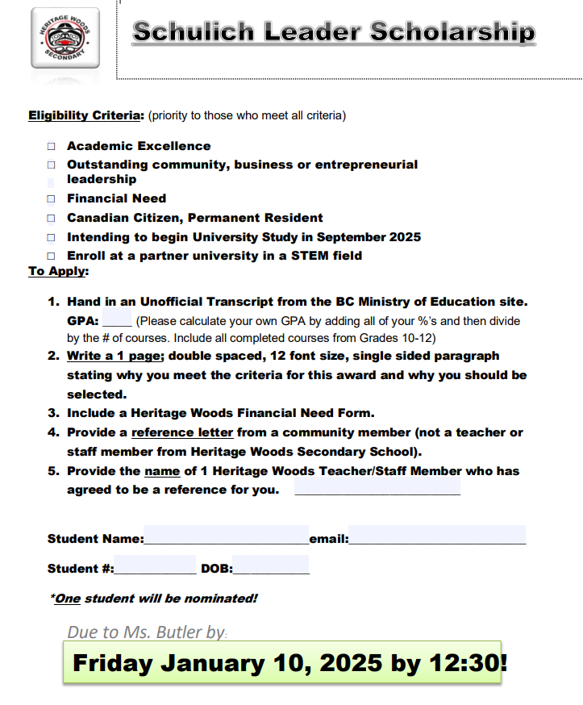

Slide 22
BC Excellence Scholarship
Students must complete the online BC Excellence Application then print and submit for consideration for school nomination
https://www2.gov.bc.ca/gov/content/education-training/k-12/support/scholarships/provincial-scholarships/bc-excellence-scholarships
Completed application are due to Ms. Butler no later than 12:30 pm on Wednesday January 15, 2025
ONE student can be nominated
***please watch for changes to requirements or nomination date as 2025 information has not yet been finalized***

Slide 23
Applications can be returned by email
or in person. Must be legible!!
To access the fillable pdf and to see the
list of other scholarships visit the Career
Centre website under the Finances/Award
Tab.
ALL SCHOLARSHIPS ARE LISTED BY APPLICATION DEADLINE DATE

