Slide 1

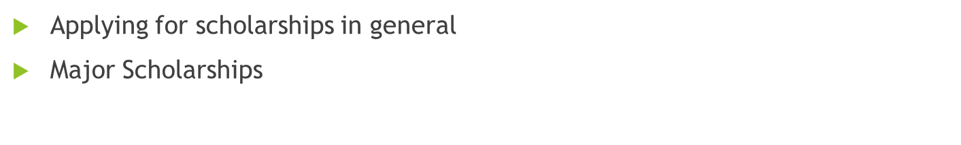
September 2022 Scholarship Meeting
Today:
Heritage Woods Secondary 2022-2023

Slide 2

For all scholarship opportunities…
You should create a BCeID account to access your transcripts as well as to give permission for transcripts to be sent to universities. Save your User ID and Password – you will need them later in your grade 12 year.
If you have questions about the scholarship process, PLEASE DO NOT WAIT UNTIL THE LAST MOMENT TO ASK FOR HELP. Email Ms. Butler dbutler@sd43.bc.ca and she can help you with your questions.

Slide 3
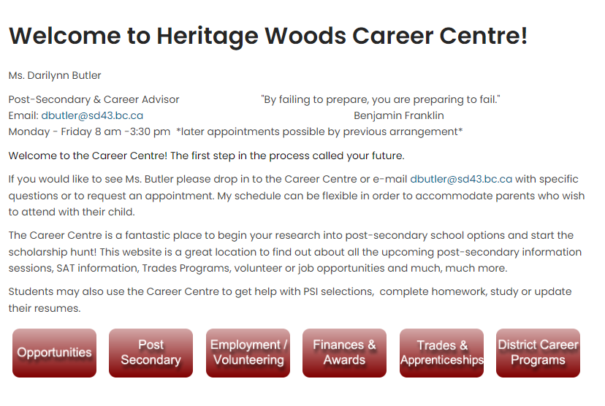

Slide 4
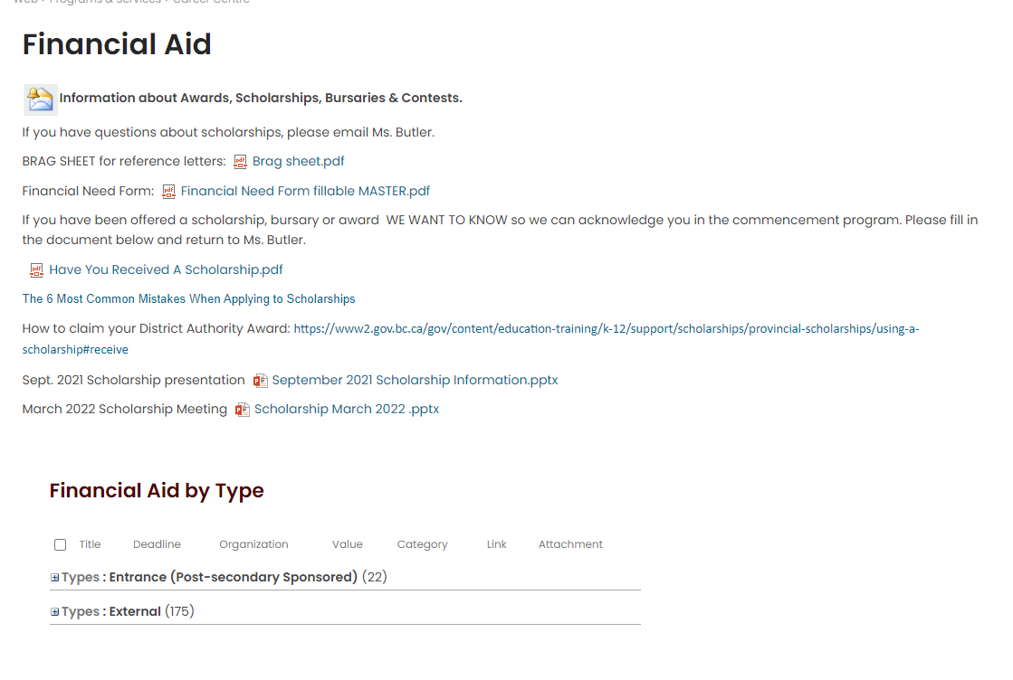

Slide 5
Student Transcript Service
There is a link on the career centre website under the post-secondary tab.
http://www.sd43.bc.ca/school/heritagewoods/ProgramsServices/career/Pages/Post-secondary.aspx#/=
You are creating a BASIC BCeID account
Keep your user ID and password as you will need it throughout grade 12
If you have already created an account to see your grades/transcripts, this is the same account – you cannot create another one
This is where you give permission for post-secondaries to receive your transcripts. Select all schools you plan to apply to. For Ontario schools select OUAC and then the individual schools. Can select US/International schools.
If you are having trouble, please email Ms. Butler dbutler@sd43.bc.ca

Slide 6
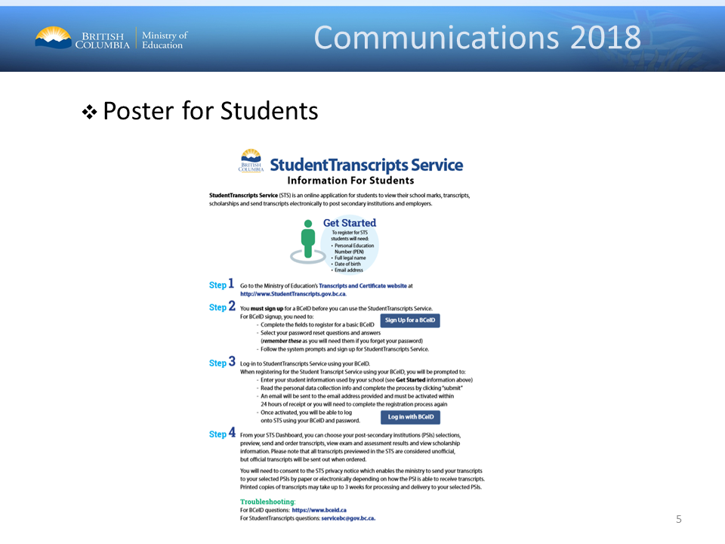
http:www.StudentTranscripts.gov.bc.ca

Slide 7

Things To Do Before Applying!
Reference Letters: Not a Relative. Choose wisely and ask in advance!
Check that you are Eligible – read criteria carefully!!
Access your on-line transcript
Confirm your application is complete… incomplete = not accepted
Due Dates…. Hand it in early!
Keep track of all the scholarships to which you apply
PRINT CLEARLY ON ALL APPLICATIONS

Slide 8
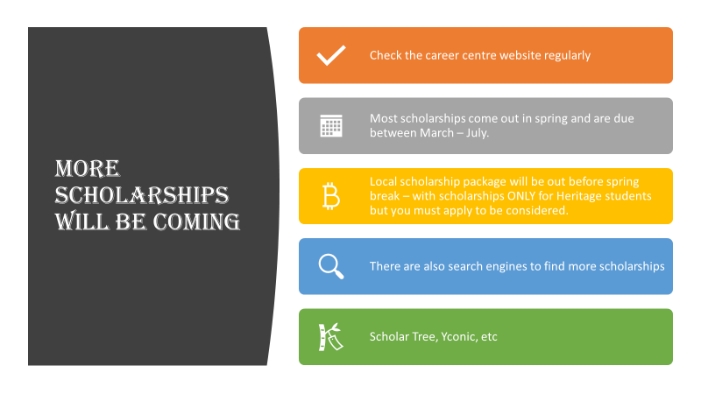

Slide 9

Major Scholarship Opportunities
Please see the following slides for information on the upcoming MAJOR scholarship opportunities.
Some will require a school nomination on a school-based application.
Remember to read the scholarship criteria carefully. Excellence is required for these major awards.
Our internal deadlines will not be the same as the actual scholarship deadlines as we require time to select nominees and winners.
All applications will be available on the career centre website LISTED BY DUE DATE.

Slide 10

THE BASANT SCHOLARSHIP

Slide 11
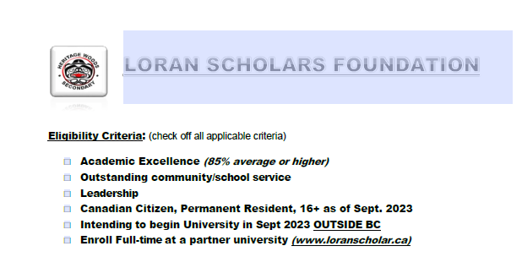
NO SCHOOL NOMINATION REQUIRED

Slide 12
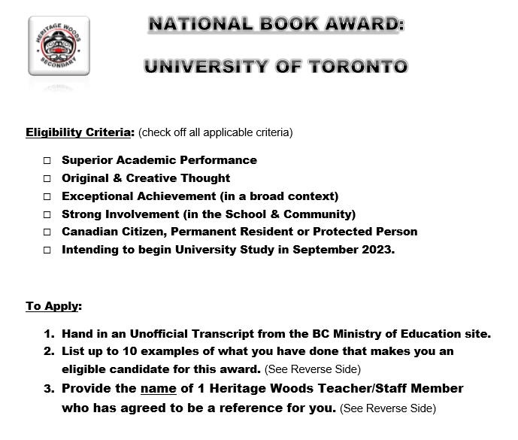
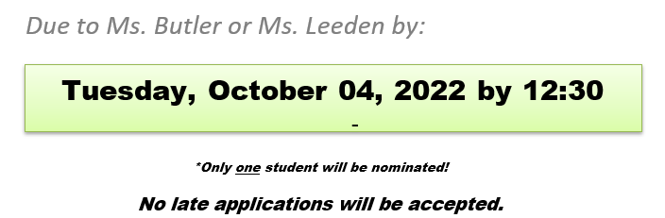

Slide 13
Selection criteria for the Morehead-Cain are:
• leadership
• moral force of character
• academic achievement
• and physical vigor
Morehead-Cain recipients are chosen solely on the basis of merit and accomplishment.
This scholarship is for
students enrolled at
UNC Chapel Hill ONLY!
Applications due to Ms. Butler or Ms. Leeden by Oct. 06, 2022 12:30 pm

Slide 14
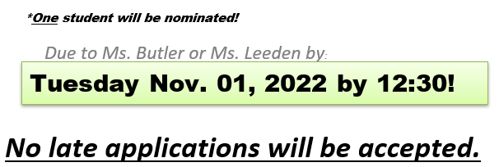
Lester B Pearson International Scholarship (at University of Toronto)
Eligibility Criteria: (must meet all criteria)
Academic excellence
Outstanding impact on school and community life
Creativity and leadership within school
International student in your final year of high school
Beginning university study at University of Toronto in September 2023

Slide 15
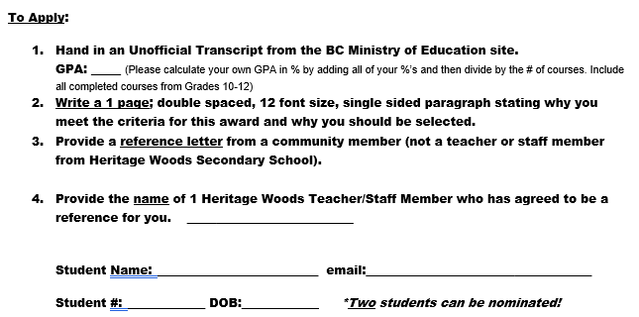
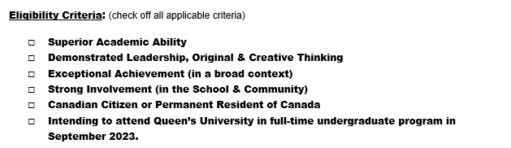
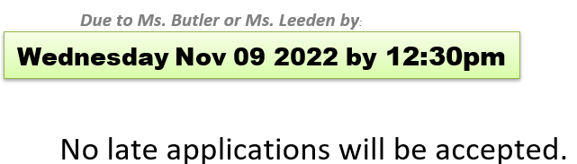
QUEEN’S UNIVERSITY:
Chancellor’s Scholarship

Slide 16
TD Scholarship for
Community Leaders
Since 1995, TD has awarded millions in scholarships to recognize students who have demonstrated an outstanding commitment to community leadership. TD Scholarship for Community Leadership recipients receive up to $70,000 for tuition and living expenses as well as opportunities for paid summer employment, peer networking and mentorship.
Have you shown exceptional leadership in helping to make a meaningful and lasting difference in your community? We’d love to hear about your community leadership efforts and what inspired you to get involved. We’re more interested in the mark you’re making in the world than the marks you’re getting in the classroom. The program is open to students with an average of 75% and up who are supporting positive change in their communities.
What is community leadership?
We’re interested in hearing from students who have demonstrated consistent and outstanding dedication to solving a community problem or making their community a better place. For example, you may be helping to clean up the environment, promote social justice, or fight child poverty.
Application deadline: November 15, 2022
**NO SCHOOL NOMINATION REQUIRED**

Slide 17
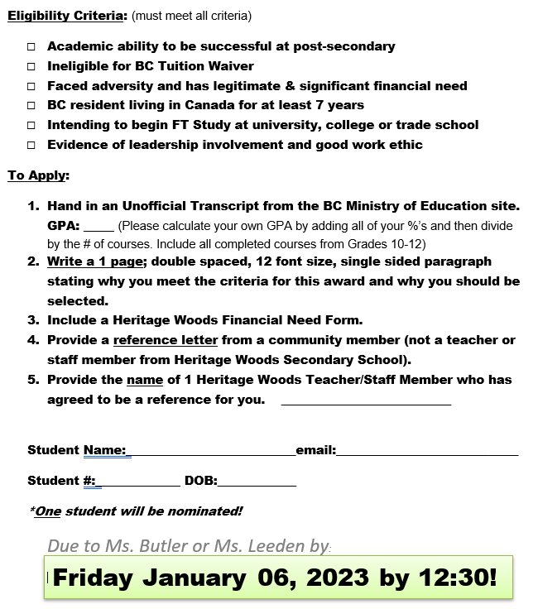

Cmolik Foundation Scholarship

Slide 18
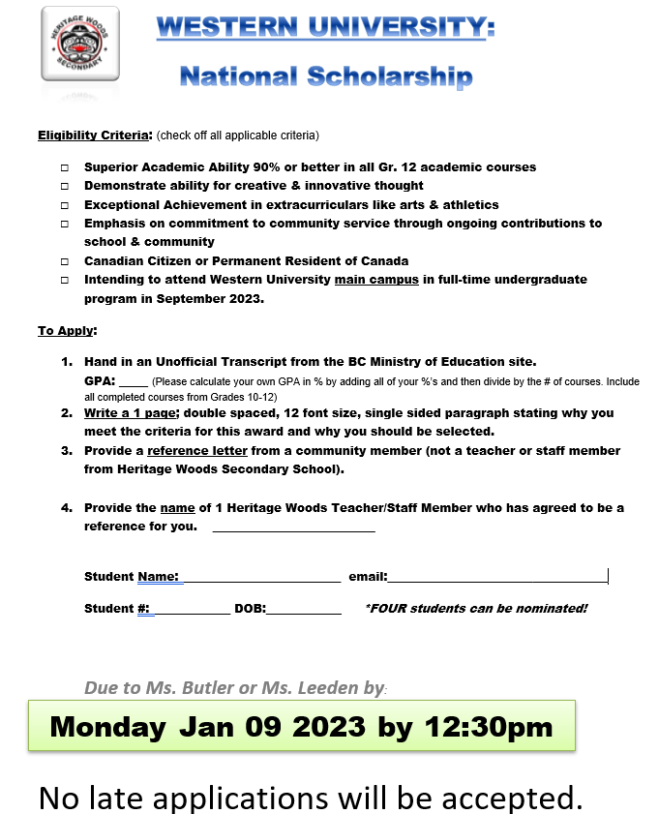

Slide 19


Slide 20
BC Excellence Scholarship
Students must complete the online BC Excellence Application then print and submit for consideration for school nomination
https://www2.gov.bc.ca/gov/content/education-training/k-12/support/scholarships/provincial-scholarships/bc-excellence-scholarships
Completed application are due to Ms. Butler or Ms. Leeden no later than 12:30 pm on Monday January 16, 2023
ONE student can be nominated
***please watch for changes to requirements or nomination date as 2023 information has not yet been finalized***

Slide 21
Applications can be returned by email
or in person. Must be legible!!
To access the fillable pdf and to see the
list of other scholarships visit the Career
Centre website under the Finances/Award
Tab.
ALL SCHOLARSHIPS ARE LISTED BY APPLICATION DEADLINE DATE

