Slide 1

SCHOLARSHIPS
LOCAL / SCHOOL BASED SCHOLARSHIPS
&
DISTRICT / AUTHORITY AWARD

Slide 2
Before you apply
You must be graduating June 2026 (if you are in grade 11 come back next year)
You must be a Canadian citizen or Pr for our internal awards (we will check so if your status has changed and you have not updated it with the office, do it now!!)
Find the application package on the Hwss career centre website listed by due date of 4/2/2026 https://www.sd43.bc.ca/school/heritagewoods/ProgramsServices/career/Pages/FinancialAid.aspx#/=
The more complete your application is the better your chances of winning so Do not leave things blank unless you have nothing to put there. Do not write 50 words for a personal statement. We want a good statement.

Slide 3

Things you must have to complete your scholarship package
PEN – located on your report cards (not your school student number – 9 digit pen)
Photo of yourself – nothing formal, just a quick snap, can be B&W, printed on regular paper
PERSONAL EMAIL ADDRESS and birthdate in mm-dd-yyyy format (May 10, 2006 = 05-10-2006)
A teacher nominator – you just require their signature verifying they support your application
A reference letter from anyone except a family member or a hwss staff
Personal statement – tell us about yourself and your goals, why you deserve scholarships
Copy of your bceid transcript
Financial need form if you are applying for any that require it – must be completed correctly or will not be eligible (do not declare family income as $0)
print legibly and put your name on the bottom of each page
HAND IN TO MS. BUTLER or ms. birsan IN PERSON before 12:30pm April 02, 2026

Slide 4
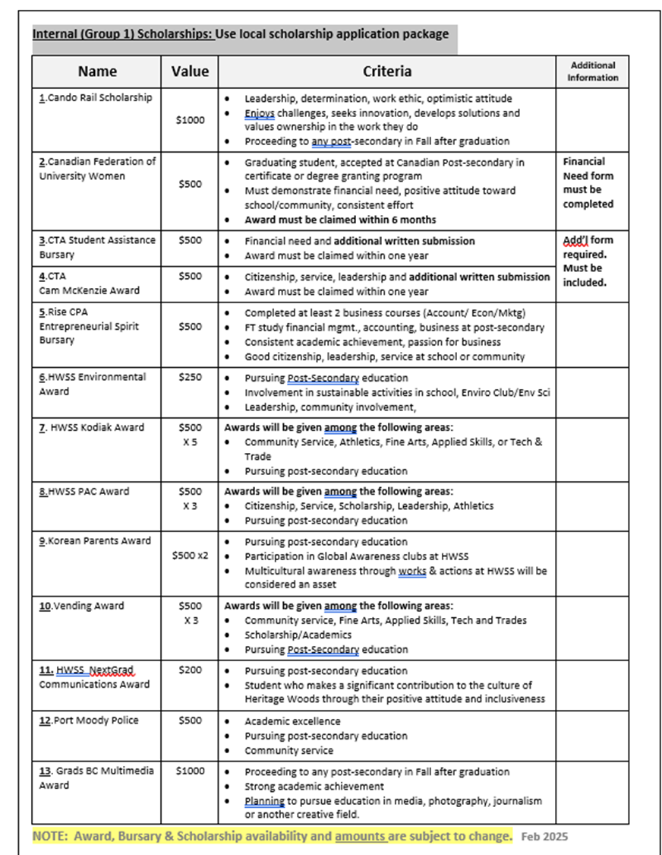
Notice that each scholarship has a number beside it? Apply for them in numerical order. If not applying for some, begin with the first number you are applying for.
Notice that each scholarship has criteria?
Indicate how you meet that criteria.

Slide 5
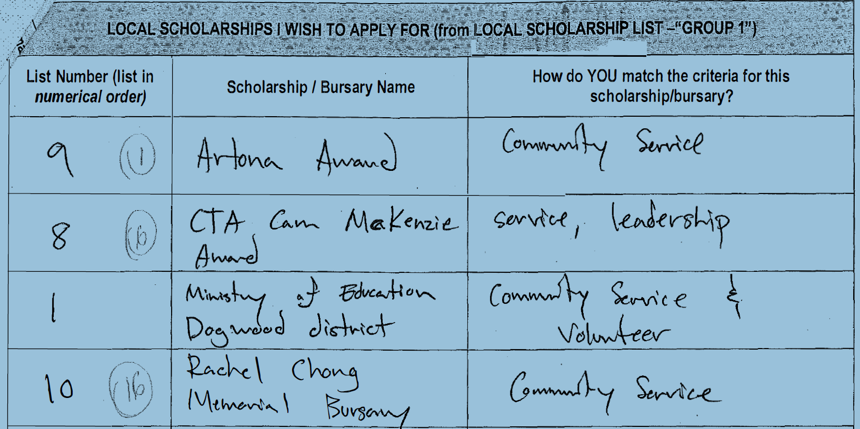
WHAT NOT TO DO

Slide 6
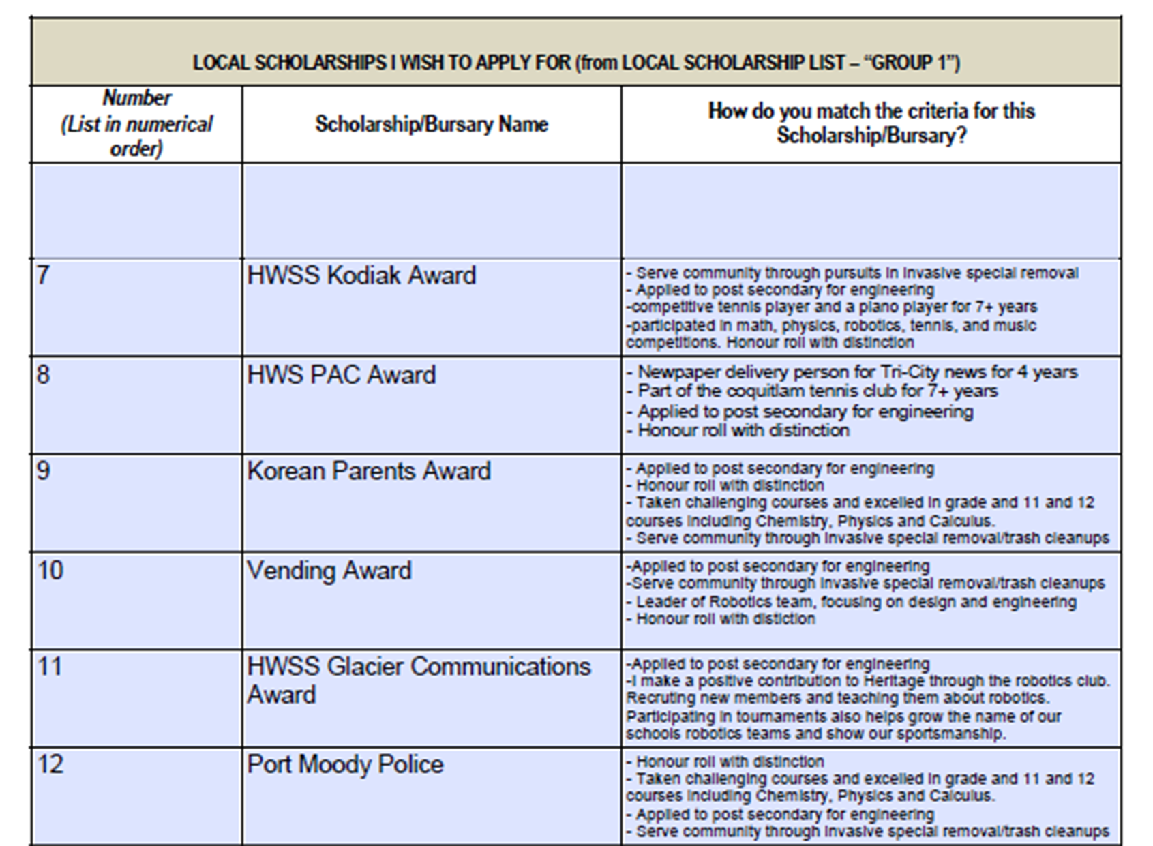
DO THIS!!!!!

Slide 7
APPLICATIONS ARE DUE:
THURSDAY, APRIL 02, 2026
NO LATER THAN 12:30 PM
Late or Incomplete Packages will not be accepted!

Slide 8
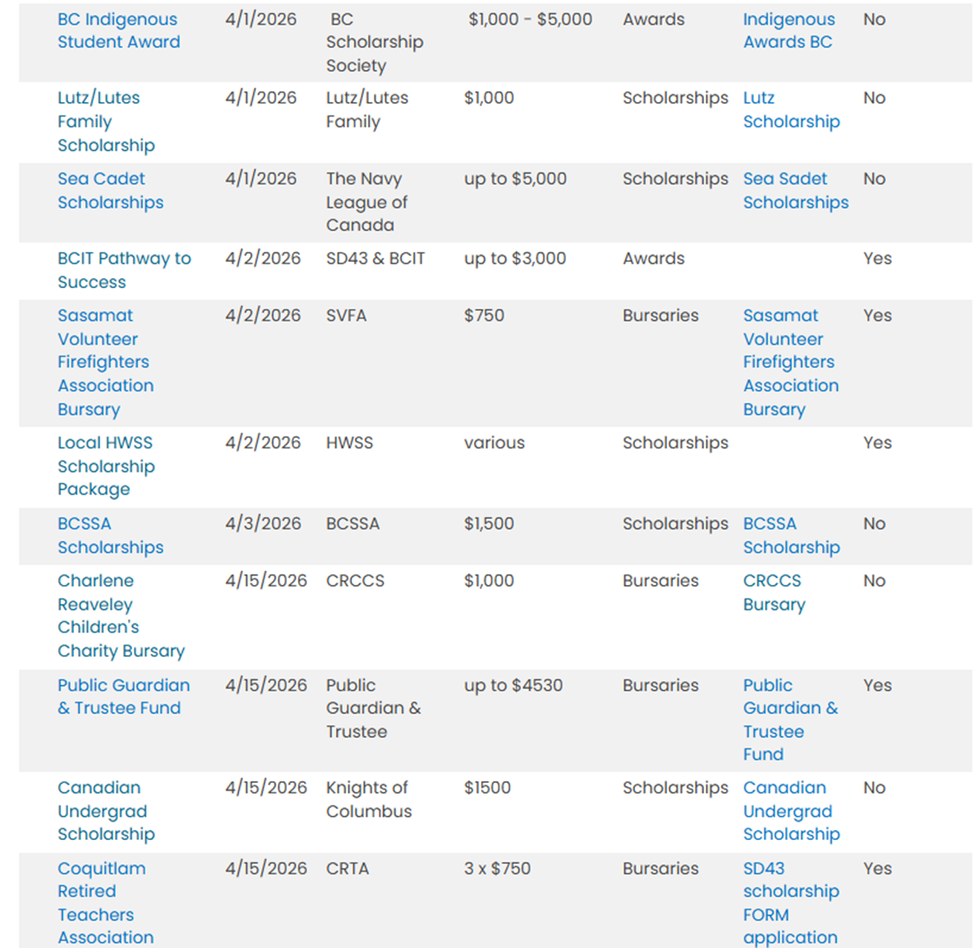
Where to find scholarships on my website
Financial Aid - Heritage Woods Secondary School (sd43.bc.ca)
Scholarships are listed by due date
Click on each scholarship to see criteria. Most applications will be attached or in the link

Slide 9
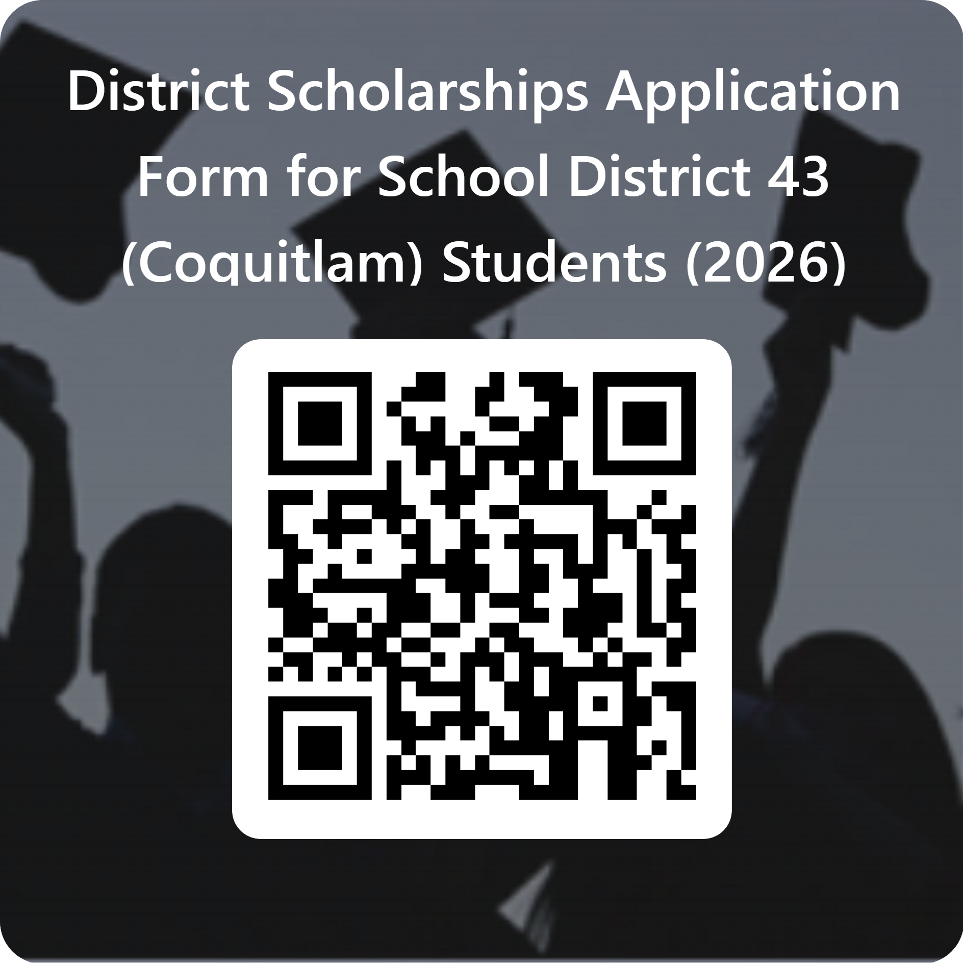

Slide 10
Things that should be obvious
All scholarship packages must be completed and submitted by YOU. We will not accept packages from parents.
Same for the sd43 application – if your parent completes and submits it you will not be considered for any awards.
Make sure we can read it
Make sure it is complete – full birthday in the correct format, full address including postal code etc.

Slide 11
WHEN WILL YOU FIND OUT IF YOU WON
And what if you won other scholarships
For scholarships awarded by hwss, Students will find out at commencement
If you won a scholarship from somewhere else, tell ms. Butler as soon as you find out so we can share your good news in the commencement brochure
We need to know no later than may 22nd for it to make it in the brochure
Why should you tell us? Your family and friends want to be able to share in your good news and maybe even brag about you a little bit ☺

Slide 12
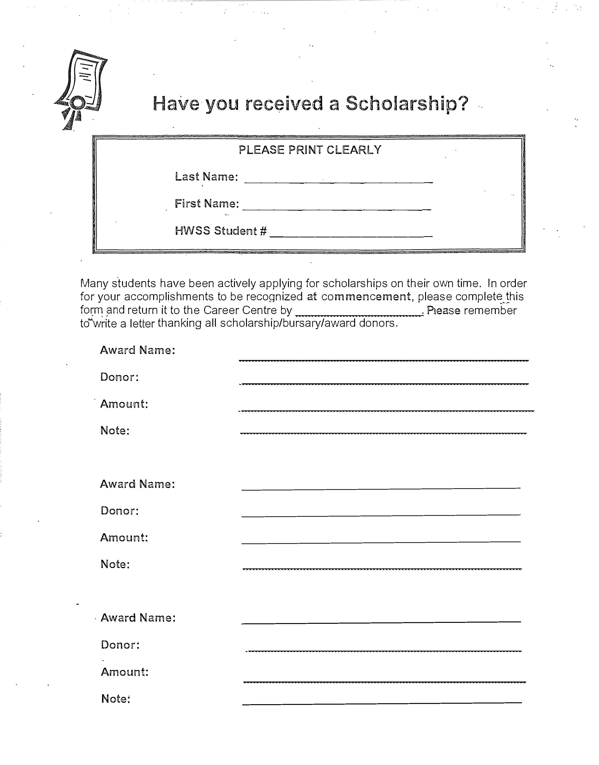
This is the form we need if you have been given a scholarship and you want it in the commencement brochure.
Must submit no later than
May 21, 2026.
Forms are on my website.

Slide 13

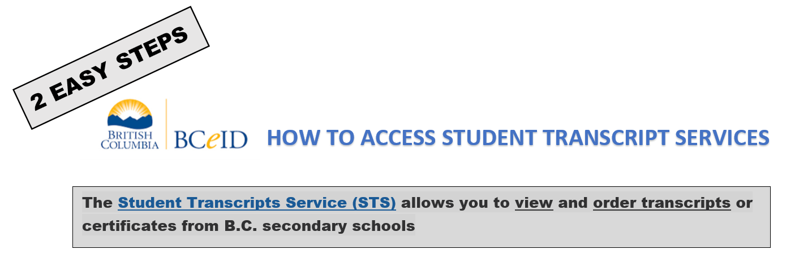
WHY?

Slide 14
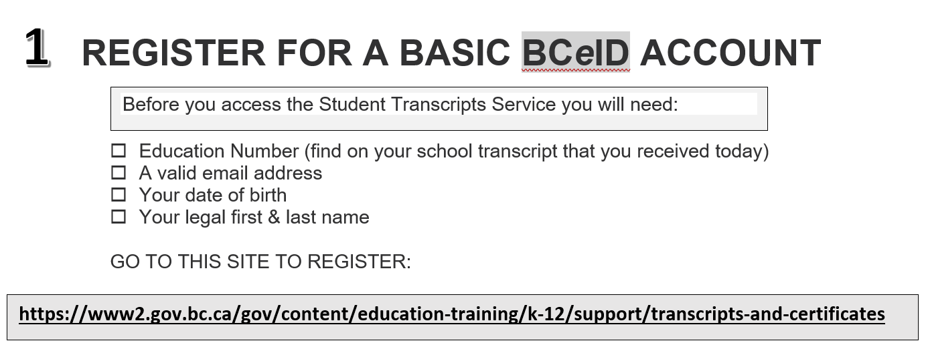

Slide 15
