Slide 1
SCHOLARSHIPS
LOCAL / SCHOOL BASED SCHOLARSHIPS
&
DISTRICT / AUTHORITY AWARD

Slide 2
Before you apply
You must be graduating June 2025 (if you are in grade 11 come back next year)
You must be a Canadian citizen or Pr (we will check so if your status has changed and you have not updated it with the office, do it now!!)
Find the application package on the Hwss career centre website listed by due date of 4/4/2025 https://www.sd43.bc.ca/school/heritagewoods/ProgramsServices/career/Pages/Financial
The more complete your application is the better your chances of winning so Do not leave things blank unless you have nothing to put there. Do not write 50 words for a personal statement.

Slide 3
Things you must have to complete your scholarship package
PEN – located on your report cards (not your school student number – 9 digit pen)
Photo of yourself – nothing formal, just a quick snap, can be B&W, printed on regular paper
PERSONAL EMAIL ADDRESS and birthdate in mm-dd-yyyy format (May 10, 2006 = 05-10-2006)
A teacher nominator – you just require their signature verifying they support your application
A reference letter from anyone except a hwss teacher or family member
Personal statement – tell us about yourself and your goals, why you deserve scholarships
Copy of your bceid transcript
Financial need form if you are applying for any that require it – must be completed correctly or will not be eligible (do not declare family income as $0)
print legibly and put your name on the bottom of each page
HAND IN TO MS. BUTLER or ms. birsan IN PERSON before 12pm April 04, 2025

Slide 4
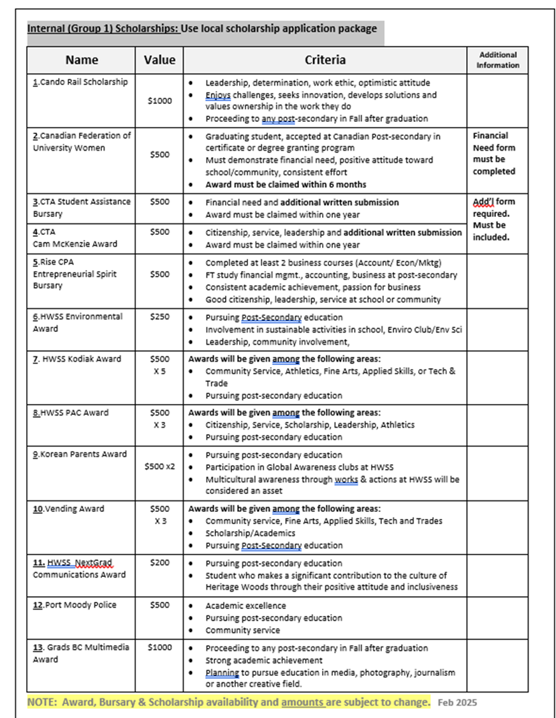
Notice that each scholarship has a number beside it? Apply for them in numerical order. If not applying for some, begin with the first number you are applying for.
Notice that each scholarship has criteria?
Indicate how you meet that criteria.

Slide 5
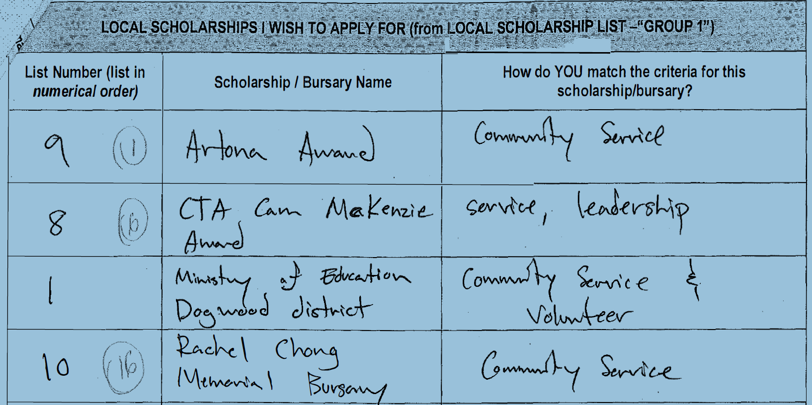
WHAT NOT TO DO

Slide 6
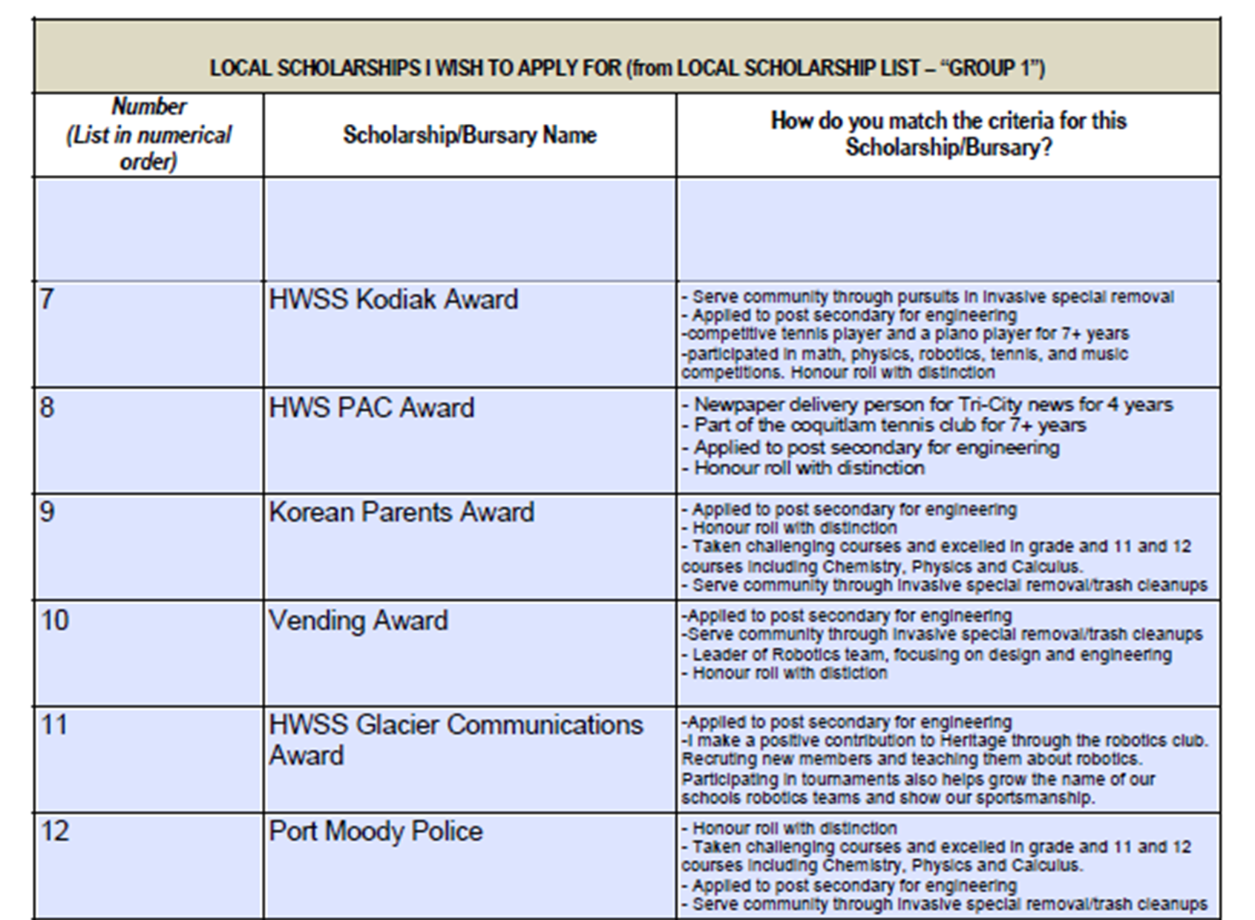
DO THIS!!!!!

Slide 7
APPLICATIONS ARE DUE:
FRIDAY, APRIL 04, 2025
NO LATER THAN 12:00 PM
Late or Incomplete Packages will not be accepted!

Slide 8
Where to find scholarships on my website
Financial Aid - Heritage Woods Secondary School (sd43.bc.ca)
Scholarships are listed by due date
Click on each scholarship to see criteria. Most applications will be attached or in the link

Slide 9
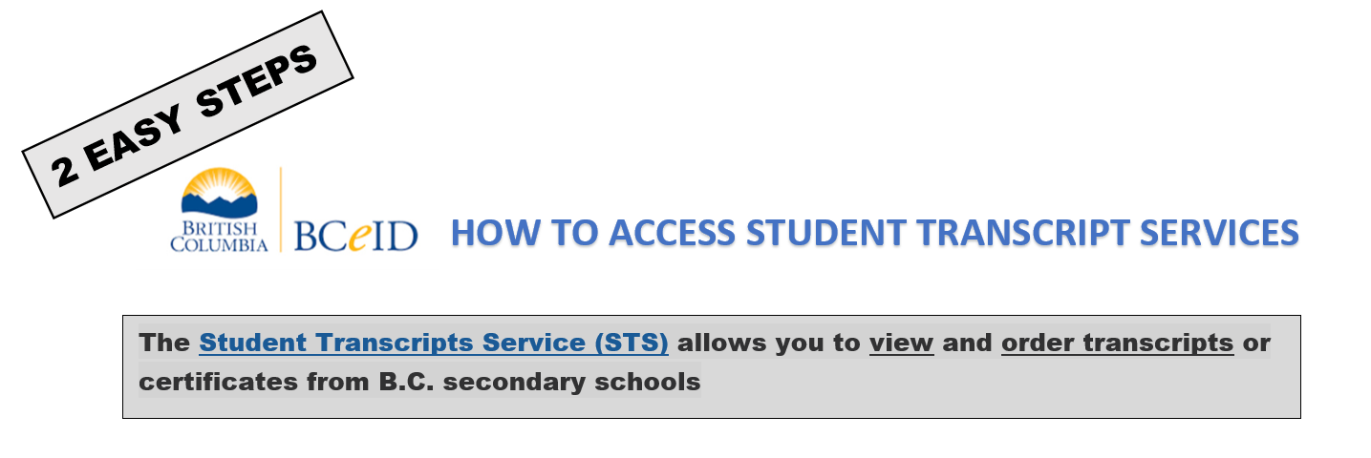
WHY?

Slide 10
