Slide 1
What do I talk about in my Presentation?

Slide 2
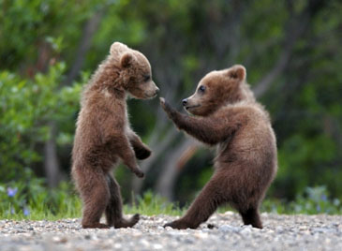
Where have you been?
Talk about your journey up to now and your proudest accomplishments
What has made you the person you are today?

Slide 3
Where are you now?
Talk about your present goals, values, plans, learning, aspirations…
Who are you today?

Slide 4
Where are you going?
Where are you going in your future?
employment,
career choices,
life choices,
post secondary,
education,
training…

Slide 5
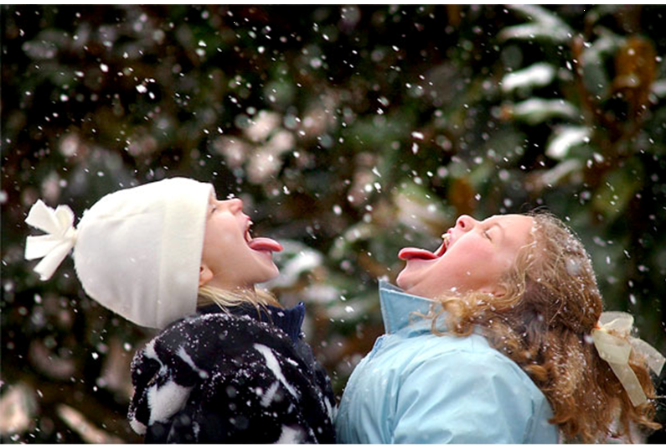
Mrs. Nunn and Mrs. Gay are here to help!

