Slide 1


Heritage Woods Course Request Information 2026-2027

Slide 2

PART 1: The Courses
Course Requirements
Grade 10
Required
Language Arts (English) 10
Math 10
PHE 10
Career Life Education 10
Science 10
Social Studies 10
Grade 11
Required
Language Arts (English) 11
Math 11
Science 11 or 12
Social Studies 11 or 12
Grade 12
Required
Language Arts (English) 12
Career Life Connections
Graduation Requirements BC

Slide 3


One Applied Design, Skills and Technologies OR Arts Education
16 credits at the Grade 12 level (includes English and CLC)
28 credits must be elective course credits
4 credits must have an Indigenous-focus (see Indigenous-Focused Graduation Requirements - Province of British Columbia (gov.bc.ca) for additional information)
+ Literacy and Numeracy Ministry assessments

Slide 4

Language Arts
ENGLISH 10: 4 Credits Total
All students CHOOSE ONE (for 2 credits):
Literary Studies 10
New Media 10
Spoken Language 10
All students enrolled in Composition 10 (2 credits)
ENGLISH 11 (choose at least one)**
English First Peoples – Literary Studies and New Media 11
English First Peoples – Literary Studies and Spoken Language 11
English First Peoples – Literary Studies and Writing 11
** this covers the Indigenous Graduation Requirement; if you take a different Language Arts 11, you responsible for making sure you complete this requirement another way
ENGLISH 12:
English Studies 12 or English Studies 12 Honours
For English Language Learners: the ELL team will assess students for placement in appropriate ELL courses

Slide 5


Mathematics
Suggested Pathways
Math 9
Workplace Mathematics 10
Foundations of Mathematics and
Pre-Calculus 10
Pre-calculus 11 or Precal Honours 11*
Workplace Mathematics 11
Foundations of Mathematics 11
Intended for study in majority of trades and workforces
Foundations of Mathematics 12
Geometry 12
Pre-calculus 12
Intended for study in programs not requiring theoretical calculus
Calculus 12
Calculus 12 AP
Discuss math options with math teacher!!!
Intended for study in programs requiring theoretical calculus

Slide 6




Social Studies
Social Studies 10
BC First Peoples 12
Comparative Cultures 12
Human Geography 12
Physical Geography 12
20th Century World History 12
Political Studies 12
Law Studies 12
Philosophy 12
Social Justice 12

Slide 7



Science
Science 10
Life Sciences 11
Anatomy and Physiology 12
Chemistry 11
Chemistry 12
Earth Science 11
Physics 11
Physics 12
Science for Citizens 11
Geology 12
Environmental Science 12
*Note: If you are planning on going into the Sciences in post secondary, make sure you carefully check the requirements of the specific programs at each institution

Slide 8
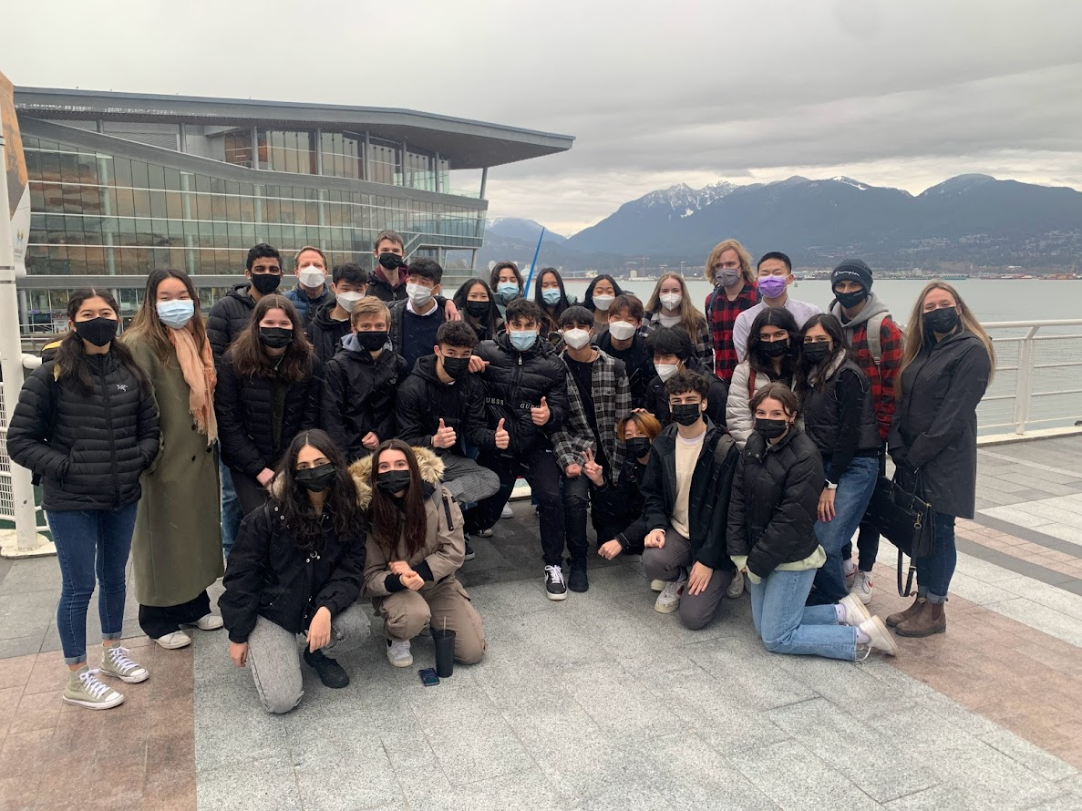




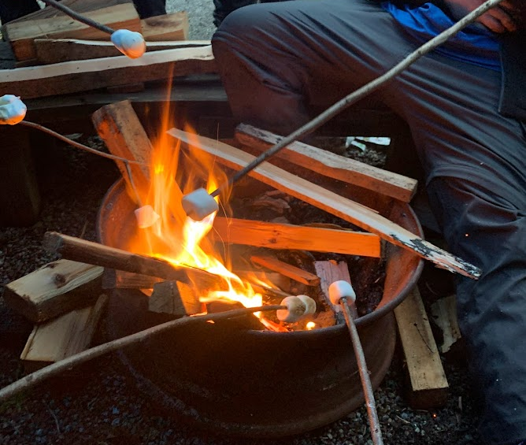

Science Co-op 11
Science Co-op 11 is a Semester 2 Cohort
Chemistry 11
Life Science 11 (Biology)
Work Experience 12
Outdoor PE 11
Leadership 11/12
Learn more about this exciting opportunity, tailored for grade 11 students who are passionate about Science, the outdoors, and networking.

Slide 9

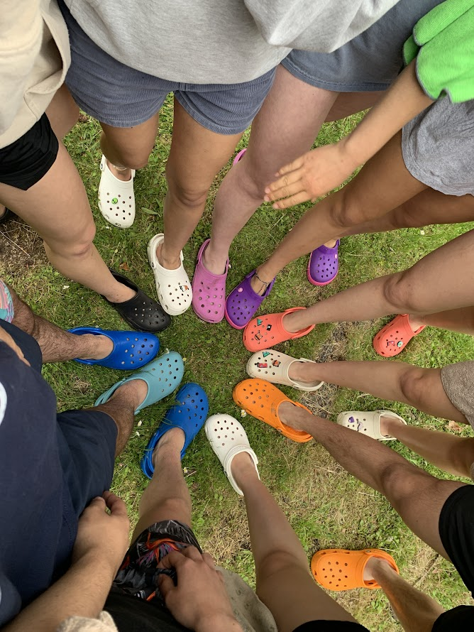
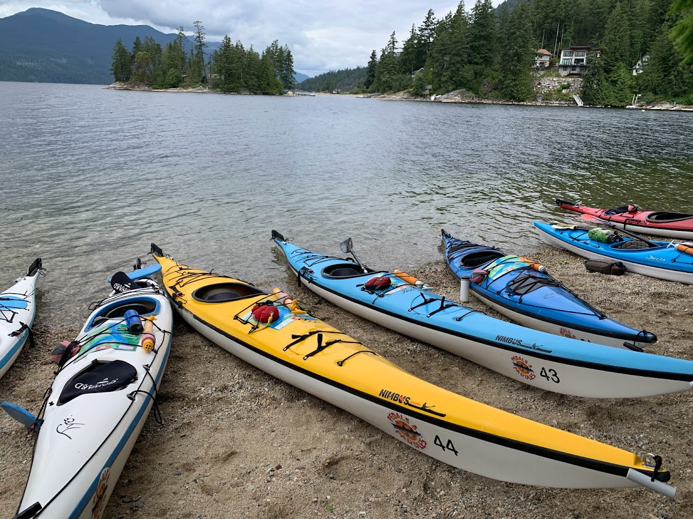
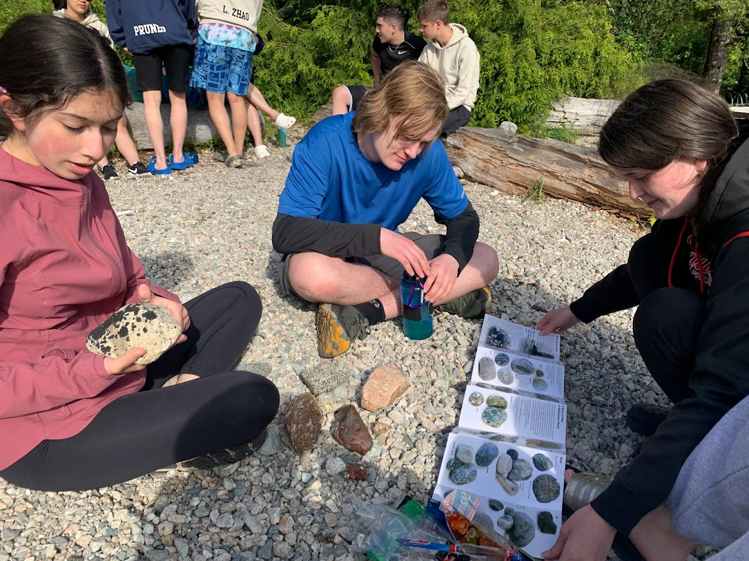
Science Co-op Info Session Early February
Teacher Sponsors
Brooke Wilson
bwilson@sd43.bc.ca
Mike Baldus
mbaldus@sd43.bc.ca
This program is only available to grade 11 students (current grade 10’s).
Students will be exposed to many exciting opportunities, including university lab work, 3-week work experience in field of choice, camping, canoeing/kayaking, community aid, and more!

Slide 10
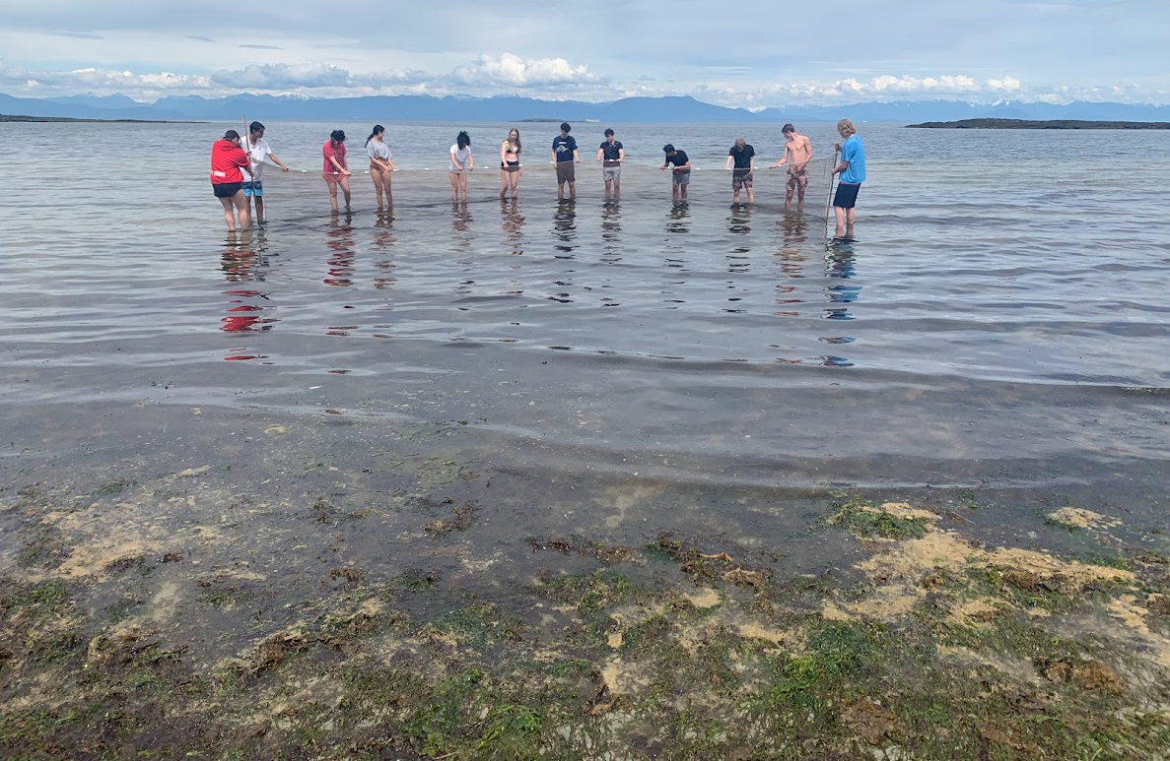
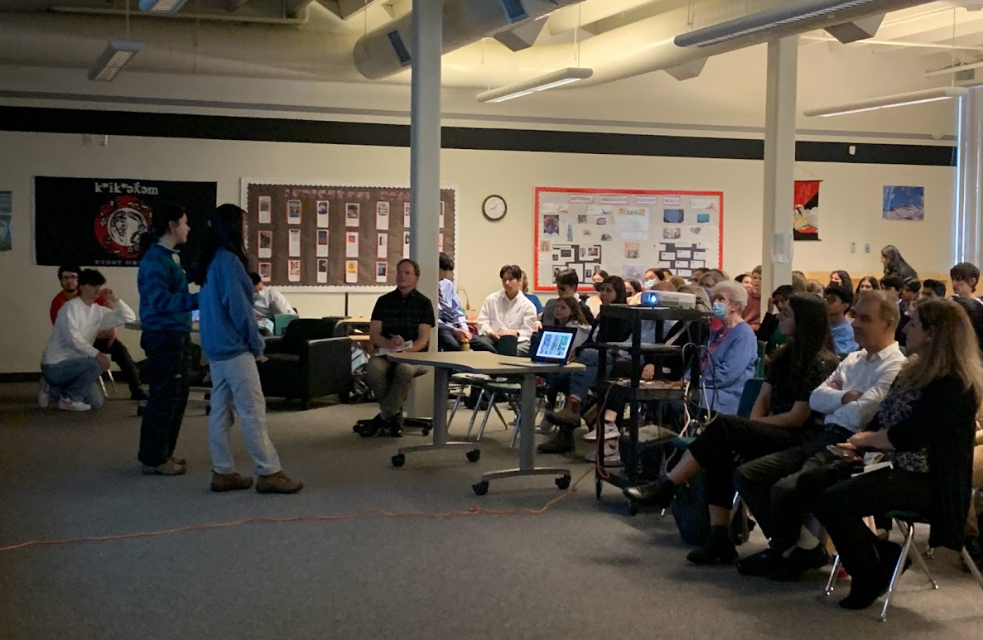
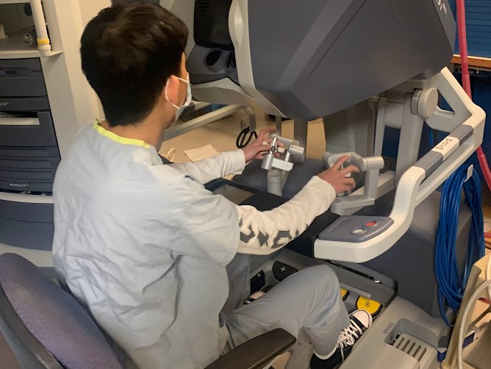
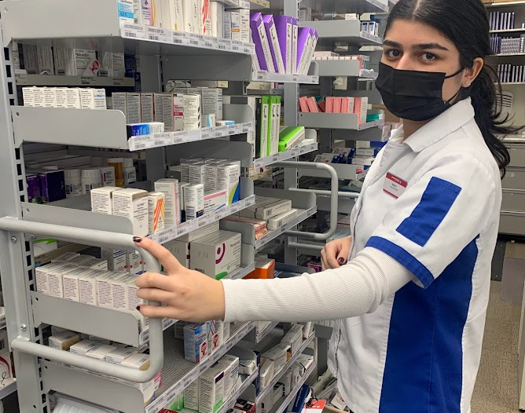
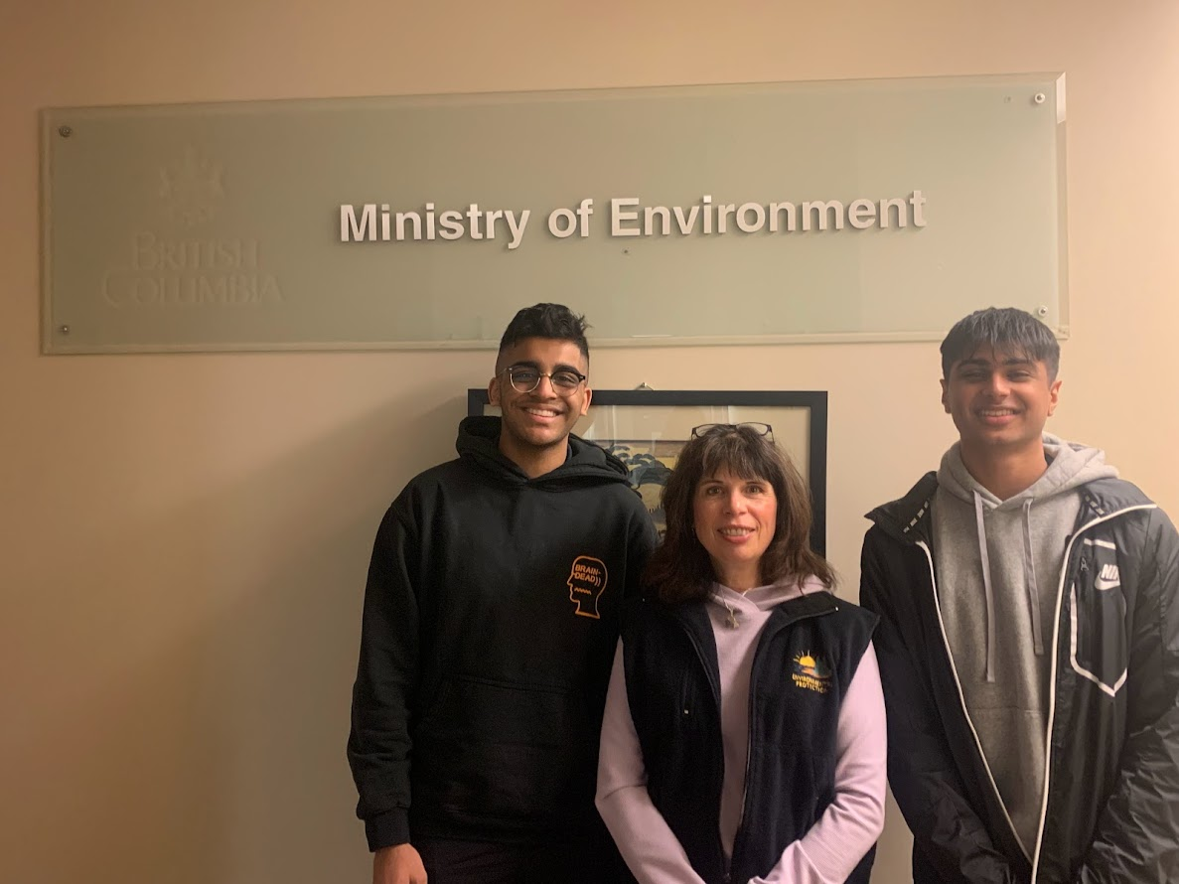

Slide 11
A note about Languages…
We offer…
French
Japanese
Spanish
Did you know?
A language is NOT required for graduation
They still count as academic courses and can be a benefit for Post Secondary Applications!
Lots of benefits!!!
***STUDENTS AND FAMILIES NEED TO CHECK INDIVIDUAL POST-SECONDARY WEBSITES***

Slide 12
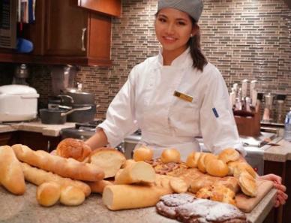
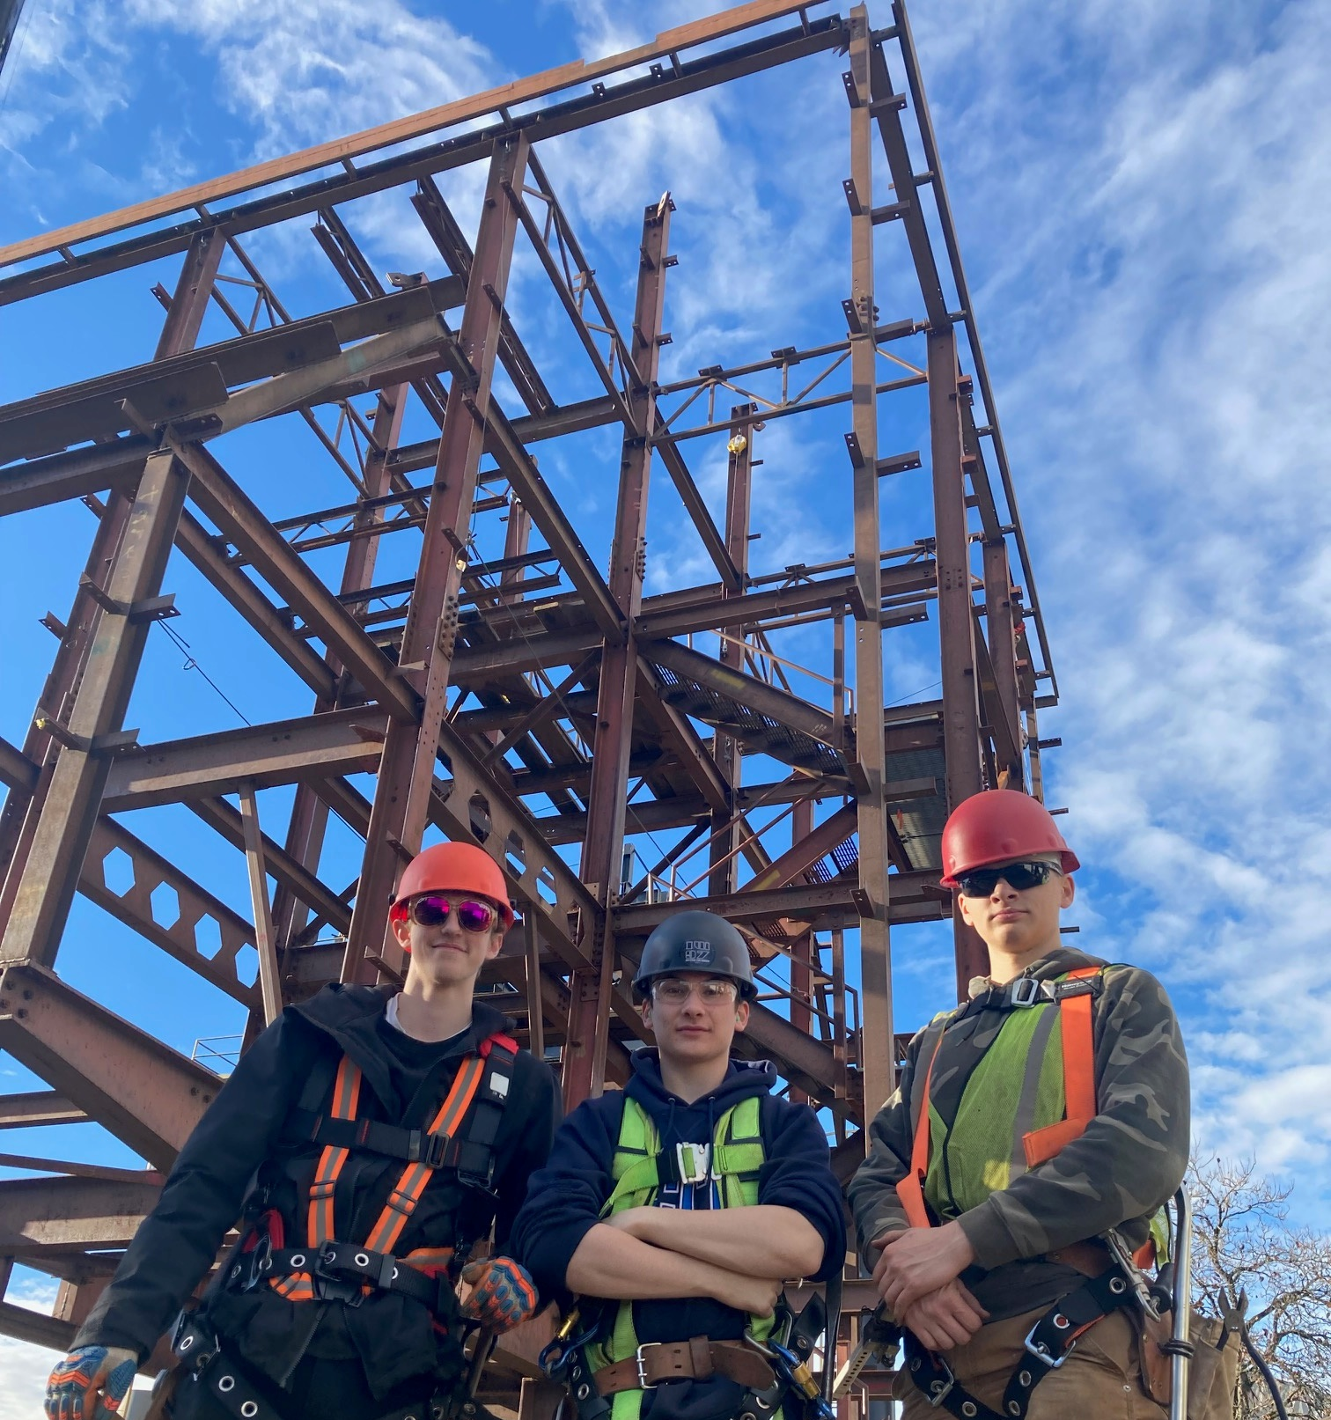
TRAIN in Trades Programs
Amazing opportunity for any grade 11 or 12 student to take one of 25+ “Train in Trades” programs:
Tuition Free – saves $1,000s
Post Secondary level training
Level 1 Certification
Dual /Triple Credits:
high school
post secondary and/or
industry

Slide 13
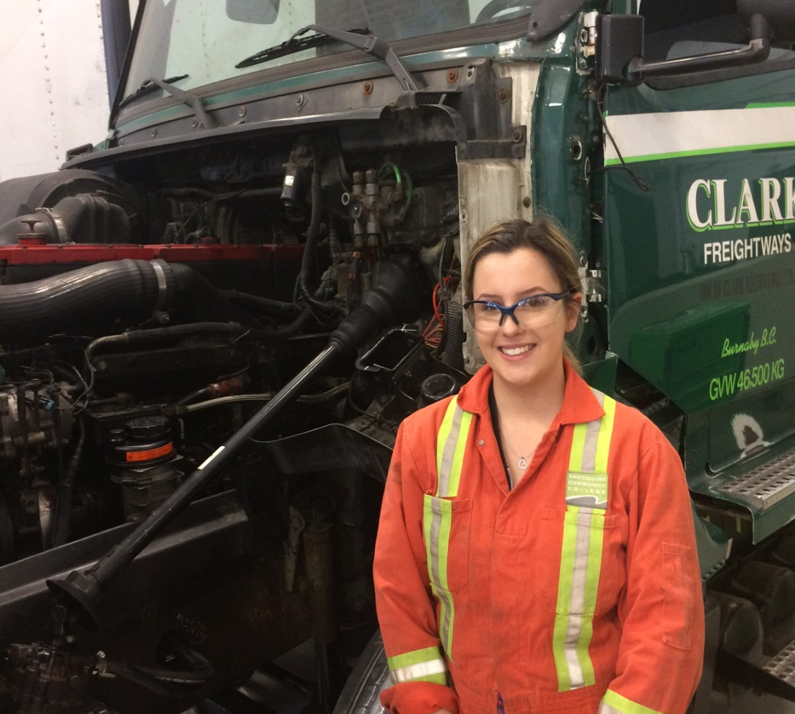
TRAIN in Trades Programs
Aircraft Maintenance Engineer
Appliance Service Tech
Auto Collision + Refinishing Tech
Automotive Service Tech
Baker
Cabinet Maker (Joiner)
Carpenter
CNC-Machinist
Cook
Electrician
Hairstylist
Heavy Duty Equipment Technician

Slide 14
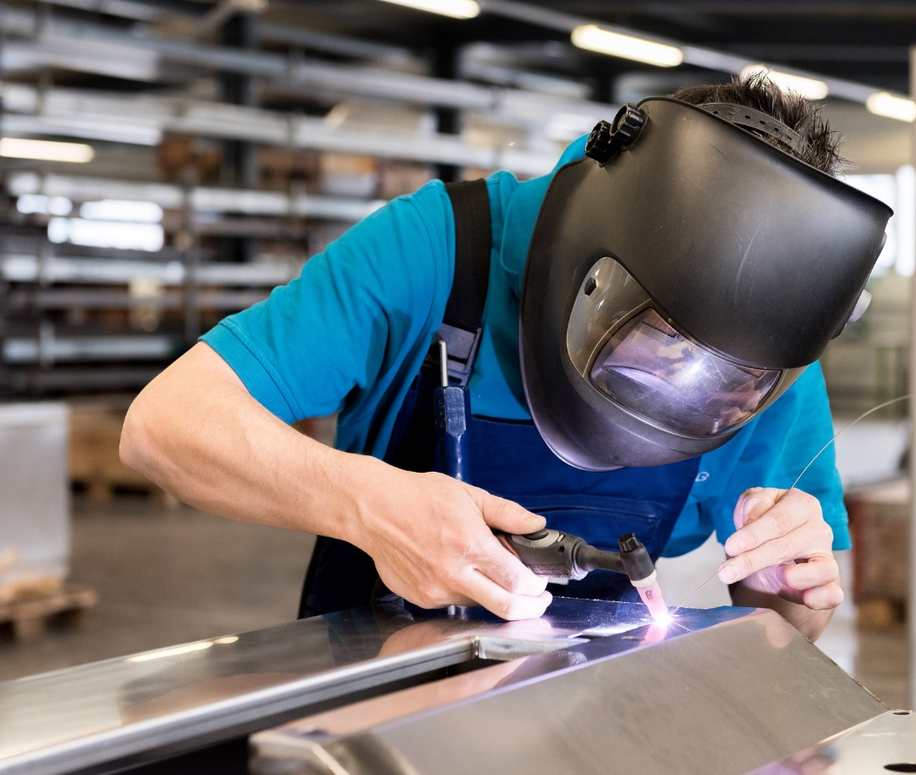
Ironworker
Landscape Horticulturalist
Marine Mechanical Technician
Metal Fabricator
Millwright
Motorcycle Mechanic
Painter (commercial)
*Part and Warehousing Person
Plumber
Refrigeration Mechanic
*Security Systems Technician
Sheet Metal Worker
Welder
TRAIN in Trades Programs

Slide 15
TRAIN contact
WORK contact
More Info
www.43Careers.com
Ben King
e: BKing@sd43.bc.ca
c: 778-984-1354
Joanna Horvath
e: JHorvath@sd43.bc.ca
c: 604-312-7739
Contact Joanna for more information

Slide 16


Slide 17






Many pathways ahead…
Trade Schools
Apprenticeships
College
University
Institutes
Travel
Workforce
….

Slide 18

Whether it’s post secondary schooling, volunteering, work, travel, apprenticeship…
Visit the Career Centre
in person or online:
Heritage Woods Career Centre

Slide 19


Post Secondary and Career Advisor:
Ms. Darilynn Butler: dbutler@sd43.bc.ca
Finances
Awards, bursaries, scholarships
College, university, institutes
Apprenticeship opportunities
Volunteering
Trade program info

Slide 20
What is new for 2025-2026!!!
NEW
Courses!!
Tabletop Games
Outdoor Education 11/12
Bicycle Maintenance and repair 11/12
Fishing and Wildlife 11/12
BC First Peoples 12
Tourism 11/12
And More!
Inside VS Outside
the Timetable
INSIDE
Blocks 1-5 (8am – 3:25)
OUTSIDE
Before Block 1 & After Block 5

Slide 21


Take your time…these are important decisions
Your choices NOW determine the school timetable
Many reasons for not getting all requests (conflict, courses not running, courses are full…)
Not able to make changes based on:
Friends
Teacher preference
Semester
Time of Day

Slide 22
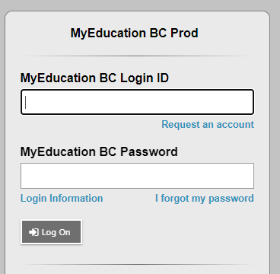
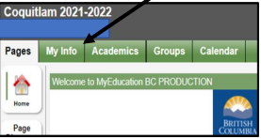
Course Selection is all done through the MyEd Portal
Go to MYED BC and login with your 7 Digit Student Number (not an email address or PEN number)
Click on “MY INFO” in the top left corner.

Slide 23
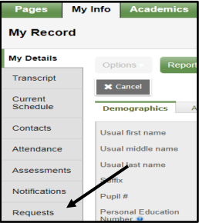
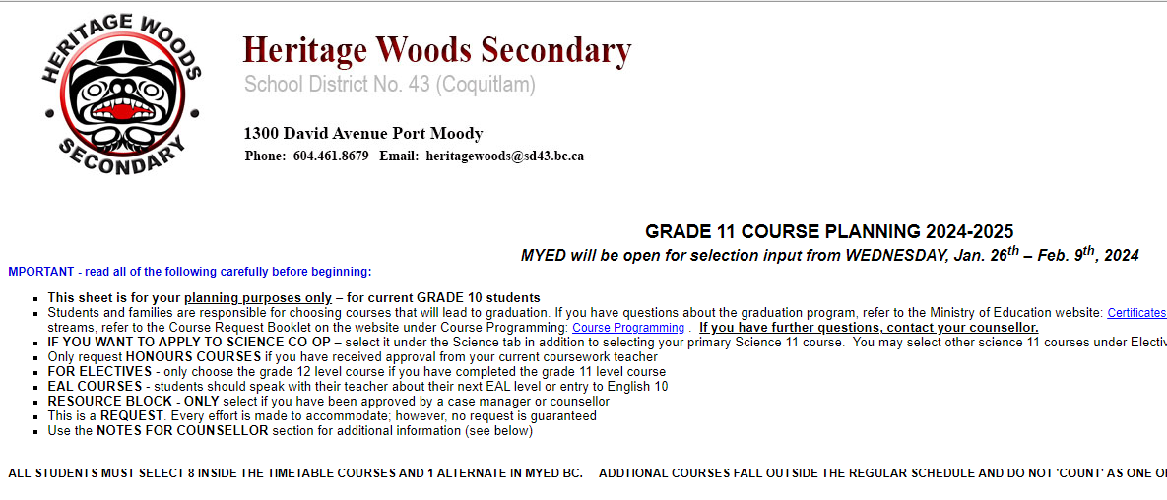
Click on REQUESTS
Click on “REQUESTS” at the bottom of the left sidebar.
STEP 3: READ all the instructions

Slide 24
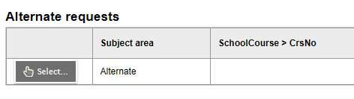
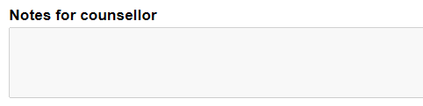
Alternates: Must have 2!
STEP 5: Notes for Counsellors
(Must be done with Student Log in)
Notes For Counsellor: Use the bullet points on the planning sheet to guide you in writing anything important we need to know for your course planning

Slide 25

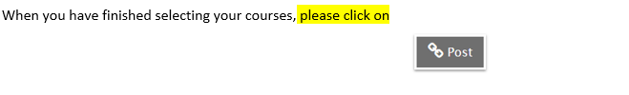

Slide 26

“Choose to pursue something you love and you will never have to work a day in your life”

Slide 27

Course Request Portal Dates:
Portal opens Late January – Dates to be Announced to all Students
Grade 10’s – Portal Closes Friday February 13th
Grade 11’s – Portal Closes Friday February 20th
Grade 12’s – Portal Closes Friday February 20

Slide 28

FOR PASSWORD RESET SUPPORT:
Please see the support document on the course planning mainpage: Course Programming - Heritage Woods Secondary School (sd43.bc.ca)

Slide 29
YOUR COUNSELLOR CONTACT INFO:
(Last Names A-G) Karen Watt
kwatt@sd43.bc.ca
(Last Names H-N) Alina Birsan
abirsan@sd43.bc.ca
(Last Names O-Z) Giovanni Zenone
gzenone@sd43.bc.ca

Slide 30

Questions?

