Slide 1
Welcome to the Woods!
Please carefully review this PowerPoint. It should answer most questions and concerns regarding how high school works and what course selection is like.
At 6:30pm on Monday, January 10, our Principal & Counselling Staff will be addressing anything that is not covered in this PowerPoint and will be available to answer any other questions that are not already on the Frequently asked Q & A Sheet:
FAQ info sheet for grade 8 Parents.pdf (sd43.bc.ca)
If you have questions that are not answered through this powerpoint or the Q & A sheet, then please email tclerkson@sd43.bc.ca to register and receive the ZOOM link to the meeting.

Slide 2
Counselling (by student’s last name)
THE HERITAGE WOODS TEAM:
Principal
Vice-Principals
Todd Clerkson
Martin Bozic (A - G)
Manjit Rai (H - N)
Mark Rao (until Feb 1st) (O - Z)
JJ Hyde (starting Feb 1st)
Youth Worker
(A - G) Shaunna Martin (Team Leader)
(H - N) Karen Watt / Karen Leeden
(O – Z) Curt Dewolff
Abhinesh Naidu
Career and Post Secondary Advisor
Darilynn Butler
Learning Centre
English Alternate Learners
Pat Vance (Team Leader)
Angeline Lee (Team Leader)

Slide 3
How Things Work:
Two semesters
Semester 1: Sept-Jan
Semester 2: Feb-June
Students take 8 courses plus digital literacy over 2 semesters
Classes are 72 minutes long
Flex Blocks: Mon-Fri, 30 mins of tutorial time with a teacher
Some students take additional courses outside of the 2-5 block schedule (band, choir, agility)

Slide 4
Bell Schedule…
MONDAY | TUESDAY | WEDNESDAY | THURSDAY | FRIDAY
Period 1 8:00-9:12​ | Period 1 8:00-9:12 | Period 1 8:00-9:12 | Period 1 8:00-9:12 | Period 1 8:00-9:12
Period 2 9:16-10:28 | Period 2 9:16-10:28 | Period 2 9:16-10:28 | Period 2 9:16-10:28 | Period 2 9:16-10:28
FLEX 10:29-10:58 | FLEX 10:29-10:58 | FLEX 10:29-10:58 | FLEX 10:29-10:58 | FLEX 10:29-10:58
Period 3 11:02-12:15 | Period 3 11:02-12:15 | Period 3 11:02-12:15 | Period 3 11:02-12:15 | Period 3 11:02-12:15
LUNCH 12:15-12:55 | LUNCH 12:15-12:55 | LUNCH 12:15-12:55 | LUNCH 12:15-12:55 | LUNCH 12:15-12:55
Period 4 12:59-2:11 | Period 4 12:59-2:11 | Period 4 12:59-2:11 | Period 4 12:59-2:11 | Period 4 12:59-2:11
Period 5 2:15-3:27 | Period 5 2:15-3:27 | Period 5 2:15-3:27 | Period 5 2:15-3:27 | Period 5 2:15-3:27
1st MONDAY OF MONTH No Scheduled Flex
Period 1 8:00-9:12​
Period 2 9:16-10:28
Period 3 10:32 – 11:45
LUNCH 12:45-12:26
Period 4 12:30-1:43
Period 5 1:47-3:00

Slide 5
Required Courses:
English 9 / or recommended EAL from middle school
Mathematics 9 (Regular or Accelerated)
Social Studies 9 / or recommended EAL from middle school
Physical & Health Education 9
Science 9
Applications of Digital Literacy 10

Slide 6
What is Applications of Digital Learning 10?
District course in conjunction with Coquitlam Open Learning
4 Graduation credits upon completion
Concepts of DL:
Where are you now? Where do you want to be in 4 years? How are you going to get there?
Students begin to create Showcase Portfolios of their work here at Heritage Woods
Tools we use to report on the Core Competencies

Slide 7
1-to-1 School: What are acceptable devices?
Laptop Computers, Tablets, iPads – Phones are not acceptable
Laptop with a hard drive is recommended (~ $300-500)
You do NOT require a top of the line device to be successful
Don’t pay for Microsoft Programs if buying a laptop – free to SD43 Students (PC and Mac)
School has some devices available to loan if purchasing is not an option – parent release forms available in September
Questions about Digital Literacy 10?
Contact one of the teachers:
Don Blake: dblake@sd43.bc.ca
Roger Raghoobarsingh: rraghoobarsingh@sd43.bc.ca

Slide 8
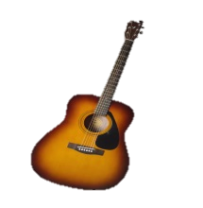
ELECTIVES Grade 9 students can request 3 main electives Descriptions can be found in our course booklet on our website under QuickLinks: Course Planning/Booklet/EpicForms
Languages: Spanish, Japanese, French
Contemporary arts: Dance, Art, Acting and Film, Photo, Ceramics, Guitar
Applied skills: Info Tech; Tech Ed – Wood Design, Drafting & Engineering, Robotics; Foods; Textiles; Business Ed
Fitness & leadership: Fitness Co-Ed, Women’s Fitness (these do not replace PHE 9); Leadership

Slide 9
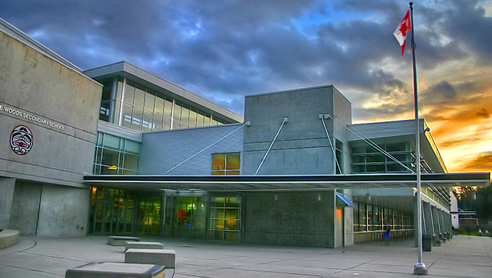
QUESTIONS ABOUT ELECTIVES?
Check out the information/upcoming dates about the VIRTURAL TOUR at the end of this presentation!
Alternate Elective Courses (2 back-up Electives)
May be used if it is not possible to get one of their top three choices
Many reasons a student may not get a course (course conflicts, class sizes, class cancelations, etc)
Therefore, these are JUST AS IMPORTANT.

Slide 10
Additional Courses: Outside Block 2 - 5
Many choices including:
Musical Theatre, Weight Training , Philanthropy, Red Cross, Agility, Band & Choir
These happen at different times of the day outside the regular schedule:
AM (Before School Hours)
FL (Flex & Lunch)
PM (After School Hours)

Slide 11
Sample Timetable
Semester 1:
Block 2 - PHE 9
FLEX
Block 3 - Science 9
Block 4 - English 9
Block 5 - Photo 9
Semester 2:
Block 2 - Math 9
FLEX
Block 3 - Social Studies 9
Block 4 - Foods 9
Block 5 – Tech Ed: Wood Design 9
Linear (year long) - Digital Literacy 10
Linear (year long) - Concert band 9

Slide 12
Looking Ahead: Questions about Grade 10-12 programming?
Check out the Ministry website for graduation program: https://www2.gov.bc.ca/gov/content/education-training/k-12/support/graduation
Grade 10-12 booklet will also be available online next month
Honours Courses:
Students entering the Honours program should expect to be challenged and will need a strong commitment to their studies
Math Accelerated and Honours Programs
English Honours Programs
AP Calculus, AP Psychology
Note: Honours designations do not appear on transcripts

Slide 13
How Do You Decide?
What do you like to do?
What are your skills and talents?
What are you curious about?
What are some things at which you excel?
Challenge yourself to try
something new!

Slide 14
Choose Courses Wisely
We base our staffing AND scheduling on these requests!
Counsellors will connect with feeder middle schools to go over the Grade 9 course selection process. Students will complete request forms and return to them to their middle school teachers.
Remember: descriptions of courses can be found on our website under Quicklinks – Course Planning/Booklet/EpicForms
Remember…these are requests…
WE WILL ALWAYS DO OUR BEST TO HELP STUDENTS GET COURSES THAT THEY WILL ENJOY!
SPRING 2022

Slide 15
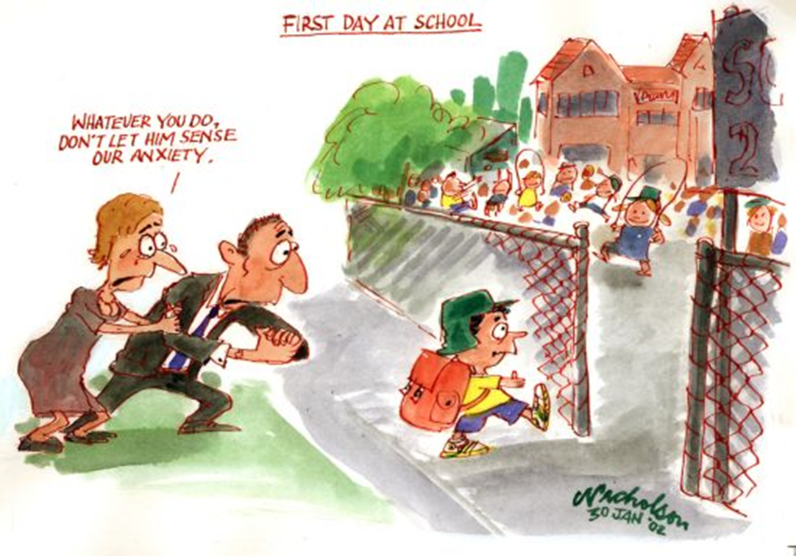

Slide 16
Going to High School… What Should Your Child Expect?
Smaller “team” larger environment
easier to fly (or swim) under radar
New routines, new clubs / activities, lockers
New friends
More freedom = More responsibility
No core teacher - Different teachers for different subjects

Slide 17
Time is the best gift to give your Teen
Discuss:
How to handle peer pressure
Attendance Expectations
Facing each day positively
Homework expectations, organization, study time at home, goal setting (SMART GOALS – specific, measurable, attainable, realistic, time-based)
Praise and reinforcement
Ask questions (of your teen, teachers, counsellors, & administration)
Learn about and use the resources available
Encourage and support them in getting involved!

Slide 18
There are many ways for them to get involved…
Clubs
Leadership Opportunities
Music
Sports Teams
Intramurals
Volunteering

Slide 19
And don’t forget to stay connected…
Telephone
Teacher email
Heritage home page
Teacher websites
Counsellor websites
Newsletters
Report cards
Parent nights
Heritage App

Slide 20
CounsellorsYouth Workers
Career Advisor
We are all KODIAKS!!
Resource
EAs
Teachers
Family and Friends
Community Agencies
Admin and Office Staff
Extra
curricular

Slide 21
How is your child going to make their mark?
Do what you love & love what you do

Slide 22
Descriptions of courses can be found in our course booklet on our website under Quick Links: Course Planning/Booklet/EpicForms
Optional Zoom Meeting (for questions NOT already answered in this PowerPoint or on the Q & A sheet!
Zoom Mtg:
Monday, January 10 (6:30 pm)
Remember:
Pre-Registration will be required! If you would like to receive the ZOOM Link, please email tclerkson@sd43.bc.ca
GRADE 8 TOUR: (Virtual)
January 28: Video Available
Middle school staff will send a link to each student who is scheduled to attend Heritage Woods in September 2022. This video will highlight our elective choices and other opportunities available to students.
This video will also be accessible to the public after January 28 on our website under:
Course Planning/Booklet/EpicForms
Important Dates:

Slide 23
MORE Important Dates:
LANGUAGE PLACEMENT ASSESSMENT
If you want to take a language course, and you have a skill set superior to our introductory level courses (Spanish, French, and Japanese), then you are required to have a Language Level Assessment to determine appropriate placement.
Information regarding assessment process will be made available in April on our website under QUICK LINKS under “Course Planning”!

Slide 24
AND MORE Important Dates:
ACCELERATED MATH 9
Accelerated Math 9 is for strong math students who are academically capable of completing Math 9 and 10 in one semester. Selection for this course is done through an application and assessment. Accelerated Math 9 Applications will be available on our Website January 14th
If you are interested, follow the steps below.
Print off Application from our website http://www.sd43.bc.ca/school/heritagewoods/Pages/default.aspx#/=
Fill in Application
Scan it and email it back to kwatt@sd43.bc.ca by Jan 31st, 2022.
Successful candidates will be notified in early June 2022 by email
Based on Covid Restrictions, the Accelerated Math 9 Assessment will take place at the Middle Schools before Spring Break. Specific Times & Dates are TBD by each individual Middle School! Applications will be available on our website on January 14th and MUST be submitted back to us by email on January 31st.

Slide 25
General Questions? For child specific questions please email your child’s counsellor or admin!
Last Names | Counsellor | Admin
A – G | Shaunna Martin smartin@sd43.bc.ca | Martin Bozic mbozic@sd43.bc.ca
H – N | Karen Leeden/Karen Watt kleeden@sd43.bc.ca kwatt@sd43.bc.ca | Manjit Rai mrai@sd43.bc.ca
O – Z | Curt DeWolff cudewolff@sd43.bc.ca | Mark Rao until Feb 1 mrao@sd43.bc.ca JJ Hyde after Feb 1 jhyde@sd43.bc.ca
Student Services | Pat Vance pvance@sd43.bc.ca
EAL | Angeline Lee alee@sd43.bc.ca

