Slide 1
WELCOME TO THE WOODS!!
Heritage Woods Course Request Information 2024-2025

Slide 2
Counselling (by student’s last name)
THE HERITAGE WOODS TEAM:
Principal
Cheryl Woods
Vice Principals (by student’s last name)
JJ Hyde (A - G)
Renee Mazzucco (H - N)
Shelly McClenahan (O - Z)
Karen Watt (A - G)
Alina Birsan (H - N)
Giovanni Zenone (O – Z)
Indigenous Youth Worker
Erika
Student Services
Youth Worker
Sherri Hughes
Derek Pengelly
Abhinesh Naidu
English Language Learner
Career & Post Secondary Advisor
Angeline Lee
Darilynn Butler

Slide 3
How Things Work:
Two semesters
Semester 1: Sept-Jan
Semester 2: Feb-June
Students take 8 courses plus digital literacy over 2 semesters
Classes are 72 minutes long
Flex Blocks: Mon-Fri, 30 mins of tutorial time with a teacher
Students may also take ADDITIONAL COURSES from the Music, Theatre, Physical Education and ELL departments, which meet outside a student’s primary timetable.

Slide 4
Bell Schedule…
Sign up for FLEX!!!
MONDAY | TUESDAY | WEDNESDAY | THURSDAY | FRIDAY
Block 1 8:00-9:12​ | Block 1 8:00-9:12 | Block 1 8:00-9:12 | Block 1 8:00-9:12 | Block 1 8:00-9:12
Block 2 9:16-10:28 | Block 2 9:16-10:28 | Block 2 9:16-10:28 | Block 2 9:16-10:28 | Block 2 9:16-10:28
FLEX 10:29-10:57 | FLEX 10:29-10:57 | FLEX 10:29-10:57 | FLEX 10:29-10:57 | FLEX 10:29-10:57
Block 3 11:01-12:13 | Block 3 11:01-12:13 | Block 3 11:01-12:13 | Block 3 11:01-12:13 | Block 3 11:01-12:13
LUNCH 12:13-12:53 | LUNCH 12:13-12:53 | LUNCH 12:13-12:53 | LUNCH 12:13-12:53 | LUNCH 12:13-12:53
Block 4 12:57-2:09 | Block 4 12:57-2:09 | Block 4 12:57-2:09 | Block 4 12:57-2:09 | Block 4 12:57-2:09
Block 5 2:13-3:25 | Block 5 2:13-3:25 | Block 5 2:13-3:25 | Block 5 2:13-3:25 | Block 5 2:13-3:25
1st MONDAY OF MONTH No Scheduled Flex
Block 1 8:00-9:12​
Block 2 9:16-10:28
Block 3 10:32 – 11:44
LUNCH 12:44-12:28
Block 4 12:32-1:44
Block 5 1:48-3:00

Slide 5
Primary Courses:
English 9 / or recommended EAL from middle school
Mathematics 9 (Regular or Accelerated)
Social Studies 9 / or recommended EAL from middle school
Physical & Health Education 9
Science 9
Applications of Digital Literacy 10
*MATH ACCELERATED:
April write for students who were absent or are new to district or Cross Catchment

Slide 6
What is Applications of Digital Learning 10?
District course in conjunction with Coquitlam Open Learning
4 Graduation credits upon completion
Concepts of DL:
Students explore multiple platforms that will be used over the next 4 years
Digital Referencing and MLA Citations of different media
Exploring Digital Citizenship
Exploring Office365 Tools
Reflecting on Core Competencies
Researching Educational Tools
And more!
Students begin to create Showcase Portfolios of their work here at Heritage Woods, using the platform EDUBLOG. This blog follows them throughout their high school career and can be a valuable reflective tool.

Slide 7
What devices will students be using?
We area BYOD school – laptops are recommended as they will be used in other courses as well
Students may wish to have a device that can be used in other courses
Don’t pay for Microsoft Programs if buying a laptop – free to SD43 Students (PC and Mac)
Questions about Digital Literacy 10?
Contact one of the teachers:
Dept Head: Ms. Elizabeth Kim (ekim@sd43.bc.ca)
Mr. Don Blake (dblake@sd43.bc.ca)
Mr. Luke Modder (lmodder@sd43.bc.ca)

Slide 8
ELECTIVES Grade 9 students can request 3 primary electives
Languages: Spanish, Japanese, French
Arts: Dance, Art, Film & Media, Acting & Film; Photo, Ceramics, Guitar
Applied skills: Info Tech; Woodwork; General Explorations; Design, Drafting & Engineering, Electronics and Robotics; Foods; Textiles; Business Ed
Fitness & leadership: Fitness Co-Ed, Fitness Girls (these do not replace PHE 9); Leadership

Slide 9
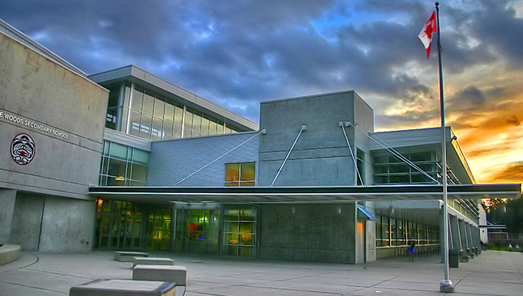
QUESTIONS ABOUT ELECTIVES?
Check out the online course description booklet on the course programming page:
Course Programming
Alternate Elective Course
May be used if it is not possible to get one of their top three choices
Many reasons a student may not get a course (course conflicts, class sizes, class cancelations, etc.)
Putting time into choosing alternate is just as important

Slide 10
A note about Languages…
Did you know?
Language is NOT required for graduation
Most post-secondary institutions do not require a language
If you later decide you need a language 11, but did not take a language 9 or 10, you can take the accelerated “Intro11” (9/10)
***STUDENTS AND FAMILIES NEED TO CHECK INDIVIDUAL POST-SECONDARY WEBSITES***
LANGUAGE PLACEMENT ASSESSMENT
You have a skill set superior to our introductory level language courses (Spanish, French,and Japanese)
Take a Language Level Assessment – contact the appropriate teacher – form on website under course programming

Slide 11
Additional Courses: Outside of Blocks 2 - 5
Many choices including:
Musical Theatre, Theatre Tech, Agility, Basketball Athletic Training, Concert Choir, Vocal Jazz, Beginner Band, Concert Band, Jazz Band, String Orchestra
These happen at different times of the day outside the regular schedule:
During Period 1 @ 8:00
Flex
Lunch
After School Hours

Slide 12
And now a word from our music department…
Kathy Fester
Music Info Night:
Immediately following this presentation
HWSS Theatre
RSVP kfester@sd43.bc.ca

Slide 13
Sample Timetable
Semester 1:
Block 2 - PHE 9
FLEX
Block 3 - Science 9
Block 4 - English 9
Block 5 - Photo 9
Semester 2:
Block 2 - Math 9
FLEX
Block 3 - Social Studies 9
Block 4 - Foods 9
Block 5 –Woodwork 9
Linear (year long) - Digital Literacy 10
Linear (year long) - Concert band 9

Slide 14
Looking Ahead: Questions about programming?
Check out the Ministry website for graduation program: https://www2.gov.bc.ca/gov/content/education-training/k-12/support/graduation
Honours Courses:
Students should expect to be challenged and will need a strong commitment to their studies
Math Accelerated and Honours Programs
English Honours Programs
AP Calculus, AP Psychology
Note: Honours designations do not appear on transcripts

Slide 15
Other ways to earn credits
Online courses
External credits (sports, dance, first aid, work safe)
Concurrent courses at Post Secondary (Emily Carr, Douglas, SFU)
Language Challenge Exam
Train in Trades, Work Experience, Apprenticeship
Check out the Ministry Website on External Credit for more information:
Approved External Credit

Slide 16
Post Secondary and Career Advisor:
Ms. Darilynn Butler: dbutler@sd43.bc.ca
Apprenticeship opportunities
Volunteering
Work experience
Finances
Awards, bursaries, scholarships
College, university, institutes

Slide 17
Planning your courses
What do you like to do?
What are your skills and talents?
What are you curious about?
What are some things at which you excel?
Challenging yourself to try
something new!
READ THE COURSE BOOKLET!
Course Programming

Slide 18
Choose Courses Wisely
Your choices NOW determine the school timetable
Many reasons for not getting all requests (conflict, courses cancelled, courses are full…)
Not able to make changes based on:
Friends
Teacher preference
Semester
Time of Day
WE WILL ALWAYS DO OUR BEST TO HELP STUDENTS GET COURSES THAT THEY WILL ENJOY!

Slide 19
“The only way to do great work is to love what you do. If you haven't found it yet, keep looking. Don't settle.”
Once you know what courses you want, it is time to fill out your planning sheet.

Slide 20
ONLINE COURSE REQUEST PROCESS
The following slides are meant to guide you through the process
Counsellors will be going into the main feeder schools reviewing process
If you are from an out of catchment school, you will be able to input your requests once cross-catchment acceptance has been granted
If you are out of district, fill out a hard copy of the form and hand it in to the office with your registration documents

Slide 21
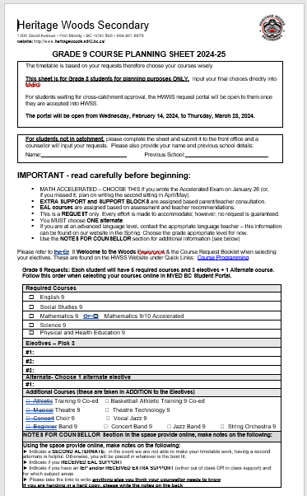
For your PLANNING only
If you are in catchment or will be accepted cross-catchment, you will be inputting your own requests through the portal once you are accepted
If you are out of district, hand in a filled out hard copy to the office

Slide 22
Now students are ready to enter the information into the portal
You can go in and out of the portal and make changes any number of times until the portal closes on March 30th, 2025

Slide 23
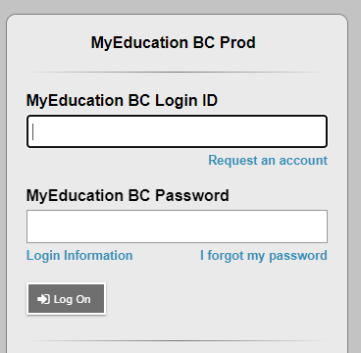
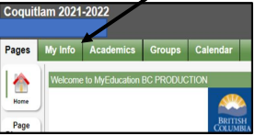
STEP 1: Login to the MyEd Portal
Go to MYED BC and login with your 7 Digit Student Number (not an email address or PEN number)
STEP 2: My Info
Click on “MY INFO” in the top left corner.

Slide 24
STEP 3: Click on REQUESTS
Click on “REQUESTS” at the bottom of the left sidebar.

Slide 25
NOTE:
As a parent/caregiver you can REVIEW the course requests through the parent portal, but cannot make changes through there
There are detailed instructions on how to view the requests on the parent portal under “Support Documents” on the HWSS course programming webpage: Course Programming - Heritage Woods Secondary School (sd43.bc.ca)

Slide 26
STEP 4: RE-READ all the instructions
Instructions mirror what is on the planning sheet

Slide 27
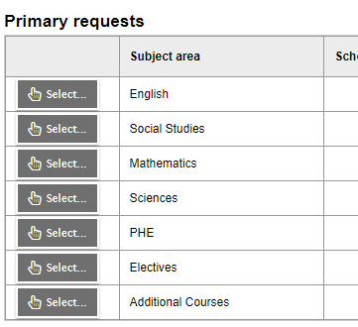
STEP 5: Enter Your REQUESTS
These Core Classes will be pre-selected
Click on select and enter the correct number of electives (3 for grade 9)
Click on if you would like to request any of the additional courses (band, choir, athletics)

Slide 28
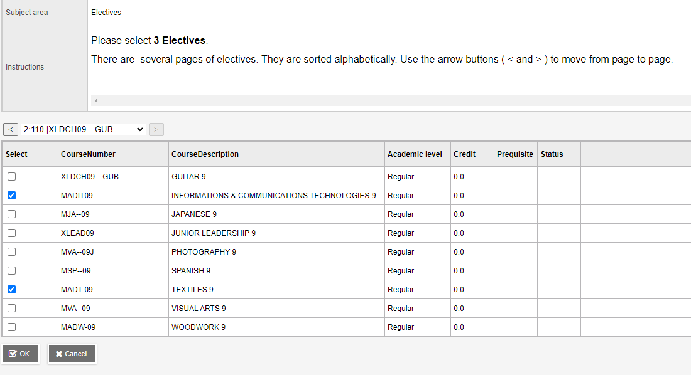
Step 6: Electives When entering electives…
When entering electives use the < > arrows to scroll through to each page of electives
Choose all three at the same time…no need to go in and out
Electives are in subject groupings!
Click okay

Slide 29
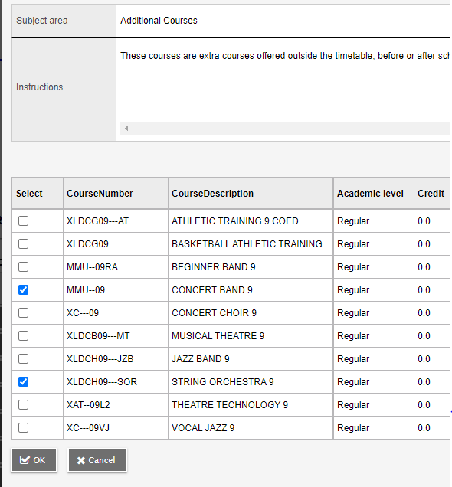
Step 7: Additional Courses
Follow the same format for choosing Additional Courses
Students may take ADDITIONAL COURSES from the Music, Theatre, Physical Education and ELL departments, which meet outside a student’s primary timetable. See course descriptions under the appropriate department for more information

Slide 30
STEP 8: Enter TWO alternates
STEP 9: Notes for Counsellor
Notes For Counsellor:
ELL? Student support?
Use the bullet points from earlier in the power point or the planning sheet to guide you in writing any additional information

Slide 31
A note about student support blocks and ELL courses
Middle school and high schools start the transition process in late April
Counsellors, teachers, support staff all meet to review students
Your case manager or ELL teacher will ensure that the most accurate information is passed along
ELL students will be assessed later in May and placed in the appropriate courses
By the end of June, case managers from the high school will be assigned
Case manager will reach out to connect

Slide 33
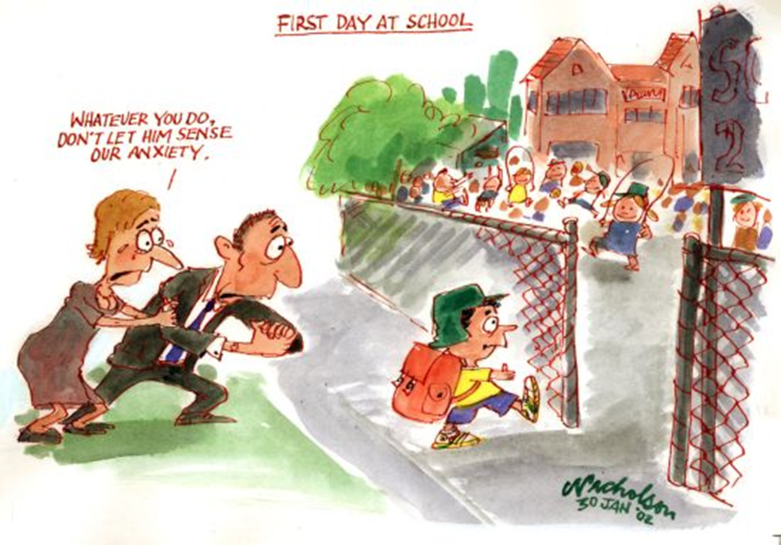

Slide 34
Going to High School… What Should Your Child Expect?
Smaller “team” larger environment
easier to fly (or swim) under radar
New routines, new clubs / activities, lockers
New friends
More freedom = More responsibility
Different teachers for different subjects

Slide 35
How to prepare with your child
Discuss:
Peer pressure
Attendance expectations
Facing each day positively
Homework expectations, organization, study time at home, goal setting
Praise and reinforcement
Ask questions (of your teen, teachers, counsellors, & administration)
Learn about and use the resources available
Encourage and support them in getting involved!

Slide 36
There are many ways to get involved…
Clubs
Leadership Opportunities
Music
Sports Teams
Intramurals
Volunteering

Slide 37
Stay Connected…
Telephone
Teacher email
Heritage home page
Teacher websites
Counsellor websites
Newsletters, school emails
Report cards
Parent nights
Heritage App

Slide 38
Counsellors
Youth Workers
Office staff
Resource
EA’s
Teachers
Family and Friends
Community Agencies
Admin
Clubs and Teams

Slide 39
Important Dates:
Planning sheets and course description booklet available online tomorrow
If you are in catchment or will be accepted through cross-catchment: DO NOT HAND PLANNING SHEETS IN

Slide 40
Bring your completed planning sheets to the counsellor visits
@ Eagle Mountain PM
February 14th
@ Scott Creek
@ Summit
March 12th
@ Moody
tba
Students will have the opportunity to go into the portal at home and make changes until the portal closes.
Students not at these schools but IN HWSS catchment – please refer to the slides and enter your information in the portal. Contact your home school counsellor if necessary.
Students not in catchment will need to wait until the cross-catchment approval date and then will be able to access the HWSS request portal.
Students out of district, hand in a hard copy
Portal Closes Thursday March 28

Slide 41
General Questions? For child specific questions please email your child’s counsellor or admin!
Last Names | Counsellor | Admin
A – G | Karen Watt kwatt@sd43.bc.ca | J.J. Hyde jhyde@sd43.bc.ca
H – N | Alina Birsan abirsan@sd43.bc.ca | Renee Mazzucco rmazzucco@sd43.bc.ca
O – Z | Giovanni Zenone gzenone@sd43.bc.ca | Shelley McClenahan smclenahan@sd43.bc.ca
Student Services | Sherri Hughes Derek Pengelly shughes@sd43.bc.ca dpengelly@sd43.bc.ca
EAL | Angeline Lee alee@sd43.bc.ca

