Slide 1



WELCOME TO THE WOODS!!
Heritage Woods
Course Request
Information
2026-2027

Slide 2
Counselling
(by student’s last name)
THE HERITAGE WOODS TEAM:
Principal
Cheryl Woods
Vice Principals
(by student’s last name)
JJ Hyde (A - G)
Renee Mazzucco (H - N)
Joe Dardano (O - Z)
Karen Watt (A - G)
Alina Birsan (H - N)
Giovanni Zenone (O – Z)
Indigenous Youth Worker
Erika
Student Services
Youth Worker
Derek Pengelly
Abhinesh Naidu
English Language Learner
Career & Post Secondary Advisor
Angeline Lee
Darilynn Butler

Slide 3

How Things Work:
Two semesters
  Semester 1: Sept-Jan
  Semester 2: Feb-June
Students take 8 courses plus digital literacy over 2 semesters
Classes are 72 minutes long
Flex Blocks: Mon-Fri, 30 mins of tutorial time with a teacher
There is a FLEX PLANNER APP
Students may also take ADDITIONAL COURSES from the Music, Theatre, Agility, and ELL departments, which meet outside a student’s primary timetable.

Slide 4

Bell Schedule…
Sign up for FLEX!!!
MONDAY | TUESDAY | WEDNESDAY | THURSDAY | FRIDAY
Block 1 8:00-9:12​ | Block 1 8:00-9:12 | Block 1 8:00-9:12 | Block 1 8:00-9:12 | Block 1 8:00-9:12
Block 2 9:16-10:28 | Block 2 9:16-10:28 | Block 2 9:16-10:28 | Block 2 9:16-10:28 | Block 2 9:16-10:28
FLEX 10:29-10:57 | FLEX 10:29-10:57 | FLEX 10:29-10:57 | FLEX 10:29-10:57 | FLEX 10:29-10:57
Block 3 11:01-12:13 | Block 3 11:01-12:13 | Block 3 11:01-12:13 | Block 3 11:01-12:13 | Block 3 11:01-12:13
LUNCH 12:13-12:53 | LUNCH 12:13-12:53 | LUNCH 12:13-12:53 | LUNCH 12:13-12:53 | LUNCH 12:13-12:53
Block 4 12:57-2:09 | Block 4 12:57-2:09 | Block 4 12:57-2:09 | Block 4 12:57-2:09 | Block 4 12:57-2:09
Block 5 2:13-3:25 | Block 5 2:13-3:25 | Block 5 2:13-3:25 | Block 5 2:13-3:25 | Block 5 2:13-3:25
1st MONDAY OF MONTH No Scheduled Flex
Block 1 8:00-9:12​
Block 2 9:16-10:28
Block 3 10:32 – 11:44
LUNCH 12:44-12:28
Block 4 12:32-1:44
Block 5 1:48-3:00

Slide 5

Primary Courses:
  English 9
  Mathematics 9 (Regular or Accelerated)
  Social Studies 9
  Physical & Health Education 9
  Science 9
  Applications of Digital Literacy 10
*MATH ACCELERATED:
April write for students who were absent or are new to district or Cross Catchment

Slide 6

What is Applications of Digital Learning 10?
District course in conjunction with Coquitlam Open Learning
4 Graduation credits upon completion
Concepts of DL:
  Students explore multiple platforms that will be used over the next 4 years
    Digital Referencing and MLA Citations of different media
    Exploring Digital Citizenship
    Exploring Office365 Tools
    Reflecting on Core Competencies
    Researching Educational Tools
    And more!
Students begin to create Showcase Portfolios of their work here at Heritage Woods, using the platform EDUBLOG. This blog follows them throughout their high school career and can be a valuable reflective tool.

Slide 7

What devices will students be using?
We area BYOD school
Don’t pay for Microsoft Programs if buying a laptop – free to SD43 Students (PC and Mac)
Questions about Digital Literacy 10?
Contact one of the teachers:
Dept Head: Ms. Elizabeth Kim (ekim@sd43.bc.ca)
Mr. Don Blake (dblake@sd43.bc.ca)
Mr. Luke Modder (lmodder@sd43.bc.ca)

Slide 8

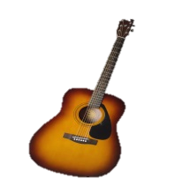


ELECTIVES
Grade 9 students can request 3 primary electives
Languages: Spanish, Japanese, French
Arts: Dance, Art, Film & Media, Acting & Film; Photo, Ceramics, Guitar
Applied skills: Info Tech; Woodwork; General Explorations; Design, Drafting & Engineering, Electronics and Robotics; Foods; Textiles; Business ED
Fitness & leadership: Fitness Co-Ed, Fitness Girls (these do not replace PHE 9); Leadership

Slide 9
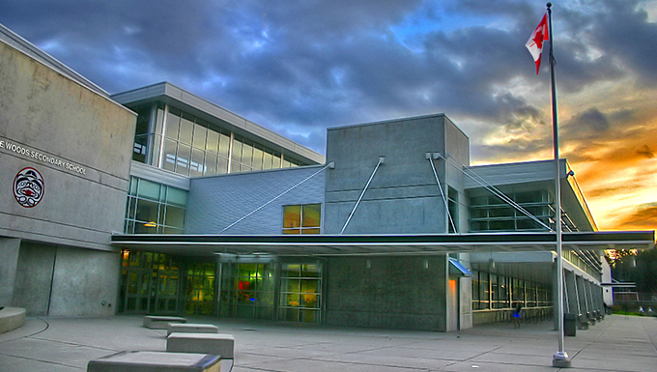

QUESTIONS ABOUT ELECTIVES?
Check out the online course description booklet on the course programming page:
Course Programming
Alternate Elective Course
May be used if it is not possible to get one of their top three choices
Many reasons a student may not get a course (course conflicts, class sizes, class cancelations, etc.)
Putting time into choosing alternate is just as important

Slide 10

A note about Languages…
Did you know?
  Language is NOT required for graduation
  Most post-secondary institutions do not require a language
  If you later decide you need a language 11, but did not take a language 9 or 10, you can take the accelerated “Intro11” (9/10)
***STUDENTS AND FAMILIES NEED TO CHECK INDIVIDUAL POST-SECONDARY WEBSITES***
LANGUAGE PLACEMENT ASSESSMENT
You have a skill set superior to our introductory level language courses (Spanish, French,and Japanese)
Take a Language Level Assessment – contact the appropriate teacher – form on website under course programming

Slide 11




Additional Courses: Outside of Blocks 2 - 5
Many choices including:
Musical Theatre, Theatre Tech, Agility, Basketball Athletic Training, Concert Choir, Vocal Jazz, Beginner Band, Concert Band, Jazz Band, String Orchestra
These happen at different times of the day outside the regular schedule:
During Period 1 @ 8:00
Flex
Lunch
After School Hours

Slide 12



Music Deparment
Kathy Fester
Music Info Night Tonight @ 7:15
In the theatre
HWSS Theatre
RSVP kfester@sd43.bc.ca

Slide 13

Sample Timetable
Semester 1:
Block 2 - PHE 9
FLEX
Block 3 - Science 9
Block 4 - English 9
Block 5 - Photo 9
Semester 2:
Block 2 - Math 9
FLEX
Block 3 - Social Studies 9
Block 4 - Foods 9
Block 5 –Woodwork 9
Linear (year long) - Digital Literacy 10
Linear (year long) - Concert band 9

Slide 14


Post Secondary and Career Advisor:
Ms. Darilynn Butler: dbutler@sd43.bc.ca
Apprenticeship opportunities
Volunteering
Work experience
Finances
Awards, bursaries, scholarships
College, university, institutes

Slide 15

Planning your courses
What do you like to do?
What are your skills and talents?
What are you curious about?
What are some things at which you excel?
Challenging yourself to try
something new!
  READ THE COURSE BOOKLET!
  Course Programming

Slide 16

Choose Courses Wisely
Your choices NOW determine the school timetable
Many reasons for not getting all requests (conflict, courses cancelled, courses are full…)
Not able to make changes based on:
    Friends
    Teacher preference
    Semester
    Time of Day
WE WILL ALWAYS DO OUR BEST TO HELP STUDENTS GET COURSES THAT THEY WILL ENJOY!

Slide 17

COURSE REQUEST PROCESS
All Course Requests are done online via MyEducation BC
Counsellors will visit Feeder Schools to support course selection
Students coming from out of district/private school can contact the school and submit a paper course selection form

Slide 18

Course Selection is done on
“The Portal”
You can go in and out of the portal and make changes any number of times until the portal closes on March 27th^{th}, 2025
COURSES ARE NOT FIRST COME FIRST SERVED!!!!

Slide 19
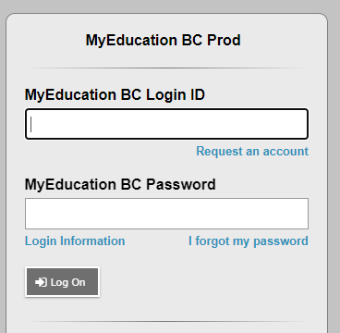
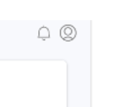
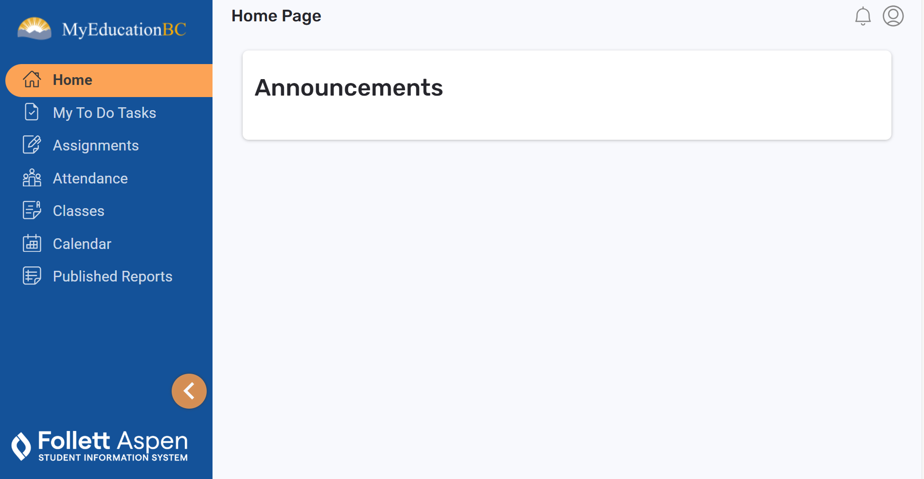
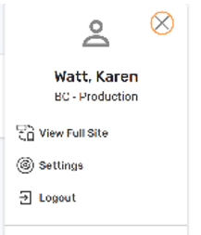
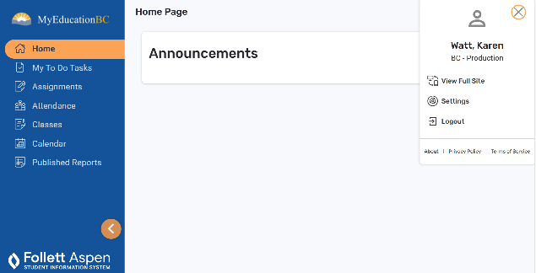
STEP 1: Login to YOUR MyEd Portal
Go to MYED BC and Login
Click on the Person Icon !!!
Click on
“Visit Full Site”

Slide 20
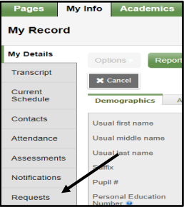
STEP 2: “My INFO” then “REQUESTS”
Click My Info at the top
Click on “REQUESTS” at the bottom of the left sidebar.

Slide 21

STEP 4: RE-READ all the instructions
Instructions mirror what is on the planning sheet

Slide 22
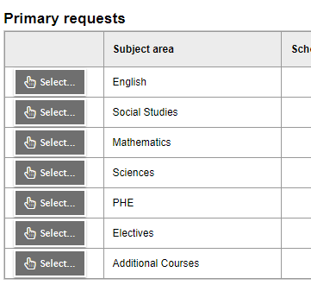
STEP 5: Enter Your REQUESTS
These Core Classes will be PRE -SELECTED
Click on select and enter the correct number of electives (3 for grade 9)
Click on if you would like to request any of the additional courses (band, choir, athletics)

Slide 23
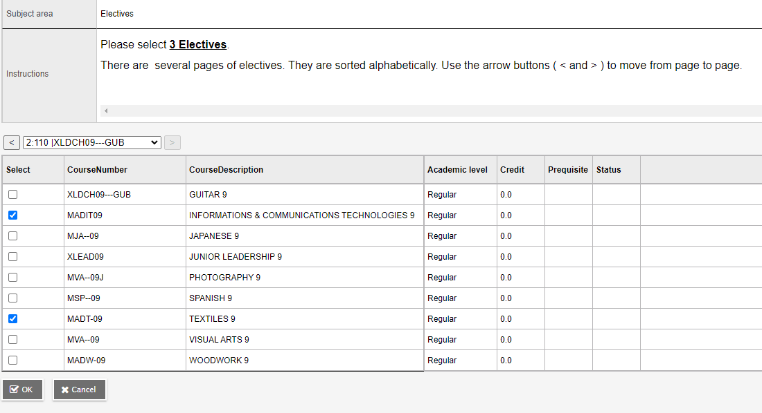
Step 6: Electives
When entering electives…
When entering electives use the < > arrows to scroll through to each page of electives
Choose all three at the same time…no need to go in and out
Electives are in subject groupings!
Click okay

Slide 24
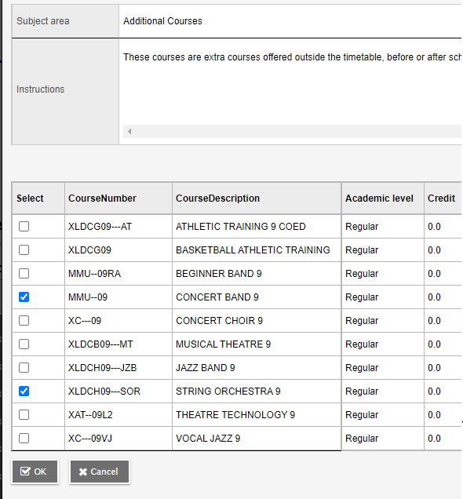
Step 7: Additional Courses
Follow the same format for choosing Additional Courses
Students may take ADDITIONAL COURSES from the Music, Theatre, Physical Education and ELL departments, which meet outside a student’s primary timetable. See course descriptions under the appropriate department for more information

Slide 25
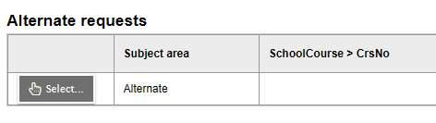
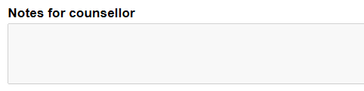
STEP 8: Enter TWO alternates
STEP 9: Notes for Counsellor
Notes For Counsellor:
ELL?
Student support?
Use the bullet points from earlier in the power point or the planning sheet to guide you in writing any additional information

Slide 26
NOTE:
As a parent/caregiver you can REVIEW the course requests through the parent portal, but cannot make changes through there
There are detailed instructions on how to view the requests on the parent portal under “Support Documents” on the HWSS course programming webpage: Course Programming - Heritage Woods Secondary School (sd43.bc.ca)

Slide 27

A note about student support blocks and ELL courses
Middle school and high schools start the transition process in late April
Counsellors, teachers, support staff all meet to review students
Your case manager or ELL teacher will ensure that the most accurate information is passed along
ELL students will be assessed later in May and placed in the appropriate courses
By the end of June, case managers from the high school will be assigned
Case manager will reach out to connect

Slide 28

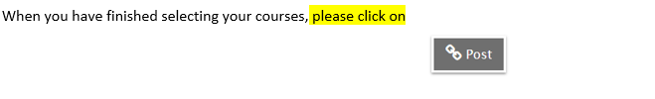

Slide 29





There are many ways to get involved…
Clubs
Leadership Opportunities
Music
Sports Teams
Intramurals
Volunteering

Slide 30

Counsellors
Youth Workers
Office staff
Resource
EA’s
Teachers
Family and Friends
Community Agencies
Admin
Clubs and Teams

Slide 31

General Questions?
For child specific questions please email your child’s counsellor or admin!
Last Names | Counsellor | Admin
A – G | Karen Watt kwatt@sd43.bc.ca | J.J. Hyde jhyde@sd43.bc.ca
H – N | Alina Birsan abirsan@sd43.bc.ca | Renee Mazzucco rmazzucco@sd43.bc.ca
O – Z | Giovanni Zenone gzenone@sd43.bc.ca | Joe Dardano jdardano@sd43.bc.ca
Student Services | Derek Pengelly dpengelly@sd43.bc.ca
EAL | Angeline Lee alee@sd43.bc.ca

Slide 32
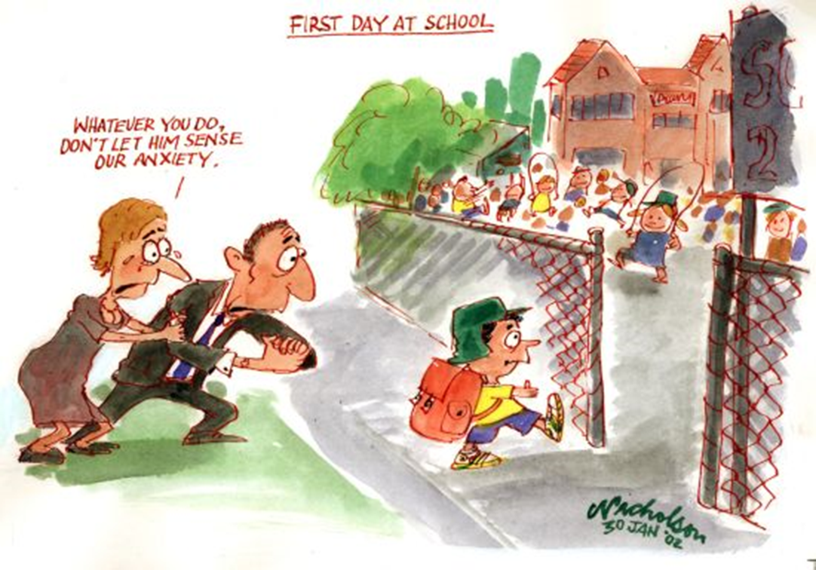
Remember…..Your kids will be Ok !!!!

