Slide 1


Heritage Woods
Course Request
Information
2023-2024

Slide 2

Grad Program Requirements
Grade 10
Required
Language Arts (English) 10
Math 10
PHE 10
Career Life Education 10
Science 10
Social Studies 10
Grade 11
Required
Language Arts (English) 11
Math 11
Science 11 or 12
Social Studies 11 or 12
Grade 12
Required
Language Arts (English) 12
Career Life Connections
Graduation Requirements BC

Slide 3


One Applied Design, Skills and Technologies OR Arts Education
16 credits at the Grade 12 level (includes English and CLC)
28 credits must be elective course credits
4 credits must have an Indigenous-focus (see Indigenous-Focused Graduation Requirements - Province of British Columbia (gov.bc.ca) for additional information)
+ Literacy and Numeracy Ministry assessments

Slide 4

Language Arts
ENGLISH 10:
All students CHOOSE ONE (for 2 credits):
  Literary Studies 10
  New Media 10
  Spoken Language 10
All students enrolled in Composition 10 (2 credits)
ENGLISH 11 (choose at least one)**
English First Peoples – Literary Studies and New Media 11
English First Peoples – Literary Studies and Spoken Language 11
English First Peoples – Literary Studies and Writing 11
** this covers the Indigenous Graduation Requirement; if you take a different Language Arts 11, you responsible for making sure you complete this requirement another way
ENGLISH 12:
English Studies 12 or English Studies 12 Honours
For English Language Learners: the ELL team will assess students for placement in appropriate ELL courses

Slide 5


Mathematics
Suggested Pathways
Math 9
Workplace Mathematics 10
Foundations of Mathematics and
Pre-Calculus 10
Pre-calculus 11 or Precal Honours 11*
Workplace Mathematics 11
Foundations of Mathematics 11
Intended for study in majority of trades and workforces
Foundations of Mathematics 12
Geometry 12
Pre-calculus 12
Intended for study in programs not requiring theoretical calculus
Calculus 12
Calculus 12 AP
Discuss your math options with you math teacher!!!
Intended for study in programs requiring theoretical calculus

Slide 6




Social Studies
Social Studies 10
BC First Peoples 12
Comparative Cultures 12
Human Geography 12
Physical Geography 12
20th Century World History 12
Political Studies 12
Law Studies 12
Philosophy 12
Social Justice 12

Slide 7



Science
Science 10
Life Sciences 11
Anatomy and Physiology 12
Chemistry 11
Chemistry 12
Earth Science 11
Physics 11
Physics 12
Science for Citizens 11
Geology 12
Environmental Science 12
*Note: If you are planning on going into the Sciences in post secondary, make sure you carefully check the requirements of the specific programs at each institution

Slide 8
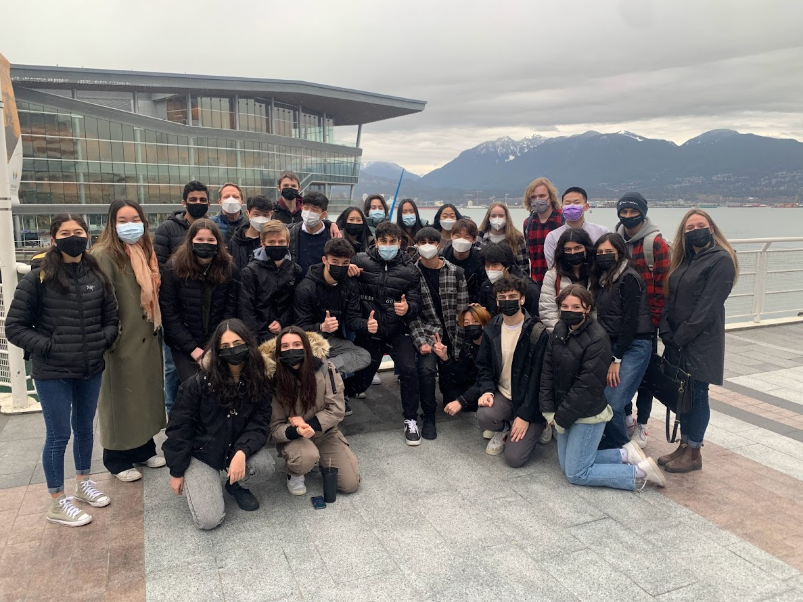




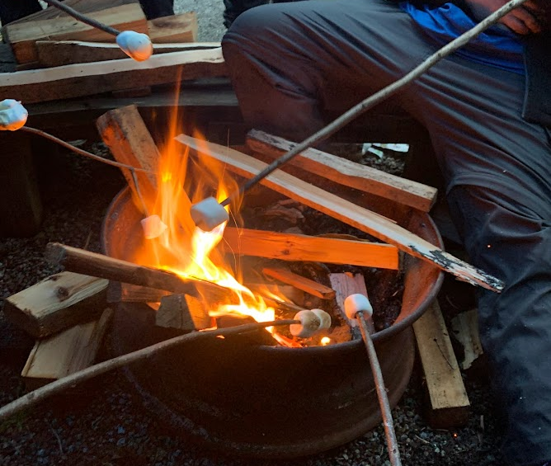

Science Co-op 11
Science Co-op 11 is a Semester 2 Cohort
Chemistry 11
Life Science 11 (Biology)
Work Experience 12
Outdoor PE 11
Leadership 11/12 *new*
Learn more about this exciting opportunity, tailored for grade 11 students who are passionate about Science, the outdoors, and networking.

Slide 9

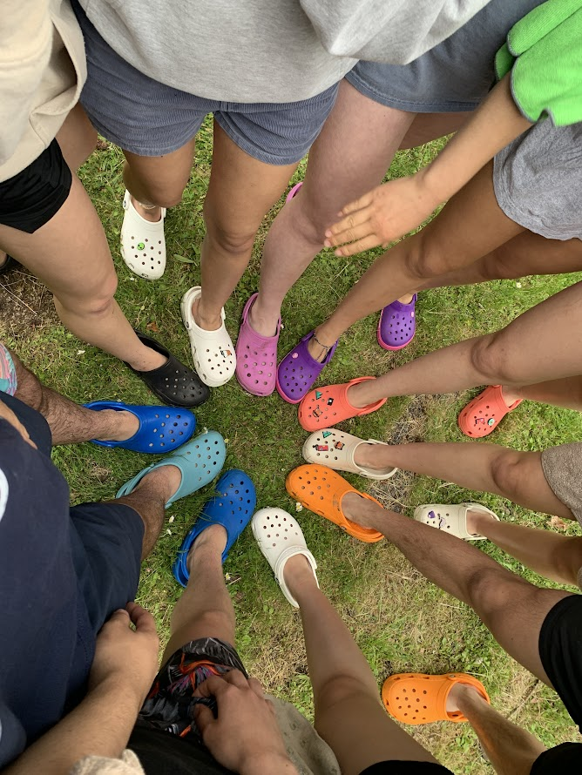
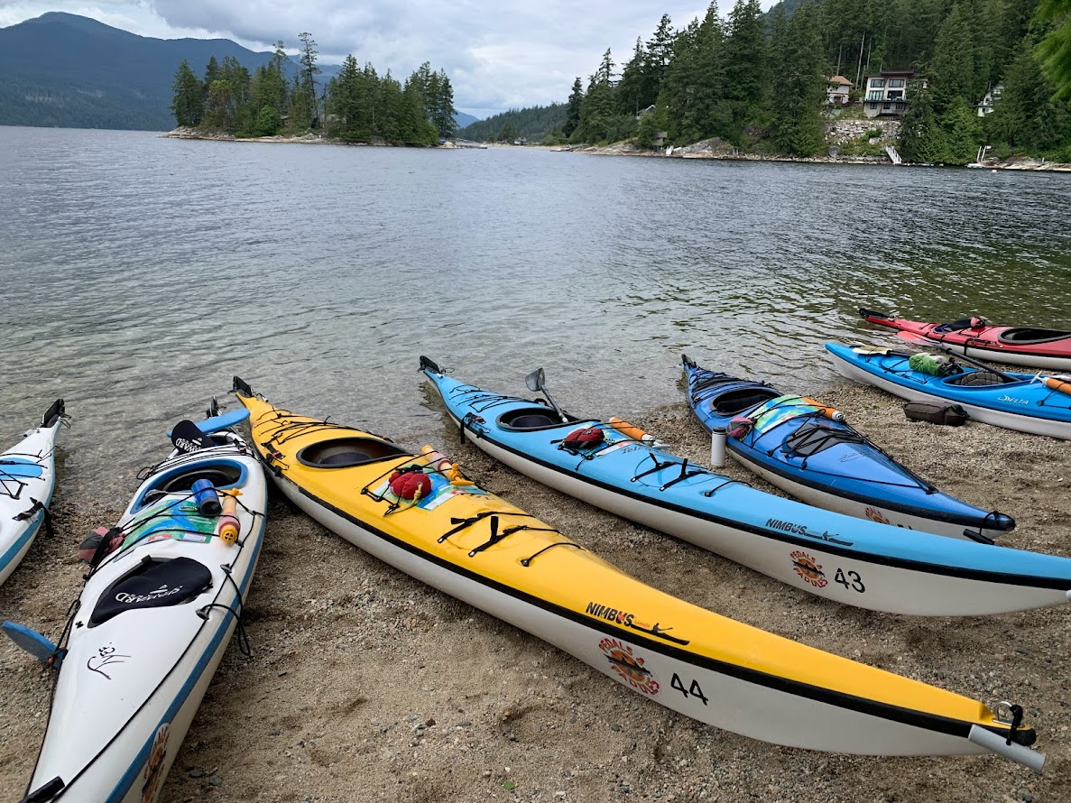
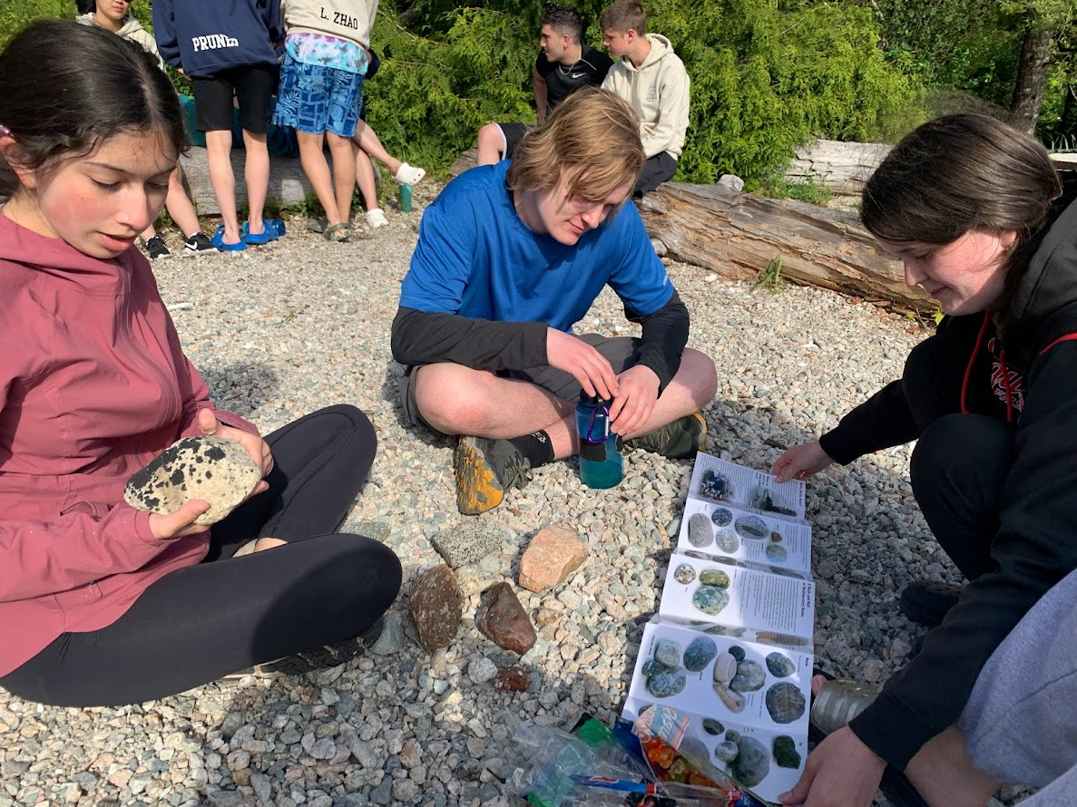
Science Co-op Info Session
Teacher Sponsors
Brooke Wilson
bwilson@sd43.bc.ca
Mike Baldus
mbaldus@sd43.bc.ca
There will be a student AND parent presentation to learn more about this exciting opportunity (dates to come!)
This program is only available to grade 11 students (current grade 10’s).
Students will be exposed to many exciting opportunities, including university lab work, 3 week work experience in field of choice, camping, canoeing/kayaking, community aid, and more!

Slide 10
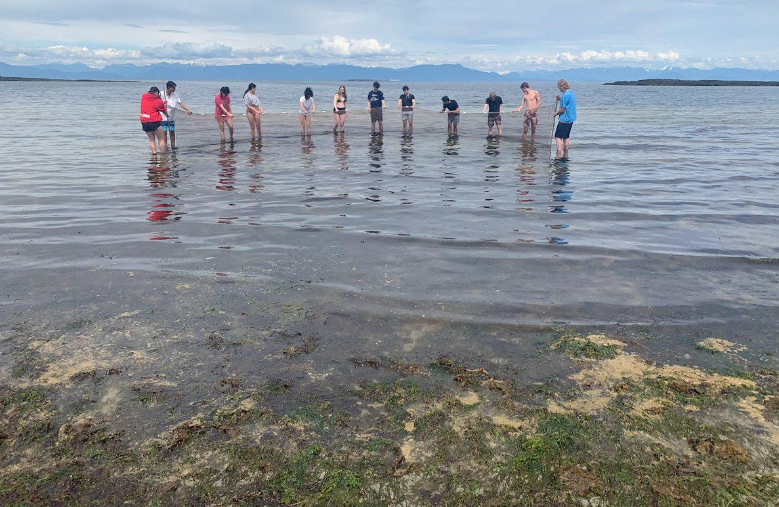
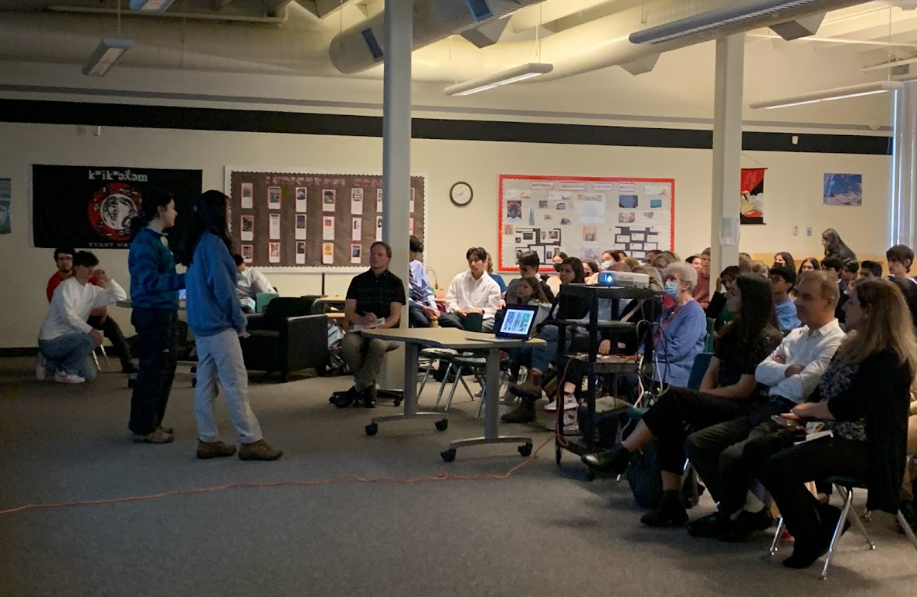
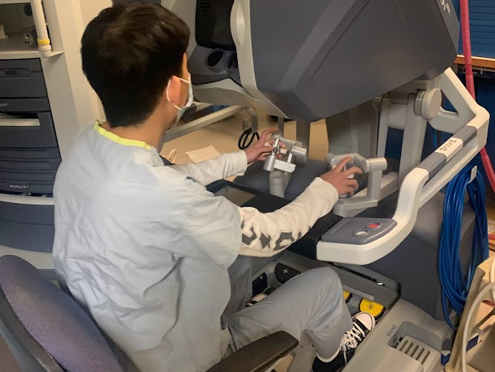
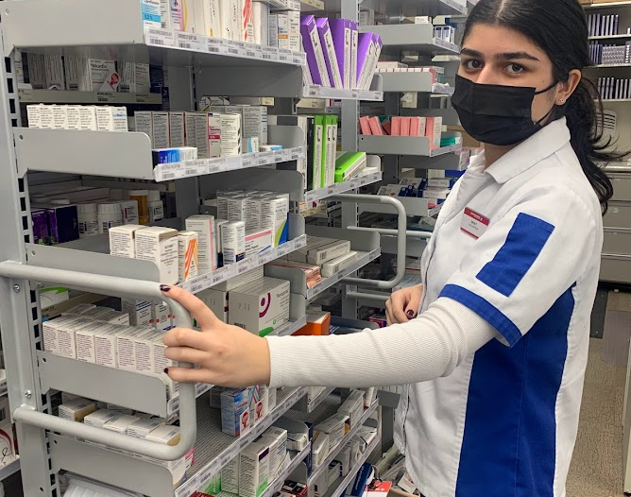
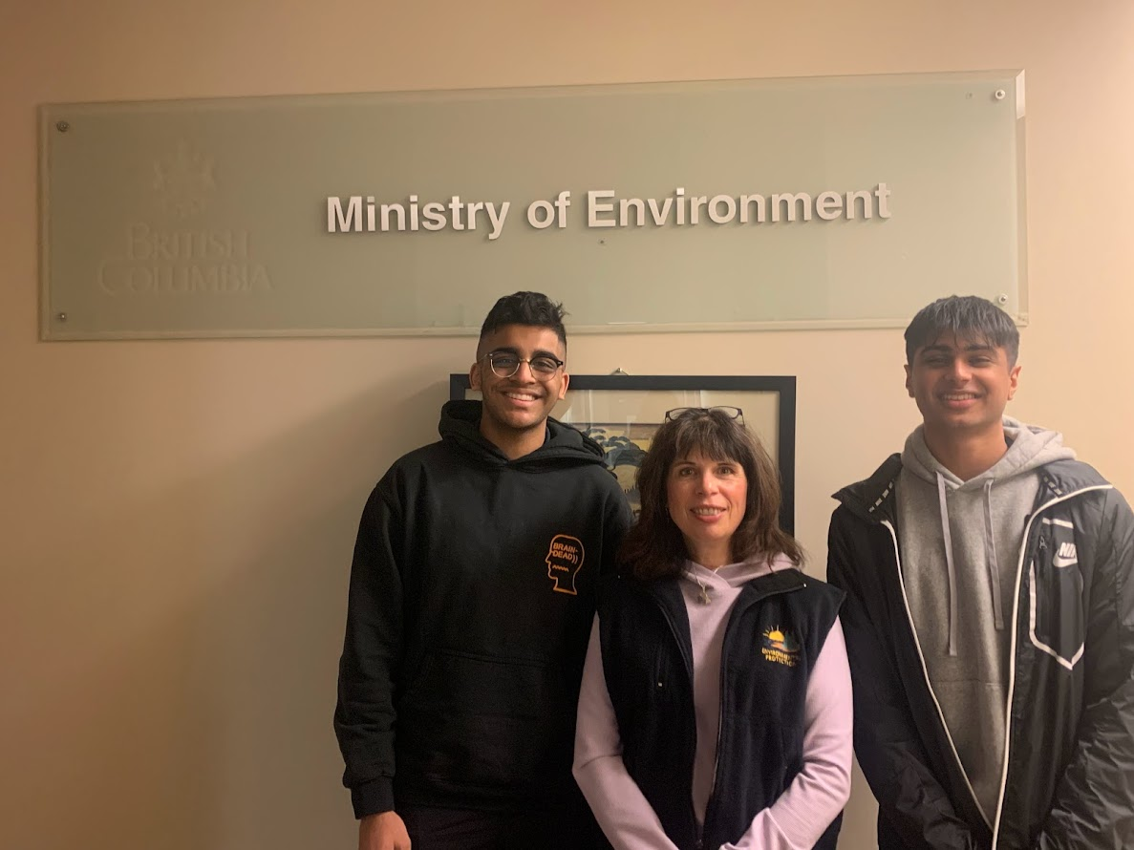

Slide 11

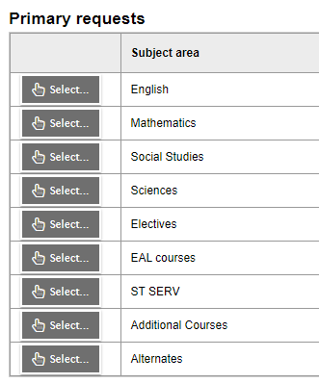
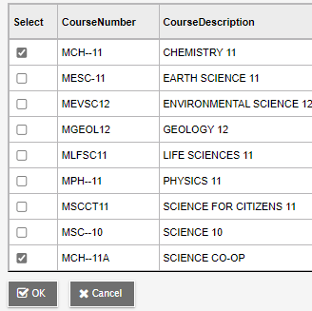
Important:
Fill out your requests as if you are NOT in co-op!
Under the Sciences tab
Choose your first choice science, but ALSO choose “Science Co-op” to indicate you wish to apply

Slide 12





Electives
Fine & Performing Arts
Home Economics
Music
Languages and English Language Arts
Technology Education
Information Technology
Fitness, Leadership,
Peer Tutoring* *(by application)
Business Education
Sciences & Math
Film & Multimedia
Youth Train in Trades, Work Experience
Social Sciences
Course Programming Webpage

Slide 13
A note about Languages…
We offer…
  French
  Japanese
  Spanish
Did you know?
  A language is NOT required for graduation
  Most post-secondary institutions do not require a language
  If you need a language 11, but did not take a language 9 or 10, you can take the accelerated “Intro11” (9 and 10 combined)
***STUDENTS AND FAMILIES NEED TO CHECK INDIVIDUAL POST-SECONDARY WEBSITES***

Slide 14

LANGUAGE PLACEMENT ASSESSMENT
You have a skill set superior to our introductory level language courses (Spanish, French,and Japanese)
Take a Language Level Assessment
Information regarding assessment process will be made available in April on our website: Course Planning

Slide 15




Other ways to earn credits
Online courses
External credits (sports, dance, first aid, work safe)
Concurrent courses at Post Secondary (Emily Carr, Douglas, SFU)
Language Challenge Exam
Train in Trades, Work Experience, Apprenticeship
Check out the Ministry Website on External Credit for more information:
Approved External Credit

Slide 16


Hockey Academy
NEW PARENT zoom meeting on January 26, 2023 @ 7pm
The meeting ID and Passcode is listed on the brochure
Brochure on HWSS course programming website: Course Programming

Slide 17
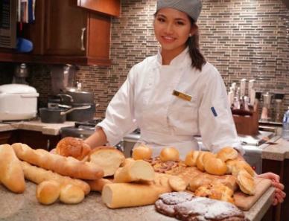
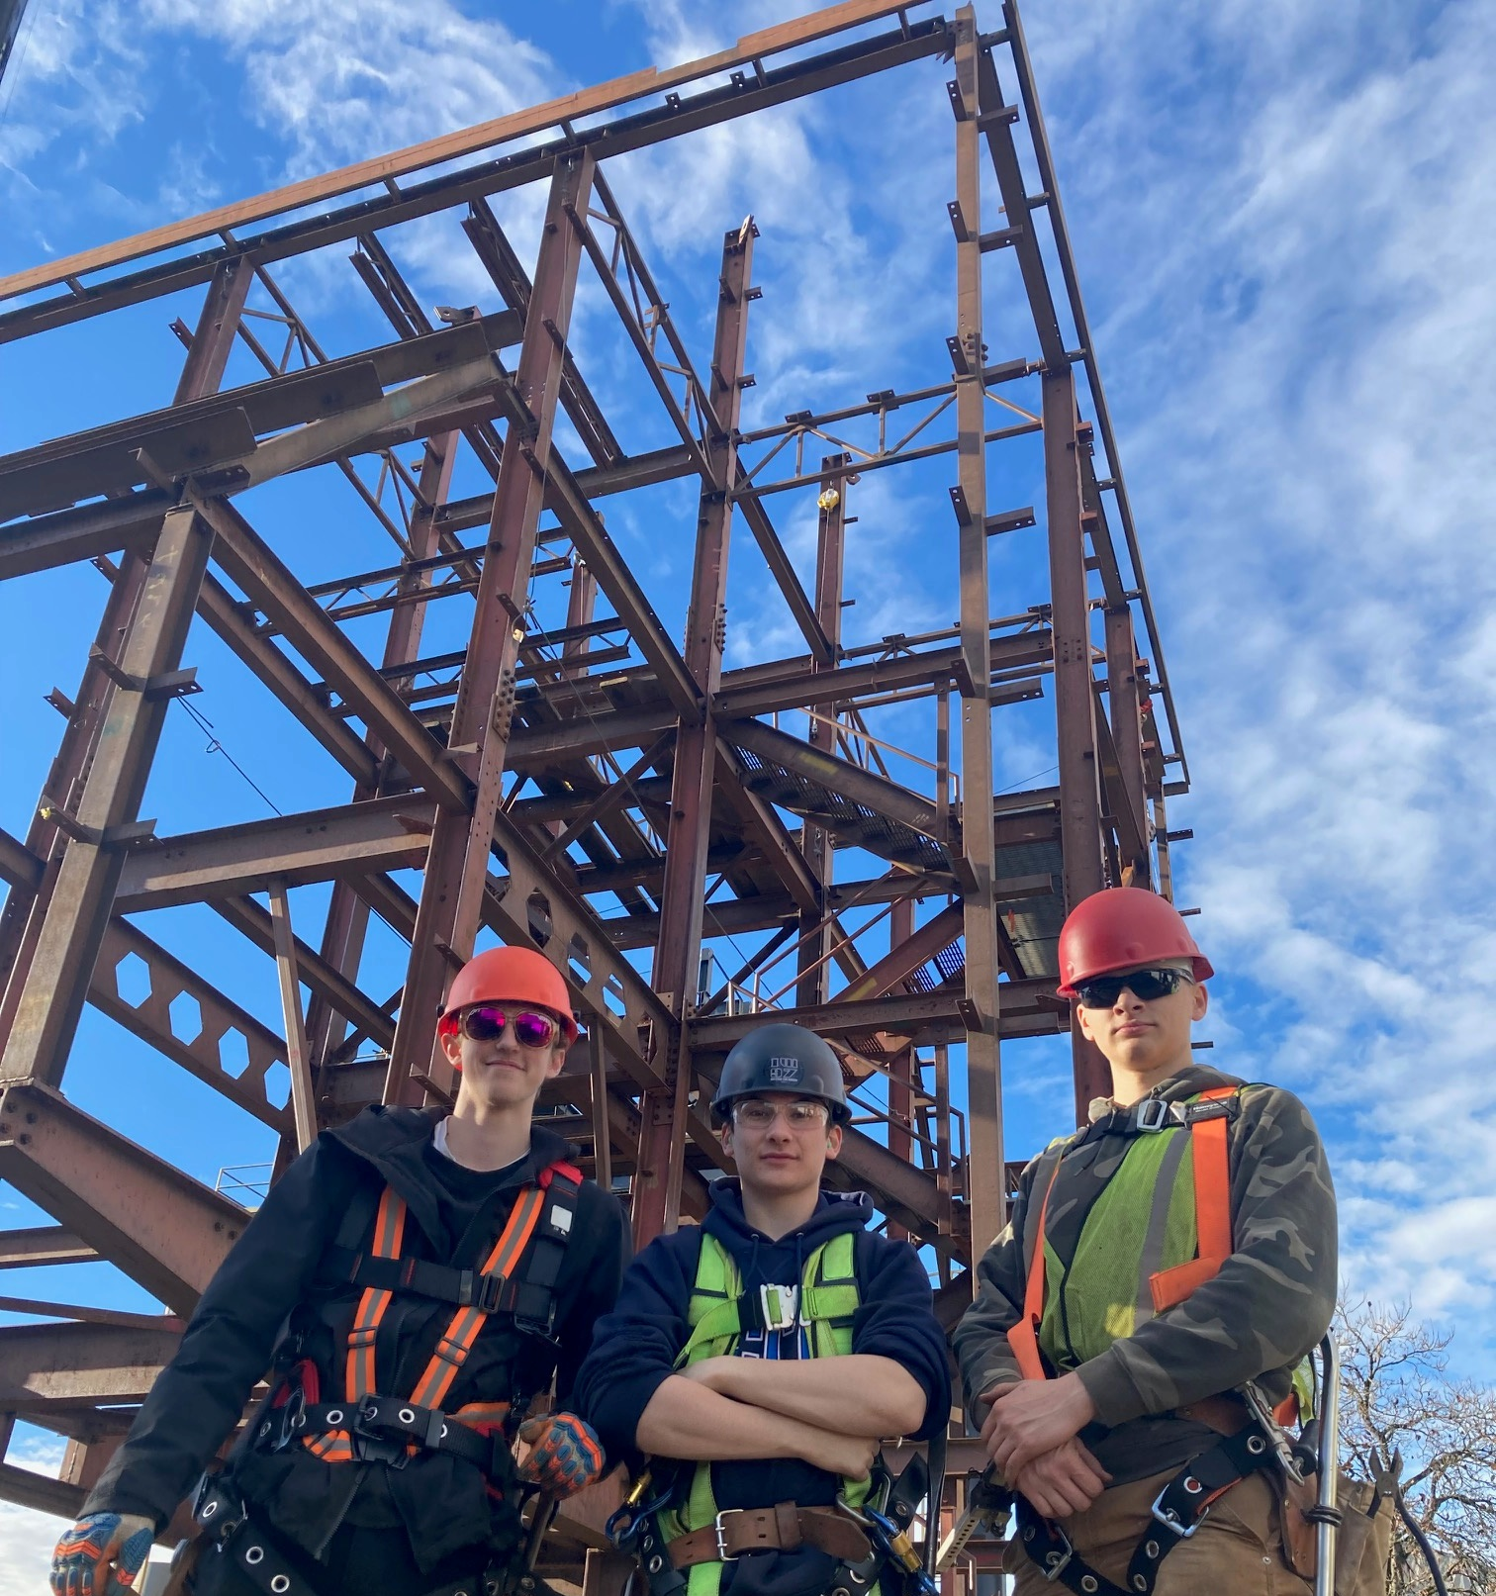
TRAIN in Trades Programs
Amazing opportunity for any
grade 11 or 12 student to take one of
22+ “Train in Trades” programs:
    Tuition Free – saves $1,000s
    Post Secondary level training
    Level 1 Certification
    Dual /Triple Credits:
      high school
      post secondary and/or
      industry

Slide 18
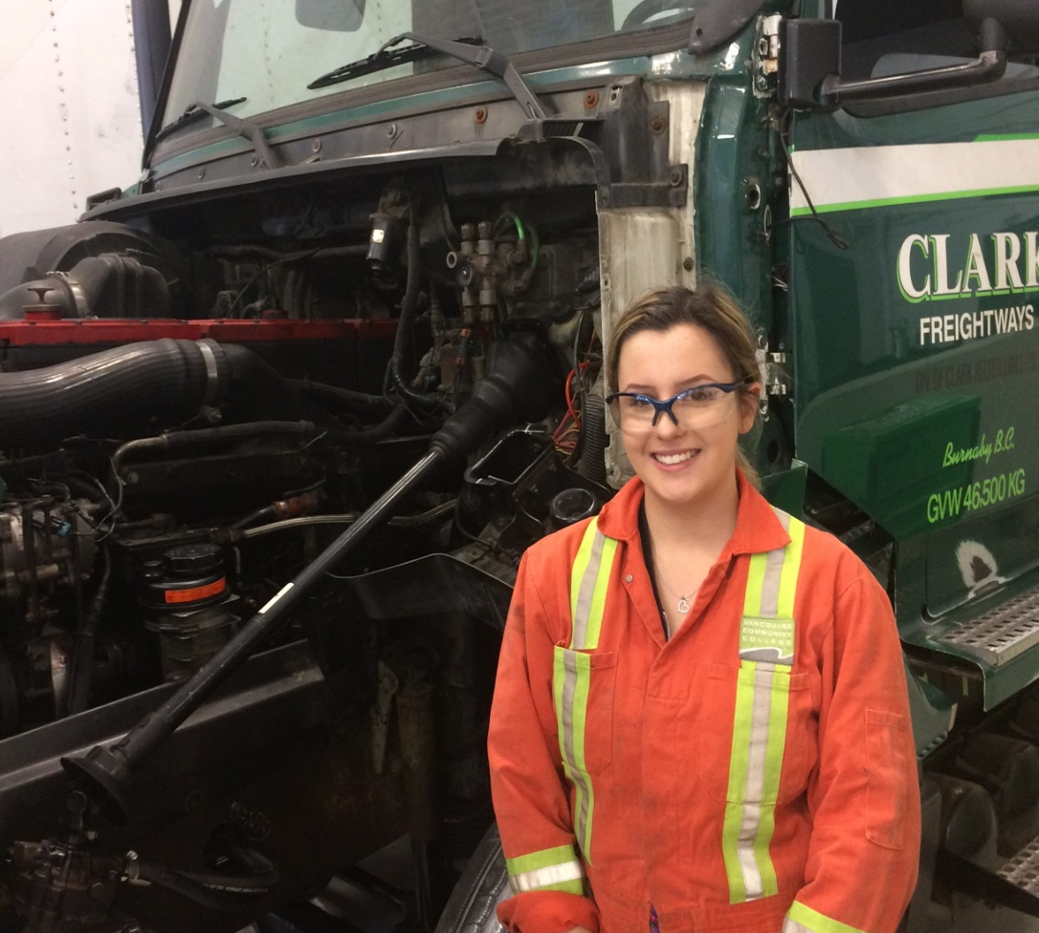
TRAIN in Trades Programs
Aircraft Maintenance Engineer
Appliance Service Tech
Auto Collision + Refinishing Tech
Automotive Service Tech
Baker
Cabinet Maker (Joiner)
Carpenter
CNC-Machinist
Cook
Electrician
Hairstylist
Heavy Duty Equipment Technician

Slide 19

TRAIN
in Trades Programs
Ironworker
*Marine Mechanical Technician
Metal Fabricator
Millwright
Motorcycle Mechanic
Painter (commercial)
*Part and Warehousing Person
Plumber
Refrigeration Mechanic
*Security Systems Technician
Sheet Metal Worker
Welder

Slide 20
WORK
in Trades Program
popular student jobs
carpenter
cook
landscaper
mechanic
floorlayer
Regardless of your career aspirations…
if you have/get a paying job in a trade you can receive credits toward high school graduation:
  120 hrs working = 4 credits (up to 16 credits)
  900+ hrs worked (before age of 20) could qualify student for a $1,000 award… gave out 30+ scholarships last year
  if you later pursue that trade career,
  those hours count towards certification

Slide 21
TRAIN
contact
WORK
contact
More
Info
www.43Careers.com
Ben King
e: BKing@sd43.bc.ca
c: 778-984-1354
Joanna Horvath
e: JHorvath@sd43.bc.ca
c: 604-312-7739
Online Parent-Student Info Session
Wed., Feb. 15 at 6:00pm
Contact Joanna for more information and the Teams meeting link

Slide 22






Many pathways ahead…
Trade Schools
Apprenticeships
College
University
Institutes
Travel
Workforce
….

Slide 23

Whether it’s post secondary schooling, volunteering, work, travel, apprenticeship…
Visit the Career Resource Centre
in person or online:
Heritage Woods Career Centre

Slide 24


Post Secondary and Career Advisor:
Ms. Darilynn Butler: dbutler@sd43.bc.ca
Apprenticeship opportunities
Volunteering
Work experience
Finances
Awards, bursaries, scholarships
College, university, institutes

Slide 25


Planning Your Courses
Think about:
  What are you good at?
  What do you like to do?
  Challenge yourself to try something new!
  Ideas for after high school?
  What courses will give you the skills you need (communication, leadership, teamwork, creative thinking)?
  What is REALISTIC?
  Talk to people
  READ THE COURSE BOOKLET!
  Course Programming

Slide 26

“The only way to do great work is to love what you do. If you haven't found it yet, keep looking. Don't settle.”

Slide 27


Take your time…these are important decisions
Your choices NOW determine the school timetable
Many reasons for not getting all requests (conflict, courses not running, courses are full…)
Not able to make changes based on:
    Friends
    Teacher preference
    Semester
    Time of Day
    Once you know what courses you want, it is time to fill out your planning sheet.

Slide 28

ONLINE COURSE REQUEST PROCESS
The following slides are meant to guide you through the process
This will be made available online on the 25th for you to go through more slowly
There will be assistance for those who need it during FLEX in the library computer lab:
  Wednesday Feb 1
  Wednesday Feb 8
  Wednesday Feb 15

Slide 29
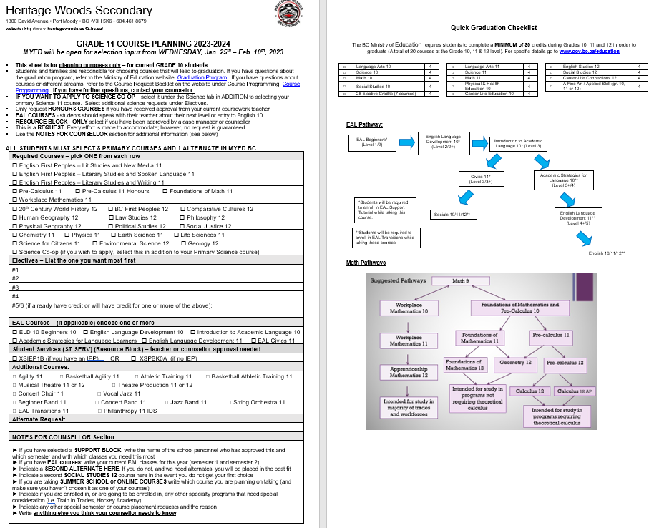
STEP 1: Fill out the Course Planning Sheet the grade you are going into
Found online Course Programming

Slide 30
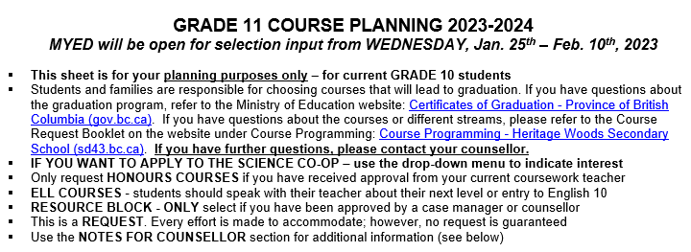
READ THE INSTRUCTIONS
Grade 10 going into 11’s example:

Slide 31
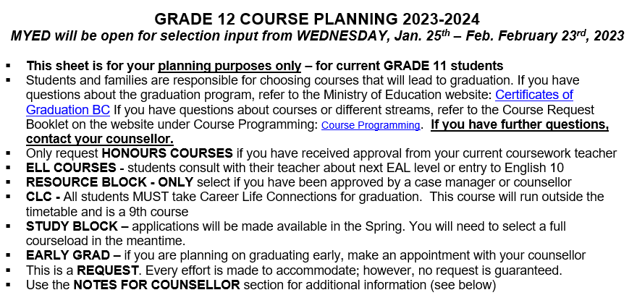
Grade 11 going into 12’s example:
Make sure you read it carefully and add any needed notes at the end

Slide 32
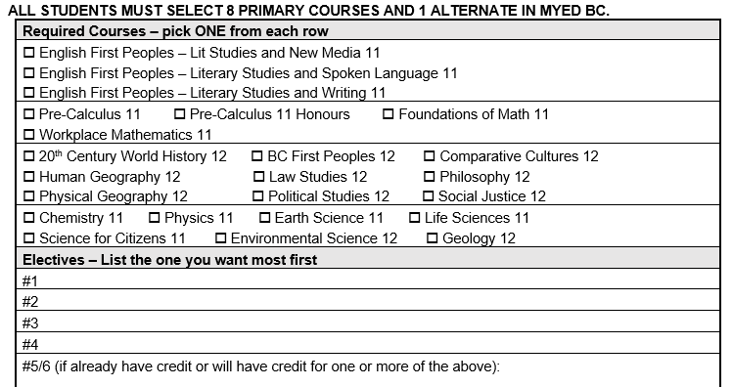
Plan your required and elective courses
Grade 10’s going into 11 example:
You need 8 or more courses total for a full course load
Required courses
Electives
If you are planning on doing summer school or online for any of the above required courses, PLAN for what you would like instead here (i.e. if you are planning on Precal 11 in summer school, you might choose Precal 12)

Slide 33
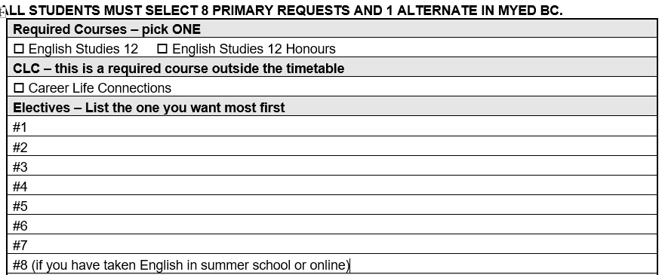
**Grade 12’s – make sure you have English 12, CLC 12 plus two other grade 12 level courses toward graduation (could have been taken any year)
Grade 11’s going into 12 example:
Only two required grade 12 courses
Everything else is considered elective

Slide 34
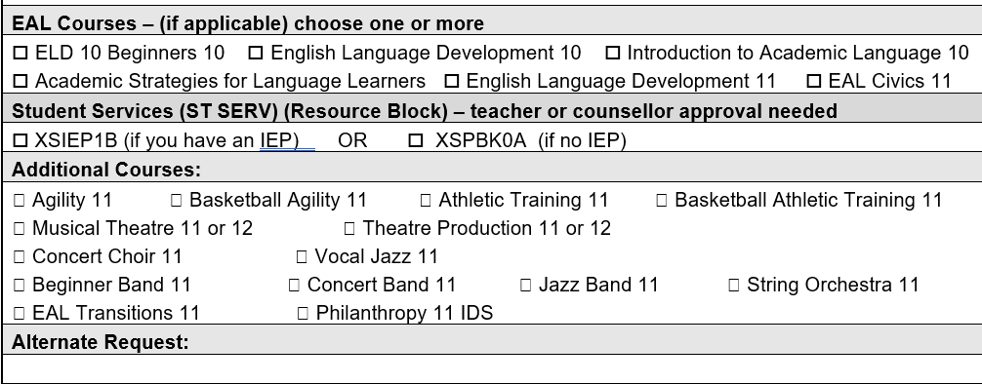

Plan if you are taking ELL, Student Services Support, Additional Courses
Choose your TOP alternate

Slide 35
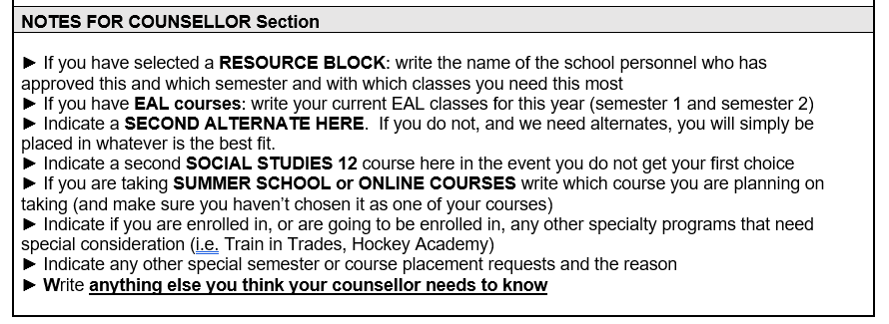

Notes For Counsellor Section
In MyEd, this section will be blank – use these points on the planning sheet to guide you through this section

Slide 36
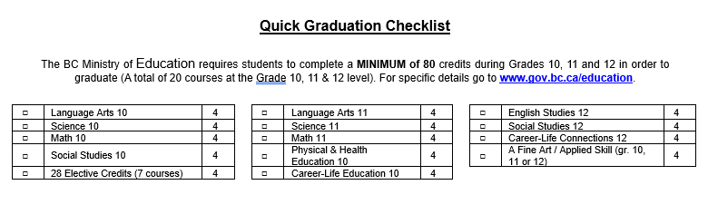
Need help knowing if you have your grad requirements?
Quick Graduation Checklist
Certificates of Graduation BC

Slide 37
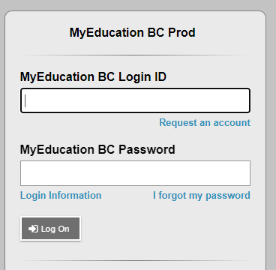
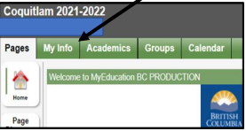
STEP 2: Login to the MyEd Portal
Go to MYED BC and login with your 7 Digit Student Number (not an email address or PEN number)
Click on “MY INFO” in the top left corner.

Slide 38
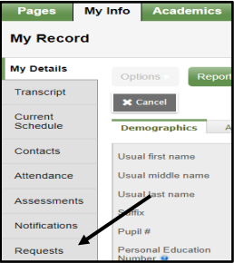
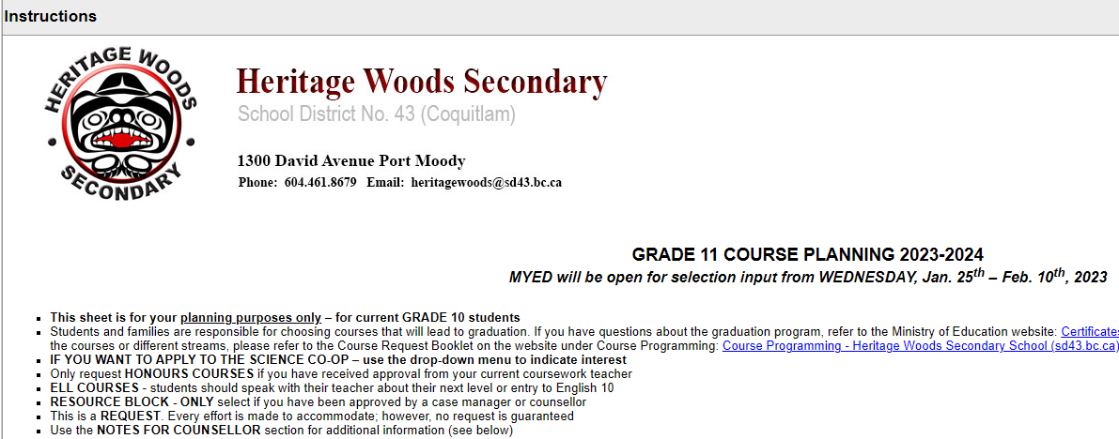
STEP 3: Click on REQUESTS
Click on “REQUESTS” at the bottom of the left sidebar.
STEP 4: RE-READ all the instructions
Instructions mirror what is on the planning sheet

Slide 39
STEP 5: Enter Your PRIMARY REQUESTS
Click on select and enter each of your core courses (this example is showing Grade 11)
Click on select and enter the correct number of electives (primary plus electives = 8)

Slide 40
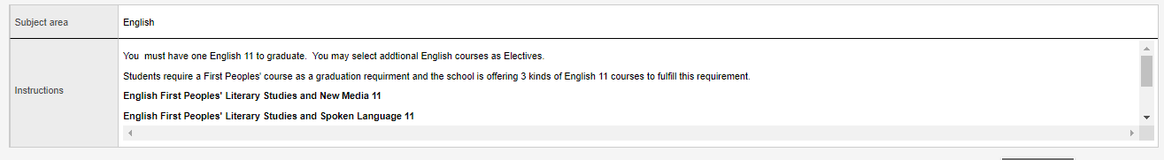
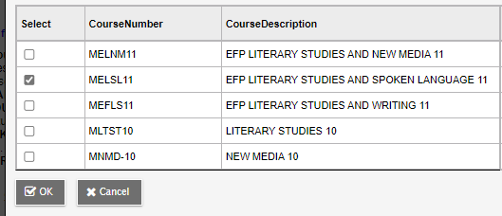
Each tab has some instructions for the subject area
You may need to scroll down (look on the right to see if there is a scroll bar so that you don’t miss something important)
Choose your course and click “OK”

Slide 41
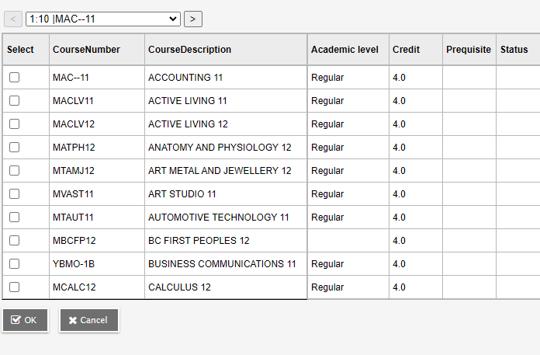
When entering electives…
When entering electives use the < > arrows to scroll through to each page of electives
Electives are in alphabetical order
Click okay

Slide 42
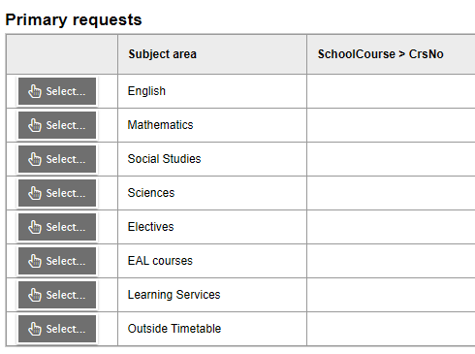
STEP 6: Enter any ELL, Student Support Services, Co-op, and Additional Courses Requests
Follow same procedure: hit select, click on course choice(s), click “OK”

Slide 43
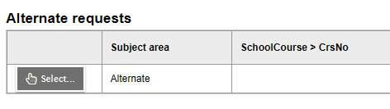
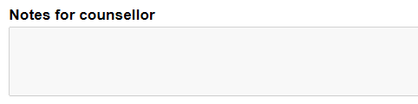
STEP 7: Enter ONE alternate
STEP 8: Notes for Counsellor
Notes For Counsellor: Use the bullet points on the planning sheet to guide you in writing anything important we need to know for your course planning

Slide 44



Slide 45

“Choose to pursue something you love and you will never have to work a day in your life”

Slide 46
STUDENT ASSEMBLIES FOR COURSE REQUEST PROCESS
Grade 9’s: January 23 @ 10:00
Grade 10’s: January 24 @ 10:00
Grade 11’s January 24 @ 1:00pm
ALL PPT AND DOCUMENTS WILL BE ON COURSE PROGRAMMING WEBSITE BY JANUARY 25

Slide 47

Course Request Portal Dates:
For 9’s going into 10:
WEDNESDAY, Jan. 25th – Feb. 3rd, 2023
For 10’s going into 11:
WEDNESDAY, Jan. 25th – Feb. 10th, 2023
For 11’s going into 12:
WEDNESDAY, Jan. 25th – Feb. 23rd, 2023

Slide 48
FLEX HELP IN THE LIBRARY COMPUTER LAB
There will be assistance for those who need it during FLEX in the library computer lab:
  Wednesday Feb 1
  Wednesday Feb 8
  Wednesday Feb 15

Slide 49

FOR PASSWORD RESET SUPPORT:
Please see the support document on the course planning mainpage

Slide 50
YOUR COUNSELLOR CONTACT INFO:
(Last Names A-G) Karen Watt
kwatt@sd43.bc.ca
(Last Names H-N) Karen Leeden
kleeden@sd43.bc.ca
(Last Names O-Z) Curt DeWolff
cudewolff@sd43.bc.ca

