Slide 1
Heritage Woods Course Request Information 2025-2026

Slide 2
PART 1: Grad Program
Course Requirements
Grade 10
Required
Language Arts (English) 10
Math 10
PHE 10
Career Life Education 10
Science 10
Social Studies 10
Grade 11
Required
Language Arts (English) 11
Math 11
Science 11 or 12
Social Studies 11 or 12
Grade 12
Required
Language Arts (English) 12
Career Life Connections
Graduation Requirements BC

Slide 3
One Applied Design, Skills and Technologies OR Arts Education
16 credits at the Grade 12 level (includes English and CLC)
28 credits must be elective course credits
4 credits must have an Indigenous-focus (see Indigenous-Focused Graduation Requirements - Province of British Columbia (gov.bc.ca) for additional information)
+ Literacy and Numeracy Ministry assessments

Slide 4
Language Arts
ENGLISH 10:
All students CHOOSE ONE (for 2 credits):
Literary Studies 10
New Media 10
Spoken Language 10
All students enrolled in Composition 10 (2 credits)
ENGLISH 11 (choose at least one)**
English First Peoples – Literary Studies and New Media 11
English First Peoples – Literary Studies and Spoken Language 11
English First Peoples – Literary Studies and Writing 11
** this covers the Indigenous Graduation Requirement; if you take a different Language Arts 11, you responsible for making sure you complete this requirement another way
ENGLISH 12:
English Studies 12 or English Studies 12 Honours
For English Language Learners: the ELL team will assess students for placement in appropriate ELL courses

Slide 5
Mathematics
Suggested Pathways
Math 9
Workplace Mathematics 10
Foundations of Mathematics and
Pre-Calculus 10
Pre-calculus 11 or Precal Honours 11*
Workplace Mathematics 11
Foundations of Mathematics 11
Intended for study in majority of trades and workforces
Foundations of Mathematics 12
Geometry 12
Pre-calculus 12
Intended for study in programs not requiring theoretical calculus
Calculus 12
Calculus 12 AP
Discuss math options with math teacher!!!
Intended for study in programs requiring theoretical calculus

Slide 6
Social Studies
Social Studies 10
BC First Peoples 12
Comparative Cultures 12
Human Geography 12
Physical Geography 12
20th Century World History 12
Political Studies 12
Law Studies 12
Philosophy 12
Social Justice 12

Slide 7
Science
Science 10
Life Sciences 11
Anatomy and Physiology 12
Chemistry 11
Chemistry 12
Earth Science 11
Physics 11
Physics 12
Science for Citizens 11
Geology 12
Environmental Science 12
*Note: If you are planning on going into the Sciences in post secondary, make sure you carefully check the requirements of the specific programs at each institution

Slide 8
Electives
Fine & Performing Arts
Home Economics
Music
Languages and English Language Arts
Technology Education
Information Technology
Fitness, Leadership,
Peer Tutoring* *(by application)
Business Education
Sciences & Math
Film & Multimedia
Youth Train in Trades, Work Experience
Social Sciences
Course Programming Webpage

Slide 9
Other ways to earn credits
Online courses
External credits (sports, dance, first aid, work safe)
Concurrent courses at Post Secondary institutions
Language Challenge Exam
Train in Trades, Work Experience, Apprenticeship
Check out the Ministry Website on External Credit for more information:
Approved External Credit

Slide 10
A note about Languages…
We offer…
French
Japanese
Spanish
Did you know?
A language is NOT required for graduation
They still count as academic courses and can be a benefit for Post Secondary Applications!
Lots of benefits!!!
***STUDENTS AND FAMILIES NEED TO CHECK INDIVIDUAL POST-SECONDARY WEBSITES***

Slide 11
Many pathways ahead…
Trade Schools
Apprenticeships
College
University
Institutes
Travel
Workforce
….

Slide 12
Whether it’s post secondary schooling, volunteering, work, travel, apprenticeship…
Visit the Career Centre
in person or online:
Heritage Woods Career Centre

Slide 13
Post Secondary and Career Advisor:
Ms. Darilynn Butler: dbutler@sd43.bc.ca
Finances
Awards, bursaries, scholarships
College, university, institutes
Apprenticeship opportunities
Volunteering
Trade program info

Slide 14
Planning Your Courses
Think about:
What are you good at?
What do you like to do?
Challenge yourself to try something new!
Ideas for after high school?
What courses will give you the skills you need (communication, leadership, teamwork, creative thinking)?
What is REALISTIC?
Talk to people
READ THE COURSE BOOKLET!
Course Programming

Slide 15
IMPORTANT:
Your choices NOW determine the school timetable
Many reasons for not getting all requests (conflict, courses not running, courses are full…)
Not able to make changes based on:
Friends
Teacher preference
Semester
Time of Day
Once you know what courses you want, it is time to fill out your planning sheet.

Slide 16
What is new for 2025-2026!!!
NEW
Courses!!
Science for Citizens
Intro to Singing
Tabletop Games
BC First Peoples 12
And More!
Inside VS Outside
the Timetable
Blocks 1-5 (8am – 3:25)
INSIDE
Before Block 1 & After Block 5
OUTSIDE
Biggest Changes
Agility/Music

Slide 17
“The only way to do great work is to love what you do. If you haven't found it yet, keep looking. Don't settle.”

Slide 18
PART 2: ONLINE COURSE REQUEST PROCESS
The following slides are meant to guide you through the process
This is available on the website

Slide 19
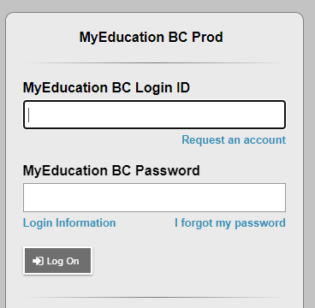
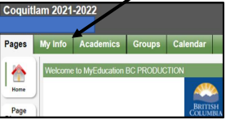
STEP 2: Login to the MyEd Portal
Go to MYED BC and login with your 7 Digit Student Number (not an email address or PEN number)
Click on “MY INFO” in the top left corner.

Slide 20
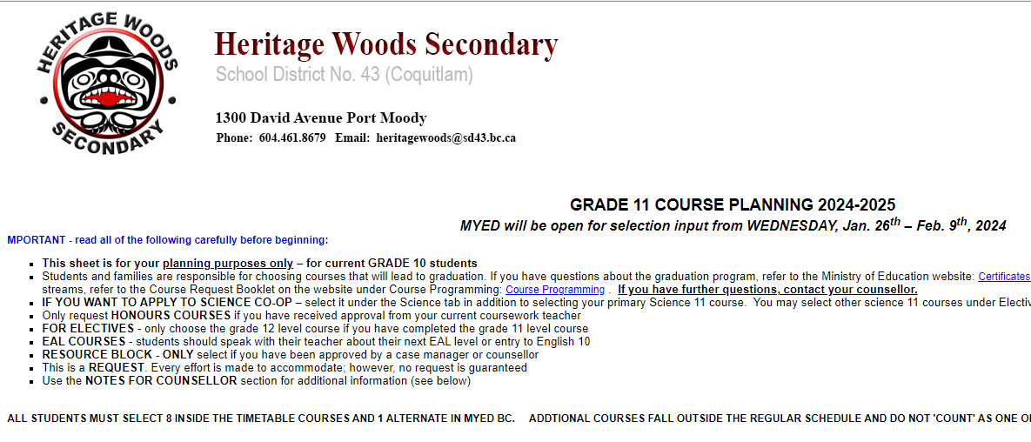
STEP 3: Click on REQUESTS
Click on “REQUESTS” at the bottom of the left sidebar.
STEP 4: RE-READ all the instructions
Instructions mirror what is on the planning sheet

Slide 21
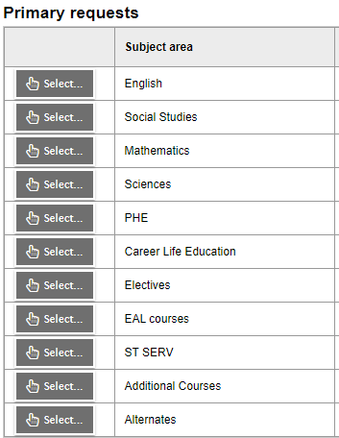
STEP 5: Enter Your PRIMARY REQUESTS
Click on select and enter each of your core courses
Click on select and enter the correct number of electives (primary plus electives = 8)

Slide 22
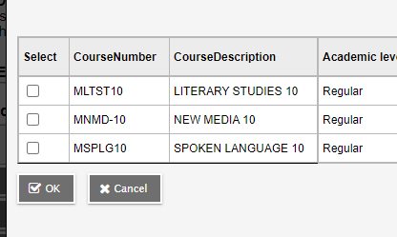
Each tab has some instructions for the subject area
You may need to scroll down (look on the right to see if there is a scroll bar so that you don’t miss something important)
Choose your course and click “OK”

Slide 23
When entering electives…
When entering electives use the < > arrows to scroll through to each page of electives
Electives are in alphabetical order
For grade 10’s: Select at least 2 to make up 8 primary courses. If you will take summer school or online, choose replacements here
Choose the appropriate number of electives. Then, click okay

Slide 24
STEP 6: Enter any ELL, Student Support Services, and Additional Courses Requests
Follow same procedure: hit select, click on course choice(s), click “OK”

Slide 26
STEP 6: Enter TWO alternates
STEP 5: Notes for Counsellors
(Must be done with Student Log in)
Notes For Counsellor: Use the bullet points on the planning sheet to guide you in writing anything important we need to know for your course planning

Slide 27
Course Request Portal Dates:
For 9’s going into 10:
Wednesday, Jan. 22nd – FRIDAY Feb. 14th2025
For 10’s going into 11:
Thursday, Jan. 23rd– FRIDAY Feb. 21st2025
For 11’s going into 12
FRIDAY, Jan. 24th– Friday Feb. 28th, 2025

Slide 28
FLEX HELP IN THE LIBRARY COMPUTER LAB
There will be assistance for those who need it during FLEX in the library computer lab:
Monday February 3rd
Tuesday Feb 4th
Friday Feb 7th
February 10-14th…the whole week!

Slide 29
“Choose to pursue something you love and you will never have to work a day in your life”

Slide 30
FOR PASSWORD RESET SUPPORT:
Please see the support document on the course planning mainpage: Course Programming - Heritage Woods Secondary School (sd43.bc.ca)

Slide 31
YOUR COUNSELLOR CONTACT INFO:
(Last Names A-G) Karen Watt
kwatt@sd43.bc.ca
(Last Names H-N) Alina Birsan
abirsan@sd43.bc.ca
(Last Names O-Z) Giovanni Zenone
gzenone@sd43.bc.ca

Slide 32
Questions?

