Slide 1
GLENEAGLE CORE COMPETENCY SCHOOLWIDE ACTIVITY FEBRUARY 8, 2022
“Learning is a journey that takes courage, patience, and humility.”
We are all learners.
ABORIGINAL WAYS OF KNOWING & BEING (BCTF)

Slide 2
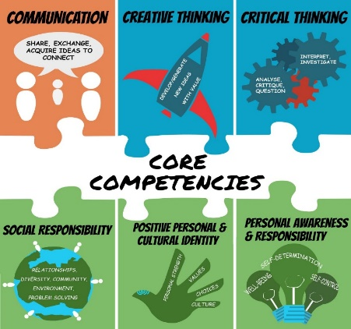
Today we are focusing on growing
Personal & Social Awareness & Responsibility

Slide 3
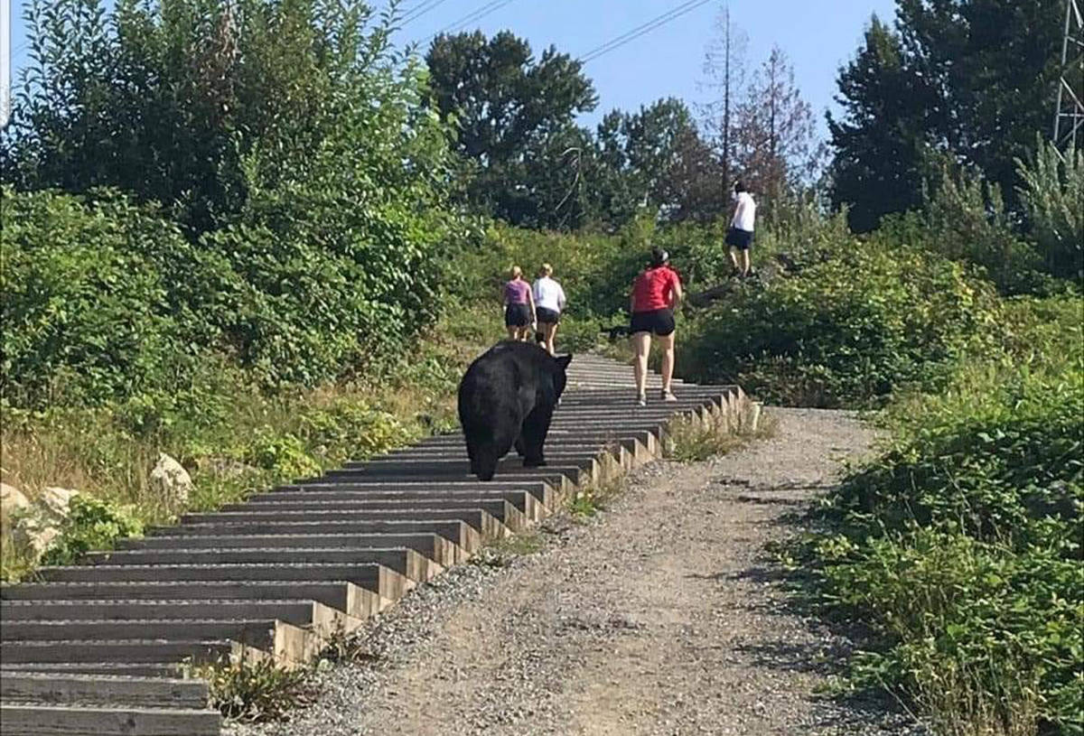
Today’s Learning Intentions:
to reflect on semester 1 and set/tweak goals for end of June & to identify artefacts of learning
to continue caring for the environment by building awareness of single-use plastics
to inspire you through the stories of others to use your unique talents for positive change and to take care of the land
Photo Coquitlam Crunch Trail
Photo of Coquitlam Crunch Trail

Slide 4
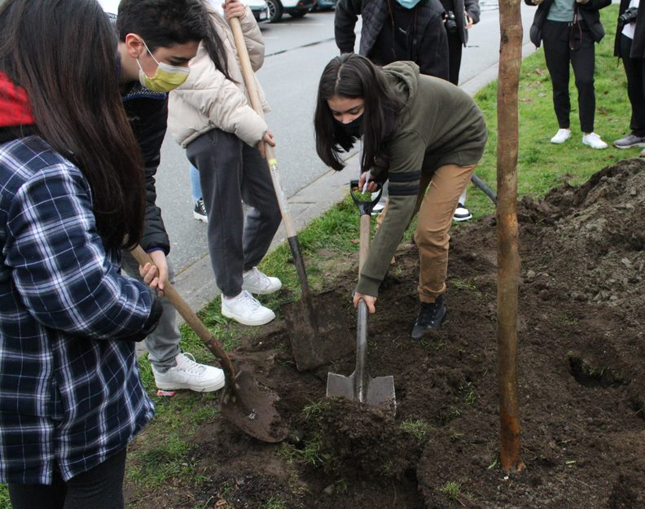
THANK YOU!
A heartfelt thank you to Ms. Croft’s and Ms. Kim’s Art & Photography classes for sharing their talent and helping others to appreciate and care for the land.

Slide 5
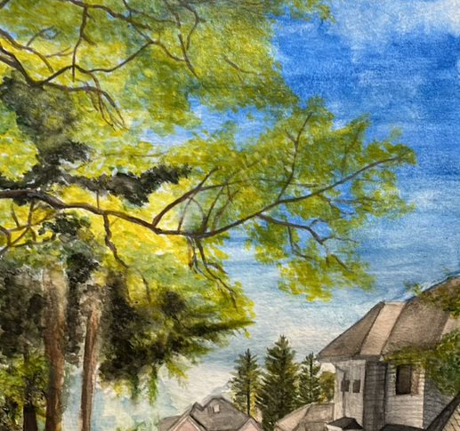
Annie He grade 11

Slide 6
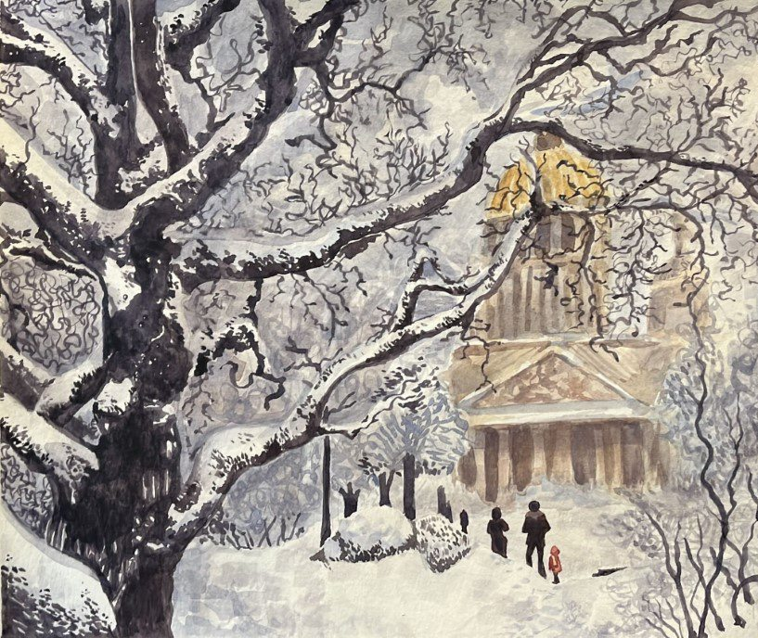
Hanna Strocel grade 11

Slide 7
YOU (& WE) are powerful and can make positive change; we can use our
“courage, patience, and humility” to guide us.

Slide 8
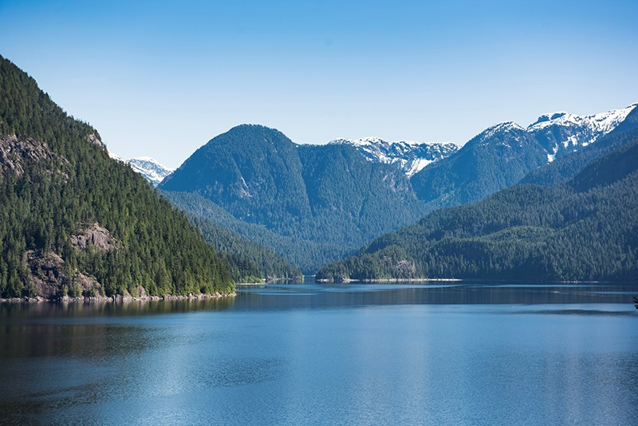
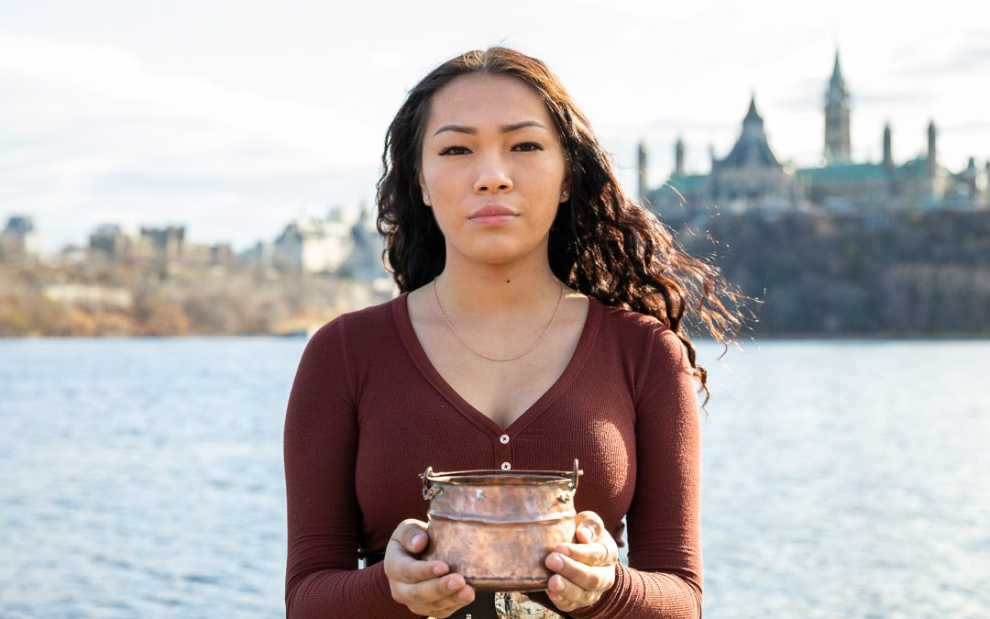
AUTUMN PELTIER
is an example of how a young person can be guided by Social Awareness and Responsibility to make positive change
…see video on next slide

Slide 9
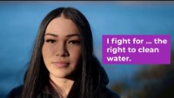
https://www.youtube.com/watch?v=A33XRMLBbOc

Slide 10
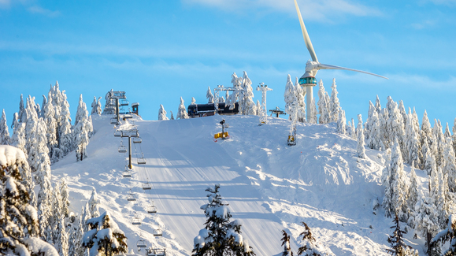
“Learning is connected to land, culture, and spirit.”
ABORIGINAL WAYS OF KNOWING & BEING (BCTF)
Grouse Mountain, Vancouver North Shore

Slide 11
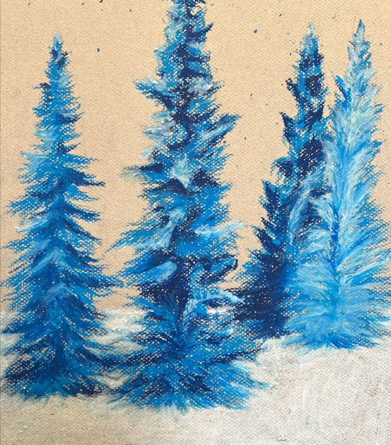
Lucy Cao grade 9

Slide 12
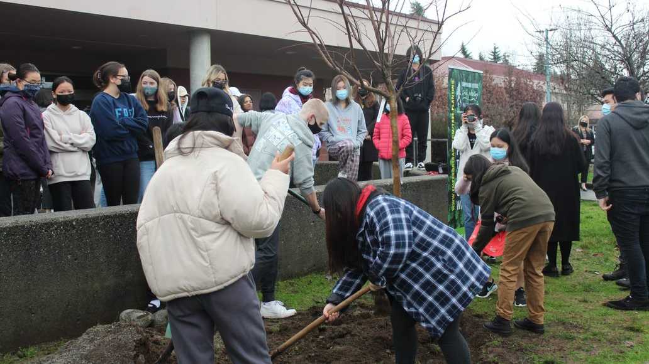
Gleneagle students planting a brighter future

Slide 13
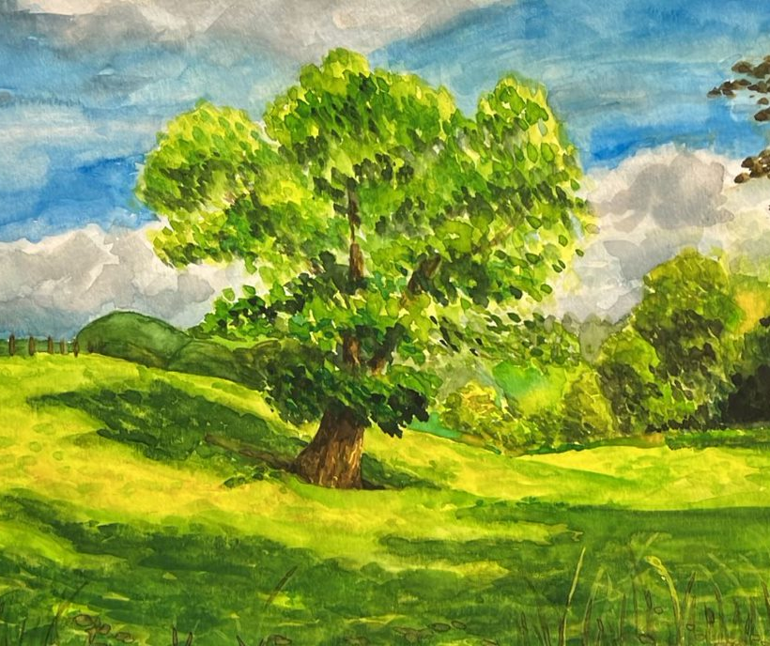
Dana Park grade 11

Slide 14
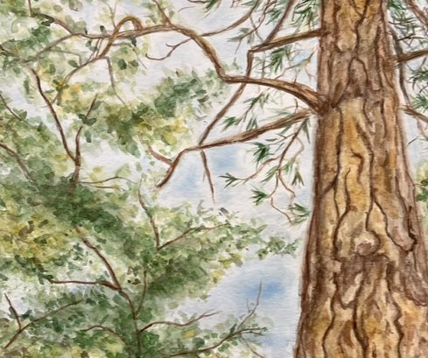
Jasmine Wong grade 11

Slide 15
Reflection on Semester 1
…
Purpose is to think about:
1. who you are
2. where you are
33. where you’re going

Slide 16

Time to reflect & write about semester 1…
Open the document sent to your student email. Save this document to your Core Competencies folder in OneDrive.
2. Complete Part A—4 questions PERSONAL AWARENESS & RESPONSIBILITY REFLECTION & ACTION
(10 mins)

Slide 17

…from Personal Awareness to Social Awareness & Responsibility

Slide 18
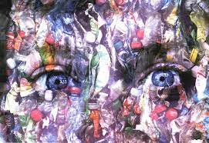
READ & RESPOND--Taking CARE OF THIS LAND WE WORK & PLAY ON
Read, Langley student, Sophia Schultz’ article, “Reducing Plastic Pollution.” (Art by Delta’s Seaquam Secondary students Abhayjeet Sachal Singh and Faith Carswell.)
Read the article and answer questions a, b, c, d, e.

Slide 19
How can a desire for Zero Waste turn into a business?
WATCH & DISCUSS// Zero Waste Solutions are Good for Business featuring NADA, a Vancouver based, zero waste grocery store

Slide 20
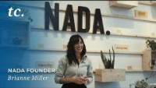
Play video…

Slide 21
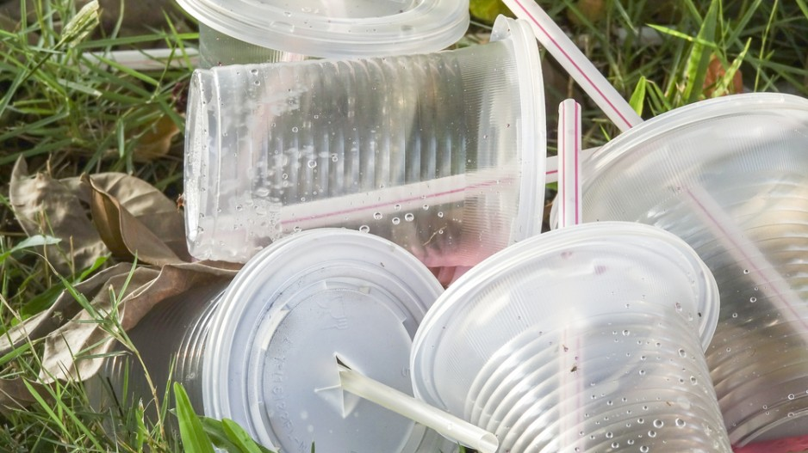
DISCUSS:
We are all familiar with the three R’s (reduce, reuse, recycle). Brianna suggests there is a fourth--R: REFUSE. What plastics can we “refuse” in our daily lives that could help make a difference?

Slide 22
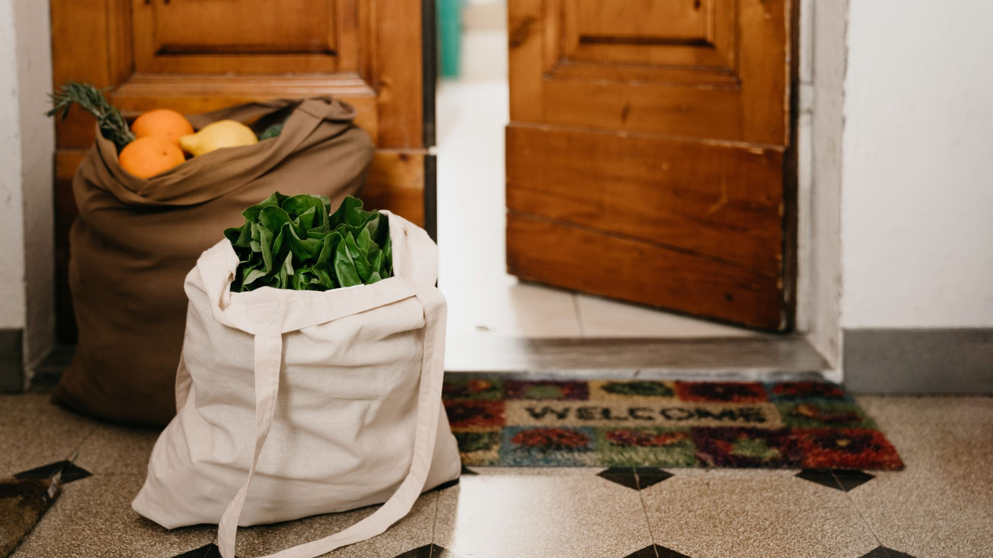
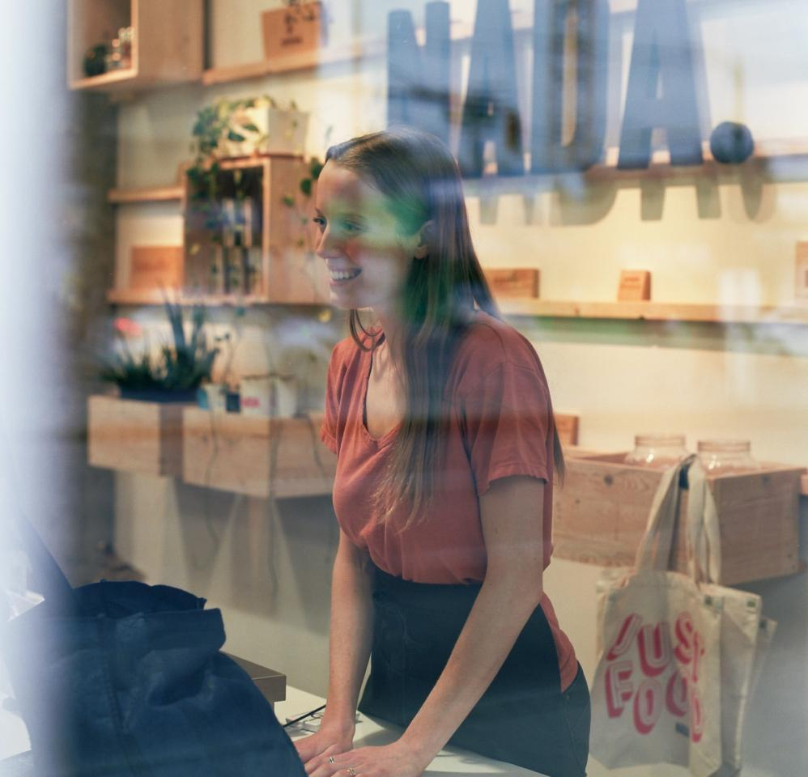
READ & DISCUSS: Zero-Waste Groceries
UBC student, Alison Carr, turns inspiration from a class assignment to a business opportunity that helps to reduce plastic and waste.
. http://
After reading, in a group, brainstorm how you might turn a passion into a career that can make a positive difference for this land we all share.

Slide 23
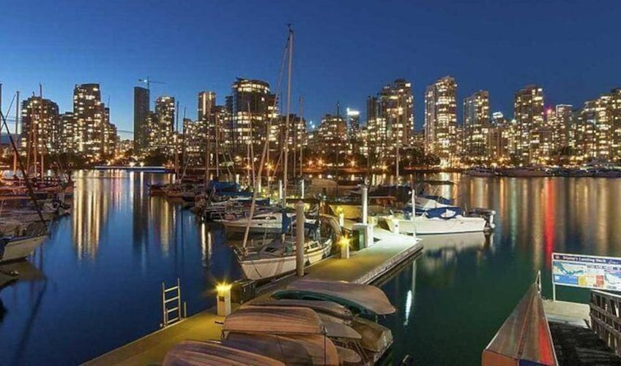
Overall takeaway: “The care of the Earth is our most ancient, most worthy, and most pleasing responsibility.”
Wendell Berry

Slide 24
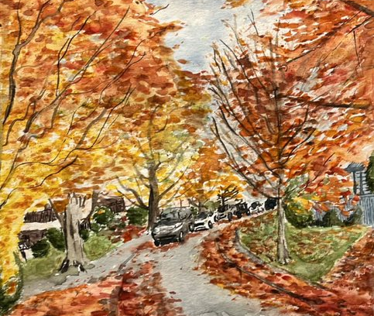
Jane Li grade 11

Slide 25
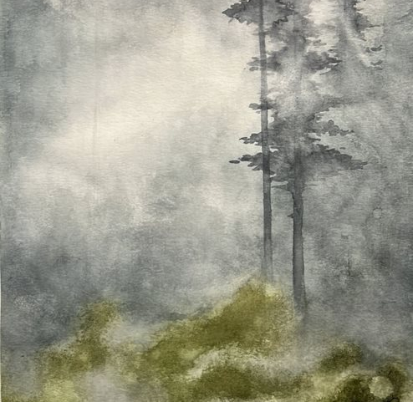
Dakota Martin grade 11

Slide 26

CONCLUSION
Thank
you for your participation today.
Save
your document to OneDrive, so you can refer to it for our next schoolwide activity.
Remember
to save/take pictures of artefacts/examples of work/activities you are proud of during the semester to show your journey towards your goals.
NEXT
CORE COMPETENCY SCHOOLWIDE ACTIVITY: May 26, 2022

