Slide 1

Gleneagle Grad
2019!
Congrats…almost
Oh, the places you’ll go… ~Dr. Suess

Slide 2

Overview
Today we will talk about:
Upcoming important dates – get your phones ready to snap a pic
Eligibility to walk the stage at commencement
Gown order and delivery
Program name and presentation name
Parameters around read aloud statement – no changes
Commencement ticket sales
Valedictorian
Dinner and Dance
After Grad

Slide 3

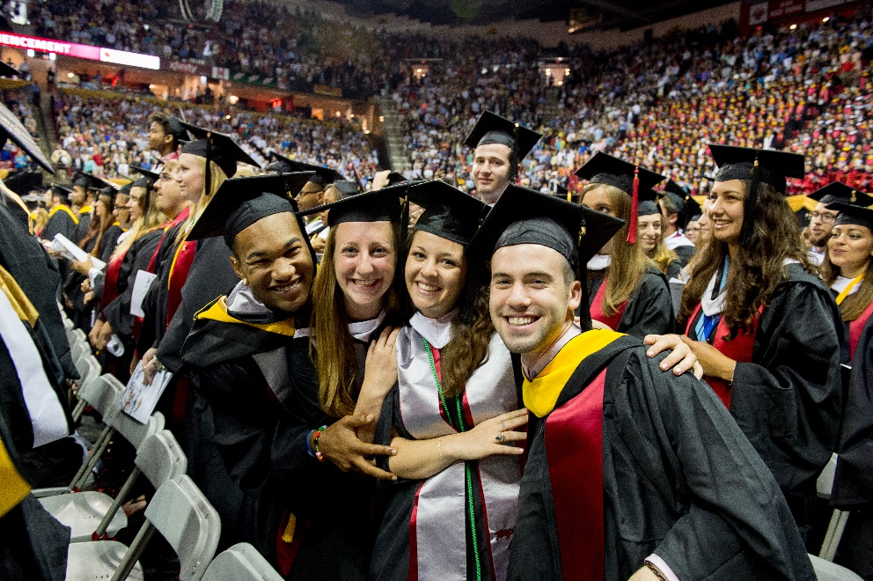
Important Dates
Guest forms for dinner and dance Out now….
due May 2nd
Valedictorian Out now and due May 2nd
Gown Pick up (block 5) June 11th
Commencement ticket sales May 27th
Commencement event June 15th
Dinner and Dance June 21st
After Grad June 22nd

Slide 4
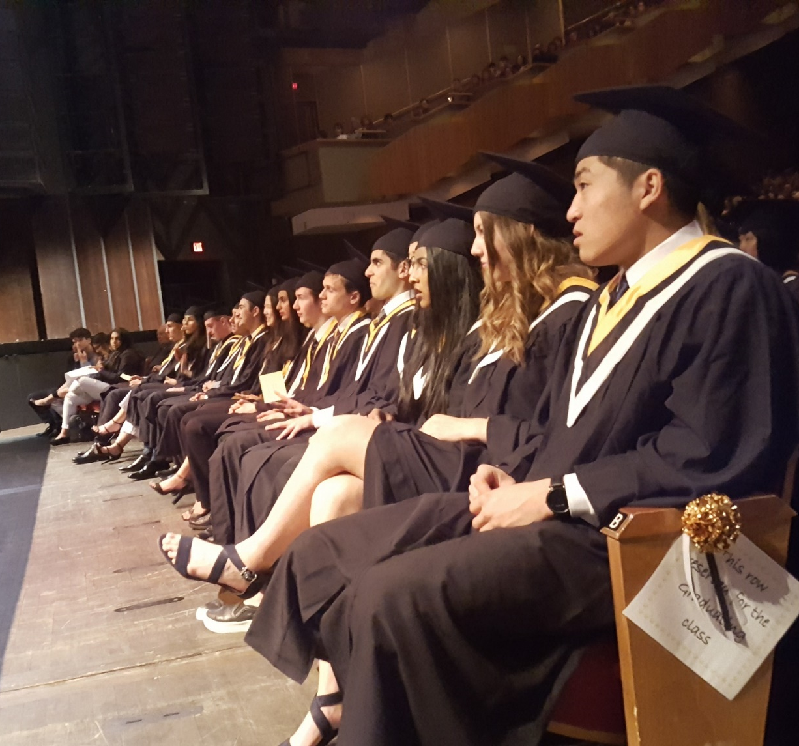
commencement
Gown Pick up (Block 5) June 11th
Commencement ticket sales May 27th
Commencement event June 15th
        11 a.m.
        Queen Elizabeth Theatre
        Arrive 10 a.m. in gown

Slide 5


Eligibility to walk the stage at commencement
Have fulfilled all your requirements for graduation – there are only a few exceptions and those students have talked with their counsellor AND they have a GRAD PLAN in place.
Complete all the requirements of your CLC 12 course – including the Capstone Project on April 15
Ensure you do not have any outstanding fees and/or any missing textbooks – find them!
Fees due – May 22nd 3pm.

Slide 6
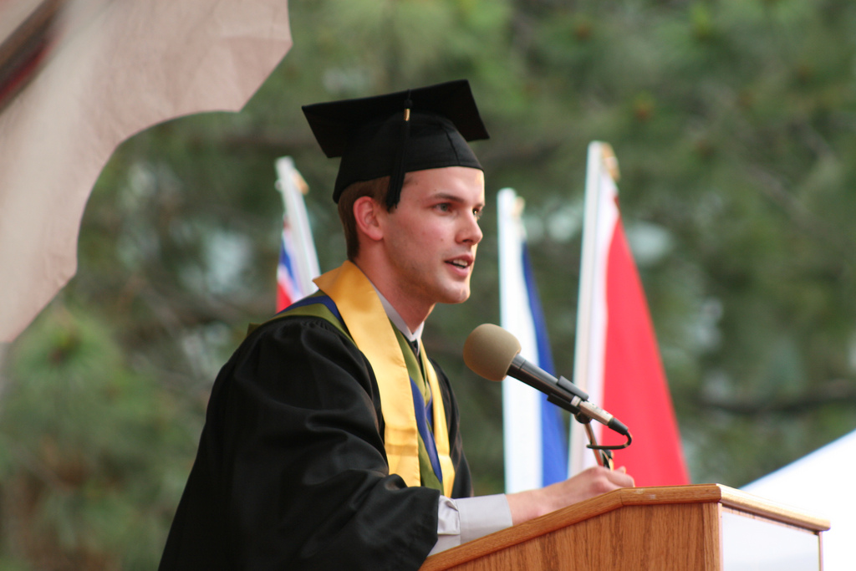
Valedictorian Process
Nomination forms available: April 16
Completed nominations in: May 2
Semi-final process starts with candidate speeches on May 16 during CL time
Audience votes using a rubric so bring a pen/pencil
Finalists identified from your votes
Final voting by Grade 12 students only (ID required) at lunch in the foyer Friday, May 17

Slide 7
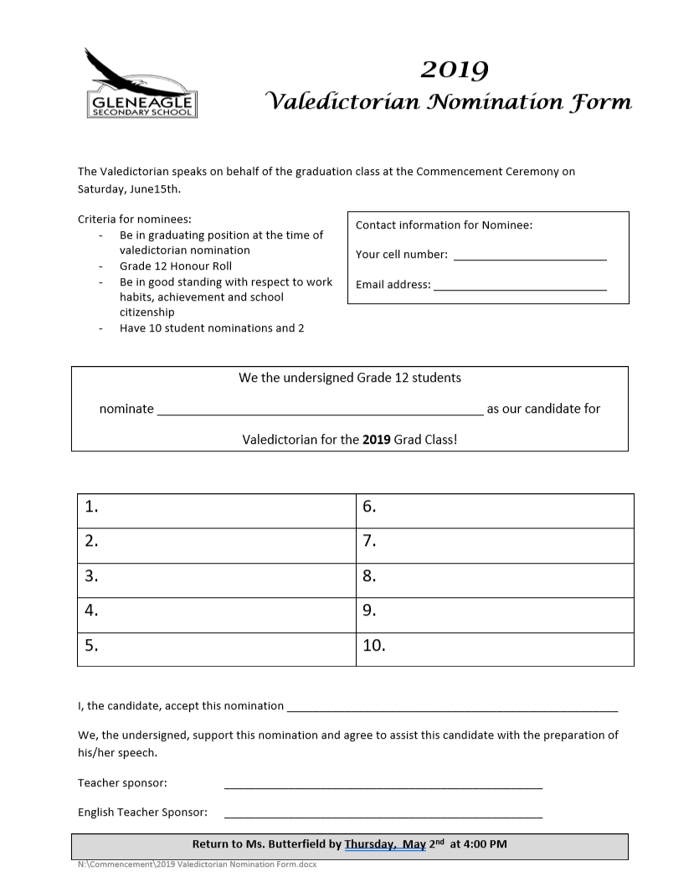
Valedictorian process…
Nomination forms due Completed nominations in to Ms. Butterfield by: May 2nd by 4:00 p.m.
Completed forms must include 10 student signatures and 2 teacher signatures (including one English teacher)
Criteria for participating in the running for Valedictorian:
Be an honor roll student
Be in good standing and a graduating position with respect to work habits, achievement, and school citizenship
Receive TWO teacher signatures to participate in the valedictorian speeches
Demonstrate outstanding attendance

Slide 8
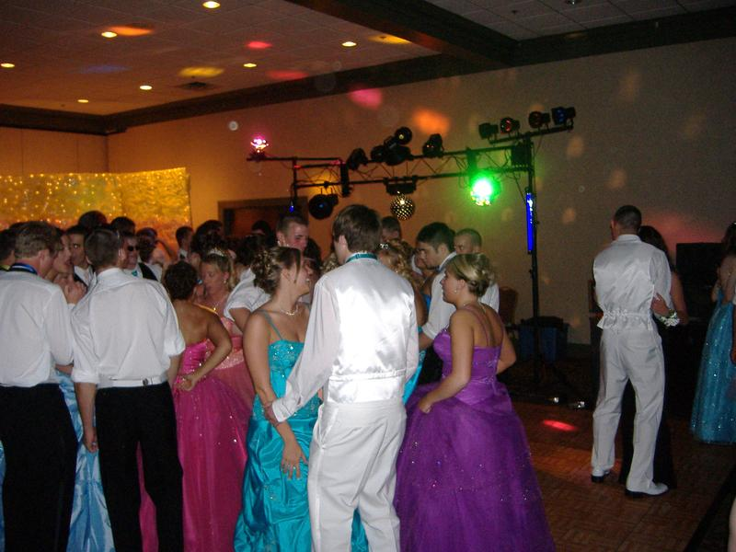
Dinner and Dance
Event is June 21^{2t} 6 p.m. – 11 p.m. Fairmont Hotel Vancouver – 11p.m. Dismissal restriction
Ticket sales START at 3:45pm on Wednesday May 29th
Ticket sales CLOSE on Wednesday June 12 at Midnight
This is an online process
Guest forms
Available April 16th
Due May 2nd
After Grad: Saturday June 22nd MIDNIGHT at Gleneagle – doors close at 1 a.m.

Slide 9
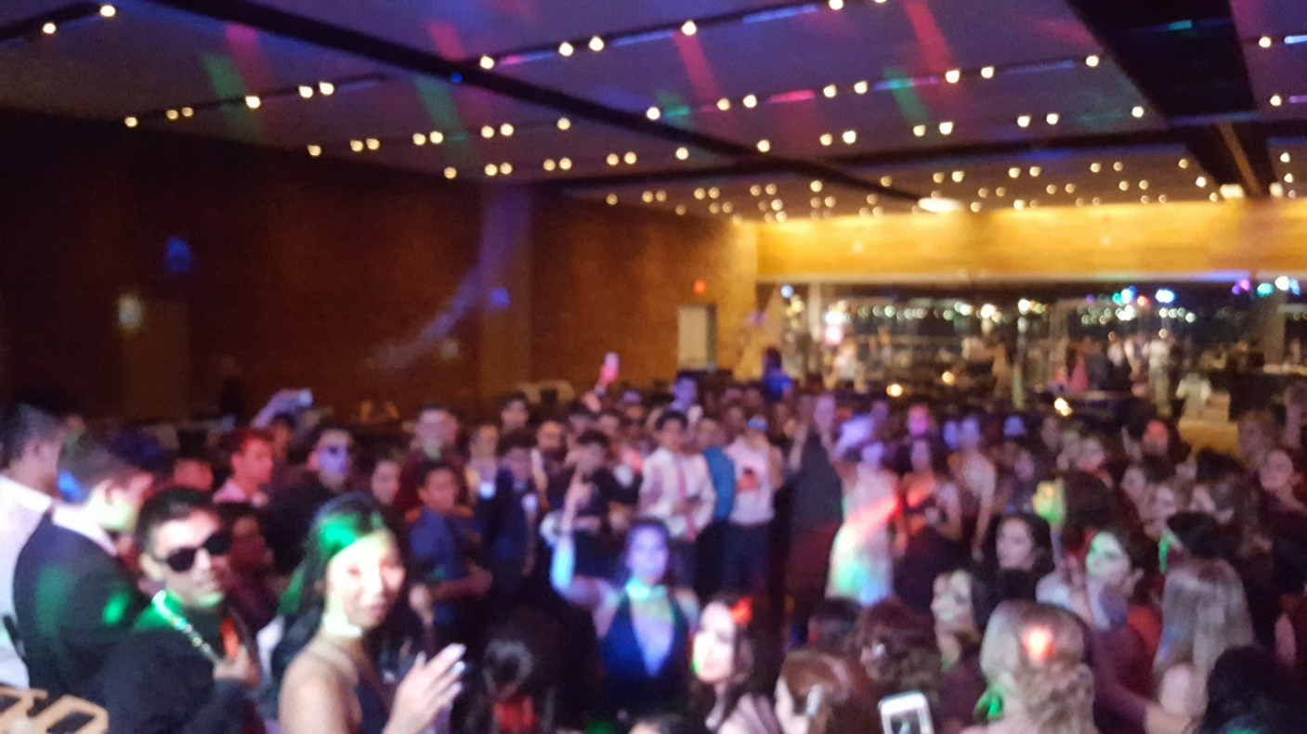
Dinner and Dance
Fees must be paid in full by
WEDNESDAY, MAY 22nd
Costs for Dinner & Dance/ After grad
$ 140.00 – dinner/dance for Gr 12s
$ 145.00 – dinner/dance with bus
$150.00 – dinner/dance for all guests
$155.00 – dinner/dance with bus
$ 40.00 – After Grad festivities

Slide 10
FEES
The ONLY way to reserve a seat for Dinner Dance is by buying a ticket and reserving a seat online at the gleneagle.inviteright.com site that will be on posters and the school website.
All CLC12 assignments & Capstone Project complete + ALL FEES paid before Wed, May 22nd = eligible to buy tickets Wed, May 29th at 3:45.
All CLC12 assignments & Capstone Project complete + ALL FEES paid Wed, May 22nd – Wed, May 29th = eligible to buy tickets Mon, June 3rd at 3:45.
All CLC12 assignments & Capstone Project complete + ALL FEES paid after Wed, May 29th = eligible to buy tickets 2-3 school days after completion due to processing time.

Slide 11
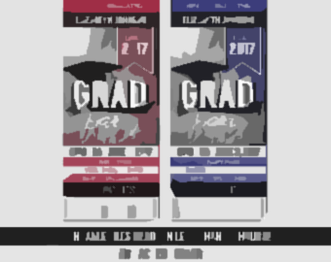
Dinner and Dance
This is a fully sponsored school function. This means school and school district rules and expectations apply
Guest forms are required for any guest that is NOT a member of the current grad class of Gleneagle 2019 (including younger Gleneagle students and past grads)
If a guest (who is a Gleneagle student) has outstanding fees, they will not be eligible to have a ticket purchased until fees are paid.
Reminders
  completed guest forms due May 2nd to the office
  Ticket sales May 29th beginning at 3:45 p.m.
  to June 12th closing at 11:59 p.m.
Ticket costs $140.00 gr 12
$150.00 guests

Slide 12
Dinner and Dance
Online purchasing system for tickets. Table selection is done through the on-line system as well; students will get to choose their seating plan on a first-come first-serve basis
Tickets are $140.00 for gr 12s, $150 for guests
Transportation is available for $5.00 to and from Gleneagle on a decorated school bus
No table-switching at the event – there is a master list that will be checked
Event Friday June 21st at Fairmont Hotel Vancouver, 6p.m. to 11p.m.
Dismissal restriction of 11 p.m. - no leaving prior to this time

Slide 13
After Grad
Entry to event will be closed at 1 a.m.
Ticket sales are online only:
  May 29th to June 12th
  NO tickets will be sold at the door
$40.00
Approved guests only
NO in-out privileges
Ends at 5a.m.
Once you leave – you CANNOT return

Slide 14

Scholarships
Have you applied for a scholarship somewhere? Best of luck to you!
Should you be awarded a scholarship from outside the school, please let us know by submitting your scholarship/award/bursary information to Ms. Austman with the details, before the end of MAY:
https://tinyurl.com/yy6avxna
Please include: Your full name (as you would like it to appear in Commencement program), the scholarship name, and the monetary award

Slide 15
Now it’s up to you…
2 months left…
Stay Golden Gleneagle!

Slide 16
Images cited
Slide One: http://www.linkconnector.com/ta.php?lc=148800000012005851&url=https%3A%2F%2Fwww.mediabakery.com%2FBXP0068971graduate-and-mother-embracing.html
Slide Two: https://classroom.synonym.com/the-significance-of-graduation-tassels-12250129.html
Slide Three: https://www.zippia.com/advice/smartest-states-in-america/
Slide Five: http://cni.pmgnews.com/images/artimg/00003578991285.jpg
Slide Five: http://church.trinitydowntown.com/wp-content/uploads/2016/06/lead1-18-400x250.jpg
Slide Eight: https://img.youtube.com/vi/y6Bz6Typ0wA/2.jpg
Slide Eleven: https://img1.etsystatic.com/125/1/6806823/il_340x270.901247409_44od.jpg
Slide Fourteen: https://s2.51offer.com/school/2016-03-09/img201603081735430.jpg?imageView/2/w/200/h/130

