Slide 1
Gleneagle Grad 2019 Commencement Assembly Rehearsal

Slide 2
Grad 2019
Commencement
What do I wear?
Dress smart - formally
What do I need?
Gown, Stole, Cap with tassel
What time do I show up?
10:00 am
Ceremony may last up to
3 hours
Where do I go?
The Queen Elizabeth Theatre Hamilton Street entrance - grads to the 3rd floor lobby

Slide 3
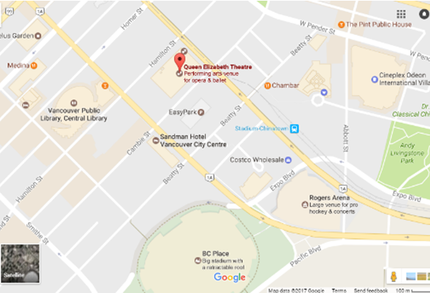
Where do I arrive?

Slide 4
The gown zipper is on the front the stole has the “V” in the front, the cap has directions on the inside and the tassel goes on the right.

Slide 5
Grads in the Choir
Arrive by 9:00 am
Go to stage entrance on Cambie Street
Warm up on stage and sound check
10:00 am, join the all of the grads in the 3rd floor lobby
Once you have your seats in the Processional, head up on the stage from the right
Return to your ordered seat when directed

Slide 6
What Happens at Commencement?
Doors open at 10 am from Hamilton Street – leave bags and purses etc. with family
Check in at the tables on the third level mezzanine and we give you your reader name card
You line up in order by last name and card number**
(four lines – first half of alpha on west side – second alpha East)
Check that the
Pronunciation of your
name is there phonetically
If the readers may need this
to help them pronounce it
correctly.
**Please stay in numerical order – so important
#11
Jennifer Kim
I I woud like to thank my family and friends for their support.

Slide 7
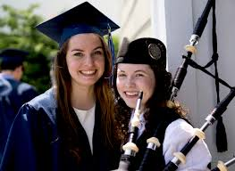
What Happens… cont’d
**Please stay in numerical order
– so important
At 10:45 we move you towards the theatre in two single file lines in order – the west group with follow Mr. Clayton and the east group will follow Mr. Ramogida
At 11am you are led into the theatre by the platform party and a bag piper
You sit, then you stand for O’Canada, sit, listen to speeches, listen to the choir sing, watch awards being presented then….

Slide 8
**Still staying in numerical order
What Happens… cont’d
We move you out in order for the stage crossing – please watch for staff members direction
You will be directed back to a seat but it may not be the same seat as previously - so again you should not bring bags/purses/etc. with you
You listen to the valedictorian speech
Valedictorian leads you out

Slide 9
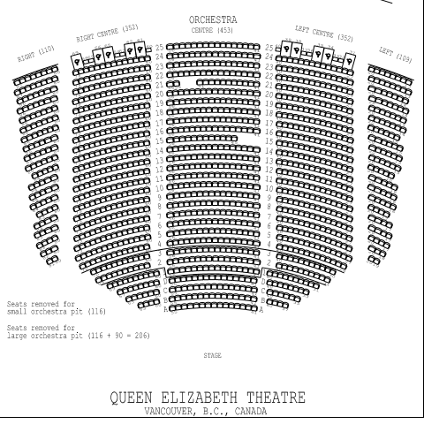
Processional
GRADS
Grads will be led into the theatre by the bagpiper and the VIP Platform Party.
The staff marshals will direct the two rows as to their entrance. Students will be seated in an orderly fashion in the center section – watch for staff direction.

Slide 10
Getting to the Stage
GRADS
Grads will be directed in order by a marshal to leave their seats and head out of the theatre. Outside the theatre, grads will be directed down a side corridor and back into the theatre near stage left.

Slide 11
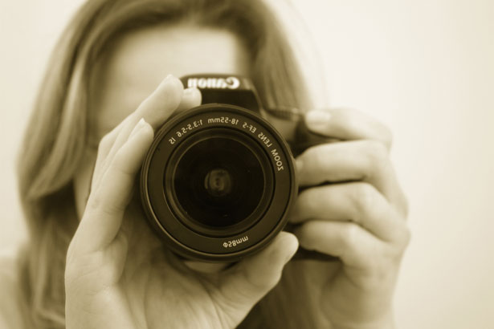
Getting Across the Stage
Photographer stage right – don’t forget to smile
GRADS
Mr. Cober
Hand name card to reader table.
Wait until you are directed in order to cross.
Stop to shake Mr. Cober’s hand.
Turn to get your picture taken.
Walk to see Ms. Potter-Smith, Mrs. Cuellar, and Mr. Chan to get your diploma folder.
Carefully exit the stage! Take hand of staff assisters – especially if in high heels.

Slide 12
Getting Back to A Seat
Grads will be up their row back to the same area as from which they came but it may not be their original seat. You will be directed again by staff members as to where to be seated.

Slide 13
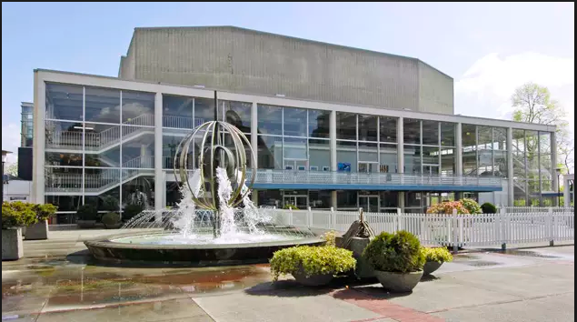
Recessional
You will be directed out in alternating rows starting from the rows closest to the front. Attend to the staff please.
After the Valedictorian speech, the Valedictorian will lead your grad class out to the music of Pomp and Circumstance. The rows closest to the stage will leave first in order alternating sides as directed by staff.
THE GRAD CLASS KEEPS WALKING OUT AND STAYS TOGETHER IN LINE. YOU WILL BE LED A LONG WAY INTO THE LOBBY TO ENSURE THAT EVERY GRAD ARRIVES INTO THE LOBBY. Here you can meet your family for hugs and photos – consider outside by the fountains hint, hint

Slide 14
After the Ceremonies
We have limited time after the ceremony to mill around as the Queen Elizabeth staff have given us a limited time frame to use their facility.
Please bear this in mind and take your photos in a timely fashion and make plans to depart fairly soon after the ceremony ends.
Go enjoy your Commencement day and celebrate your graduation from Gleneagle. ☺

Slide 15
What Now?
After Period 4 TODAY go to GYM C
We will hand out your cap, gown, stole and tassel
Please be CAREFUL
with the TASSEL – loop it
around the button on the
cap right away – easy to lose.

Slide 16
DID YOU MISS GETTING YOUR PHOTO TAKEN?
After you pick up your Grad Gown you can go to Room 213 and Mr. Udell will take your picture to be used during the Commencement Ceremony

Slide 17
Do not forget your cap, gown, stole, and tassel as that is your ticket in the door Commencement day.
Students who were away today can pick up their gowns from the front office before school, at lunch or after school starting Wednesday

Slide 18
Questions?

Slide 19
Images Cited:
Slide 2: https://www.gograph.com/vector-clip-art/graduation-cap-and-tassel.html
Slide 3: https://www.1st-vancouver.com/vancouver-theatre.html
Slide 7: https://sturgissoundings.files.wordpress.com/2014/07/meredith-and-bagpiper.jpg
Slide 11:
https://pixabay.com/images/search/camera/
Slide 13:
http://www.montrealgazette.com/Queen+Elizabeth+Theatre/2221375/story.html

