Slide 1

Grad Assembly 2026
Wednesday, April 1st

Slide 2

Almost at the Finish Line
Grad Requirements to walk the stage:
You are in a position to graduate; on target to complete all required graduation credits.
This includes the completion of CLC 12
Before you receive your cap and gown, all outstanding fees are paid; uniforms, textbooks and library books have been returned.

Slide 3
CLC 12 – Capstone Day Tuesday, April 28th
Modified Assembly Schedule
Capstone Schedule
X Block: 7:55-8:55
Block 1: 9:00-10:00
Block 2: 10:05-11:05
LUNCH: 11:05-11:45
Block 3: 11:50-12:50
Block 4: 12:55-1:55
Assembly Block for Capstone Presentations: 2:00 – 3:20
Student 1: 2:00 - 2:20
Student 2: 2:20 – 2:40
Student 3: 2:40 – 3:00
Student 4: 3:00 – 3:20

Slide 4
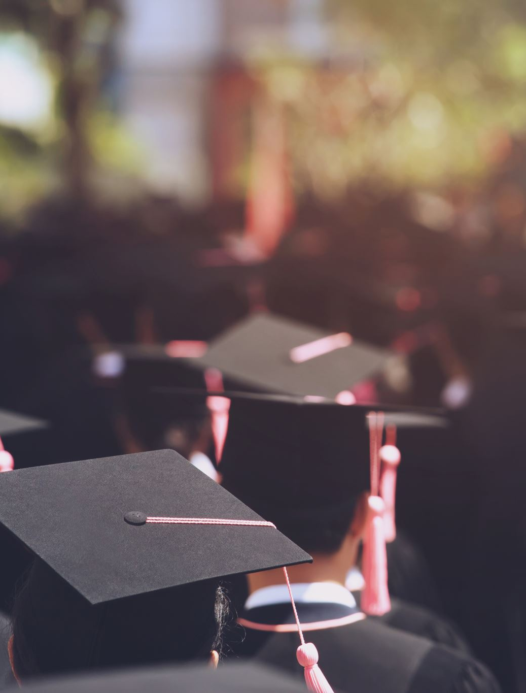
Important Dates/Deadlines
Valedictorian Selection Process
Wed. April 1st Grad Assembly #1 Valedictorian Nomination Forms available at front reception desk
Wed. April 15th – Valedictorian Nomination forms due to Ms. Butterfield by 3:30pm. NO LATE FORMS WILL BE ACCEPTED!
Wed. April 29th (last half bl. 3) Grad Assembly #2 Valedictorian Speeches (narrow down to three finalists)
Thurs. April 30th – Gr. 12 Vote on three finalists at lunch in main foyer

Slide 5
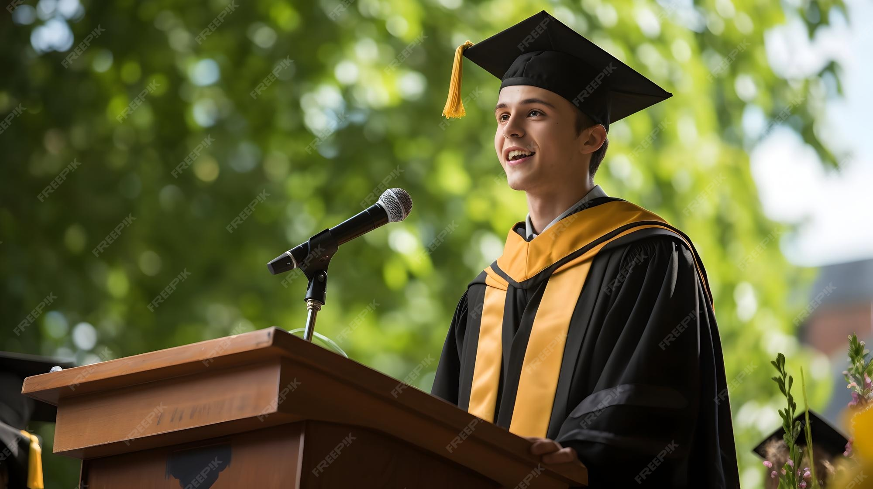
Valedictorian 2026 The Valedictorian represents their Graduation class and speaks at Commencement. If you are interested in being nominated for Valedictorian, you must meet this criteria to be a nominee:
Be in graduating position at the time of valedictorian nomination
Be in good standing with respect to school citizenship
Be in good standing with respect to achievement, in both curricular and extra-curricular areas
Be in good standing with respect to work habits
Have 10 student nominations and 2 teacher signatures

Slide 6
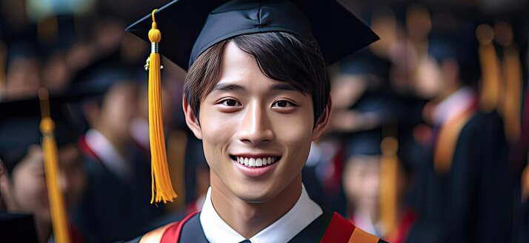
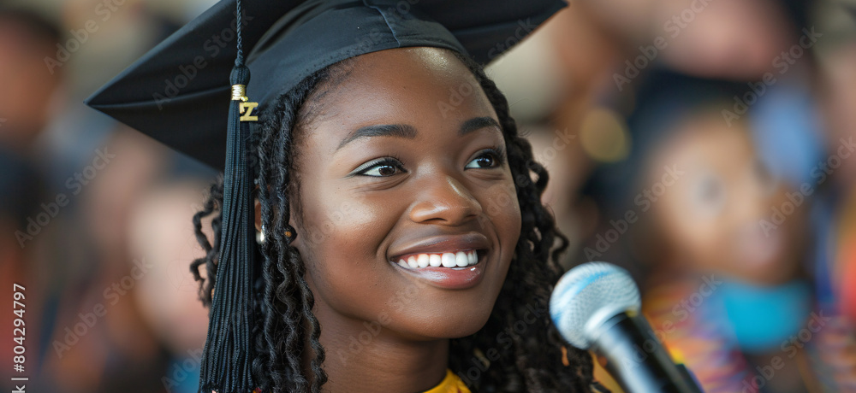
Valedictorian Speech
Prepare a 1 min speech (no longer) for assembly on April 29th
“Why I’d be a great valedictorian”
“Why you should vote for me”
Initial speech does not have to be super serious/formal – this is a demo.
Speech can be funny or serious but must be appropriate and respectful
The chosen final valedictorian will deliver a 3-4 minute speech to their peers and guests at the commencement ceremony on June 21st.

Slide 7
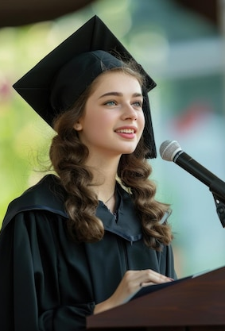
Valedictorian 2026
Valedictorian nomination forms will be available at the office starting today
The Nomination Form must be returned to
Ms. Butterfield by Wed. April 15th by 3:30pm
If you are an eligible nominee, you will be notified about next steps which include:
- Making a speech to your peers and staff on Wednesday April 29th.
How the voting process will work, and more…

Slide 8
Important Dates/Deadlines
Wed. June 3rd (Block 1, 9:45am) Grad Assembly #3 – Dinner Dance Information
Fri. June 5th – Dinner Dance at Vancouver Trade and Convention Centre
Mon. June 15th (Block 4) - Grad Assembly #4 – Commencement Assembly/Cap and Gown Distribution
Sun. June 21st – Commencement Ceremony at SFU Convocation Mall

Slide 9

Dinner Dance – Friday, June 5th
Venue – Vancouver Trade and Convention Centre. All Grade 12 Gleneagle Students are welcome to attend!
Tickets are already on sale and can be purchased through School Cash Online on school website
Last day to purchase tickets is FRIDAY, MAY 15th
Table Booking Dates: May 7th / May 14th / May 21st (Thursdays)
-Only those who have paid for their ticket can book a table.
-Students CAN reserve a table for friends, so 1 person can reserve for their group if all their group members are on the paid list.
-Seating for 10 people at each table

Slide 10
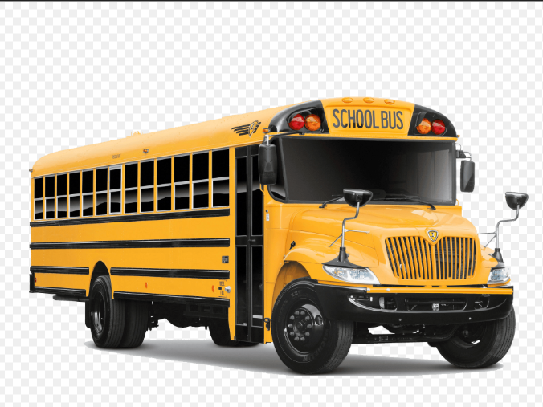
Bus Transportation to Dinner Dance
Bus transportation will be offered but spaces are limited.
See Ms. Chan in the office so she can add the $20 fee to your school cash online.
Transportation is a RETURN TRIP – One-way trips are NOT Permitted.
Transportation to Vancouver Convention Centre and then to After Grad at the Rec Room. If you do not attend After Grad you will be taken back to the school after the Rec Room drop-off.
All students MUST arrange their own rides home from either the school at approximately 11:30pm or from After Grad at the Rec Room at 3:30am.

Slide 11
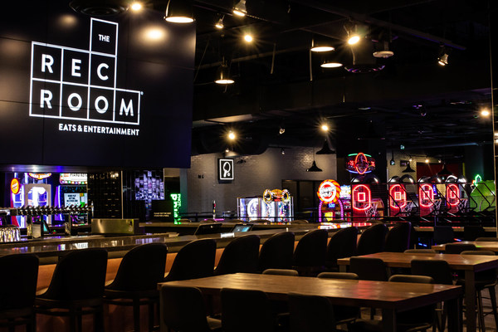
AFTER GRAD at the Rec Room 11pm-3:30am Immediately following the dinner dance
Tickets are on sale NOW through Cash Online. DEADLINE to purchase May 15th

Slide 12
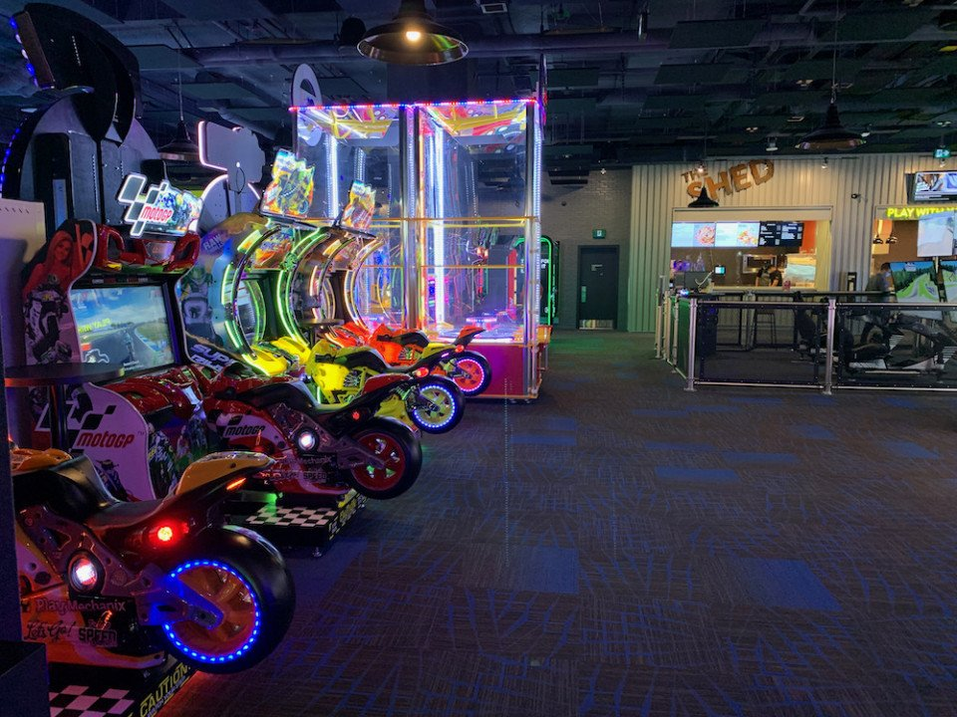
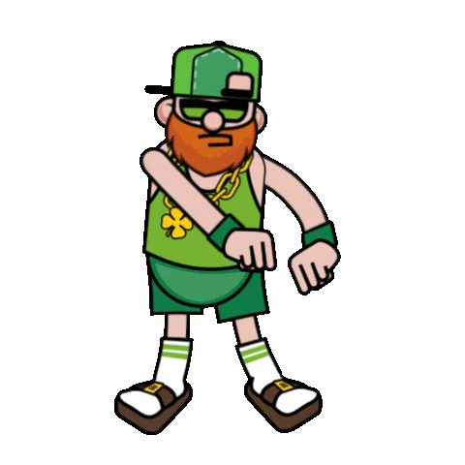
A
F
T
E
R
G
R
A
D
WHERE: REC ROOM BRENTWOOD
WHEN: JUNE 5th 11PM – June 6th 3:30AM
FOOD
DJ & DANCE FLOOR
KARAOKE
ARCADE VIDEO GAME CREDITS
POOL TABLES & PING PONG
DOOR PRIZES

Slide 13
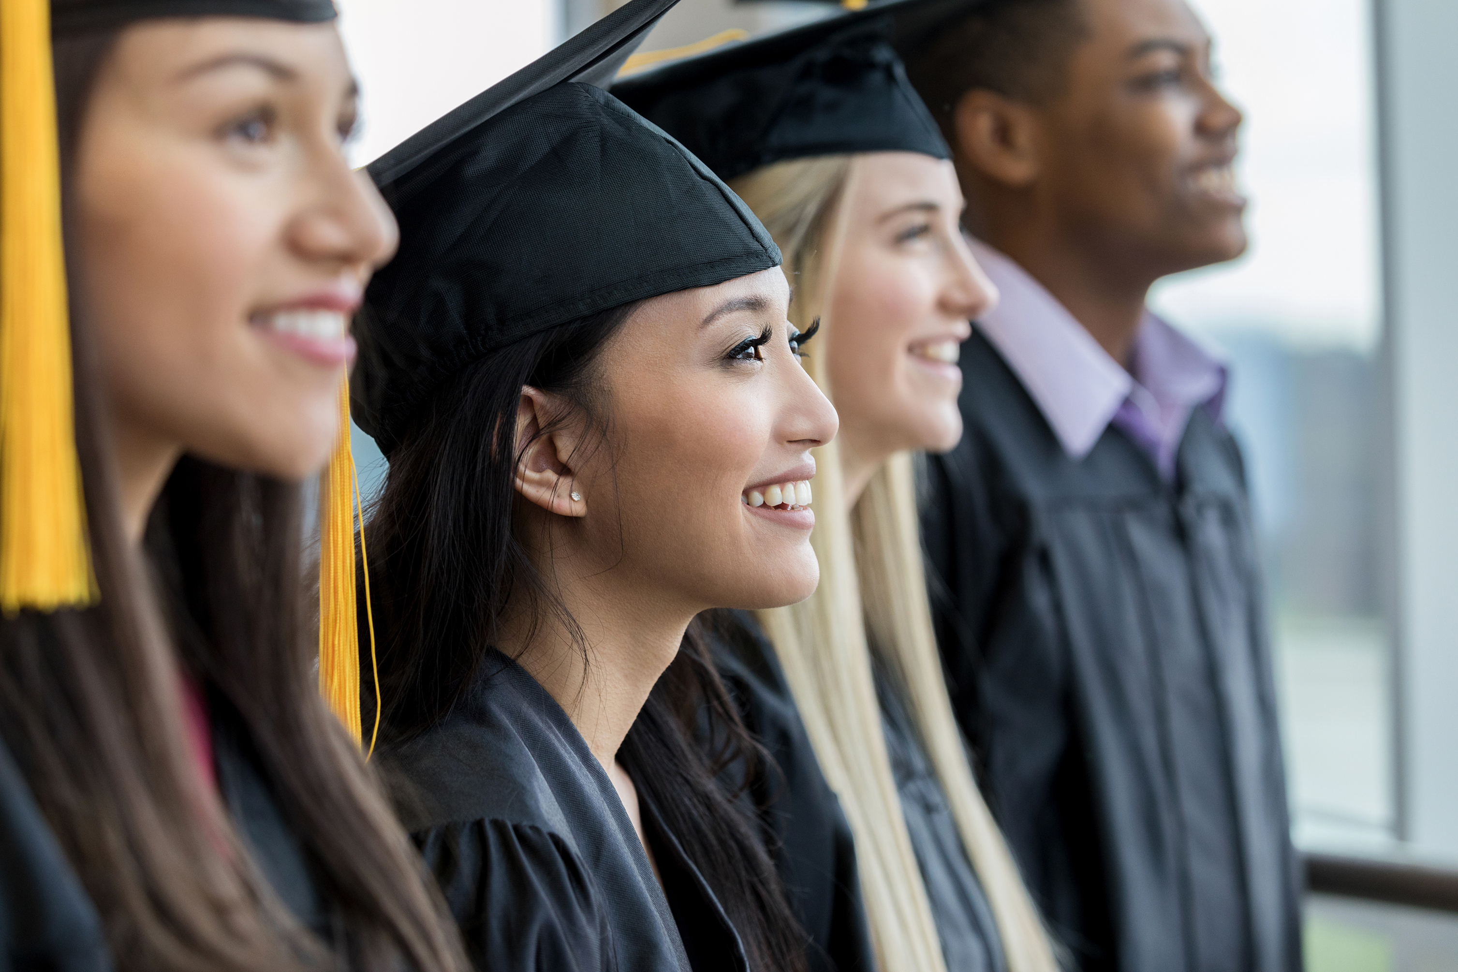
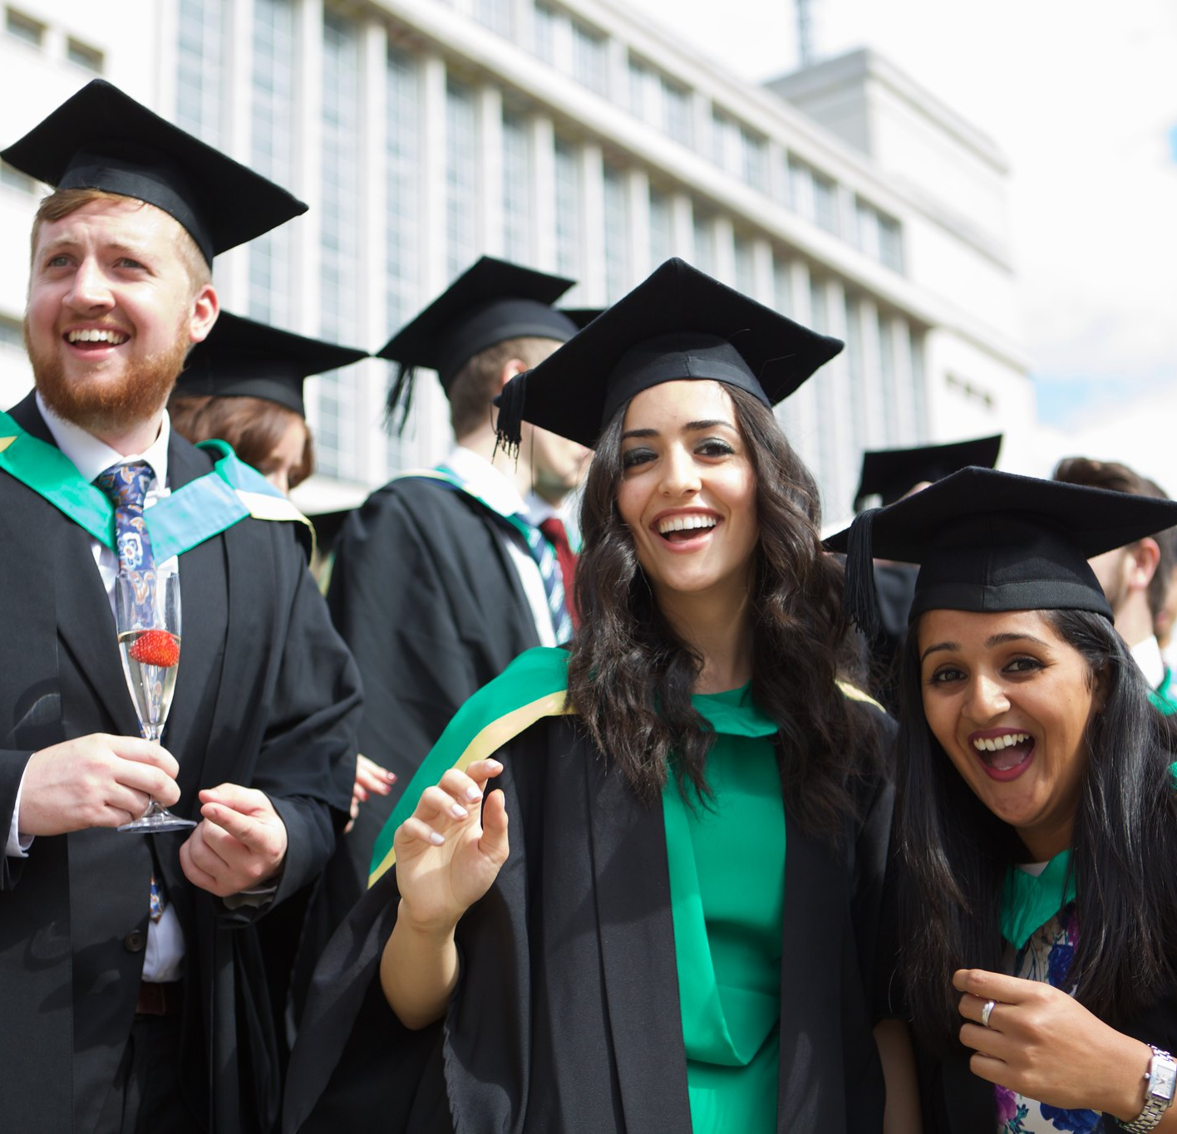
Commencement Assembly/Cap and Gown Distribution Monday, June 15th Period 4
-All grads MUST attend!
-Gown distribution will take place in Gym C after the Block 4 rehearsal in the MPR.
-No gowns will be distributed prior to the rehearsal. Cap/Gown package must be picked up by graduate; no gowns will be distributed to friends.
-If you have any outstanding fees or have not completed CLC, you will not receive your cap/gown or yearbook until these items are looked after.

Slide 14

Questions???

