Slide 1
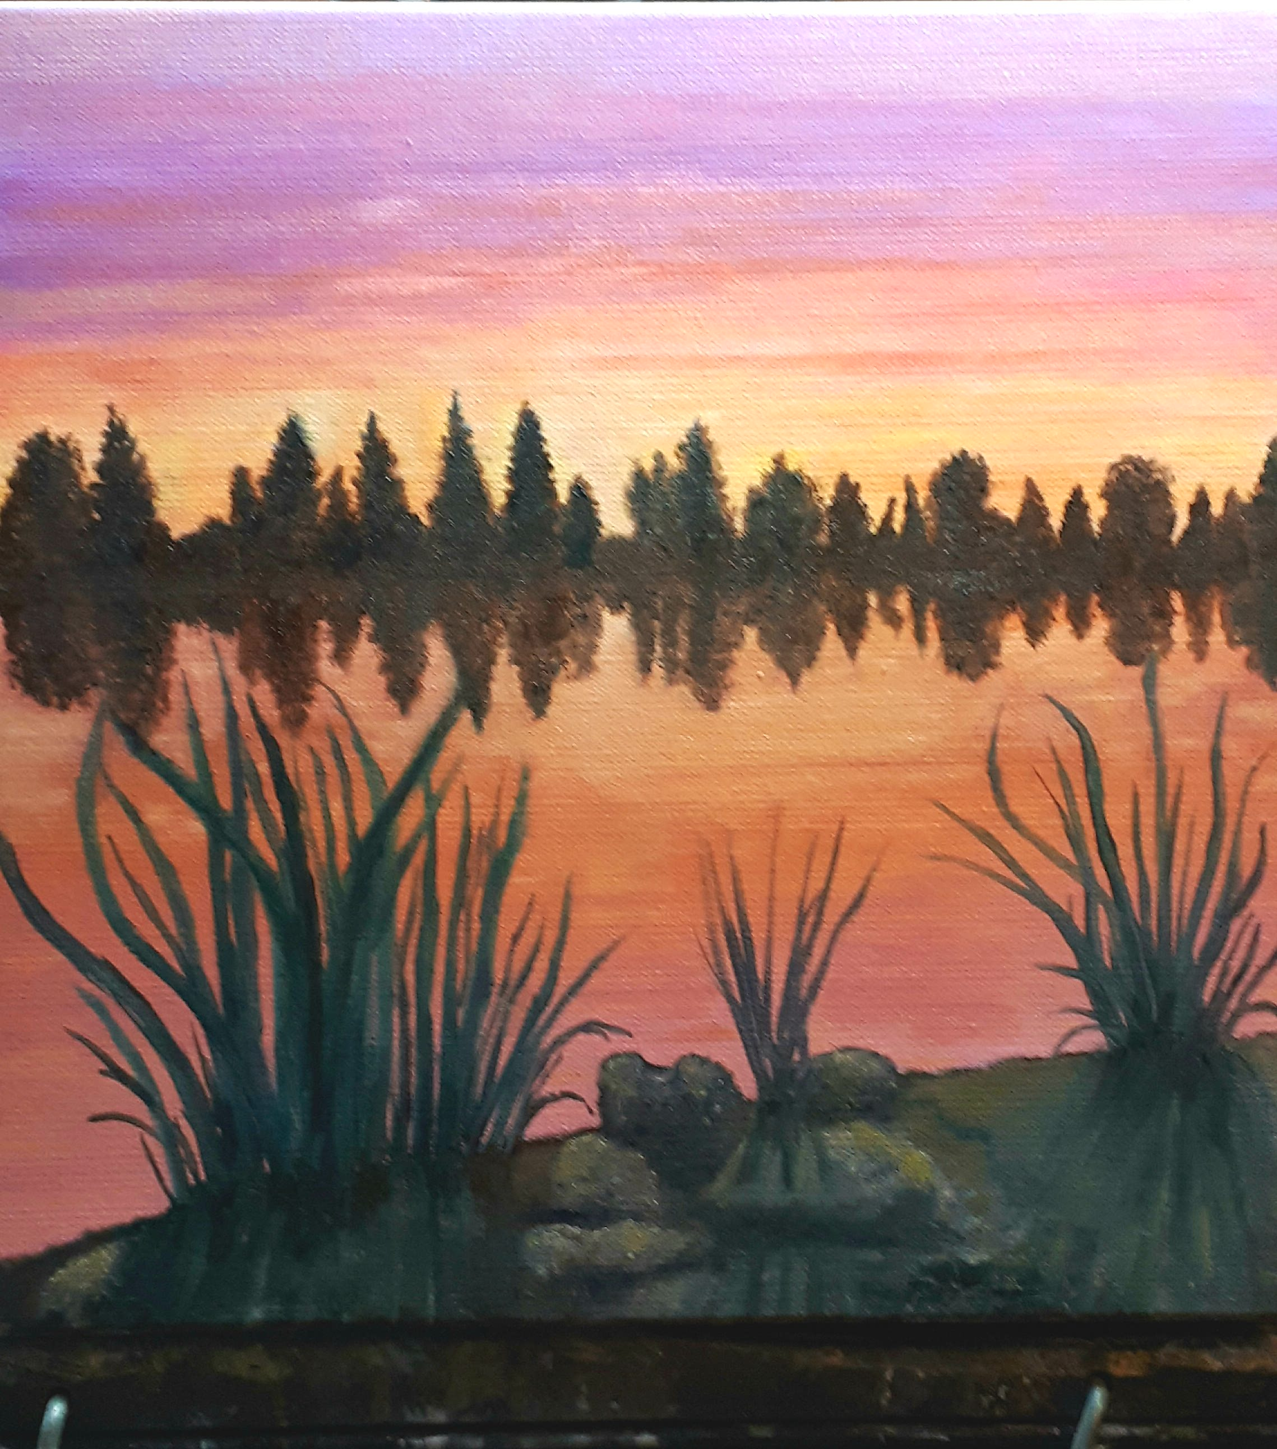
“It is very important to know
who you are. To make decisions.
To show who you are.”
– Malala Yousafzai

Slide 2
VIDEO BY MADDY https://binged.it/35ntoq7
Application tips/4:34 Profile tips
Her top tips
Be concise, be thorough, talk like yourSELF
Write your draft and build. Don’t write it over and over.
Understand the question!! ANSWER THE QUESTION.
4. Have 2 people review & critique. One known/unknown.
5. Proofread your responses.
Check grammar and spelling.
6. Choose reliable references. Someone who knows you!!

Slide 3
The Personal Profile –
What is UBC looking for?
ENGAGEMENT & ACCOMPLISHMENT | LEADERSHIP
SUBSTANCE | VOICE

Slide 4
The Personal Profile –
What is UBC looking for?
ENGAGEMENT& ACCOMPLISHMENT What do you do with your time? What are you significant contributions? What have you learned? | LEADERSHIP Leadership comes in many forms. Not just being a leader, what has leadership taught you? Have you contributed to your community. What did you learn?
SUBSTANCE Have you answered the questions in a meaningful way? Is it insightful and relevant? | VOICE Is my profile genuine and unique. Is it authentic? Will it stand out?

Slide 5
The Personal Profile –
What is UBC looking for?
COLLEGE ESSAY GUY TIPS
ENGAGEMENT& ACCOMPLISHMENT What do you do with your time? What are you significant contributions? What have you learned? CORE VALUES | LEADERSHIP Leadership comes in many forms. Not just being a leader, what has leadership taught you? Have you contributed to your community. What did you learn? “SO WHAT MOMENTS” (IMPORTANT AND INTERESTING CONNECTIONS, INSIGHT)
SUBSTANCE Have you answered the questions in a meaningful way? Is it insightful and relevant? CRAFT – Is it interesting and succinct. Logical and connected? | VOICE Is my profile genuine and unique. Is it authentic? Will it stand out? VULNERABILITY – ARE ANSWERS FROM YOUR HEAD OR YOUR HEART AND GUT?

Slide 6
ADDITIONAL TIPS
INFORMATION IN RED IS HOW THE COLLEGEESSAYGUY.COM WOULD INTERPRET THE PERSONAL PROFILE CRITERIA.
He urges students to keep away from predictable values ie the violin – discipline, commitment, hard work
Instead he shows the impact of unpredictable values – ie the violin –
Privacy, risk, personal integrity.
STAND OUT – BE UNIQUE – USE A VARIETY OF ‘VALUE STATEMENTS’ (see the sheet of values statements.)

Slide 7
Other tips to consider:
Do not repeat grades or repeat info on your application!
Always dial back extreme language.(ie. the ‘most’, ’ultimate’ ‘everybody’)
Beware of writing about someone else. It should be about YOU.
Illuminate the active steps you have taken use examples and show what you have learned.
Write like you are writing to a smart friend. Edit!! Be succinct. “GOOD WRITING IS RE-WRITING”
Visit Guide | 1.5 - Values Exercise (collegeessayguy.com)for some excellent worksheets, tips and essay examples.
Use varied core values and self-descriptors – do not repeat the SAME ones. (eg. hard work, perseverance, determination = same) (instead use: autonomy, resourcefulness, diversity etc.)

Slide 8
Building your essay
Once you have brainstormed and have an idea of what you will write.
USE THE FORMULA OF
1. CONTENT
2. STRUCTURE
3. DETAILS
MAKE SURE YOU ANSWER THE QUESTION.

Slide 9
MyCampusGPS.com Tips/Essay Problems
Many lack REFLECTION on experiences and activities. Show what you learned.
Illuminate how your experience impacted you/your community. “feely stuff” (aka vulnerability)
Use big words selectively! Too many will have a distancing effect on the reader. Be YouSELF
Connect HOW you will use the experience in the future.
Try not to make sweeping statements. ie. Medical Doctor – “I like science and I like helping people.” Too vague.
Always try to show the reader you understand the field you are applying to and passionate about.

Slide 10
107: What I've Learned from Reading Over 10,000 College Essays (collegeessayguy.com)
The College Essay Guy Podcast

Slide 11
EXAMPLES OF LEADERSHIP (UBC)
Thinking about the needs of the whole beyond individual needs
Effective and productive dynamics in small group work
Effective conflict resolution working with others
Ability to make decisions
Ability to motivate and inspire others
Demonstrates confidence in action and decision making
Demonstrates and shares a sense of purpose and enthusiasm for project or work
Demonstrates tolerance, sense of calm, and order in times of distress

Slide 12
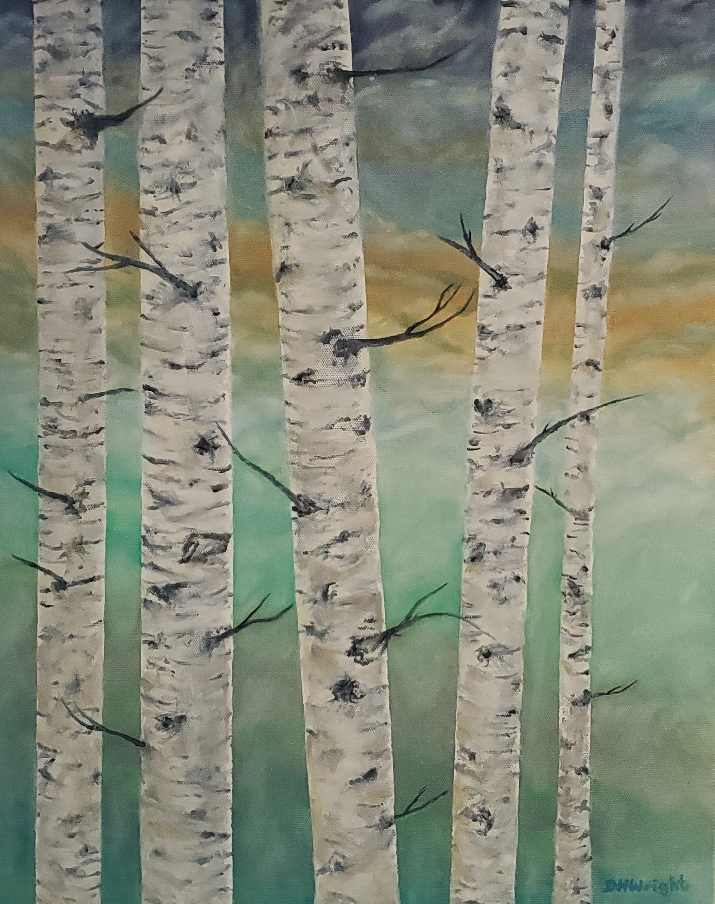
TIME AND EFFORT MATTERS
Two different UBC readers will review your profile. ALL are read.
A great profile will especially help students who are on the cusp with marks. Take the time!!
They receive thousands every year.
A bad profile will be very evident to UBC. Students who don’t put in the effort will not be accepted.
A FINAL NOTE –
I am happy to review your personal profile and give general feedback.
I do this if time permits and I have sufficient notice. Generally during work hours. I do not review profiles with imminent deadline dates!! Please do not leave it to the last minute!!
Thanks, Mrs. HW

