Slide 1
Welcome to our CABE Graduation Brunch

Slide 2
GRAD BRUNCH SHIRT DESIGN (Margaux Llanillo)
The Sun represents hope
The rainbow inclusivity
The trees represent a sense of community and nature
Logan and Mittens (dog and cat) friendship that breaks stereotypes
The ducklings are following their path, led by a protective adult duck
The paw is CABE’s symbol
The water is Como Lake, which until 1887 was known as Welcome Lake, and although small in size is the headwater of the Como Lake Watershed

Slide 3
An Opportunity to Change Your Life For the Better

Slide 4
Wesbild LIFT Scholarships
Well over $200,000 in LIFT scholarships have been awarded to CABE students since 2013
LIFT scholarships are renewable each post-secondary term
Scholarship link must be requested and sent out to you by Ms. Charboneau or Mr. Roosma
Your application will submit when you are finished. Please check with Ms. Charboneau to make sure she has received it
Application must be submitted no later than Friday, May 16th at 3:00pm

Slide 5
Not Ready? Don’t Worry!
Wesbild LIFT scholarships can be applied for two times a year: May and October.
You have 18 months after you graduate to apply for Wesbild LIFT.
Once you are awarded your scholarship, you have 12 months to use it.
See Ms. Charboneau to help you plan your timeline for applying to school and for Wesbild LIFT funding

Slide 6
What can I use Wesbild LIFT scholarships to pay for?
Your TUITION at publicly funded accredited post-secondary institution.

Slide 7
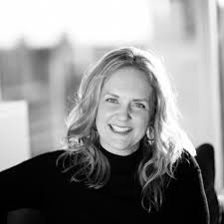
Please meet Ms. Jen Derbyshire!
You will receive your Wesbild LIFT scholarship award information from Jen.
You must read all of the terms
You will be communicating with Jen moving forward regarding payment of fees, future plans and any requests for continuing funding
You have to be on top of this; Jen is AMAZING but she is not a magician!
Communication is key!

Slide 8
MARK YOUR CALENDARS!
We will be available to support you in applying for your Wesbild LIFT scholarships on the following day:
Tuesday, May 6th at 2:20 pm
Your support team (Charbs, Ms. Bawa, Ms. Corra, Mr. Roosma) will be there to make sure you are on the right track!

Slide 9
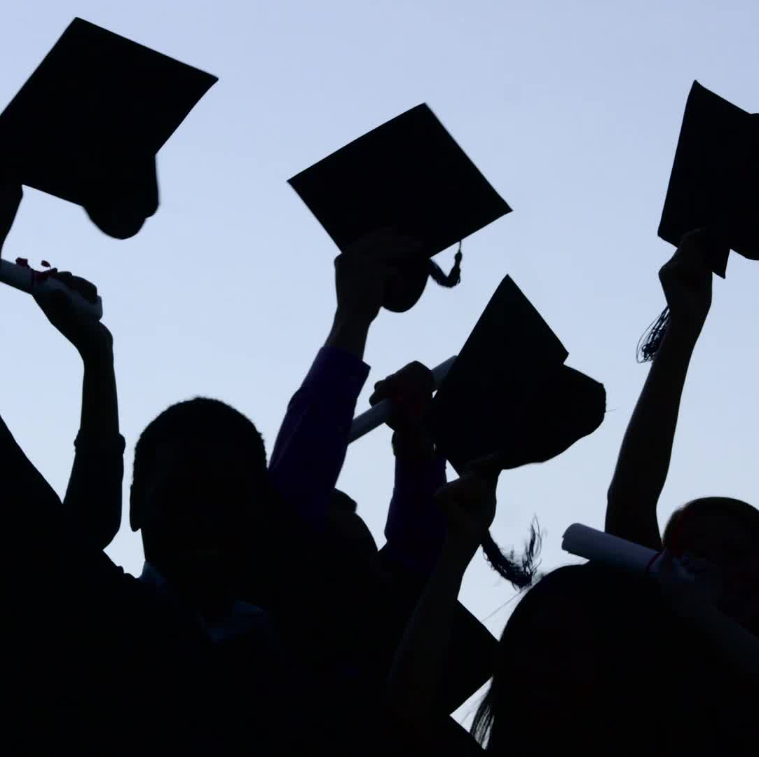
Coquitlam Teachers' Association Scholarships
Cam McKenzie Award (1 x $500)
CTA Student Assistance Bursary (1 x $500 )
Applications due Friday May 16th at 4:00pm
Submit to rcharboneau@sd43.bc.ca

Slide 10
Scholarships & Bursaries
Know the due dates
Know the requirements
Take advantage of the support offered
Scholarship session will be on TUESDAY, MAY 6^{th.}
Take a deep breath. This all feels overwhelming but reframe and remember what a great opportunity you have to be supported!

Slide 11
GRATITUDE IS IMPORTANT!
Written acknowledgement and a thank you are not only expected but are just good etiquette and manners.
Please make sure that if and when you receive a scholarship or bursary, you understand how to do this and where to send your thanks (Hint: See Charbs for help figuring out who to send it to if necessary).

Slide 12
Where can I get help?
Post-secondary information:
Mrs. Healeywright or Ms. Charboneau
Scholarship information:
Ms. Charboneau

Slide 13
How do I move from being a potential grad to a graduate of the Class of 2025?
Complete all courses and provincial assessments necessary in order to meet Ministry of Education requirements.
Potential Graduate
Complete all courses and Provincial Assessments
Work hard
GRADUATE

Slide 14
Important Things to Remember!
TAKE THE TIME TO BE PROUD OF YOURSELF AND ENJOY THIS TIME!
ASK QUESTIONS IF YOU HAVE THEM
Be aware of DATES and deadlines
Work hard:
only 35 days before Grad
Complete your coursework

Slide 15
CABE Graduation Ceremony
Friday June 20th
At CABE Secondary
Between 11am and 3:15pm
We will be connecting with you to ensure you have your caps and gowns

Slide 16
What will Graduation Day look like?
Each half-hour, a group of up to 9 students will cross the stage one at a time with their guests present.
Each graduate can invite 6 guests. Please talk to Charbs or Ms. Lauzon if you need a few more.
Everyone will remain in the gym until all graduates in your group have crossed the stage.

Slide 17
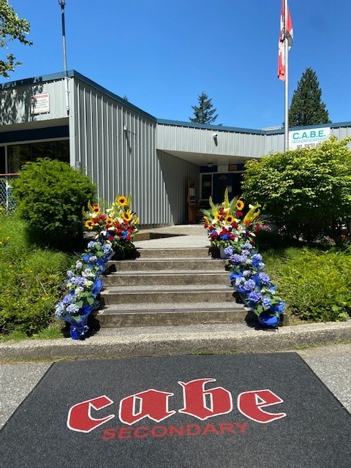
Photo Opportunities
Students and their guests will be directed to the front of the school where there will be opportunities for photos.
Students can keep their cap and gown so they can take pictures at the school, in the community or at home.
Students will receive an email from Ms. Lam/Mr. Smelser with their grad photos.

Slide 18
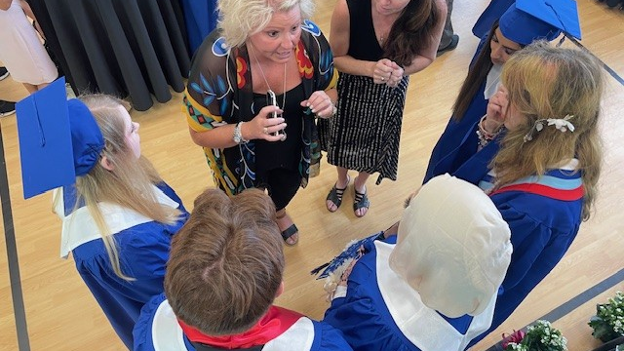
Booking your graduation time for June 20th.
You and your parent/guardian will receive an email in mid-May advising you on the process for booking your timeslot.

Slide 19
Important Things You Need to Do!!
Please send your yearbook comment to Ms. Lam/Mr. Smelser via QR code!
Please send your stage walk comment to Ms. Charboneau via the same QR code (theme is gratitude and thanks)
CHECK YOUR EMAIL REGULARLY, both school and private!!!!
Please make sure you check with Annie in the office to make sure your address is up to date
Please give Annie a non-school district email as well. Please also be checking both of your emails regularly!

Slide 20
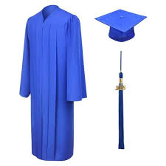
Graduation Information Review
Check your SD43/private email email often if applying for post-secondary, for jobs or for scholarships.
Get your yearbook and stage walk comments into Charbs and Mr. Smelser.
June 20th – SAVE THE DATE.
Sign up for specific timeslots will happen in mid-May.
Caps & gowns will be distributed in early June. $20 fee can be paid online or in the office.

Slide 21
Questions

Slide 22
Door Prizes
Every student who has attended today’s information session will receive a gift courtesy of Wesbild.
CABE Exclusive grad brunch shirts
$50 Amazon Gift Card
$100 Amazon Gift Card
Laptop Computers

