Slide 1

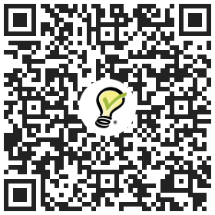
2026 Volunteer Sign Up
Interested in Helping out at the 2026 Port Moody Golden Spike Days Festival?
Scan the QR Code to learn about Opportunities and to sign up
We are still looking for volunteers! Please email volunteers@goldenspike.ca if you would like more detailed information.
For more information on 2026 Golden Spike Days Festival visit our website www.goldenspike.ca

