Slide 1

Weaving
Indigenous Worldviews Into Practice Authentically

Slide 2
Gleneagle Sec.
Notes:
Clarify the purpose of WHY we Acknowledge the Territory at gatherings: (Reconciliation)

Slide 3
Notes:
As part of Reconciliation the Ministry of Education recognized the importance of integrating Indigenous worldviews into the curriculum of K-12. The First Peoples Principles of Learning provided a crucial lens for teacher teams when drafting the new curriculum.

Slide 4
Sort and connect
First Peoples Principles of Learning
And
Core Competencies
Notes:
To prepare for this activity:
divide your staff into groups of four,
Each group gets a set of FPPL cards printed on coloured paper (1 principle per card = 9 cards)
Each group also needs a set of Core Competency cards printed on a different coloured paper (one facet per card = 20 facets)
Ask each group to sort and connect the cards in silence.

Slide 5
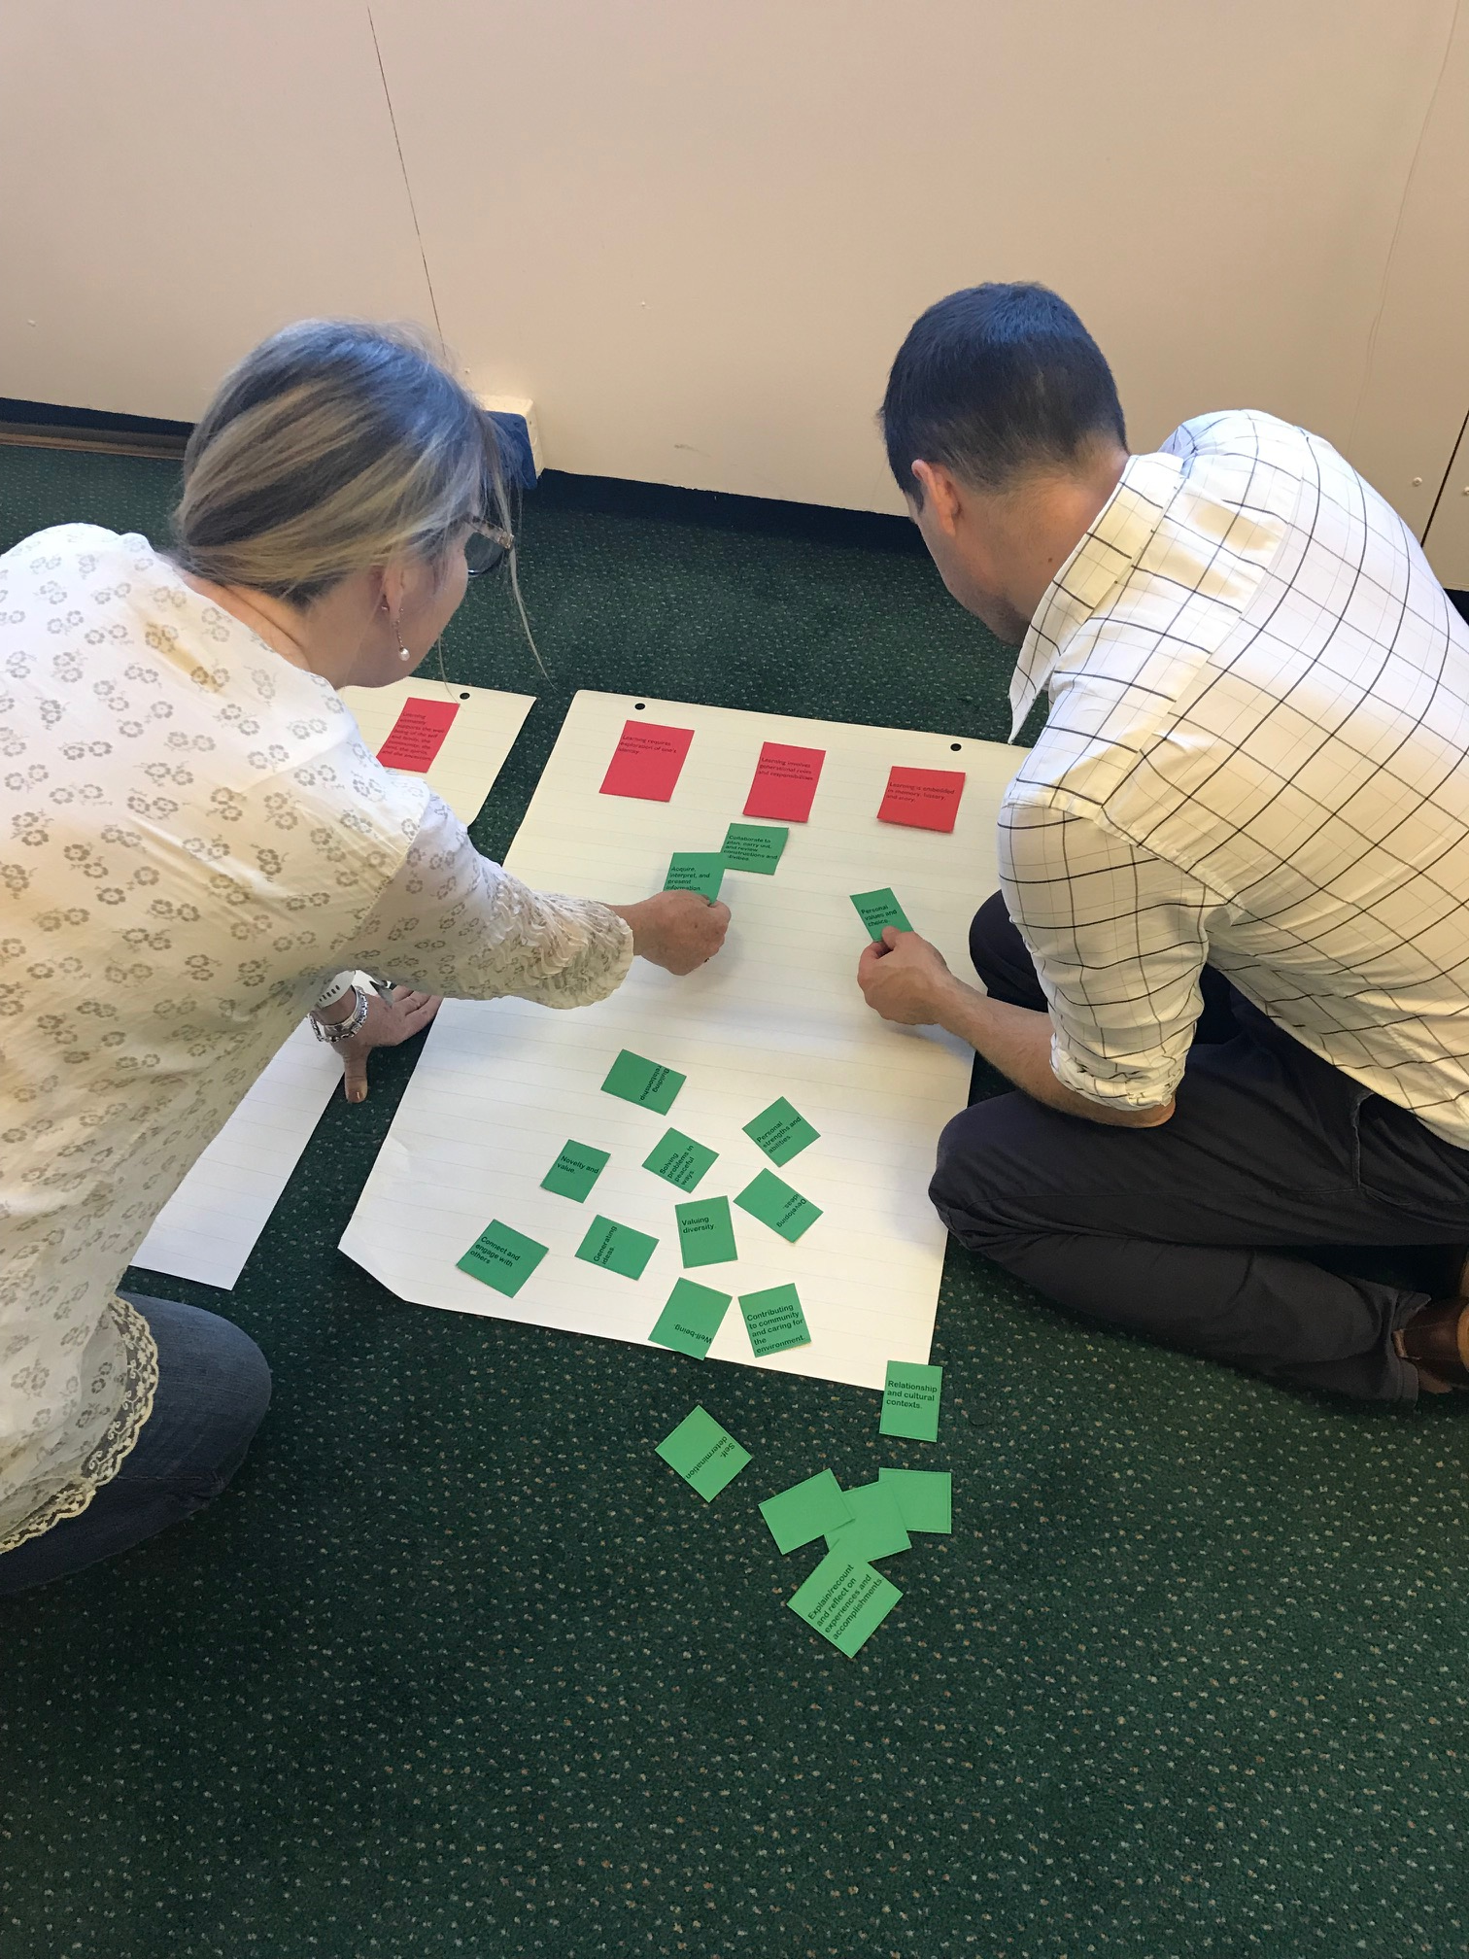
Activity: ‘Silent Sort’
Lay out all the cards (use FPPL as headings)
Silently read each CC card and think about which FPPL heading it belongs under
Silently begin to move CC cards under the headings where you feel it best fits
Notes:
Facilitator Note: Watch for when teachers disagree on a sort. Suggest that they either write on the card or use the blank cards provided.

Slide 6
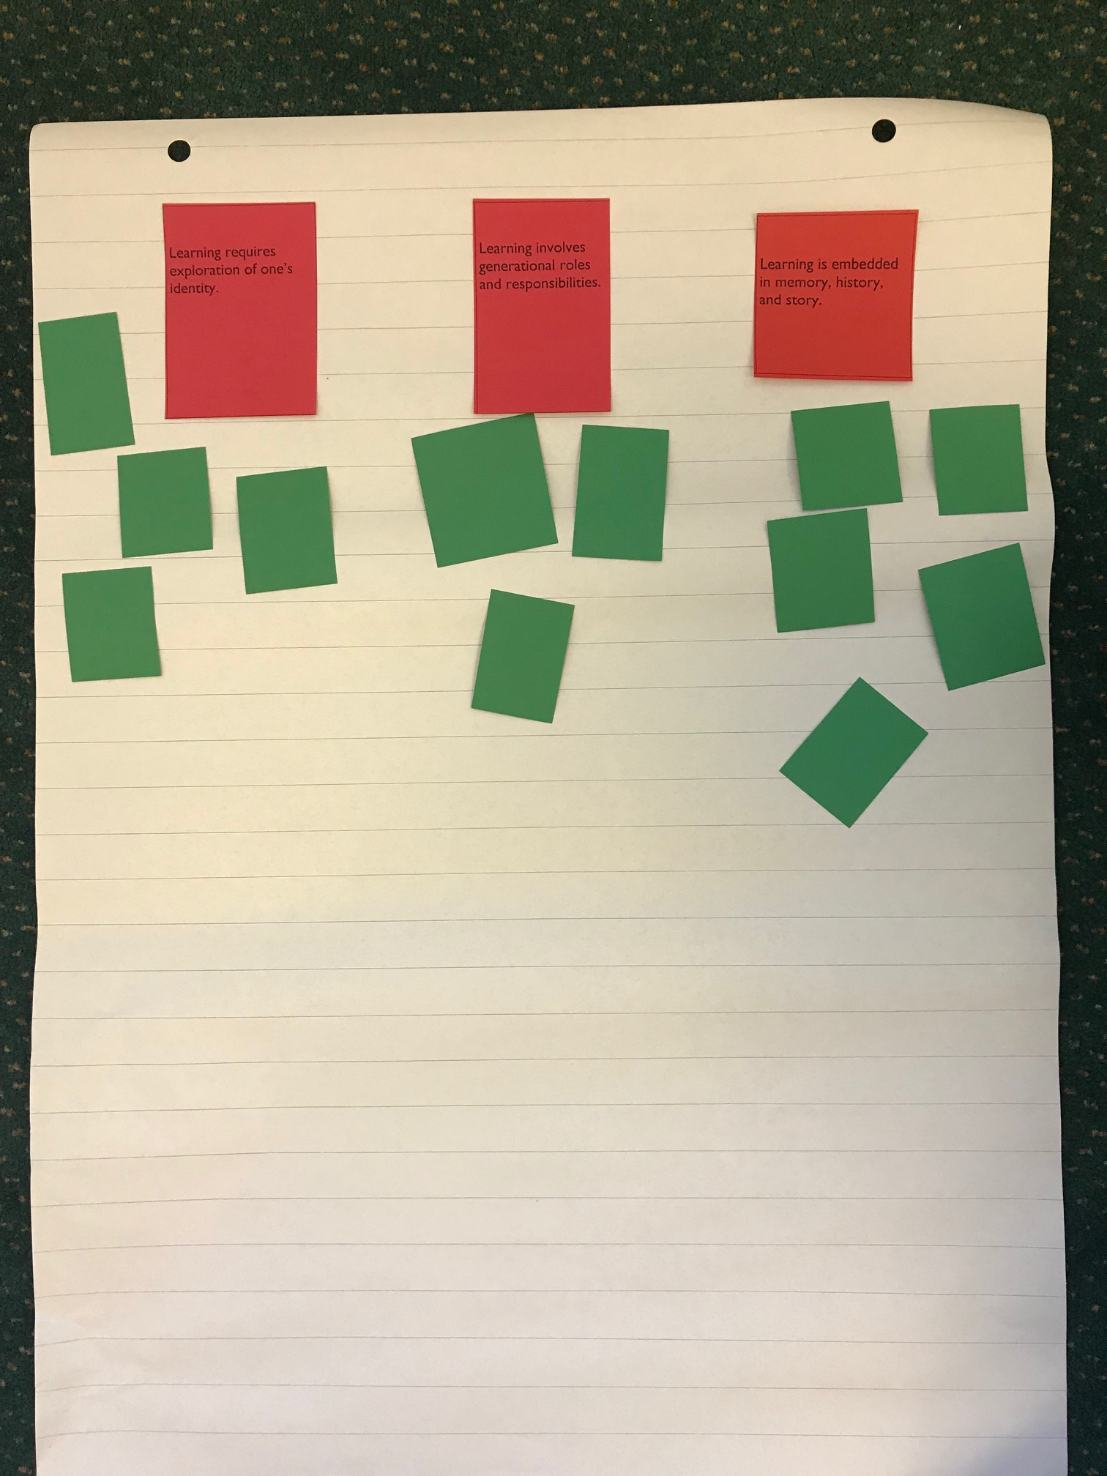
‘Silent Sort’ Activity Continued…
Once finished sorting; in your groups of four openly discuss points of connection and decisions made as to why
Choose one point to share with the whole group

Slide 7
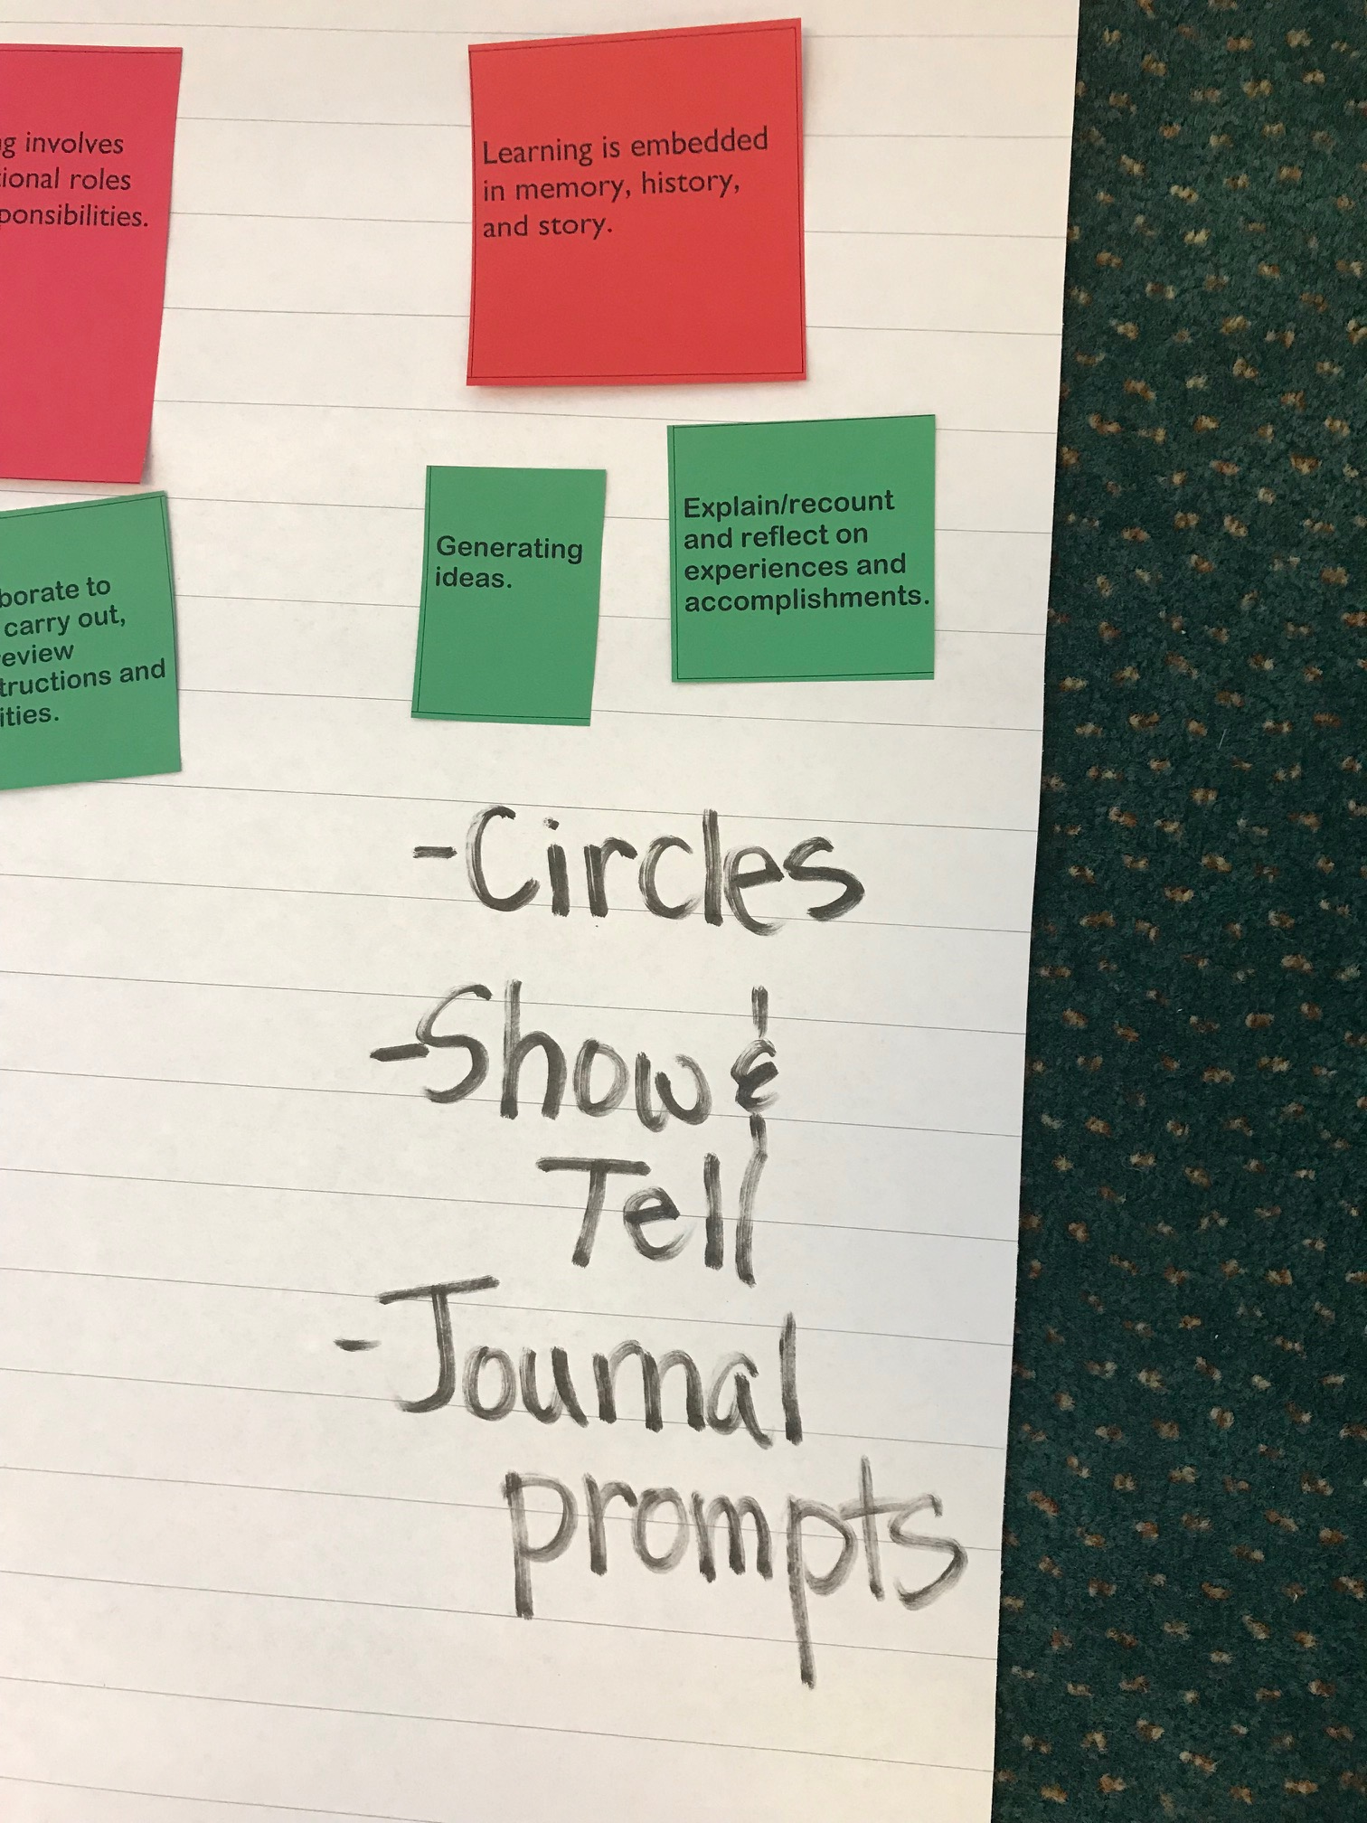
Using one point of connection your group has made,
share a related strategy, approach or activity that you have used or might use in your classroom.
Notes:
On chart paper, in your groups, write down strategies, approaches, and activities teachers suggest. Share groups results.

Slide 8
How do I weave Indigenous worldviews into my practice? (Two Ways)
Connecting Content with:
Pictures/Art
Artifacts
Inquiry Projects
Themes/Stories/Legends
2. Indigenous Worldview:
Circles (small & large)
Experiential Learning (place-based/ hands-on)
Story/Oral traditions
Compare (cultures/traditions/perspectives)
Inquiry Model (see/wonder/inquire)
Reflection

Slide 9
Example of Weaving
Indigenous Pedagogy and Content
using
First Peoples Principle of Learning:
•Learning is embedded in memory, history and story

Slide 10

Artist: Dylan Thomas
What story might this picture tell?
Notes:
Have people in small groups share from this prompt: “This picture tells me…”
You may want to have the groups share widely following group discussion.

Slide 11
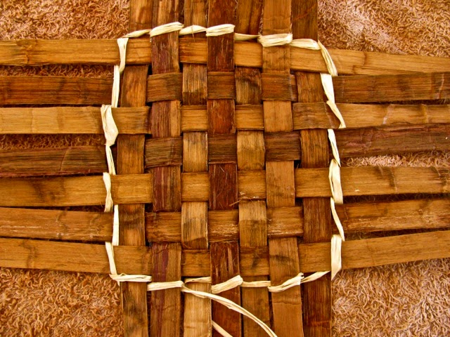
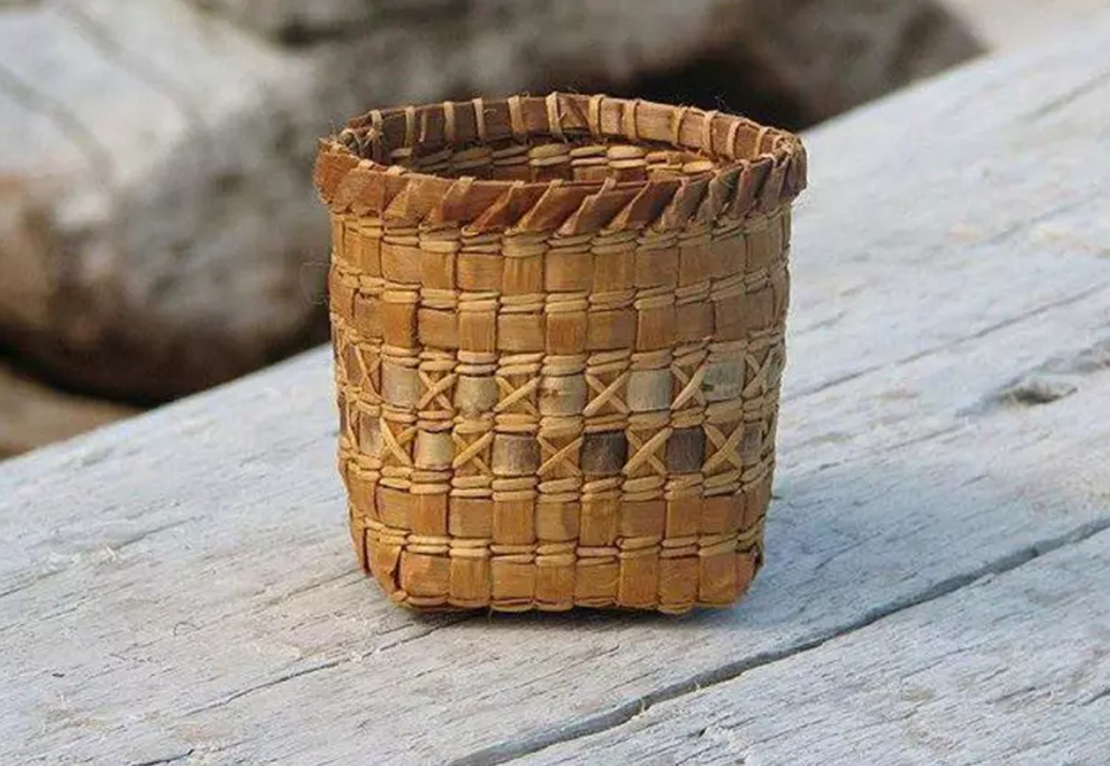
Through the lens of your subject area or grade level;
How are these pictures and your subject area connected?
Notes:
Have people in small groups share from this prompt: “My subject like these images because…”
You may want to have the groups share widely.
The purpose of this slide is to have teachers make a connection between their subject matter and Indigenous culture through artifacts (objects or pictures)

Slide 12
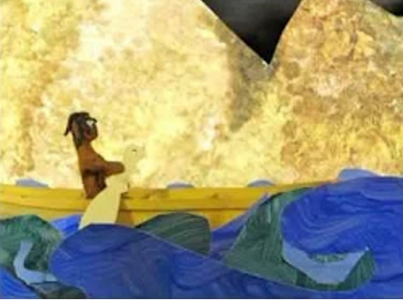
Connecting Story and Place: An Example
https://www.youtube.com/watch?v=bR7Vbq3qF0I
The Two-Headed Serpent: A Story from the Squamish Nation

Slide 13
Next Steps:
Decide on a topic
Decide how you are going to connect/weave Indigenous worldviews (through content or practice)
Try-try-try

Slide 14
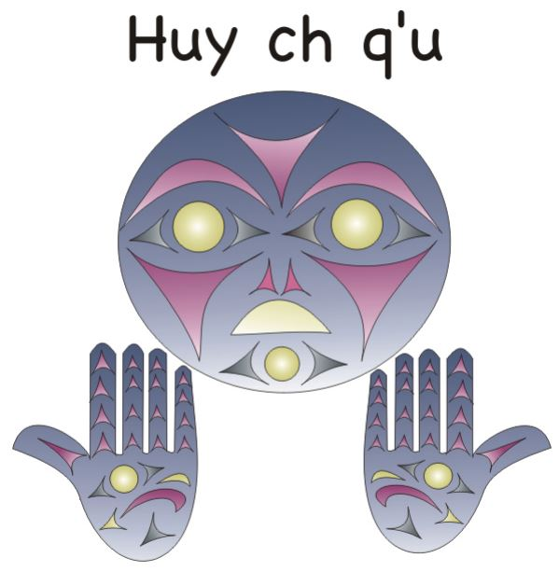
Stuart Pagaduan

Slide 15
First Peoples Principles of Learning Headings
Learning ultimately supports the well-being of the self and family, the community, the land, the spirits, and the ancestors. | Learning involves generational roles and responsibilities. | Learning requires exploration of one’s identity.

Slide 16
Learning involves recognizing the consequences of one’s actions. | Learning involves patience and time. | Learning is embedded in memory, history, and story.

Slide 17
Learning is holistic, reflexive, reflective, experiential and relational (focused on connectedness, on reciprocal relationships, and a sense of place). | Learning recognizes the role of indigenous knowledge. | Learning involves recognizing that some knowledge is sacred and only shared with permission and/or in certain situations.
Learning ultimately supports the well-being of the self and family, the community, the land, the spirits, and the ancestors. | Learning involves generational roles and responsibilities. | Learning requires exploration of one’s identity.

Slide 18
Core Competencies Cards
Collaborate to plan, carry out, and review constructions and activities. | Developing ideas. | Self-regulation. | Building relationship.
Explain/recount and reflect on experiences and accomplishments. | Relationship and cultural contexts. | Well-being.

Slide 19
Connect and engage with others | Novelty and value. | Personal strengths and abilities. | Solving problems in peaceful ways.
Acquire, interpret, and present information. | Generating ideas. | Self-determination. | Valuing diversity.

Slide 20
 | Personal values and choice. | Contributing to community and caring for the environment.

