Slide 1
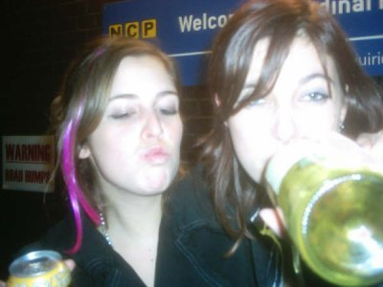
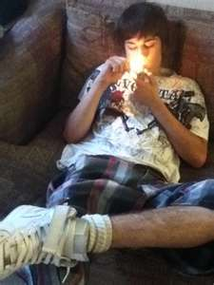
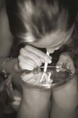
Understanding and Responding to Teen Substance-Use
Presented by: Robb McGirr
Coquitlam School Dist. 43

Slide 2
Why should Schools do it?
Problematic Substance use is one of the leading factors in a students failure to succeed in school…
performance, attendance, behavior
Approx 50% of Chronic truancy is drug-use related
The majority of adult addictions originated in adolescence
Using additional school resources to assist a marginal or failing student will likely fail unless the substance abuse issue is addressed.
Tutoring, curriculum manipulation, alternate ed programs

Slide 3
How common is drug use?
Approx. 5% are using daily
more than 3 times per week
Most likely Marihuana or Alcohol
Another 10% are using outside of school at a level that negatively impacts their ability to succeed at school (weekends, weekday nights)
Using hardcore drugs (Ecstasy, Cocaine) or Binge drinking etc
An average Secondary School (1500 students) has approx. 225 students that are using at a level that impacts their ability to succeed

Slide 5
Our goal in Prevention & Education
To Delay “First Use”
To help satisfy curiosity without the need to use or experiment
providing accurate, current, and relevant information
stimulate on-going discussion
allow students to challenge ideas and express their own opinions (a two-way dialogue)
To make students feel connected, and valued
A predictable, safe, and supportive environment

Slide 6
Understanding First Use Risks
The earlier the first-use... The higher the risk
Highest Risk period
Summer after grade 8 - the end of grade 9
The first three months of High School!
Adjusting to a new social environment
“What do I need to do to fit in?”

Slide 7
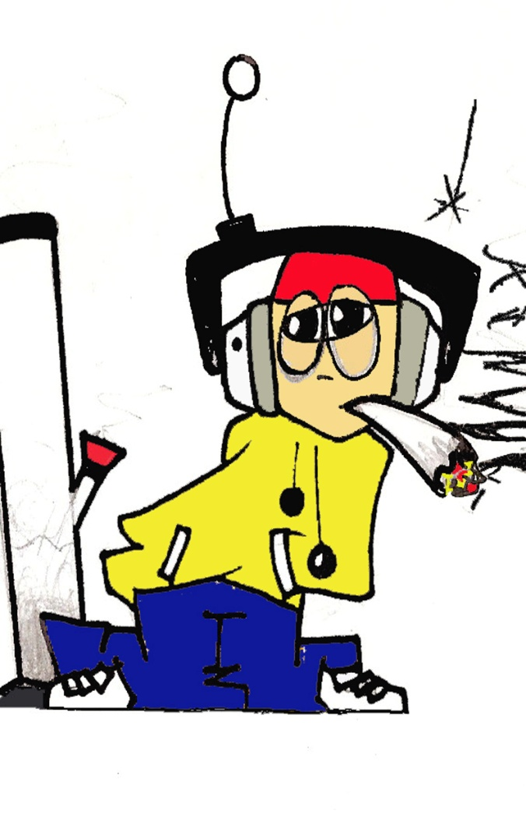
The “First Use” scenario
Curiosity + Opportunity
= high risk for 1st USE
“Everybody Uses”
Drug-active teens tend to associate with other teens who share their drug habits
Peer Pressure
“What do I need to do to fit in?”

Slide 8
How Does “First Use” Occur?
Usually on a weekend
Almost always in a “social setting”
Will usually be spontaneous and unplanned
Over 60% of the time it will be with a close or best friend with them

Slide 9
How do they Satisfy Curiosity?
What sources of information do they trust and have access to?
The Four most trusted sources of Info are:
Parents,
Teachers,
Printed Material,
Multi-Media
Where do they actually get their information from?
Peers,
Internet,
Media

Slide 10
Less than 10% of students suspended were “First Use” scenarios
“First Use” usually occurs on weekends in social settings
Substance use during school days is a likely indication of problematic use

Slide 11
Some Teens are Higher Risk
Don’t Feel connected…
Socially, Family, School
Don’t feel like they belong…
Don’t feel safe, secure in their lives
Don’t feel valued
High levels of conflict in their lives
Kids who feel “bad” more than they feel “good”….

Slide 12
Prevention for Parents
Understand the “first-use” risks that are relevant for your child
Energy drinks, Smoking, Marihuana, Alcohol
Be aware when your child demonstrates drug curiosity
Keep connected to your child AND their friends.
Maintain connections with key school staff
Vice principals
Counsellors
Youth workers

Slide 13
Spheres of Influence
Family
Work/School
Social
Pre-school
Elementary School
High School

Slide 14
Spheres of Influence
Family
Work/School
Social
Healthy Overlaps
High- Risk

Slide 15
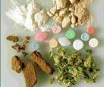
Drugs of Choice
Drug Identification
Marihuana / Alcohol
Ecstasy
Magic Mushrooms
Cocaine
Crystal Methamphetamine
Heroin

Slide 16
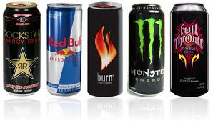
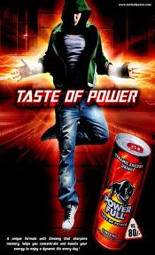
Energy Drinks

Slide 17
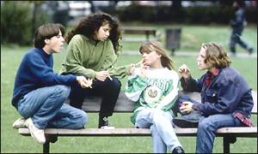
Smoking
Rates of Teen smokers is slowly dropping…
About 8 – 10%
Experimentation most common in Middle School Students
Regular exposure during first year of High School

Slide 18
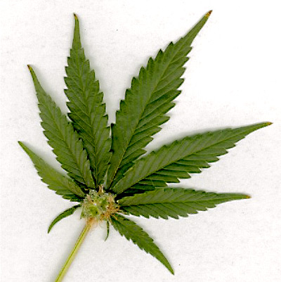
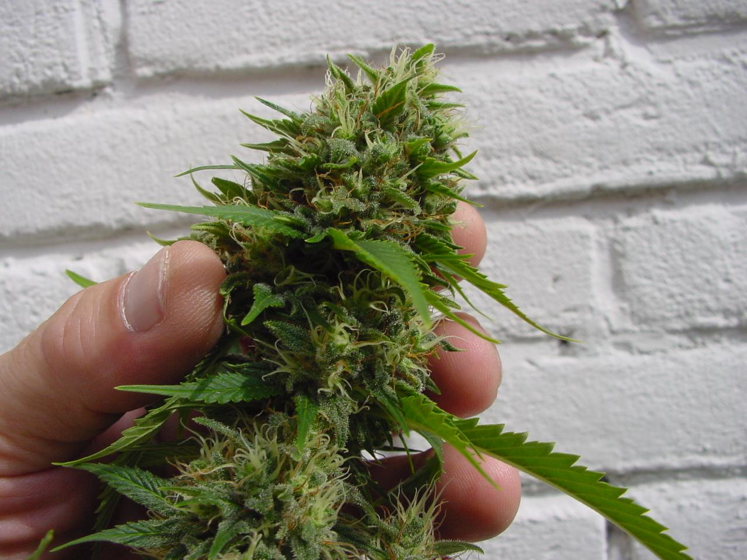
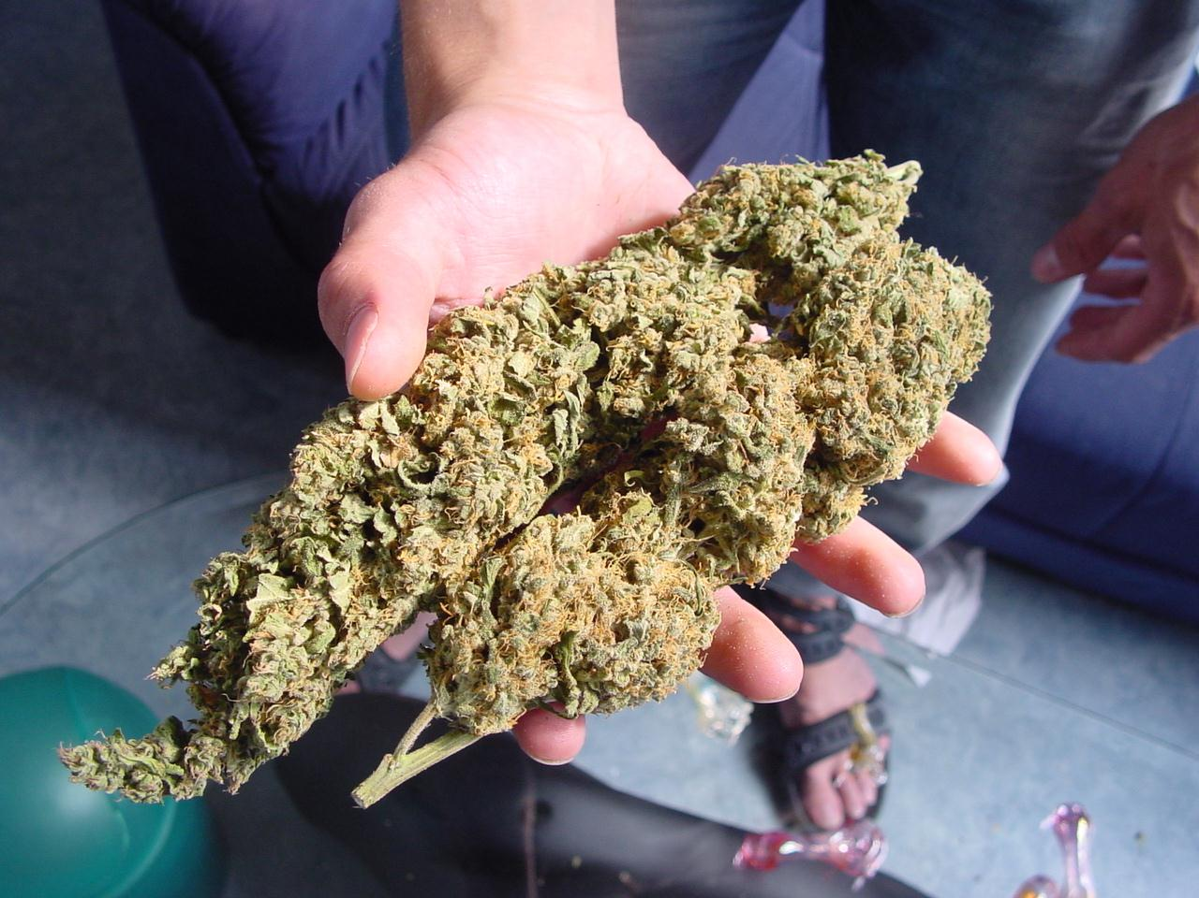
Marihuana

Slide 19
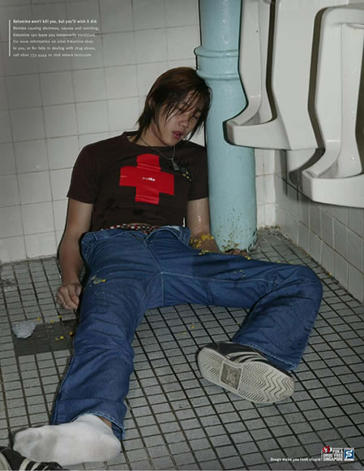
Alcohol

Slide 20
Alcohol Abuse
Binge Drinking
Lots of reasons for Binge Drinking
The Social aftermath
Teen Alcoholism
Regular daily use
Almost always associated to mental health issues
Anxiety disorders
Depression
Mental health assessment/ support

Slide 21
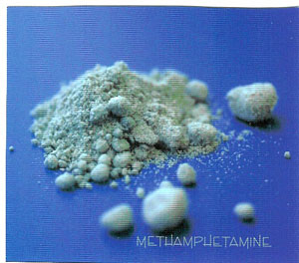
Ecstasy

Slide 22
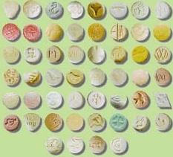
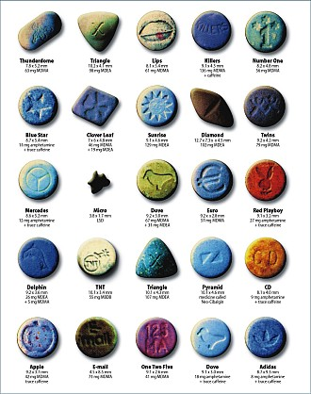
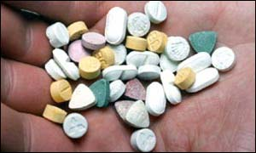

Slide 23
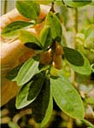
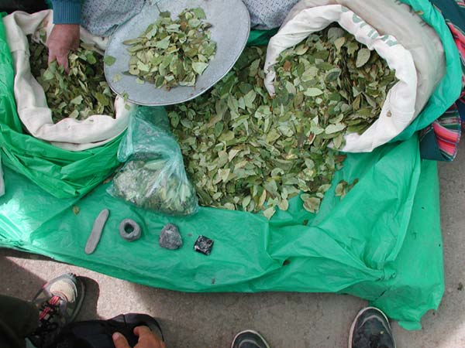
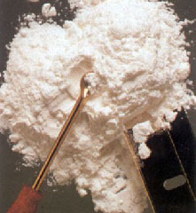
Cocaine

Slide 24
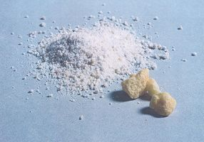
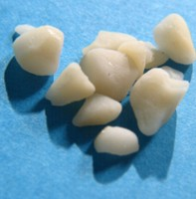
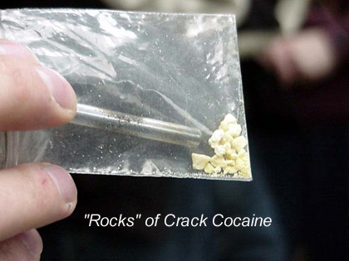

Slide 25
What you’re up against The “Feel Good” scale
Favorite Meal… 150 - 200 units
Vigorous workout 200 - 300 units
Intimate Sex… 250 - 350 units
Marihuana… 250 - 350 units
Ecstasy… 400 - 500 units
Cocaine… 600 - 800 units
Heroin… 700 - 900 units
Methamphetamine… 900 - 1100 units

Slide 26
The Drug-Active Child… Helping parents respond

Slide 27
Understanding Addiction
Physical Addiction
Alcohol, Caffeine, Heroin, Meth
Psychological Addiction
Cocaine, Ecstasy, Marihuana
Marihuana Addiction
A definition of addiction: a pattern of use that continues despite obvious and persistent negative consequences
“Use that continues, not to feel good, but to keep from feeling bad”

Slide 28
The Gap in Service!

Slide 29
Parental Assessment Objectives
To determine the level of interest or use
Based on escalating levels of use
To identify the core drugs of choice
Can be more than one… what’s their home drug?
To determine willingness to change
Based on Stages of Change

Slide 30
Escalating Levels of Use
Curiosity
Obvious interest … may not even be using
Experimentation
Curiosity and opportunity
Recreational Use
Almost always in a social setting (most likely only on weekends)
Coping Tool
Using alone, Using during the week
Using to help sleep, when they are bored,
Using to deal with stressful situations (before or after)
Dependence / Addiction

Slide 31
Maintenance
(Living with Change)
Relapse
Action
(Implementing Change)
Stages of Change
Planning
(Ideas for change))
Considering Change
(All talk...no Action)
Relapse is an anticipated stage of Change...Where they landed determines what support is required
Resistant to Change
(Denial or Hopelessness)

Slide 32
The Teen in Denial
Resistant to Change
The chance for EARLY Intervention
Everyone else sees the changes but them
A place of conflict
Self-Assessment
(their reasons to change… not yours!)
Not the time to get them to stop using
getting them to define their own line
Third party examples

Slide 33
CONSIDERING CHANGE… (planning Change)
Understanding TRIGGERS!
Triggers are NOT what makes someone use…they are simply the circumstances where they are MOST LIKELY TO USE.
Understanding their triggers provides the most successful way to achieve day-to-day control over problematic use or addiction.

Slide 34
What Creates Change?
TRAUMA!... (An Unpleasant or Distressing event)
Single Serious event
“crash and burn”
A series of increasing negative events that overwhelm
“Enough is enough”
CONFLICT! Increases as Substance Use escalates…
Substance mis-use is not compatible with the Social Condition…
The need to recognize moments of motivation
The need to be able to offer support quickly

Slide 35
Summary for Supporting Change
Assessment:
What are they Using? How often? Willingness to change?
Resistant to Change (Denial)
Supporting Self Assessment
Considering / Planning Change
Understanding Triggers
Which ones can you support?
Relapse (a plan for a trigger failed)
What was the trigger ? (create a different plan)
Where did they Land?

Slide 36
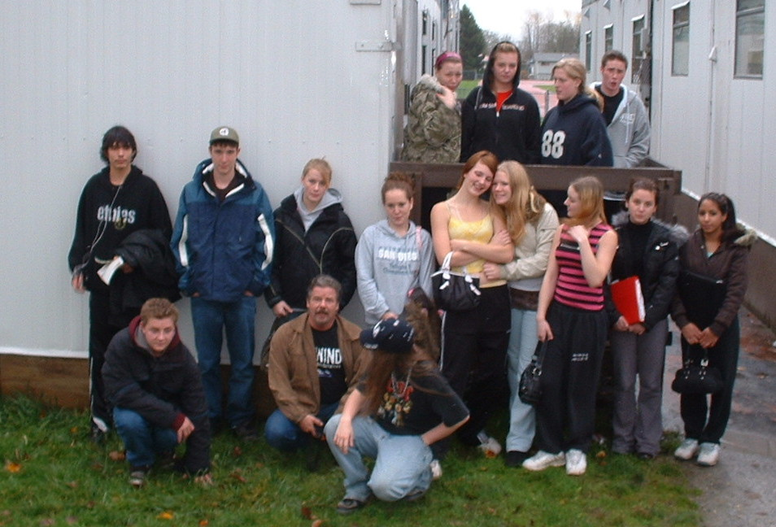
Robb McGirr
Front-Line Prevention Services
www.frontlineprevention.com
604-833-8649

