Slide 1
Pinetree Secondary Grade 10-12 Parent Night
Graduation Program Requirements
Pinetree special programs
Number of courses
Choosing courses
Post Secondary options
Timeline information
Notes:
Meena

Slide 2
GRADUATION PROGRAM (Grades 10-12) 80 Credits
Required 52 credits:
English Language Arts 10, 11 and English Studies 12 12 credits
Social Studies 10 4 credits
Social Studies 11 or 12 4 credits
Science 10 4 credits
Science 11 4 credits
A Mathematics 10 4 credits
A Mathematics 11 4 credits
Physical and Health Education 10 4 credits
Fine Arts or Applied Skills 10, 11 or 12 4 credits
Career Life Education 10 4 credits
Indigenous focused coursework (*new*)
Career Life Connections (meets of the grade 12 level course requirement) 4 credits
Electives (Grade 10, 11 and 12) 28 credit
TOTAL - 80 credits
Required Assessments:
Numeracy 10 Assessment
Literacy 10 Assessment
Literacy 12 Assessment
Of the 80 credits required to graduate, at least 4 credits must have an Indigenous focus
*16 of your credits (4 classes including English Studies 12 and CLC 12) must be grade 12 level*
Notes:
Meena

Slide 3
Graduation Assessments
Numeracy 10 Assessment:
All students will be required to complete the numeracy 10 assessment as a graduation requirement.
Typically written in the semester student completes Math 10
Literacy 10 Assessment:
All students will be required to complete the literacy 10 assessment as a graduation requirement
Typically written in the semester students completes Language Arts 10
Literacy 12 Assessment:
All students will be required to complete the literacy 12 assessment as a graduation requirement
All grade 12 students will be registered to write the assessment in January. They may re-take the assessment in June, should they choose to.
See the Ministry website for more info:
https://curriculum.gov.bc.ca/provincial/grade-10-numeracy-assessment
https://curriculum.gov.bc.ca/provincial/grade-10-literacy-assessment
https://curriculum.gov.bc.ca/provincial/grade-12-literacy-assessment
Notes:
Gio

Slide 4
Indigenous-Focused Graduation Requirement
Effective last year all students must successfully complete at least 4 credits in Indigenous-focused coursework.
There is no change to the total number of credits required to graduate, which remains at 80.
Students can meet this graduation requirement through a variety of course options at Pinetree Secondary:
English First Peoples and Writing 11
English First Peoples and New Media 11
English First Peoples and Writing 11 Honours
English First Peoples 12
Social Studies - BC First Peoples 12

Slide 5
Arts Education 10, 11, or 12 --Applied Design, Skills, and Technologies 10, 11 or 12
Students are required to complete 4 credits in Arts Education or Applied Design, Skills, and Technologies:
SOME EXAMPLES INCLUDE:
Drafting 11 (AS)
Graphic Arts 11 (FA)
Marketing & Promotion 11 (AS)
Drama 11(FA)
Textiles 11(AS)
Art Studio 11 (FA)
Food Studies 11(AS)
Auto Tech 11(AS)
Composition & Production 11(FA)
Choral Music 11(FA)
Automotive Tech 11(AS)
Any Info Tech 11(AS)
Instrumental Music (Band) 11 (FA)
Notes:
Gio

Slide 6
English
English 10 Course Offerings:
Each of the grade 10 English classes will be paired with Literary Studies 10. Choices include:
Creative Writing 10
Composition 10
New Media 10
Composition and Literary Studies 10 HONOURS
English 11 Course Offerings:
Each of the grade 11 English classes will have an English First Peoples Focus. This will meet the Indigenous Focuses Coursework requirement for Graduation.
EFP Literary Studies and Writing 11
EFP Literary Studies and New Media 11
EFP Literary Studies and Writing 11 HONOURS
Notes:
Gio

Slide 7
English
Grade 12 English Language Arts:
Students must complete one of the following English courses for Graduation:
English Studies 12
English Studies 12 Honours
English First Peoples 12
The following course can be taken as an English 12 elective:
Literary Studies 12 - offers the opportunity to explore famous and increasingly complex texts, both ancient and modern. This course will allow students to engage in rich discussion, debate, and individual inquiry. THIS COURSE IS OPEN TO GRADE 11 and 12 STUDENTS
Notes:
Gio

Slide 8
Mathematics
Math 10 Options (Grad Requirement)
Workplace Mathematics 10
Foundations of Math & Pre-Calculus 10
Pre-Calculus 10/11 Honours (full year program)
Math 11 Options (Grad Requirement)
Workplace Mathematics 11
Pre-Calculus 11
Foundations of Math 11 (Bridge )
Notes:
Meena

Slide 9
Mathematics
Math 12 Options
Pre-calculus 12
Calculus 12
Pre-calculus 12 Honours/Calculus 12 Honours
(is a year-long program)
Independent Directed Studies (IDS) Mathematics
Grade 12 Math is not required for Graduation but check post-secondary program requirements
Notes:
Meena

Slide 10
Social Studies
Social Studies 12:
NO Social Studies 11 courses at Pinetree (11’s can take a Social Studies 12 for their grad requirement)
Comparative Cultures 12
Social Justice 12
20th Century History 12
Physical Geography 12
Law Studies 12
Philosophy 12
BC First Peoples 12
Psychology 12 – note this is an elective course and does not satisfy the Social Studies graduation requirement.
Notes:
Gio

Slide 11
Course Equivalency/External Credits
Students may also obtain credits towards graduation through:
Equivalency: Course equivalency is the process of receiving credit based on documentation indicating that the student has achieved the learning outcomes for an approved Grade 10, 11 or 12 course at an institution outside of BC or Canada.
External Credits: credit for courses completed outside Pinetree (see your counsellor)
Notes:
Meena

Slide 12
Honours/Advanced Placement
Students may select Honours/AP courses; AP is a university level course that may give credit or advance standing at Post Secondary depending on performance on AP Exam. AP classes are taken in your grade 12 year.
What type of student is the AP/Honours program designed for?
❖ Gifted students, extremely talented and motivated students.
❖ Students who enjoy hard work and being challenged in class.
What are the advantages of an Honours class?
❖ Students of similar abilities and interests work together in an enriched environment.
❖ Students develop their higher-level thinking skills.
❖ Students participate in the subject areas that match their talents.
❖ Honours courses help prepare students for AP courses.
Will I have more homework in the AP/Honours program?
❖ Some of the courses may need more time for homework.
❖ The assignments generally require higher level thinking skills and are therefore more challenging.
Notes:
Gio

Slide 13
Honours Courses
Students should only select Honours if they are prepared for the rigors of an Honours Program
Departments have established a process to select candidates
Students should be certain they want the Honours course and that they are able to meet the rigors of the course.
DROPPING AN HONOURS COURSE once the class has started is not possible.
Notes:
Gio

Slide 14
Honours Courses
Focused Literary Studies and Composition 10 Honours
EFP Literary Studies and Writing 11 HONOURS
English Studies 12 Honours
Socials 10 Honours
Pre-Calculus 10/11 Honours (year-long/2 semesters)
Precalculus 12 Honours/Calculus 12 Honours (year-long/2 semesters)
Science 10 Honours
Life Science 11 Honours
Anatomy and Physiology 12 Honours (AP)
Physics 11 Honours
Physics 12 Honours (AP)
Chemistry 11 Honours
Chemistry 12 Honours (AP)
IDS 12 for Science and IDS 12 for Mathematics
Notes:
Gio

Slide 15
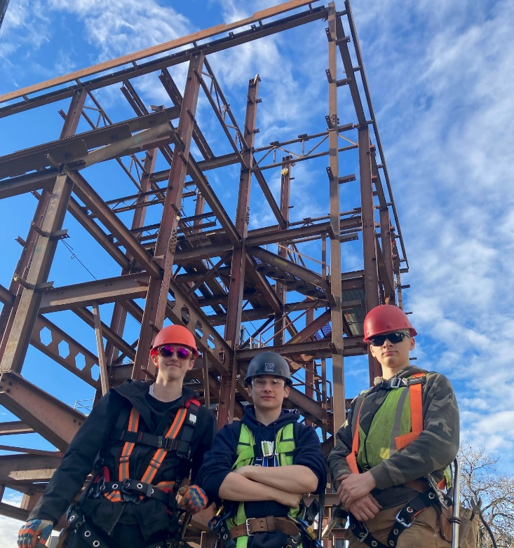
TRAIN in Trades Programs
Amazing opportunity for any grade 11 or 12 student to take one of 24+ “Train in Trades” programs:
Tuition Free – saves $1,000s
Post Secondary level training
Level 1 Certification
Dual /Triple Credits:
high school
post secondary and/or
industry

Slide 16
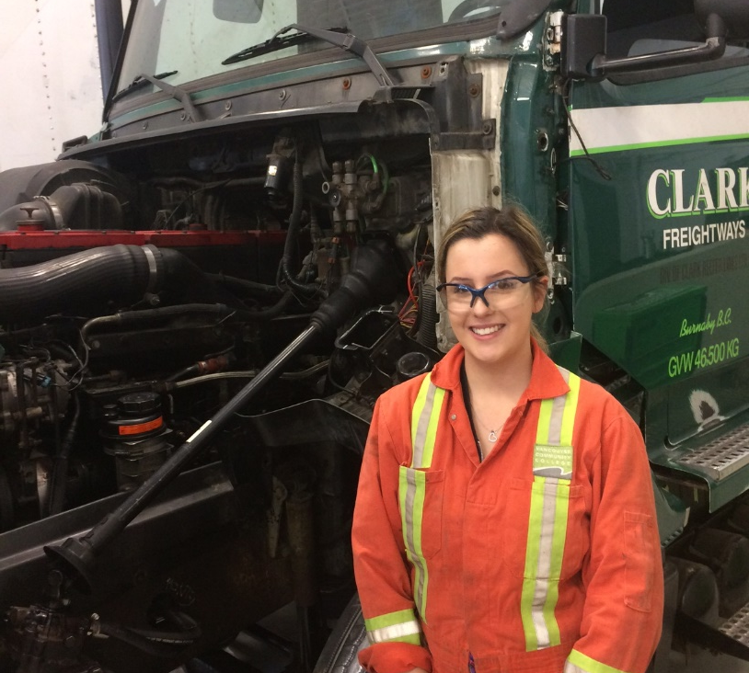
Aircraft Maintenance Engineer - M
Appliance Service Tech
Auto Collision + Refinishing Tech
Automotive Service Tech
Baker
Cabinet Maker (Joiner)
Carpenter
CNC-Machinist
(Professional) Cook
Electrician
Hairstylist
Heavy Duty Equipment Technician
TRAIN in Trades Programs

Slide 17
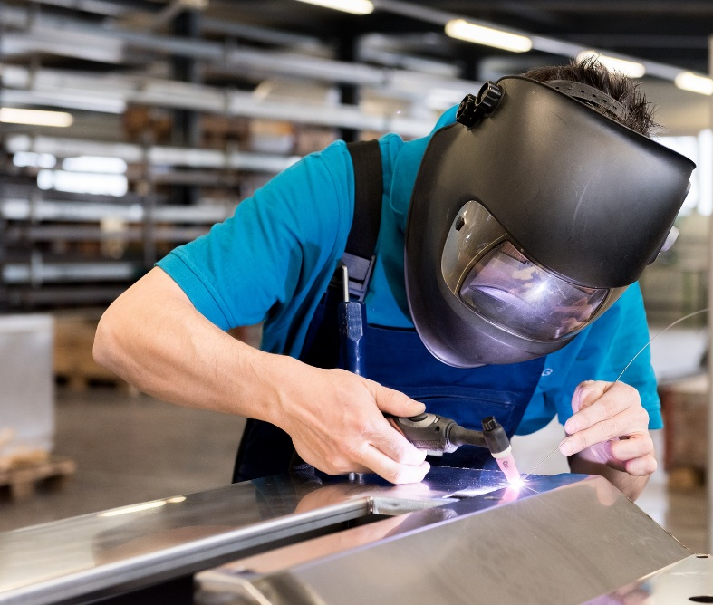
Ironworker
Marine Mechanical Technician
Metal Fabricator
Millwright
Motorcycle Mechanic
(Commercial) Painter
Parts & Warehousing Person
Plumber
Refrigeration Mechanic
Security Systems Technician
Sheet Metal Worker
Welder
TRAIN in Trades Programs

Slide 18
WORK in Trades Program
popular student jobs
carpenter
cook
landscaper
mechanic
floorlayer
Regardless of your career aspirations… if you have/get a paying job in a trade you can receive credits toward high school graduation:
120 hrs working = 4 credits (up to 16 credits)
900+ hrs worked (before age of 20) could qualify student for a $1,000 award… gave out 30+ scholarships last year
if you later pursue that trade career, those hours count towards certification

Slide 19
TRAIN contact
WORK contact
More Info
www.43Careers.com
Ben King
e: BKing@sd43.bc.ca
c: 778-984-1354
Joanna Horvath
e: JHorvath@sd43.bc.ca
c: 604-312-7739
Parent-Student Info Session
Wed., Feb. 13 at 6.00pm at Centennial
Visit the SD43 Career & Trades website for more info

Slide 20
Post Secondary Applications and Admission
Families should research post-secondary admission requirements and be aware of the application process & deadlines.
In most instances, post-secondary institutions will also be looking at your grade 11 marks.
Counsellors and Ms. Moorhouse (Post Secondary & Career Advisor) are available to assist you.
Ms. Moorhouse can be reached at: cmoorhouse@sd43.bc.ca
Notes:
Meena

Slide 21
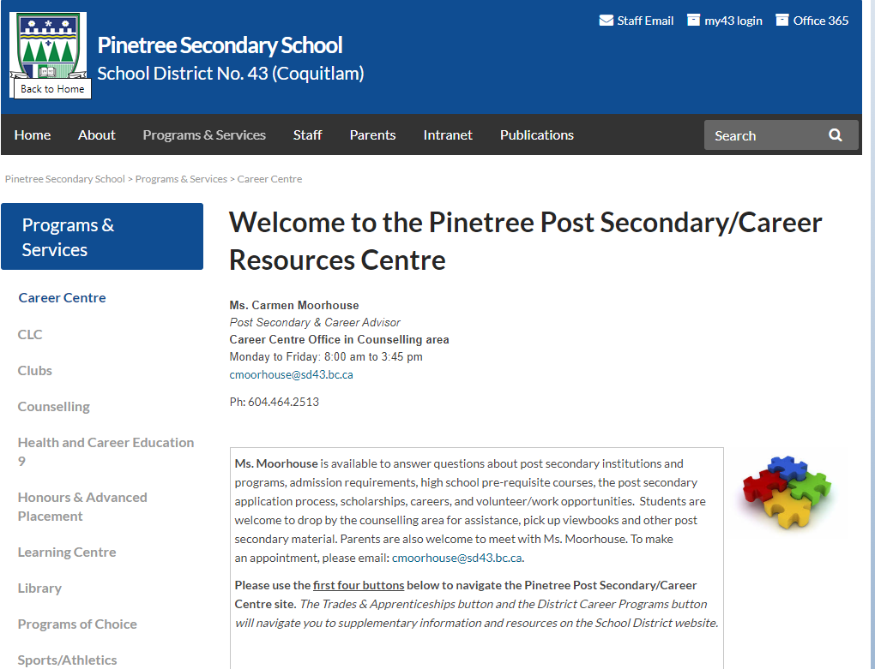
Notes:
Meena

Slide 22
University & College Options in BC
UBC, SFU, UVIC, UNBC
Capilano University
Kwantlen Polytechnic University
Trinity Western University
Emily Carr University of Art and Design
BCIT
Thompson Rivers University
University of the Fraser Valley
Vancouver Island University
Douglas College
Langara College
Vancouver Community College
Some universities and/or programs are competitive entry
Check required courses, % grade, English and Math and OTHER requirements for each university and program
Notes:
Carmen

Slide 23
Language Courses
UBC Vancouver requires a grade 11 language (for example, French 11)
SFU requires a grade 11 language (will accept a beginner language like Intro Spanish 11)
An External Language credit satisfies the language 11 requirement for SFU & UBC
UBC will not accept a Language 12 challenge towards the admission average.
SFU will accept a Language 12 challenge towards the admission average.
Information about Language Challenge exam registration opens in October. Exam writes are in January
Other than SFU and UBC no University across Canada has a second language requirement
**Check requirements at each Post Secondary Institution**

Slide 24
Post Secondary Education: SFU Admission Requirements
Admission based on Grade 11 & 12 courses (SFU approved course list)
General Required Grade 11 courses:
English 11 (All English 11 options are approved)
Math 11 Min 60% (Pre-Calculus 11 or Foundations 11)
Language 11 (Introductory language 11 or higher)
Science 11 (chemistry, physics, life science or earth science) Physics 11 & Chem 11 required for science-based courses.
Socials 11 or 12
Required Grade 12 courses:
English Studies 12 minimum final grade of 70%
Minimum of 5 Grade 12 courses, including English Studies 12, from SFU’s approved course list – much different than in the past
Program-specific approved courses and minimum course grades.
The admission evaluation will be based on all approved grade 11 & 12 courses, with greater emphasis on ‘List A’ Grade 12 courses.
http://www.sfu.ca/students/admission/admission-requirements/fall-2020.html
Notes:
Carmen

Slide 25
SFU Quantitative and Analytical Skills Requirement
Minimum of 60% in an approved grade 11 or grade 12 math course.
A 70% minimum grade is required to enroll directly in Q courses at SFU.
Some programs require higher minimum math grades.
(e.g. Minimum course grade requirements for all Engineering programs)
Notes:
Carmen

Slide 26
UBC Holistic Admission Evaluation
Secondary School Grades
It is recommended you have a least 6 Grade 12 courses (academic/non- academic)
UBC may consider all your academic Grade 11 and Grade 12 course grades. Applied design, skills, technologies courses, career ed, and physical education course grades will not be used.
UBC will look closely at all academic Grade 11 and Grade 12 courses related to your degree.
Personal Profile
4-8 short essay questions depending on the program you apply to.
Evaluated based on breadth and depth of your experiences.
Additional requirements for some programs: video interview, test, resume, audition etc.
Notes:
Carmen

Slide 27
How UBC Holistic Admission Cont’d
Assessment of Individual Courses
Strong grades in key courses (in many cases it would be Eng. 12 & Pre-Calc 12)
Recognition of Breadth, Rigour and Relevancy of Coursework
Pursue all your academic interests.
Challenge yourself by taking additional academic courses, advanced courses or first-year university courses.
Demonstrate knowledge in your area of study by taking courses that relate to the degree you intend to apply at UBC.

Slide 28
SFU & UBC English Language Competency
Applicants must demonstrate English language competency prior to admission.
SFU English Language Requirement – 3 years of full-time study in Canada and 70% in English Studies 12 or one of the other following ways:
English language requirement - Undergraduate Admission - Simon Fraser University (sfu.ca)
UBC English Language Admission Standard (ELAS) - 4 years of full-time study in Canada or one of the other following ways:
English language competency - UBC | Undergraduate Programs and Admissions
For UBC Vancouver ONLY, must also have a Final Grade of 70% in
Grade 11 or 12 English:
https://you.ubc.ca/applying-ubc/requirements/canadian-high- schools/#british-columbia
Notes:
CarmenEnglish language competency - UBC | Undergraduate Programs and Admissions

Slide 29
University of Victoria
General Admission Requirements
Admission Averages are based on:
English 12 and 3 additional approved academic grade 12 courses
Grade 11 requirements
English 11, Social Studies 11, Pre-calculus 11 or Foundations of Math 11 (depending on the faculty), an Academic Science 11 (Bi 11, Ch 11, E. Sc 11, Ph 11),
No second language requirement.
Check the website for approved grade 12 courses for each faculty!
https://www.uvic.ca/future-students/undergraduate/admissions/high-school/bc-yt/index.php
NOTE: Supplemental application needed for some programs including Business.
Notes:
Carmen

Slide 30
Douglas College
www.douglas.bc.ca
Eligible for admission if you:
Completed BC secondary school and minimum mark in English 12 (C).
Different deadlines and entrance requirements for each program.
Check carefully!
If you are applying to a university transfer program your registration date for courses depends on your GPA! Check with an academic advisor at Douglas or Mrs. Moorhouse for more information.
Notes:
Carmen

Slide 31
CHOOSING COURSES Important Decisions…
Ensure you meet Graduation requirements
Check post-secondary requirements
(See Ms. Moorhouse or your counsellor)
Seek out the advice of family members, mentors or your counsellor
Read the Course Calendar Online
Be aware that we will not be able to change classes once the school year starts.
Notes:
Meena

Slide 32
Course Calendar Online
Notes:
Meena

Slide 33
Detailed Description of all courses!

Slide 34
Required Courses
Grade 10
(8 classes)
English Lang. Arts 10
Social Studies 10
Career Life Educ. 10
Science 10
A Mathematics 10
Physical Education 10
Two (2)Electives
*NOTE: a second language course is not a graduation requirement
Grade 11
(8 classes)
One of Lang Arts 11 Options
Any Science 11
Any Mathematics 11
Social Studies 12 (can be done
Grade 12 year)
Four (4) additional courses
Grade 12
(8 classes)
English Studies 12 1.___________12
2.___________12
3.___________12
Four (4) additional courses
Career Life Connections
When choosing courses make sure to plan out the course you want to take over the graduation years for each grade.
Notes:
Meena

Slide 35
When Choosing Courses:
For all core academics you must have successfully completed the prerequisite course
i.e. for Chemistry 11 you must have successfully passed Science 10
i.e. for French 11 you must have successfully passed French 10
For all gr 12 electives you must have the grade 11 prerequisite as well.
i.e. you can not take Auto 12 without completing Auto 11
i.e. you can not take Accounting 12 without completing Accounting 11
Notes:
Meena

Slide 36
Extra and Online Classes
Extra Courses: Jazz Band, Choir , and Vocal Jazz, Musical Orchestra, Leadership, Athletic Leadership, Graphic Production (yearbook), any online courses (these would be in addition to your 8 courses)
Grade 9-11 students must have 8 classes in their Pinetree timetable (extra courses/online not included)
Grade 12 students may apply to have 7 classes (and receive an extra off block)
Most students will graduate with more than 80 credits
If you wish to Grad earlier in January of your grade 12 year please see your Counsellor to discuss further
Notes:
Meena

Slide 37
STUDENT SUCCESS
Strive to do your best
Course failure may result in:
Remedial Summer School
Gr. 9 and 10 only –purpose is to get to a "passing" level
Summer School Full Credit (Grade 10-12)
Summer School information and registration will be available late April/early May
Repeating the course next year
This will need to be reflected in the course planning sheet
Notes:
Meena

Slide 38
Summer School
Summer School info will be updated Spring 2024. Visit www.summerlearningcoquitlam.ca for more info about programs.
Secondary Remedial
For Grade 9 student who have insufficient evidence of learning in one of their core classes and teacher recommendation
For Grade 10, this would be a student who got between 40 and 49%
Summer School Full Credit (Grade 10-12, registration dates TBA)
5-6 weeks (3 hours/day)
Notes:
Meena

Slide 39
Summer School/Online
If you are planning to take a summer school course or an online course you must indicate this in “Counsellor Notes” when you select your courses online and on your course planning sheet
You cannot drop courses you are enrolled in at Pinetree and then take that course online once the semester has started. This planning needs to occur now.
Notes:
Meena

Slide 40
Course Selection:
Grade 9 Programming Presentation- January 23th
Course request input in Student Myed Portal will be open from Jan 23th – Feb 1st
Course Planning Sheet and Inputting Deadline – February 1st
Grade 10 Programming Presentation- February 7th
Course request input in Student Myed Portal will be open from Feb 7th– Feb16th
Course Planning Sheet and Inputting Deadline – February 16th
Grade 11 Programming Presentations –February 14th
Course request input in Student Myed Portal will be open from Feb 14th– Feb23rd
Course Planning Sheet and Inputting Deadline – February 23rd

Slide 41
Questions?
Pinetree Administration​
PRINCIPAL: ​
Ms. Janine Close​ jclose@sd43.bc.ca
​
VICE PRINCIPALS: ​
Mr. Chris Martin - A-J ​ chmartin@sd43.bc.ca
Ms. Marina Mahai - K-P mmahai@sd43.bc.ca
Mr. Mark Rao - Q-Z mrao@sd43.bc.ca
​
Counsellors
Ms. Ririe - A-I lririe@sd43.bc.ca
Mr. Kevin Nelson - J-O kenelson@sd43.bc.ca
Ms. Meena Dhillon - P-Z mdhillon@sd43.bc.ca
Ms. Nicole Carson - International Student Contact ncarson@sd43.bc.ca

