Slide 1
Pinetree Secondary Programming 2024
Graduation Program Requirements
Pinetree Programs
Number of courses
Choosing courses
Post-Secondary options
Timeline information
Notes:
Meena

Slide 2
GRADUATION PROGRAM (Grades 10-12) 80 Credits
Required 52 credits:
English Language Arts 10, 11 and English Studies 12 12 credits
Social Studies 10 4 credits
Social Studies 11 or 12 4 credits
Science 10 4 credits
Science 11 4 credits
A Mathematics 10 4 credits
A Mathematics 11 4 credits
Physical and Health Education 10 4 credits
Fine Arts or Applied Skills 10, 11 or 12 4 credits
Career Life Education 10 4 credits
Indigenous focused coursework
Career Life Connections 4 credits
Electives (Grade 10, 11 and 12) 28 credit
TOTAL - 80 credits
Required Assessments:
Numeracy 10 Assessment
Literacy 10 Assessment
Literacy 12 Assessment
Of the 80 credits required to graduate, at least 4 credits must have an Indigenous focus
*16 of your credits (4 classes including English Studies 12) must be grade 12 level* (CLC 12 counts)
Notes:
Meena

Slide 3
Indigenous-Focused Graduation Requirement
All students must successfully complete at least 4 credits in Indigenous-focused coursework.
Students Graduating June 2024 – current grade 11’s first group to graduate with this requirement.
There is no change to the total number of credits required to graduate, which remains at 80.
Students can meet this graduation requirement through a variety of course options at Pinetree Secondary:
English First Peoples and Writing 11
English First Peoples and New Media 11
English First Peoples and Writing 11 Honours
English First Peoples 12
Social Studies - BC First Peoples 12

Slide 4
FNA or ASK 10, 11 or 12-Graduation Requirement
Students are required to complete 4 credits in either
Fine Arts ( any Drama, Dance, Music or Visual Art course) OR
Applied Skills (any Business Ed. , Home Ec, Info Tech and Tech Ed. Course)
In Grade 10, 11 or 12
Most of students will have already met this requirement from an elective you completed in grade 10 or 11.

Slide 5
Arts Education 10, 11, or 12 --Applied Design, Skills, and Technologies 10, 11 or 12
Students are required to complete 4 credits in Arts Education or Applied Design, Skills, and Technologies:
SOME EXAMPLES INCLUDE:
Drafting 11 (AS)
Graphic Arts 11 (FA)
Marketing & Promotion 11 (AS)
Drama 11(FA)
Textiles 11(AS)
Art Studio 11 (FA)
Food Studies 11(AS)
Auto Tech 11(AS)
Composition & Production 11(FA)
Choral Music 11(FA)
Automotive Tech 11(AS)
Any Info Tech 11(AS)
Instrumental Music (Band) 11 (FA)
Notes:
Gio

Slide 6
Course Equivalency/External Credits
Students may also obtain credits towards graduation through:
Equivalency: Course equivalency is the process of receiving credit based on documentation indicating that the student has achieved the learning outcomes for an approved Grade 10, 11 or 12 course at an institution outside of BC or Canada.
Note: 80% match of curriculum is needed
External Credits: credit for courses completed outside Pinetree (see your counsellor)
Some Examples include:
Music: BC Conservatory of Music, Conservatory Canada, Royal Conservatory
Music: Victoria Conservatory Music, Trinity College-London
Dance: Jazz, Cecchetti, Tap, Modern Theatre Dance, Royal Academy of Dancing
Sports: Athlete, Coach, Official,
Youth Development: Cadets, 4-H, Guides, Scouts
Industrial and Occupational: Tourism, Wood products, Lifesaving, Red Cross Water
Safety Instructor: First Aid, Computer Certification, Canadian Private Pilot’s License
Notes:
Meena

Slide 7
English
English 10 Course Offerings:
Each of the grade 10 English classes will be paired with Literary Studies 10. Choices include:
Creative Writing 10
Composition 10
New Media 10
Composition and Literary Studies 10 HONOURS
English 11 Course Offerings:
Each of the grade 11 English classes will have an English First Peoples component. This will meet their Indigenous Focuses Coursework requirement for Graduation.
EFP Literary Studies and Writing 11
EFP Literary Studies and New Media 11
EFP Literary Studies and Writing 11 HONOURS
Notes:
Gio

Slide 8
English
Grade 12 English Language Arts:
Students must complete one of the following English courses for Graduation:
English Studies 12
English Studies 12 Honours
English First Peoples 12
The following course can be taken as an English 12 elective:
Literary Studies 12 - offers the opportunity to explore famous and increasingly complex texts, both ancient and modern. This course will allow students to engage in rich discussion, debate, and individual inquiry. THIS COURSE IS OPEN TO GRADE 11 and 12 STUDENTS
Notes:
Gio

Slide 9
Pinetree Mathematics
One Math 11 course is required for graduation:
Workplace Mathematics 11
Pre-Calculus 11
Foundations of Math 11 (Bridge )
The main purpose of this course is to provide students with the opportunity to build their skills and knowledge in math.
Is applicable to students interested in future studies in Non-Science/Engineering/Business programs. (i.e., Humanities/Arts).
Topics are similar to the Pre-Calculus 10 curriculum and attempt to bridge some topics taught in the Pre-Calculus 11 course. Depending on overall success, some students will elect to continue towards the Pre-Calculus pathway after completing this course.
Recommended for students who received btw 50%-60% in Foundations of Math &Pre-Calc 10
Grade 10 Teacher recommendation
Notes:
Meena

Slide 10
Pinetree Mathematics
Math 12 Options:
Pre-calculus 12
Calculus 12
Pre-calculus 12 Honours/Calculus 12 Honours
This is a year long course!
IDS Mathematics 12-This course continues from the Calculus 12 Honours program
NOTE: A Grade 12 Math is not required for Graduation; however, check post-secondary program requirements.
Notes:
Meena

Slide 11
Social Studies
Social Studies 12:
NO Social Studies 11 courses at Pinetree (11’s can take a Social Studies 12 for their grad requirement)
Comparative Cultures 12
Social Justice 12
20th Century History 12
Physical Geography 12
Law Studies 12
Philosophy 12
BC First Peoples 12
Psychology 12 – note this is an elective course and does not satisfy the Social Studies graduation requirement.
Notes:
Gio

Slide 12
Honours Courses (Subject to Enrollment)
EFP Literary Studies and Writing 11 HONOURS
English Studies 12 Honours
Pre-Calculus 10/11 Honours (year-long/2 semesters)
Precalculus 12 Honours/Calculus 12 Honours (year-long/2 semesters)
Life Science 11 Honours
Anatomy and Physiology 12 Honours (AP)
Physics 11 Honours
Physics 12 Honours (AP)
Chemistry 11 Honours
Chemistry 12 Honours (AP)
IDS 12 for Science and IDS 12 for Mathematics
Notes:
Gio

Slide 13
Honours/Advanced Placement
Students may select Honours/AP courses; AP is a university level course that may give credit or advance standing at Post Secondary depending on performance on AP Exam. AP classes are taken in your grade 12 year.
What type of student is the AP/Honours program designed for?
❖ Gifted students, extremely talented and motivated students.
❖ Students who enjoy hard work and being challenged in class.
What are the advantages of an Honours class?
❖ Students of similar abilities and interests work together in an enriched environment.
❖ Students develop their higher-level thinking skills.
❖ Students participate in the subject areas that match their talents.
❖ Honours courses help prepare students for AP courses.
Will I have more homework in the AP/Honours program?
❖ Some of the courses may need more time for homework.
❖ The assignments generally require higher level thinking skills and are therefore more challenging.
Notes:
Gio

Slide 14
Honours/Advanced Placement
Students may self-select Honours and/or AP courses in Myed BC and on the course planning sheet
Honours/AP 12 courses are reserved for grade 12 students only
Departments have established a process to select candidates
Successful candidates will be able to see in May/June in MYED BC if selected
Students should be certain they want the Honours course and that they are able to meet the rigors of the course.
DROPPING AN HONOURS COURSE once the class has started is not possible.
Notes:
Gio

Slide 15
Notes:
Doug

Slide 16
Youth TRAIN in TRADES Programs
http://www.sd43.bc.ca/CareerPrograms/Pages/Trades.aspx#/=

Slide 17
WORK in Trades Program
popular student jobs
carpenter
cook
landscaper
mechanic
floorlayer
Regardless of your career aspirations… if you have/get a paying job in a trade you can receive credits toward high school graduation:
120 hrs working = 4 credits (up to 16 credits)
900+ hrs worked (before age of 20) could qualify student for a $1,000 award… gave out 30+ scholarships last year
if you later pursue that trade career, those hours count towards certification

Slide 18
TRAIN contact
WORK contact
More Info
www.43Careers.com
Ben King
e: BKing@sd43.bc.ca
c: 778-984-1354
Joanna Horvath
e: JHorvath@sd43.bc.ca
c: 604-312-7739
Open House –Explore Trades Programs
Tues., Feb. 13 at 6.00pm at Centennial Secondary
Contact Joanna for more information and the Teams meeting link

Slide 19
Post-Secondary Applications and Admission
It is YOUR responsibility to research post-secondary admission requirements and to be aware of the application process & deadlines.
Be aware that in most instances, post-secondary institutions will also be looking at your grade 11 marks
Don’t rely on your friends for information. Always go directly to the post-secondary websites.
Counsellors and Ms. Moorhouse (Post Secondary & Career Advisor) are available to assist you.
Ms. Moorhouse is in the counselling office. You can also email her at cmoorhouse@sd43.bc.ca and join her Post-Secondary Teams for updates and info!
Notes:
Meena

Slide 20
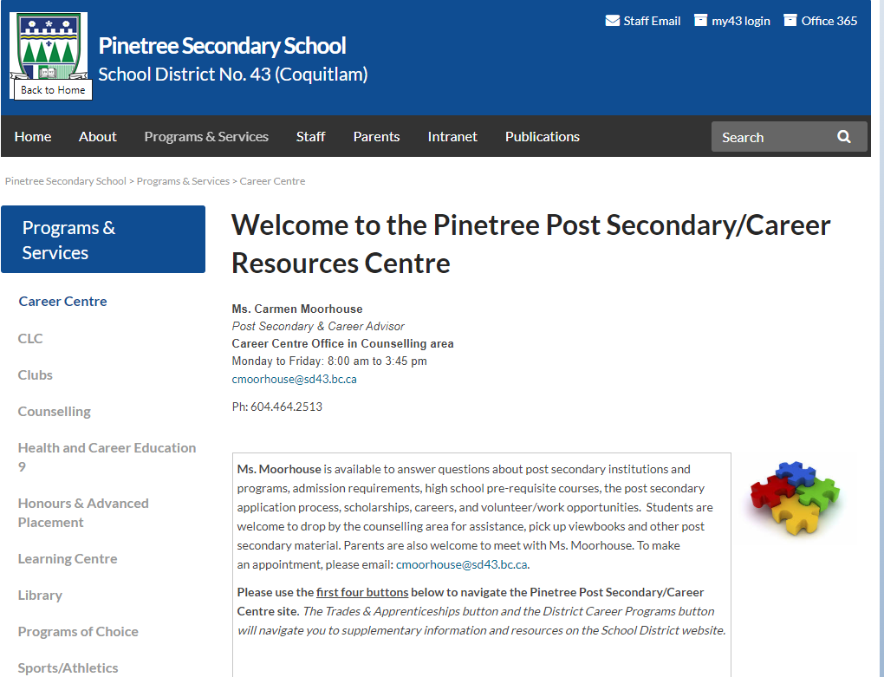
Notes:
Meena

Slide 21
Admission to UBC Vancouver & Okanagan
Admission Process is Competitive and Comparative
UBC will look at all grade 11 & 12 academic courses.
English Language Admissions Standard Requirement (Vancouver & Okanagan)
Complete 4 or more consecutive years of recognized, full-time education in English within Canada immediately prior to attending UBC (see other ways of meeting requirement).
Must achieve a 3/Proficient on the Literacy 12 assessment.
UBC Vancouver General Requirements
At least six academic/non-academic Grade 12 courses is recommended.
Min. 70% in Grade 11 or Grade 12 English.
Need a language 11 (introductory language not accepted).
UBC Okanagan General Requirements
At least six academic/non-academic Grade 12 courses recommended.
Note: No language 11 requirement
Specific degree requirements at each campus.
Should take courses that relate to your degree. (subject area categories)
UBC Online application requires completion of a Personal Profile.
Portfolio, audition, interview etc. required for some programs.
Canadian high schools - UBC | Undergraduate Programs and Admissions

Slide 22
How UBC Holistic Admission
Assessment of Individual Courses
Strong grades in key courses (in many cases it would be Eng. 12 & Pre-Calc 12)
Recognition of Breadth, Rigour and Relevancy of Coursework
Pursue various academic interests
Challenge yourself by taking additional academic courses, advanced courses or first-year university courses.
Demonstrate knowledge in your area of study by taking courses that relate to the degree you intend to apply at UBC.

Slide 23
UBC Personal Profile
This is your chance to tell UBC what you are most proud of and what you’ve learned from your experiences.
Take time to reflect.
Be specific.
Be true to who you are.
You will need to list your activities, answer questions and list 2 references. (letters not required)
Write your personal profile - UBC | Undergraduate Programs and Admissions

Slide 24
Admission to SFU
Admission is Competitive
English Language Requirement
Completion of the last 3 years of full-time secondary education in English in Canada and a min. 70% in English Studies 12. (see other ways of meeting the requirement)
Quantitative and Analytical Skills Requirement
A minimum grade of 60% in an approved grade 11 or grade 12 math course depending on the faculty you are applying to.
Some programs require higher minimum math grades.
(e.g. Engineering Science – 75% Pre-Calc 12)
A minimum of five approved Grade 12 courses, including English Studies 12
Grade 11 Required Courses.
Language 11 Required. (Intro Language accepted)
A Social Studies 12 fulfills Social Studies 11 requirement.
Specific Degree Course Requirements
Admission evaluation is based on all approved Grade 11 & 12 courses, with greater emphasis on List A courses. Some programs require a supplemental application.
Canadian high school - Undergraduate Admission - Simon Fraser University (sfu.ca)

Slide 25
Admission to UVic
Admission is Competitive
Recommended admission averages are published on the UVic website.
English Language Requirement
Must have studied full-time for at least four years within Canada in an English academic program. (see other ways of meeting requirement).
Grade 11 required courses.
Four Grade 12 required courses
English Studies 12 and three approved courses.
Minimum 67% in English Studies 12.
Specific degree course requirements.
Some programs require a supplemental application.
Admission averages are calculated using all required Grade 12 courses.
Undergraduate programs - Undergrad - University of Victoria (uvic.ca)

Slide 26
Admission to Douglas College
Open Enrollment Programs – non-competitive entry
Must meet general admission requirements and English proficiency requirement.
Completed BC secondary school and minimum mark in English 12 (C).
Limited Enrollment Programs
Must meet general, English proficiency and specific admission requirements. Candidates selected on first-qualified, first admitted basis, except if program ranks candidates.
English Proficiency Requirement
English 12 – minimum final grade ‘C’
Different deadlines and entrance requirements for each program. Check carefully!
If you are applying to a university transfer program, your registration date for courses depends on your GPA! Check with an academic advisor at Douglas or Ms. Moorhouse for more information.
General Admission Information | Douglas College

Slide 27
Many more University & College Options in BC
UBC, SFU, UVIC, UNBC
Capilano University
Kwantlen Polytechnic University
Trinity Western University
Emily Carr University of Art and Design
BCIT
Thompson Rivers University
University of the Fraser Valley
Vancouver Island University
Douglas College
Langara College
Vancouver Community College
Some universities and/or programs are competitive entry
Check acceptable courses, % grade, English and Math and OTHER requirements for each university and program
Notes:
Carmen

Slide 28
Language Courses
UBC requires a grade 11 language (for example, French 11)
SFU requires a grade 11 language (will accept a beginner’s language: Intro Spanish 11, Intro Japanese 11)
An External Language credit satisfies the language 11 requirement for SFU & UBC
UBC will not accept a Language 12 challenge towards the admission average.
SFU will accept a Language 12 challenge towards the admission average.
Information about Language Challenge exam registration opens in October. Exam writes are in January
Check requirements at each Post-Secondary Institution.

Slide 29
CHOOSING COURSES Important Decisions…
Ensure you meet Graduation requirements
Check post secondary requirements
(See Ms. Moorhouse or your Counsellor)
Seek out the advice of family members, mentors or your Counsellor
Read the Course Calendar Online
Be aware that we will not be able to change classes once the school year starts.
Notes:
Meena

Slide 30
Course Calendar Online
Notes:
Meena

Slide 31
Detailed Description of all courses!

Slide 32
NUMBER OF COURSES
GRADE 11 students
8 Courses
Extra Courses: Jazz Band 11, Choir 11, Vocal Jazz 11, Music Orchestra 11, Graphic Production 11 (formerly Desktop Publishing 11). Only One Leadership 11 course can be selected.
These courses are in addition to your 8 courses if you choose to take one or more of them.
GRADE 12 students
8 Courses Plus CLC 12
Extra Courses: Jazz Band 12, Choir 12, Vocal Jazz 12, Music Orchestra 11/12, Graphic Production 11/12 (formerly Desktop Publishing 11/12), Only one Leadership 11/12 course.
These courses are in addition to your 8 courses if you choose to take one or more of them.
GRADE 12's have the option of requesting a study block-
must complete the application form in myed
Must still enter 8 as an off block is not a guarantee!

Slide 33
When Choosing Courses:
For all core academics you must have completed the prerequisite course for all grades 9 through 12
i.e., for Chemistry 11 you must have successfully passed Science 10
i.e., for French 11 you must have successfully passed French 10
For all gr 12 electives you must have the grade 11 prerequisite as well.
i.e., you cannot take Auto 12 with having completed Auto 11
NOTE:
Courses with no pre-requisites: Art Metal Jewelry 12, Child Development 12 and Entrepreneurship 12, Economics 12
Notes:
Meena

Slide 34
Extra and Online Classes
Extra Courses: Jazz Band, Choir , and Vocal Jazz, Musical Orchestra, Leadership, Athletic Leadership, Graphic Production (yearbook)
Any online courses (these would be in addition to your 8 courses)
Grade 9-11 students must have 8 classes in their Pinetree timetable (extra courses not included)
Grade 12 students may apply to have 7 classes (and receive an extra off block)
Most students will graduate with more than 80 credits
If you wish to Grad earlier in January of your grade 12 year, please see your Counsellor to discuss further
Notes:
Meena

Slide 35
CHOOSE WISELY!
It will be very difficult if not impossible to make changes to your courses in September; therefore, please choose your classes carefully.
There will be a verification of your selected courses in May. This will be your opportunity to make sure your choices are correct.
Students will receive a draft of their schedule by mid-June.

Slide 36
STUDENT SUCCESS
Strive to do your best!
Course failure may result in:
Remedial Summer School
Gr. 9 and 10 –goal is to get to passing level
Summer School Credit (Grade 10-12)
To accelerate program (although not required )
Summer School information will be available Late April/ Early May
Repeating the course next year
This will need to be reflected in the course selection in Myed BC
Notes:
Meena

Slide 37
Summer School or Online
If you are planning to take a summer school course or an online course, you must indicate this on your course planning sheet and in the NOTES to Counsellor section in MYED BC when you select your courses.
If you complete a course (summer school, or online) without telling us, we will not be able to change your schedule to a preferred elective in September. You will be placed in a class that has room.
You cannot drop courses you are enrolled in at Pinetree and then take that course online once the semester has started. This planning must occur now.
Notes:
Meena

Slide 38
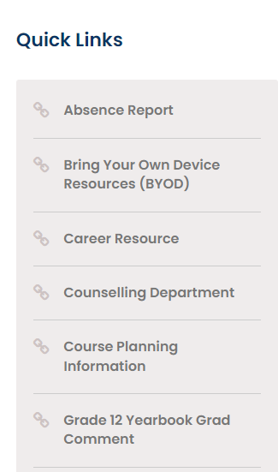
Use this sheet to help you plan!
Go to the course planning page to download a copy if needed.

Slide 39
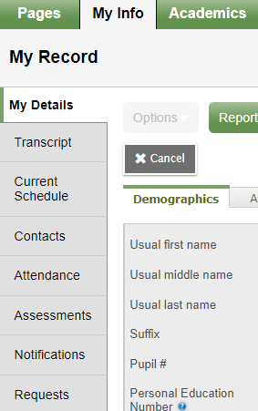
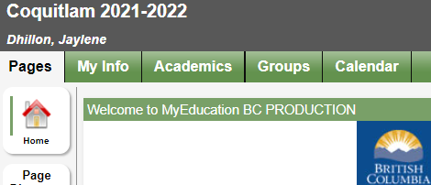
Inputting your Course Selection in MyEd BC
1. Log into your student MyED BC account
You will see the heading as shown below. Click on the green tab title “My Info”.
2. Click on the tab in the left column that reads “Requests”.

Slide 40
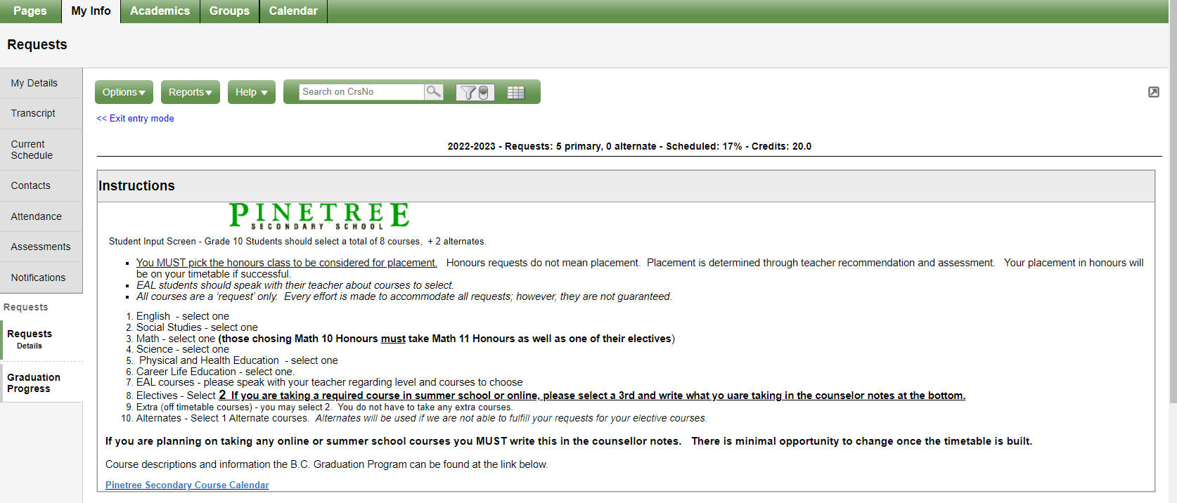
3. You will then see this page. Read the instructions carefully!

Slide 41
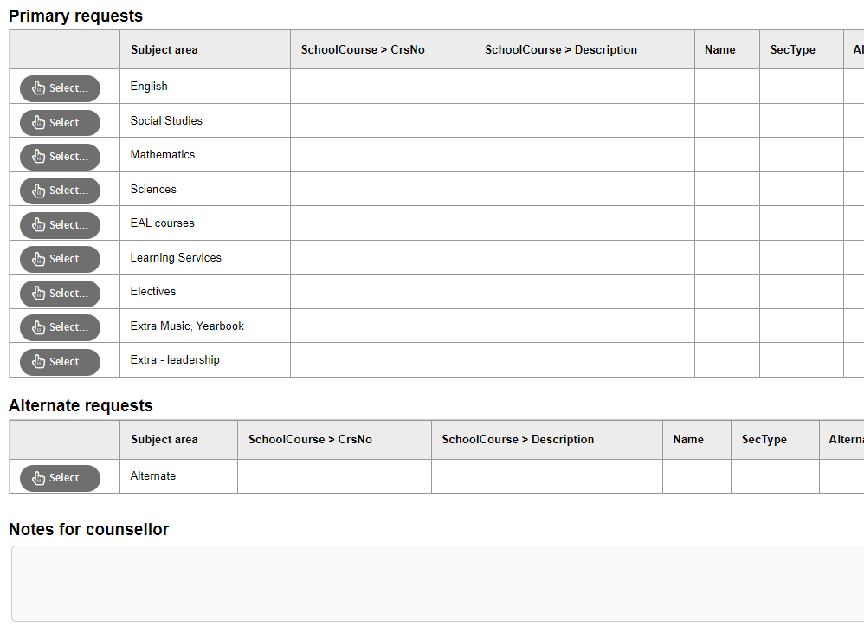
4. Primary request, Alternate selection, Notes- Grade 11's must choose 8 plus an alternate (extra courses do not count as part of your 8)
Write any information you want your counsellor to have in this section: summer school, online etc.

Slide 42
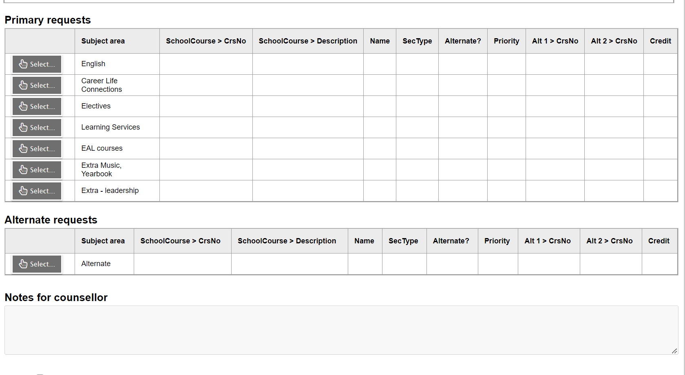
4. Primary request, Alternate selection, Notes
GR. 12 (must choose 8 plus CLC and An alternate) Even if you plan to apply for a study block. (extra course are not part of your 8)
Write any information you want your counsellor to have in this section: summer school, online etc.

Slide 43
TIMELINE
PLAN CAREFULLY, TALK TO YOUR PARENTS AND IF YOU HAVE QUESTIONS SEE YOUR COUNSELLOR.
Email your counsellor to set a meeting time or come to the counselling offices
Email Ms. Moorhouse to set a meeting time.

Slide 44
FINAL DUE DATE TO ENTER YOUR COURSE SELECTION ONLINE IN MYED BC and to complete your course planning sheet!
GRADE 10’S – Online Inputting and Planning sheet due to counsellor no later than FEBRUARY 16TH
GRADE 11’S – Online Inputting and Planning sheet due to counsellor no later than FEBRUARY 23rd
IF YOU HAVE PROBLEMS ACCESSING YOUR STUDENT MYED BC PORTAL AND NEED YOUR PASSWORD RESET- PLEASE EMAIL YOUR VICE-PRINCIPAL.

