Slide 1
Class of 2014–
The Road To Graduation and Beyond
March 7th, 2013

Slide 2

Agenda For Today…
Graduation Requirements
Course Planning
Scholarships
Post Secondary Options
Post Secondary Entrance Requirements
Questions?

Slide 3
GRADUATION PROGRAM
Total needed to Graduate-80 Credits
All Courses offered at Pinetree are 4 credits
1. Required 48 credits:
  Language Arts 10, 11, 12 (English or Communications)
  Social Studies 10
  Social Studies 11 or 12 (SS 11 or First Nations 12)
  Science 10
  Science 11 or 12 (Ch, Ph, Bi, Earth Science, Sc &Tech)
  Mathematics 10
  Mathematics 11 or 12
  Physical Education 10
  Fine Arts or Applied Skills 10, 11 or 12
  Planning 10
2. Graduation Transitions 4 credit
3. Electives 28 credits
A minimum of 16 credits must be at the Grade 12 level which does not include GT 12.

Slide 4
GRADUATION PROGRAM EXAMS
Required Graduation Program Exams
Language Arts 10
Mathematics 10
Science 10
Social Studies 11/12 (SS 11, First Nations 12)
Language Arts 12 (English 12, Communications 12)
Exam marks blended with course marks
Grade 10 / 11 exams, and First Nations 12 worth 20%
English/Communications12 exams worth 40%

Slide 5
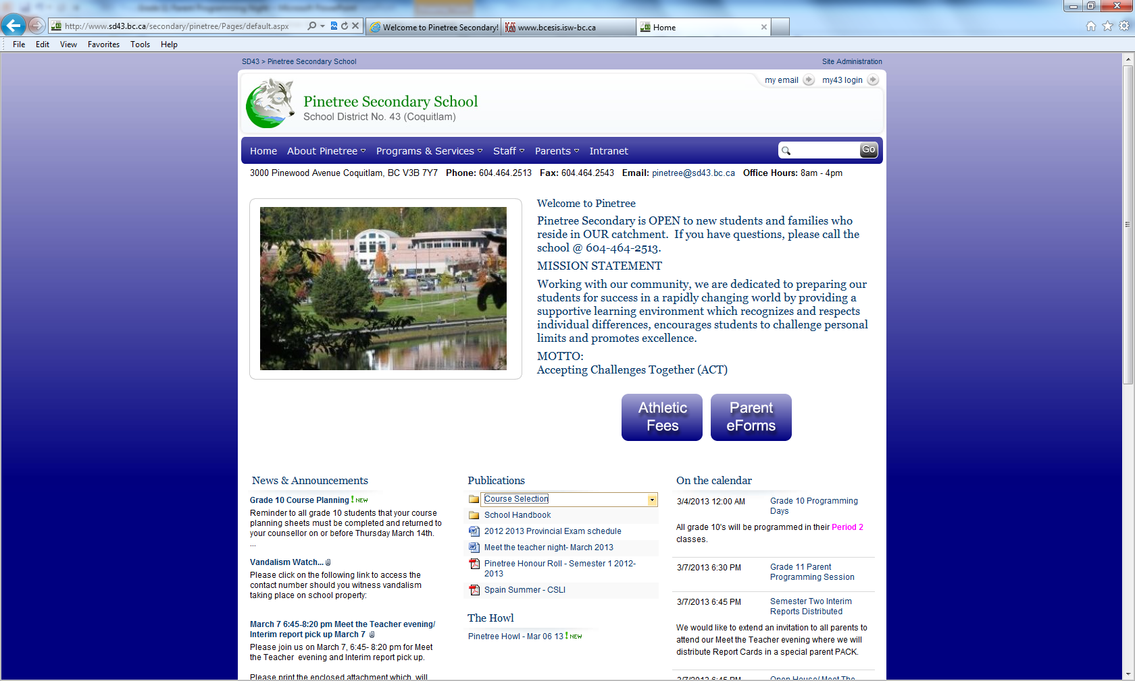
Course Calendar Online-
Detailed description of all courses!

Slide 6
Transition Programs
Work Experience (30 hours employability skills/ 90-100 hours on a jobsite)
School Apprenticeship or ACE-IT programs.
SSA(Secondary School Apprentice) –work in a trade and earn High School Credit
(Examples include: construction workers, cooks, mechanics, and auto body, hairdressing)
This program will allow students to: Gain high school credit (every 120 hour of work earns 4 credits to a maximum of 16 credits)

Slide 7
Number of Courses
Grade 12’s must enroll in 8 plus GT
Exceptions (extra music course) Jazz Band, Choir , and Vocal Jazz (these would be in addition to your 8 courses)
Online courses are not counted in the 8 needed at Pinetree
Most students will graduate with more than 80 credits

Slide 8
Honours Courses
English 11H/ AP English Language and Composition 12 (year long)
English 12H/AP English Lit and Composition 12 (year long)
Social 11 Honours
History 12 Honours
Math 12H/ Calculus 12 H(AP) (year long)
Biology 11 and 12 Honours (AP)
Physics 11 and 12 Honours (AP)
Chemistry 11 and 12 Honours (AP)
IDS 12 for Science and Math

Slide 9
What’s New at Pinetree?
Writing 12
For: Students who have completed English 10 and would like to improve their writing skills
University bound? Feel that your writing skills still need some work?
Writing 12 may be the course for you. Writing12 will cover writing styles frequently used in a variety of university faculties.
These styles include: analysis, persuasion, description, narration, argument and compare/contrast.
The skills you will learn in this course will enhance your ability to experience success in English11/12

Slide 10
Advice for students from Previous Grade 12’s:
Next year as a GRADE 12 student it will be very important to do the following:
Read the Howl daily (on the website)
Visit the career centre often
Attend as many post secondary information sessions as possible –this information will be in the howl as dates come up
When applying to post secondary institutions apply to more than 1 school
Write the LPI in Semester II if needed
Apply for Scholarships
Finish Your Grad Transitions
Stay organized

Slide 11
CAREER CENTRE
http://public.sd43.bc.ca/secondary/Pinetree/careercentre/default.aspx
Scholarship Information
Post Secondary Information
Career Information
Volunteer Opportunities
See Mr. McBride anytime in Room A200

Slide 12
Scholarships
Grade 12’s will receive scholarship information Mid- October. A meeting is held to provide information on:
External Scholarships
University Entrance Scholarships
Provincial Scholarships
Local Scholarships
District Scholarships
Passport to Education
http://public.sd43.bc.ca/secondary/Pinetree/careercentre/default.aspx

Slide 13
Post Secondary Education: Simon Fraser University
General Admission:
Graduation
English 11 & 12
Socials 11
Principles of Math 11
Language 11 (beginner language 11 or higher)
Science 11
Entrance Averages:
Based on 4 Grade 12 Courses
English 12
3 other academic 12’s
BC First Nations Studies 12 , English Lit 12, French 12, German 12, History 12, Japanese 12, Principles of Math 12, Spanish 12, Biology 12, Chemistry 12, Geography 12, Geology 12, Physics 12, Mandarin 12
Plus(New this year): Calc 12, Comp Civ 12, Economics 12, Law 12
Note: SFU Accepts Language Challenge exams for admission purposes.

Slide 14
SFU Quantitative Requirements
(this has not changed)
  70% in Principles Math 11 or 12 depending on the program you are applying to
  OR
  60-69% in Principles Math 11 or 12 plus a score at least 20/30 on a diagnostic skills test (Q Placement test) at SFU before beginning their quantitative courses
  OR
  60-69% in Principles Math 11 or 12 plus complete within your 1st year a Foundations of Analytical and Quantitative Reasoning course with a grade of C or better before beginning quantitative courses at SFU

Slide 15
SFU English Language Skills Requirements
(this has not changed)
75% or higher in English 12
OR
A grade of 60-74% in Eng 12 plus a score of 4 on the essay section of the LPI exam and a minimum score of 50% on all other parts of the LPI exam
OR
A grade of 60-74% in Eng 12 plus with in your 1st year complete of a Foundations in Academic Literacy course with a C or higher

Slide 16
SFU Business
Academic Requirements
  English 12, Math 12 + two additional approved grade 12 courses
Broad Based Application
  Demonstrates excellence, leadership and/or achievement in extra-curricular area(s) such as: entrepreneurship, social activism, athletics, arts, community leadership and/or involvement
  Broad Based Application process opens December 15th, 2011
Admission Average
  80% or higher is required for broad-based admission

Slide 17
Post Secondary Education: UBC Vancouver / Okanagan
General Admission
Grade 11 Course Requirements:
English 11, Social Studies 11, Pr. Math 11, a Language 11
  Beginner’s is not accepted, External Lang 11 is accepted
  Language requirement not needed for UBC Okanagan
an Academic Science 11 (Bi 11, Ch 11, E. Sc 11, Ph 11)
Language Challenge Courses:
Not accepted for admission purposes
Can be used to satisfy general admission requirement such as a language 11 or language 12 requirement for the Faculty of Arts Degree program

Slide 18
Post Secondary Education: UBC Vancouver/ Okanagan
ENGLISH LANGUAGE REQUIRMENTS:
The English Language Admissions Standard (ELAS)
    Meet by being in school in Canada for 3 years consecutively, up to and including grade 12
    If not can meet this requirement in other ways. Go to https://you.ubc.ca/ubc/vancouver/elas.ezc
    And see pg. 40 in the UBC viewbook. (Toefl, Ielts)
Final Grade of 70% Grade 11 or 12 English(including provincial exam)
    https://you.ubc.ca/ubc/vancouver/cdnhs.ezc

Slide 19
Post Secondary Education: UBC Vancouver/ Okanagan
3. Language Proficiency Index (LPI):
    This is a registration requirement before you can enroll in your first year English course
    Exemption from the LPI requirement is determined according to the following criteria:
      Interim grade of 80% in En 12 (April 2012 Report Card) or a final grade of 75%. (Class mark or Blended, whichever is higher)
      Completing the Faculty of Arts Degree Program (BA, BFA, BMUS). These students will enroll in a mandatory first year writing requirement course

Slide 20
Post Secondary Education: UBC Vancouver / Okanogan
What is different about UBC’s application process:
Admission is no longer calculated on English 12 plus 3 other approved grade 12 courses
UBC is now taking a holistic view towards admissions
It will now be less transparent as to what it takes to get into UBC
Weighting of grades vs. personal profile is unknown. Likely it will be different depending on the faculty you are applying to

Slide 21
Post Secondary Education:University of Victoria
General Admission Requirements
Admission Averages are based on
  English 12 and three additional approved academic grade 12 courses
Grade 11 requirements
  English 11, Social Studies 11, Pr. Math 11, an Academic Science 11 (Bi 11, Ch 11, E. Sc 11, Ph 11), Fine Arts 11, a language 11
  An approved language 11 required only for the Faculty of Humanities and Fine Arts.
  (approved list on the website) http://web.uvic.ca/calendar2009/FACS/UnIn/UnAd/UCYe1ARBSSG.html

Slide 22
Post Secondary Education: University of Victoria
NEW Effective May 2012 Academic Writing Requirement
To ensure that you have an opportunity to develop the advanced literacy skills expected at the university level, all undergraduate students enrolled in a degree program are required to complete a 1.5 unit AWR-designated course
To be exempted from taking this course:
  score of at least 86% on the BC English 12 Provincial Examination

Slide 23
Applying To Post Secondary
Be careful – each institution has different math, language, English and other course pre-requisites.
Check with your counsellor or in the Career Centre.

Slide 24
Post Secondary Education: University of Toronto
Basic Admission Requirements
English 12 plus 4 academic courses (formerly provincially examinable)
Average will be calculated on English 12 plus these 4 subjects or 5 subjects if Calculus 12 is required for the faculty student is apply to (e.g. Science, Business)
Note: Language Challenge Course Marks are not acceptable Note: for online courses 50% of the course must be done to be considered for admission

Slide 25
Post Secondary Education: University of Toronto
University of Toronto’s Policy on Repeated Courses:
Individual programs at U of T reserve the right to give preference to students whose marks are the result of a first attempt at each course, particularly in prerequisite subjects
Faculty of Applied Science and Engineering generally consider first attempts ONLY.
Rotman Commerce Program in the Faculty of Arts and Science will ONLY consider first attempt in all courses.

Slide 26
Ontario Universities General Info
Common Application Process- please refer to the following website to apply online
http://www.ouac.on.ca/105/
Deadline for early admission to all Ontario universities is early January
Grade 11 marks will be used for early admission offers as Semester I final marks usually are not available until February.
Recommended that when you have new grades you send new transcripts.

Slide 27
Post Secondary Education: Eastern Universities
University of McGill
Entrance Requirements
Based on the average of their top five grade 12 academic courses
http://www.mcgill.ca
Each faculty requires certain high school courses as prerequisites for applying. Please refer to their website
http://www.mcgill.ca/applying/standards/canada/
Of the five courses used for admission at least 4 must have optional provincial exams. If a student chooses to write the optional provincial exam than the blended mark will be considered
If a student repeats courses McGill takes an average for admissions calculations

Slide 28
Douglas College
General Admission Requirements
Student has successfully completed BC secondary school graduation
Must meet English language proficiency by providing proof of one of the following:
  A Minimum C in English 12 (Blended final mark to include provincial exam) OR
  A minimum B in Communications 12 ( Blended final mark to include provincial exam)
Douglas College has open enrolment programs, limited enrolment programs and University Transfer programs. Please check the Douglas College website for details.

Slide 29
BCIT
Technology, Trades, Business, Sciences and more….
Business
  e.g.. Financial Management (Diploma and Degree Programs)
Computing
  e.g. Computer Systems Technology
Process, Energy and Natural Resources
  e.g.. Forestry, Mining, Petroleum and Natural Gas
Health Sciences
  e.g. Medical radiography, Public Health Inspector
Trades and Apprenticeships
  e.g. Plumbing, Sheet Metal, Auto Mechanics, Electrician

Slide 30
Questions? Please visit the Career Centre or the Counselling Department.

