Slide 1
Digital literacy
Your Passport to Success
With Your Guides – Mr. Aitken and Mr. Prensky

Slide 2
Digital Literacy - Overview
Year 1 of Digital Literacy at HWSS!
What is Digital Literacy
Goals of Digital Literacy Program
Why Digital?
Characteristics of Digital Literacy
Benefits of Bring Your Own Device
Your Own Blog – EduBlogs
Security Tips
Device Options

Slide 3
Meet Madison – She’s Digitally Literate
Madison is 23 years old and is a pharmacist
She has a blog – Nails by Madison
She stores her files on OneDrive, and shares them with friends and coworkers
She uses her Google account to backup all her photos
She chats with family using Skype
She uses social media regularly to promote her blog and interact with others interested in nails – Facebook, Instagram, Twitter
Her Facebook is set to private
She often checks more than one website to verify that news and information is correct

Slide 4
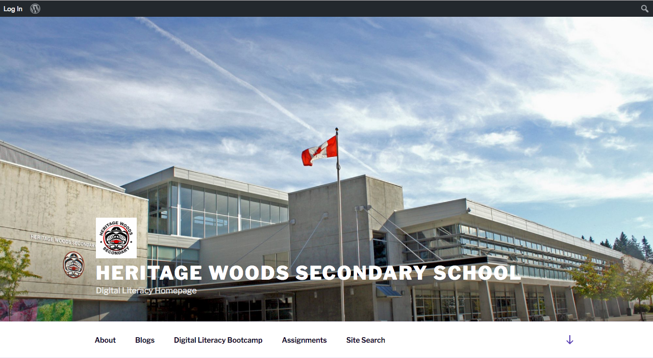
DigLit Home
kodiaks.sd43.bc.ca
heritagewoods.sd43.bc.ca
Click on “Programs and Services”
Select “Digital Literacy”

Slide 5
Partner Exercise
Every other person raise your hand, starting at stage left
Your partner is to your right
Define “digital literacy” for your partner
Based on your definition, how digitally literate are you? Explain.

Slide 6
What is Digital Literacy?
According to the BC Ministry of Education, Digital Literacy is…
“the interest, attitude and ability of individuals to appropriately use digital technology and communication tools to access, manage, integrate, analyze and evaluate information, construct new knowledge, create and communicate with others”.
In other words, using technology appropriately, creatively, and intelligently.

Slide 7
Goals of Digital Literacy
Prepare students for a digital life
Develop Digital Citizenship
Ensure that students are safe online
Build community, participation, and belonging

Slide 8
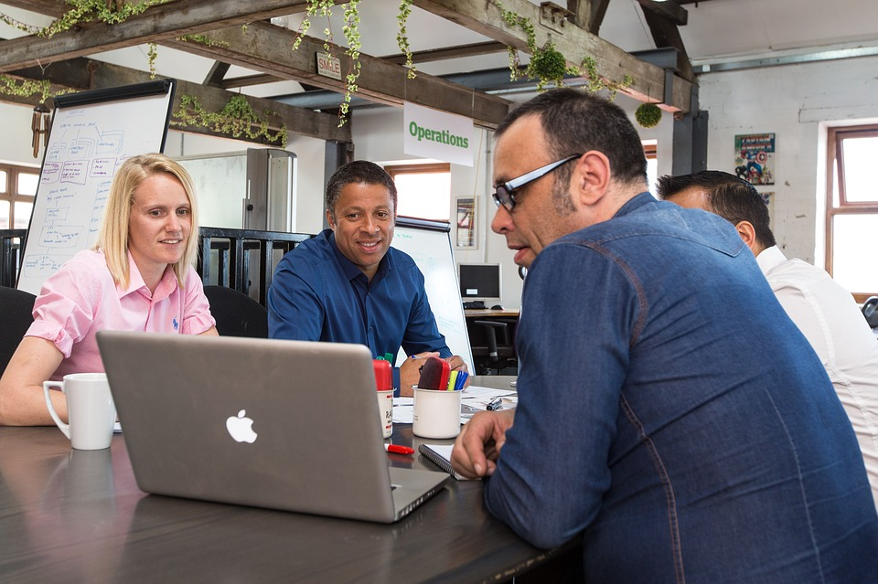
Why Digital?
Most students will use technology in their future careers
Employers expect tech knowledge
Classrooms are more engaging and relevant

Slide 9
Digital Literacy Characteristics
6 characteristics of a digitally literate student
Research and Information Literacy
Critical Thinking, Problem Solving, and Decision Making
Creativity and Innovation
Digital Citizenship
Communications and Collaboration
Technology Operations and Concepts

Slide 10
Research and Information Literacy
How to gather information
How to evaluate the information you gather
How to use that information
Evaluating Websites

Slide 11
Critical Thinking, Problem Solving, and Decision Making
Plan and conduct research
Manage projects
Solve problems
Make informed decisions
Use appropriate tools and resources
What is Critical Thinking?
Image Credit: http://ontariomedic.ca/2016/09/27/critical-thinking/

Slide 12
Partner Exercise
Raise your hands again
Your partner is on your right (or partner with someone behind / in front of you)
Have you ever posted something and then regretted it?
Would you be comfortable with your parents seeing everything you post?
What are some possible negative consequences of posting something “bad”

Slide 13
Creativity and Innovation
Demonstrate creative thinking
Develop innovative products and processes using technology
Innovation is new ideas
Some ideas that were once new – the wheel, automobiles, Facebook, iPod, photography
Image credit - http://shiftkeylabs.ca/introduction-to-innovation-bootcamp/

Slide 14
Digital Citizenship
Understand key issues related to technology, such as:
Cyber bullying
Internet addiction
Social Media addiction
Digital Footprint
Technology inequality
What is Digital Citizenship?
Consequences of poor behaviour online

Slide 15
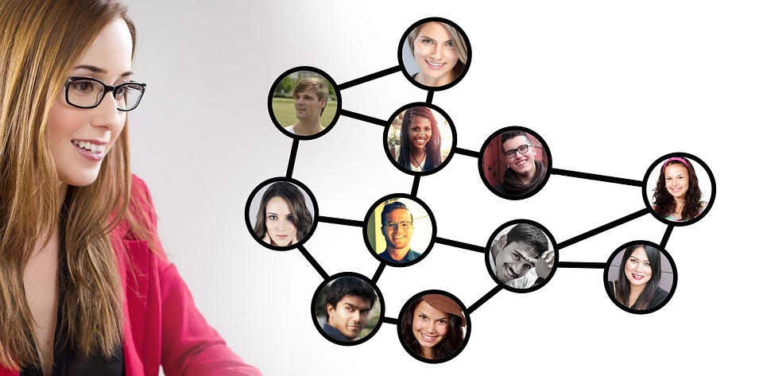
Communications and Collaboration
Using digital media to communicate
Presentations
Videos
Blogs
Websites
Podcasts
Webcasts
Photography
Using digital media to collaborate
In person
At a distance
Some collaboration tools you could check out

Slide 16
Technology Operations and Concepts
Demonstrate understanding of technology concepts, systems, and operations
How a computer works
How to edit photos or videos
Using digital tools in different specialty areas
How a network works
How the Internet works
Understanding different file types

Slide 17
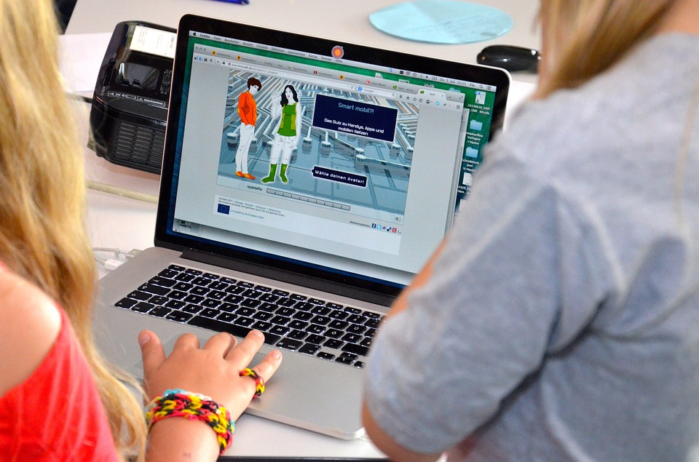
Benefits of Bring Your Own Device
No papers to lose
Study and work anywhere at any time
Lighter backpack
Access to online resources at all times
Everything on one device
Ability to collaborate more easily

Slide 18
Tips for Security
Physically lock your device in your locker when you aren’t using it
Use a Keylock/Password on your device
Don’t leave your device on a table in the Grand Hall, then walk away
Protect your device with a case
Download a tracking app such as “Find my iPad”
Be very cautious about letting others use your device

Slide 19
Affordability of Devices
Devices can be purchased for $300 to $500 (and up)
HWSS has a partnership with Staples
Price Guarantee
Extended Warranties
Financing
Just tell them you’re a student at HWSS
Not all families can afford to purchase a device
The school has some devices available to loan to students for the year
Email Mr. Prensky or Mr. Aitken or see us afterwards
rprensky@sd43.bc.ca OR paitken@sd43.bc.ca

Slide 20
Logging On
Add a new wireless network
System Preferences / Network
Settings / Wireless and Networks
Network and Sharing / Manually add network
SD43Learn
Password is Secure4School
Network type is WPA / WPA2 Personal
You will be prompted for the username and password you received in Advisory

Slide 21
Social Media
Find a partner (follow directions)
Show your partner all your social media
Snapchat
Instagram
Facebook
Twitter
Tumblr
Reddit
YouTube
Google+
LinkedIn
Pinterest
Twitch
WhatsApp
WeChat
Kik
Blogger
DeviantArt
Flickr
ASKfm
Blogger
Telegram

Slide 22
Grade 9 DigLit Survey
Go to http://tinyurl.com/HWDigLit1
Complete the survey
Image Credit - www.timeshighereducation.com

Slide 23
Office 365
As an SD43 student you get FREE Microsoft Office software - $150 value!
You can download and install the entire Microsoft Office Suite (NOT NOW!!!)
Go to sd43.bc.ca
Click on the Office 365 link
Login
Click on Install Office 2016

Slide 24
OneDrive
Part of your FREE MS Office subscription is online (cloud) storage
OneDrive gives you 1 terabyte of storage
Install the OneDrive app on all your devices
Think of it as a folder you can access from any device at any time
Files on OneDrive can be shared with classmates for collaboration

Slide 25
OneNote
OneNote is awesome!
Store all your notes in one place
Access from any device – laptop, desktop, phone, tablet
All your classes, to-do list, vacation research, meeting notes, group projects
Information is organized into Notebooks, Sections, and Pages
Example – School Notebook, English Class (section), Shakespeare – Hamlet (page)

Slide 26
Get Your Reminders
This will be our only meeting with you outside of English or Science classes
You will have homework assignments to get credit for your Digital Literacy course
We will need to remind you about due dates, assignments, etc
Go to remind.com Click “Sign Up” and enter your email address and/or phone number (we don’t see your info)
Install the app
Join @hwdiglit

Slide 27
Social Media – Part 2
Find a new partner (follow directions)
Introduce yourselves (super quiet voices)
Do a Google search for your partner’s name
What can you find out about them?
Is their Facebook account open or closed?
What social media accounts show up?
Can you find any personal information that shouldn’t be posted?

Slide 28
Intro to EduBlogs
WordPress is an easy to use platform for creating websites and blogs
EduBlogs is a platform for creating educational blogs using WordPress
An EduBlog account has been created for you
You must hand in your parent consent form
Your EduBlog is where you hand in Digital Literacy and Core Competency assignments
Your EduBlog is where you store examples of what you’ve done in high school
It’s a portfolio that shows your progress over time

Slide 29
Logging in to EduBlogs
Go to kodiaks.sd43.bc.ca
Click on – Login
Enter your username and password
Username = FirstName + LastInitial + 2017
Example for Steve Jobs = stevej2017
Password = 12345

Slide 30
Username Exceptions
Ariyaratne, Thineth thinetha2017
Chen, Tony tonyc2017
Chen, Guan Xi guanxic2017
Garousy, Faraz farazg2017
Hall, Rachel rachelh12017
Bejarano Castaneda, Laura laurabc2017
Ben Zvi, Lara larabz2017
Callander-McLennan, Keely keelycm2017
De Carvalho, Nikolas nikolasdc2017
Munoz Giraldo, Juanita juanitamg2017
Navajas De Aldana, Mateo mateona2017
Obedzinski, Hannah hannahob2017
Purves-Smith, Russel russelps2017
Simpson-Ferguson, Soryn sorynsf2017
Tseng-West, Tara taratw2017
VanBeest, Christina christinavb2017
VanBeest, Julianna juliannavb2017

Slide 31
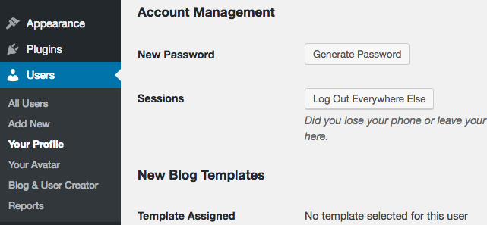
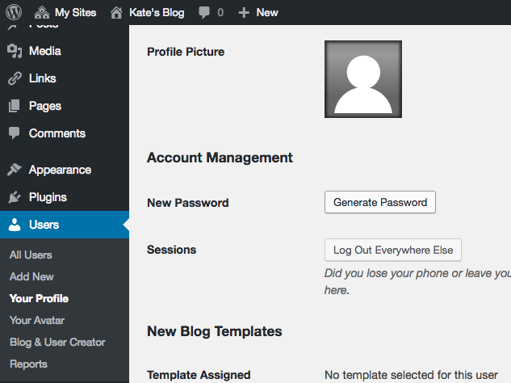
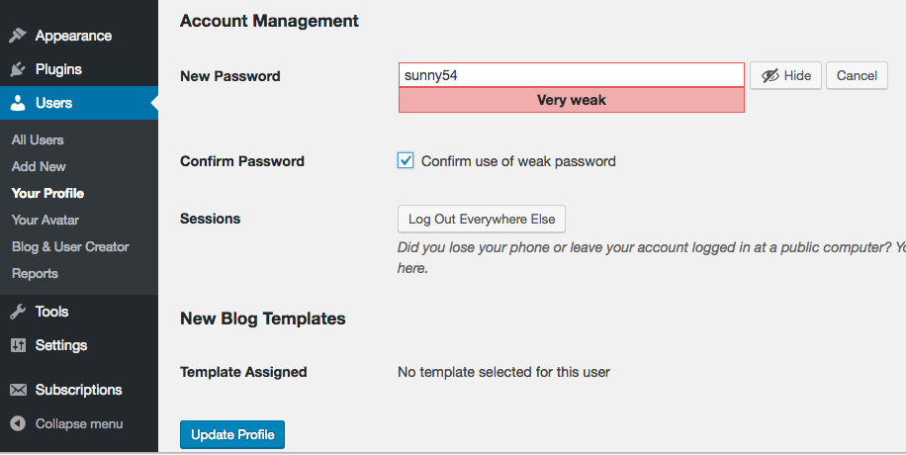
You’re In!
You’re In! Let’s change your password!
Go to Users / Your Profile
Scroll down to the bottom
Click on the “Generate Password” button
Enter a new password – same as your school password
Click on “Confirm Use of Weak Password”
Click on “Update Profile”

Slide 32
Change Blog Title and Tagline
Click “Customize”
Click “Site Identity”’
Change the Site Title and Tagline
Click “Save and Publish”
Click the left arrow (back) to return to the “Customize” menu

Slide 33
Changing the theme
Still in the “Customize” menu
Click “Change” on the left menu to change the active theme
Try “Live Preview” on at least 3 themes
You can keep the theme or choose a new one
You can modify Colors, Menus, Background Image, and Header Image
You can also choose to use a Static Front Page, which doesn’t change as you add posts

Slide 34
Changing the banner image
Click on the Home icon - “Joe’s Blog” (with your name)
Click “customize” at the top
Click on “Header Image” on the left menu
Click “Add New Image”
Recommended size for default template is 1000 X 150
You can find royalty-free images at pixabay.com
Click the “Save and Publish” button

Slide 35
Create “About Me” Page
Page vs. Post
Select “Joe’s Blog” at the top
Click “Dashboard”
On the left, choose “Pages” / “Add New”
Title is “About Me”
Assignment Rubric – 5 Completion Marks
Changing Theme and Header – Image and Title
Paragraph about you completed – at least 5 sentences
Quote and paragraph about quote completed
Embedded video and explanation of its importance to you
Image and explanation of its importance to you
15 minutes to work now – complete for homework
Assignment at kodiaks.sd43.bc.ca

Slide 36
Creating your first blog post
This is your 1st assignment for DigLit
This assignment will be marked
It is due by September 30th
You will be reflecting on your Digital Footprint
The assignment can be found on the DigLit homepage – kodiaks.sd43.bc.ca

Slide 37
Assignment #1 – Your Digital Footprint
Watch the video about managing your digital footprint. http://www.youtube.com/watch?v=o8C1a2z_cuQ
Research your digital footprint. Google yourself. Try to picture how your footprint comes across to others.
Answer the questions by creating one of the following:
Video Response
Poster / Infographic / Website
Article
You can view the assignment on the DigLit homepage

Slide 38
Conclusion
DigLit will continue in your English and Science classes
You will be marked on:
- Blog setup (from today)
- About Me page (from today)
- Digital Footprint assignment
These should all be completed by Sept. 30th
- 3 English assignments
- 3 Science assignments
Thank You!

