Slide 1

Leaving the Woods
Grad 2018
Heritage Woods Counselling Department
October 2017

Slide 2

Heritage Woods Counsellors
Ms. Shaunna Martin A-G
Mr. Paul Gangnes H-N
Ms. Karen Leeden/
Mr. Curt Dewolff O-Z
Heritage Woods Career Facilitator
Ms. Darilynn Butler

Slide 3

“If it is to be, it is up to me!”
GAP YEAR
TRAVEL
APPRENTICESHIP
So Many
choices
COLLEGE
UNIVERSITY
TRADES
VOLUNTEER
WORK

Slide 4

Let’s Make sure you Graduate 1st!
You MUST check your transcript on-line! Is it accurate?
Go to the Student Transcripts Service Website:
  http://www2.gov.bc.ca/gov/content/education-training/k-12/support/transcripts-and-certificates

Slide 5

A Quick Review
In order to graduate you need 80 credits (20 courses)…
  English 10, 11 and 12
  Mathematics 10 and 11
  Physical Education 10
  Planning 10
  Science 10 and 11
  Social Studies 10 and 11
  A Fine Art or An Applied Skill 10, 11 or 12
  4 Electives at the grade 10, 11 or 12 level
  3 Electives at the grade 12 level
  Graduation Transitions

Slide 6

Other ways to Attain Credits
Equivalency
External Credits
Course Challenge
Courses take elsewhere
Career Programs (i.e. ACE-IT)
If you think you should be receiving some of these, but have not, bring proof of your courses to your counsellor

Slide 7
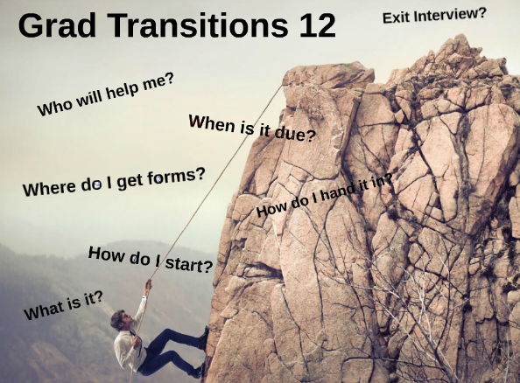
Graduation Transitions
Your GT staff are:
Ms. Gay and Ms. Nunn
  Community Connections
  Personal Health
  Career and Life Plan
  Presentation
  If you do not have your booklet, there are some more available, see one of the GT teachers or counsellors, or download from the GT portal

Slide 8
StudentTranscripts Service Overview
Students are responsible for ensuring transcript accuracy prior to transmission!

Slide 9
Benefits for Students
View assessment, exam marks, transcript, scholarships & awards
Download digital, pdf or hardcopy of official transcripts
Select up to 25 Post-Secondary Institution (PSI) selections for FREE!
Request real time transfer
Authorize updates throughout the year
Feedback on status of transcript delivery

Slide 10
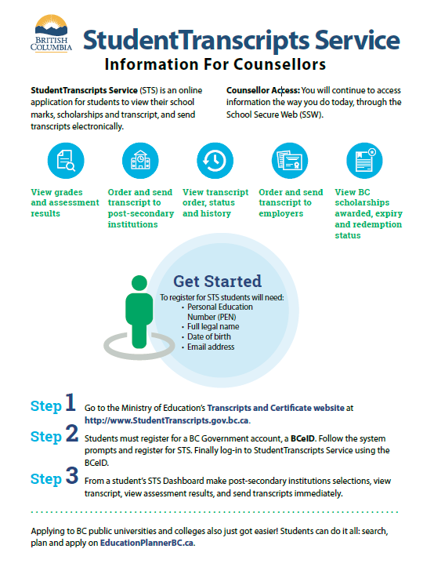
This can be found posted outside the counsellors office & under QUICKLINKS on our schools homepage!

Slide 11
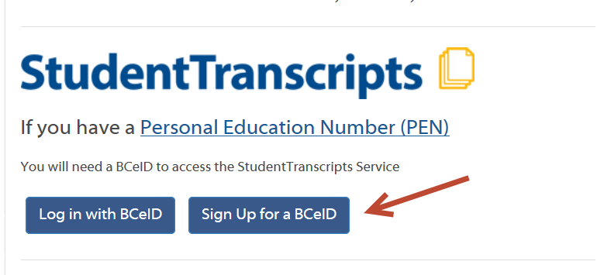
Getting Started: BCeID Sign Up
Notes:
BCeID is an online service that makes it possible for you to use one user ID and password to sign in securely to many Government services in British Columbia.

Slide 12
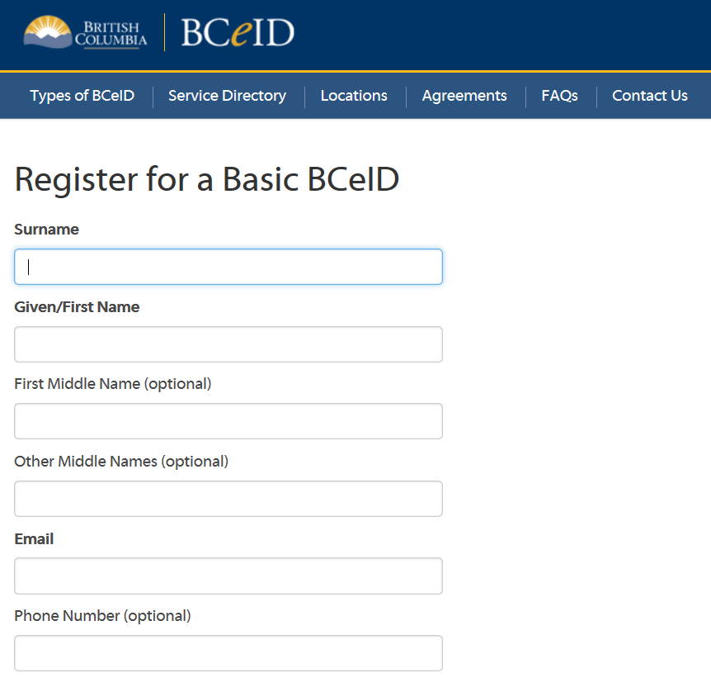
Getting Started: BCeID Sign Up
Complete the Fields to register for a BCeID

Slide 13
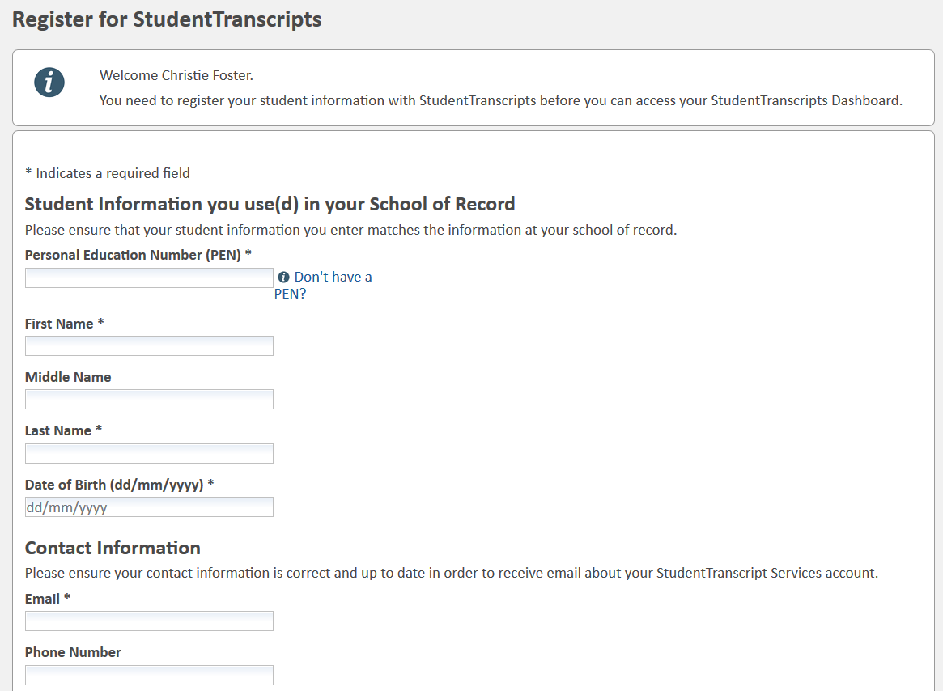
Register for StudentTranscripts
PEN, First Name, Last Name and email are mandatory fields
Notes:
Students must provide their PEN, legal name and birthdate to obtain access to their records.

Slide 14
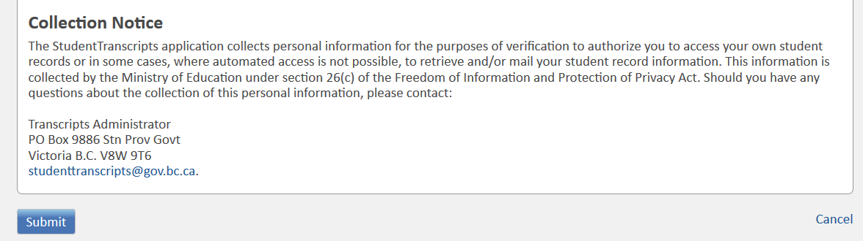
Authorize Data Collection
Read the Data Collection to complete the process.

Slide 15
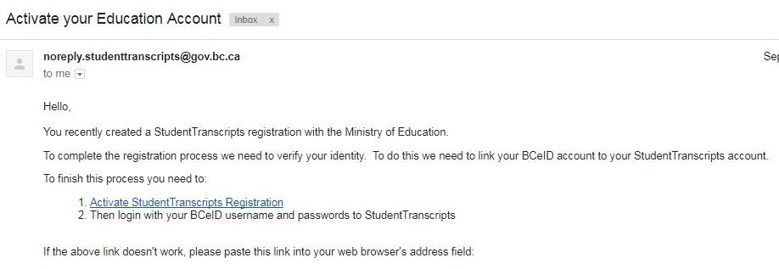
Email Verification
An email confirmation will be sent to activate registration.
Click on the LINK to connect the newly created BCeID to the students STS account.
Notes:
The system will display a registration confirmation message advising an email has been sent; to activate the registration and link a BCeID to a student’s STS Account you need to click a link in the email.
After you click the link the system will prompt you to enter your BCeID user name and password to finalize the process.

Slide 16
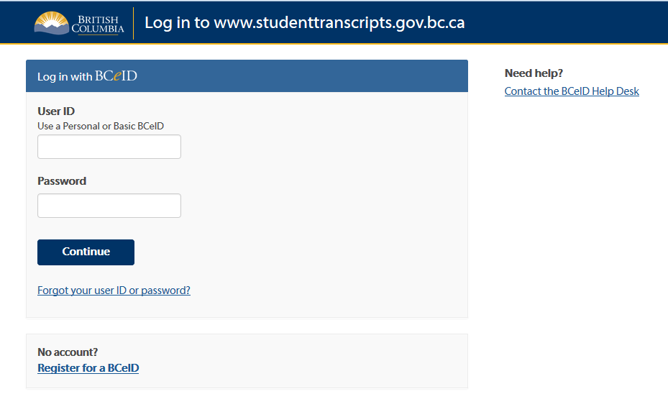
Logon with the BCeID

Slide 17
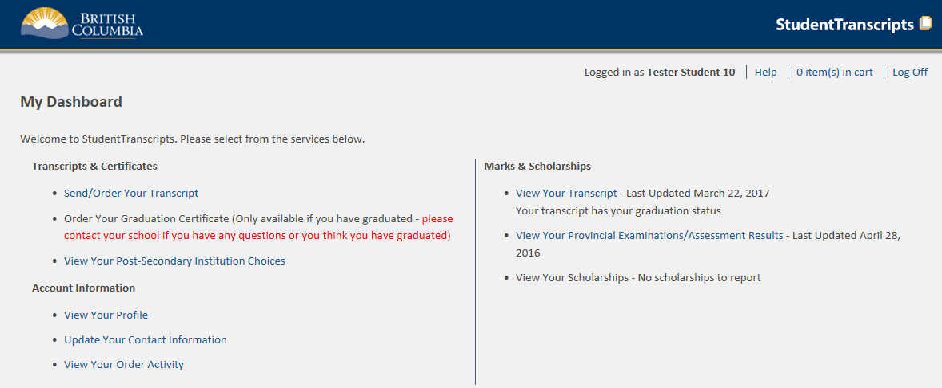
Student Dashboard
Main Student Dashboard following authentication and authorization
Notes:
The Student Dashboard provides access to the functions available to students once they have:
1. authenticated using either a Basic BCeID or BC Services card, and
2. successfully been authorized to access their transcript records.

Slide 18
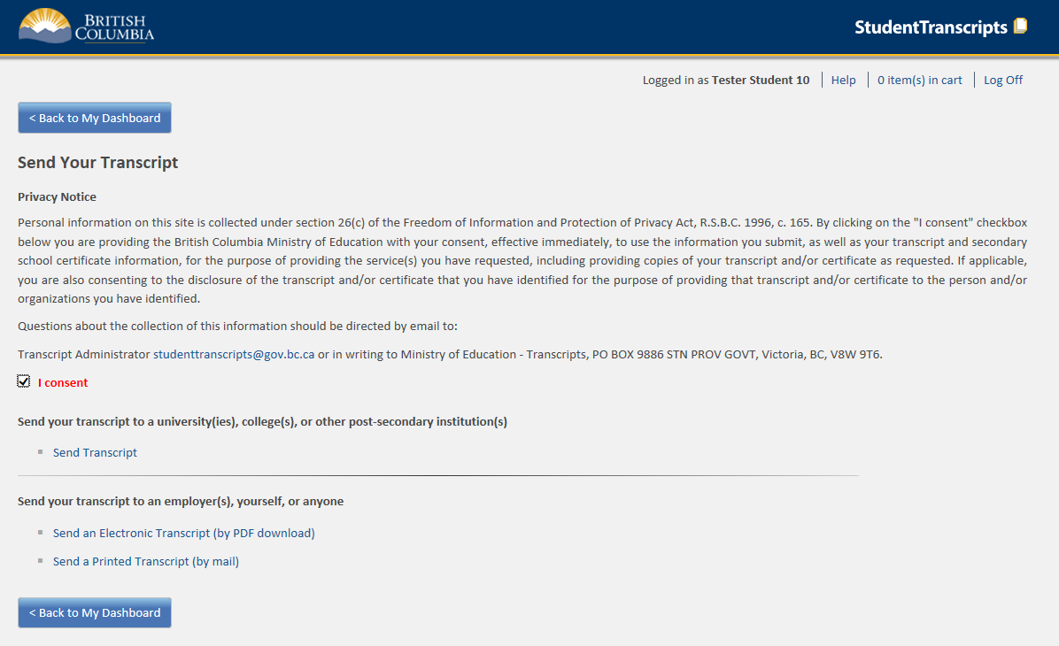
Send/Order your Transcript
Privacy consent activates links below
Send Transcript to selected PSI
Send PDF Transcript or Send Printed Transcript
Notes:
Privacy consent box (once checked) enables the other links for:
Sending transcripts to PSIs; or,
Sending transcripts to other third parties.
Electronic Transcript (by PDF download) will operate much like an electronic bank transfer transaction requiring the email address of the receiver and a shared security question and answer.
Printed Transcripts will now also be automated through direct PDF transcript printing at BCMail for subsequent mailing to the specified destination.

Slide 19
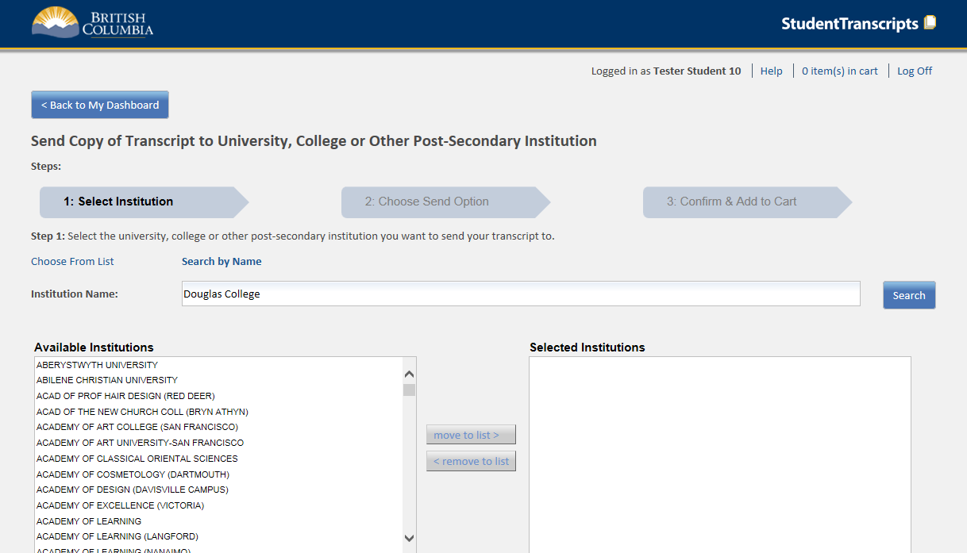
Step 1 – Search for PSI
Select one or more institutions
Notes:
After selecting Send Transcript to PSI
Step 1 is to select the institutions to receive the transcript. Multiple institutions may be selected or removed from the selected institutions box.

Slide 20
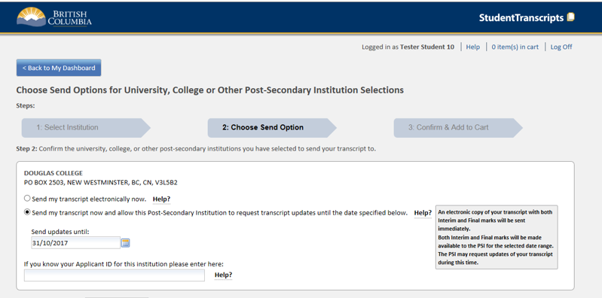
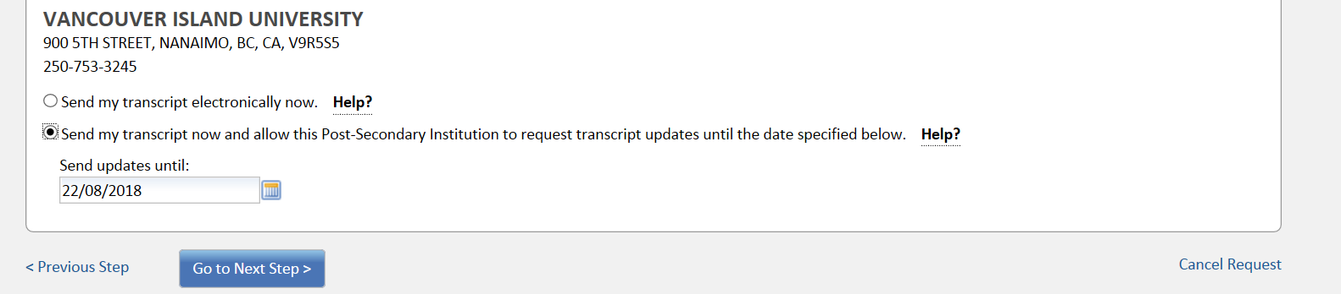
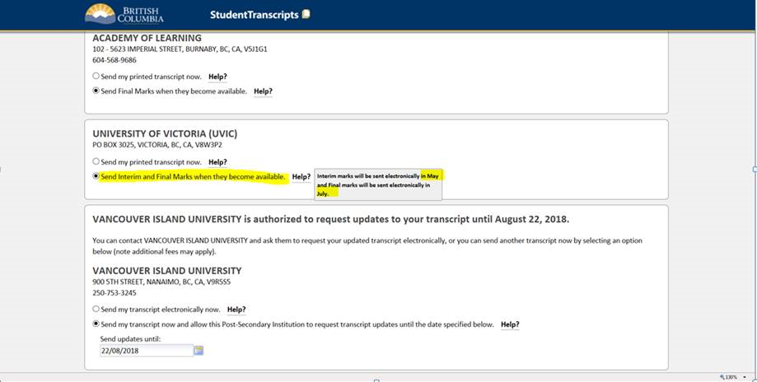
Step 2 – Choose send option
Options available for an institutions that receive printed transcripts
Options available for an institutions that receive the TRAX electronic batch file
Send Interim and Final Marks when they become available.
Notes:
Step 2 will display these options for PSIs that receive transcripts via printed transcript or via a batch electronic file in May (for interim marks) and July (for final marks) If multiple institutions were selected, multiple boxes (one for each institution) will be displayed with their appropriate send options.
The send options available will vary depending if the institution receives paper, batch electronic, or xml transcripts.
The send options will also vary for Current or Former students.
Post-Secondary Institutions that receive printed transcripts will display these options:
Send my printed transcript now – Sends a one-time printed transcript by mail based on currently completed courses (no interim marks or current courses are displayed)
Send Final Marks when they become available – Sends a final transcript by mail after all final marks are recorded in July.
Post-Secondary Institutions that receive batch electronic files will display these options:
Send my printed transcript now - Sends a one-time printed transcript by mail based on currently completed courses (no interim marks or current courses are displayed)
Send Interim and Final marks when they become available – Sends an electronic file of transcript interim marks in May and also sends an electronic file of final marks in July.

Slide 21
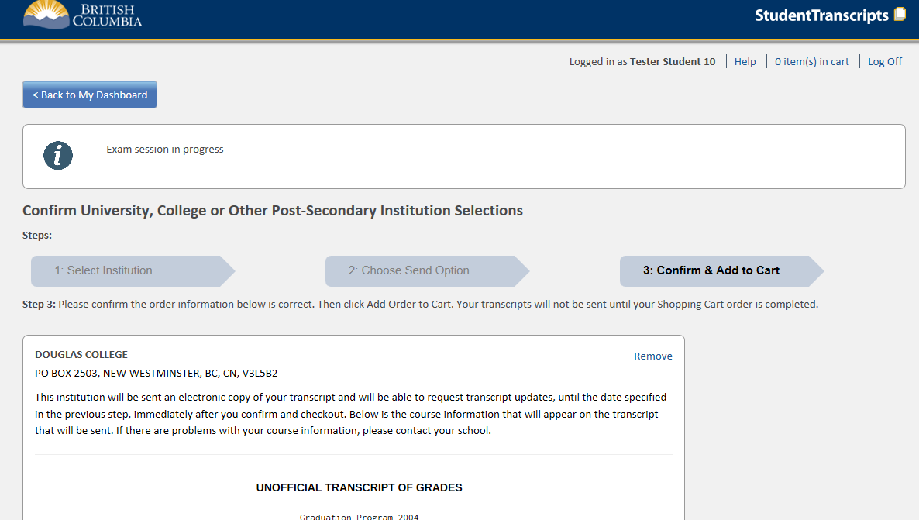
Step 3 – Confirm and add to cart
Informational message area to warn students of any exam marks that may not yet be complete
Preview of Transcript prior to sending
Notes:
Step 3 provides the student with the opportunity to view their current transcript prior to sending to ensure that it is accurate.
It is important that students review this carefully to ensure that all current courses and courses taken at other schools are included. If any information is incorrect or incomplete, students should contact their home school and cancel the transcript order until they can confirm that the information is correct.
An informational message (controlled by TRAX administrators) may also display relevant information about the status of examination marks that may be in progress at certain periods of time so the students are aware of why certain marks may not yet be available.

Slide 22
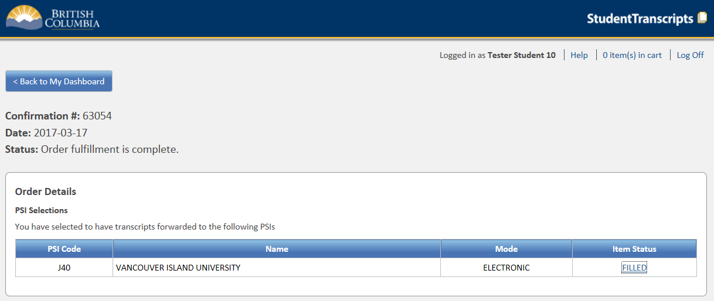
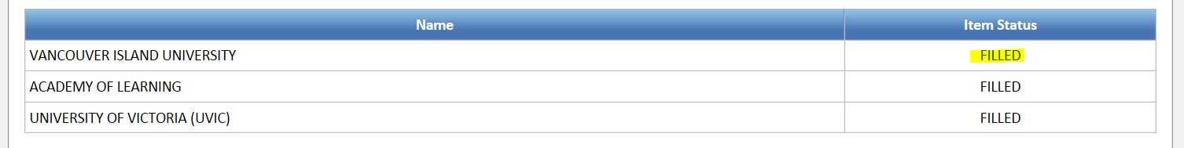
Review Order Details
Lists all of the institutions (Order Details) that constitute a particular Order
Some institutions (capable of receiving XML transcripts) will have a link on the Item Status to provide more information about when your transcript was sent and when it was received
Notes:
Once the order is complete, the student may view their order and see the status of each of the institutions selected on that order.
A “Filled” status that indicates that the transcript request has been placed
For PSIs able to receive the XML transcript, students may select the link on the Item Status to see more detailed dates and times that the transcript was sent and received by the PSI
For PSIs that receive printed transcripts, students can expect that it will take about 1 week for the PSI to receive the transcript via mail.
For PSIs that receive the electronic batch file, the student is recorded on the PSI selection file and the file of interim marks and final marks will be sent in May and July.

Slide 23
For more information
Ministry of Education
Student Certification Branch
Email: student.certification@gov.bc.ca

Slide 24








Headed to Post Secondary?
- Do Your Research!
Go to Post-Secondary Websites for updated program requirements!
Attend Information Sessions!
Visit Institutions of interest in person or Virtual On-line Tours!
Talk to people in your life that you trust!

Slide 25
APPLICATION PROCESS
  For BC Institutions → www.applybc.ca
  For Alberta Institutions → www.applyalberta.ca
  For Ontario Institutions → www.ouac.on.ca
All are open now – start applying!

Slide 26
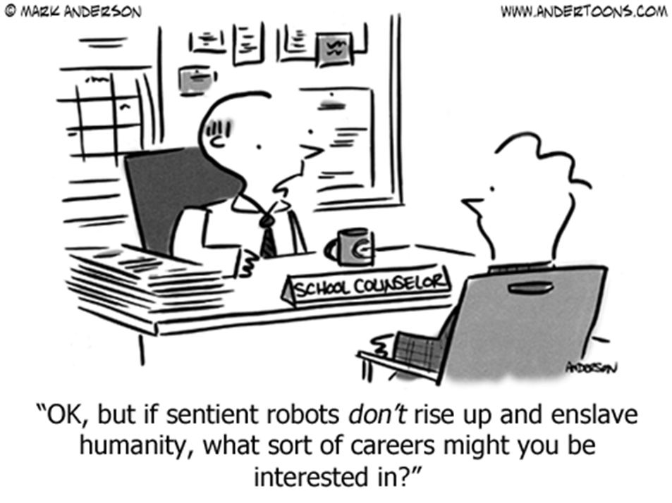

Slide 27


Don’t Worry if you don’t have it figured out just yet…
Constant process of inquiry and reflections
College/University does NOT guarantee a job
Workforce, travel, trades, etc.
The world of work puts emphasis on skills, knowledge and abilities (4 key skills: communicate, computer, continuous learning and collaboration)
There is more than one path to the end goal
Just make sure you are thinking ahead and talking about it…

Slide 28
The CAREER CENTRE is your one-stop shop for all things related to:
    Post Secondary Opportunities
    Program Information
    Scholarships, Awards, Student Loans, Bursaries
    Employment Opportunities
    Volunteer Opportunities
    Be sure to stay tuned to the Career Centre TV monitor and the Kodiak for announcements related to any of these
    MAKE SURE YOU HAVE DONE YOUR OWN RESEARCH FIRST!!!

