Slide 1
Heritage Woods Course Selection Information 2020-2021

Slide 2
Grad Program Requirements
Grade 10
Required
English 10
A Math 10
PHE 10
Career Life Education 10
Science 10
Social Studies 10
Grade 11
Required
An English 11
A Math 11
A Science 11
A Social Studies 11 or 12
Grade 12
Required
An English 12
Career Life Connections** (outside timetable)
4 Grade 12 Courses
(including English)
One Applied Skill OR Fine Arts
80 Credits
total
+ 28 additional elective credits
+ Ministry assessments

Slide 3
Ministry assessments Numeracy 10 Literacy 10 Literacy 12
Students graduating in 2021 complete Numeracy 10 and Literacy 12
Students graduating 2022 and beyond complete all 3
NOT connected to Math 10, English 10, or English 12 and will not affect their mark in these courses
Students have two opportunities to rewrite; high score is recorded
https://www2.gov.bc.ca/gov/content/education-training/k-12/support/graduation

Slide 4
Social Studies
Social Studies 10
BC First Peoples 12
Comparative Cultures 12
Human Geography 12
Physical Geography 12
20th Century World History 12
Political Studies 12
Law Studies 12
Philosophy 12
Social Justice 12

Slide 5
English
ENGLISH 11 (choose at least one of):
Composition 11
Literary Studies 11 or Literary Studies 11 Honours
New Media 11
ENGLISH 10:
All students take Composition 10 (for 2 credits)
All students choose ONE of (for 2 credits):
Literary Studies 10
New Media 10
Spoken Language 10 *new offering*
ENGLISH 12:
English Studies 12 or English Studies 12 Honours
*the EAL team will assess students for placement in appropriate EAL courses

Slide 6
Mathematics
Suggested Pathways
Math 9
Workplace Mathematics 10
Foundations of Mathematics and
Pre-Calculus 10
Workplace Mathematics 11
Foundations of Mathematics 11
Pre-calculus 11
Foundations of Mathematics 12
Geometry 12
Pre-calculus 12
Apprenticeship Mathematics 12
Intended for study in programs not requiring theoretical calculus
Calculus 12
Calculus 12 AP
Intended for study in majority of trades and workforces
Intended for study in programs requiring theoretical calculus

Slide 7
Science
Science 10
Life Sciences 11
Anatomy and Physiology 12
Chemistry 11
Chemistry 12
Earth Science 11
Physics 11
Physics 12
Science for Citizens 11
Geology 12
*Note: If you are planning on going into the Sciences in post secondary, make sure you carefully check the requirements of the specific programs at each institution

Slide 8
Science Co-op 11
Important
On your course request form:
Fill out your requests as if you are NOT in co-op!
Check the box that states you are interested in applying!
Biology 11 Co-op
Chemistry 11 Co-op
Work Experience 11 Co-op
Active Living Co-op
For more information:
Attend the information night TOMORROW at 6pm in the theatre
contact Mr. Baldus at
mbaldus@sd43.bc.ca

Slide 9
Electives
Fine & Performing Arts | Home Economics | Music
Languages and English Language Arts | Technology Education | Information Technology
Business Education | Fitness, Leadership, Peer Tutoring* *(by application) | Sciences & Math
Social Sciences | Film & Multimedia | Youth Train in Trades, Work Experience

Slide 10
A note about Languages…
We offer…
French
Japanese
Mandarin
Spanish
A second language is NOT required for graduation
The majority of post-secondary institutions do not require a language (check requirements on websites)
If your child need a language 11, but did not take a language 9 or 10, they can take the combined accelerated “Intro11” course which will then allow them to take a language 11 course
Did you know?

Slide 11
Other ways to earn credits
Online courses
External credits (for example: sports, dance, first aid, work safe)
Concurrent courses at Post Secondary (Emily Carr, Douglas, SFU)
Language Challenge
Train in Trades, Work Experience, Apprenticeship

Slide 12
Train in Trades Program
Amazing opportunity for any grade 11 or 12 student to take one of 19 “Train in Trades” programs:
Tuition Free
Post Secondary level Training
Level 1 Certification
Dual /Triple Credits:
high school
post secondary and/or industry
Regardless of their career aspirations… if they have/get a paying job in a trade they can receive credits toward high school graduation:
120 hrs working = 4 credits (up to 16 credits)
900+ hrs worked (before age of 20) could qualify student for a $1,000 award… gave out 30+ scholarships last year
if they later pursue that trade career, those hours count towards certification

Slide 13
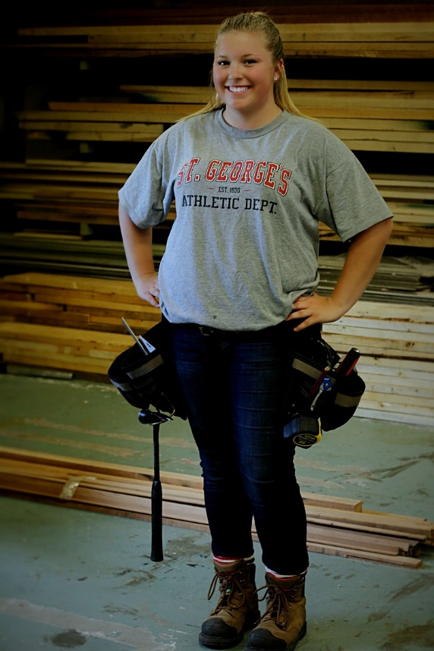
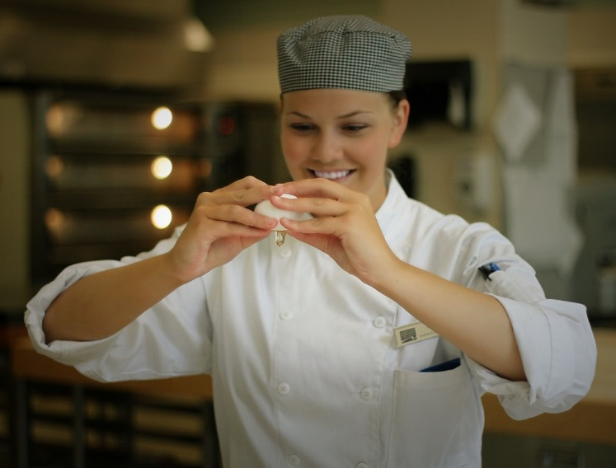
Automotive Collision Repairer
Automotive Painter
Automotive Service Technician
Baker
Bricklayer (Masonry)
Cabinet Maker
Professional Cook
Electrician
Hairstylist
Heavy Duty Mechanic
Metal Fabricator
Millwright
Motorcycle Mechanic
Commercial Painter
Plumber
Sheet Metal Worker
Welder

Slide 14
TRAIN contact
WORK contact
Info + Apps
@HW Tuesdays:
Doug MacLean
e: DMaclean@sd43.bc.ca
c: 604-341-8977
Joanna Horvath
e: JHorvath@sd43.bc.ca
c: 604-312-7739
www.43Careers.com
Ashely Impellezzere
aimpellezzere@sd43.bc.ca

Slide 15
Thinking Ahead… College In BC
Grade 12 Graduation Minimum:
Some programs require minimum English marks
Check individual program requirements
College can be equivalent to university, and even better (grades are higher, smaller classes, cost)

Slide 16
Thinking Ahead…University In BC
English 12 and anywhere from 3-5 more Approved Academic Courses
(each University has its own list of what they consider to be “approved”)
Grade 11 marks are now often used as part of the admissions process
Grade 9 and 10 marks are used for schools in the U.S.
BE AWARE of minimum marks for Math 11 and English 12
BE AWARE of Language Requirements
Universities outside of BC often have more requirements
CHECK THE UPDATED REQUIREMENTS FOR EACH INSTITUTION CAREFULLY

Slide 17
Online, Summer School, Repeated Courses
Some universities prefer student take all classes in regular day school – not online, not summer school.
For some universities, online courses have specific completion dates that are earlier than taking the course at HWSS
Some schools will not accept the mark for a repeated course (particularly for Engineering or Business) or will automatically deduct % off.

Slide 18
Thinking ahead…volunteer, work, travel, apprenticeship…
Visit the
Career Resource Centre

Slide 19
Because there are many options after graduation…
Trade Schools
Apprenticeships
College
University
Institutes
Travel
Workforce
….

Slide 20
How to help your child decide?
Think about:
What do they like to do?
Where do they excel?
Their skills and talents?
Challenge them to try something new
What are their ideas for after high school?
What is REALISTIC?
TALK TO PEOPLE
What courses will look good on a resume for their career, life, or school goals after graduation?
What courses will give them the skills they need after graduation?

Slide 21
Take time – These are important decisions
The course planning booklet is on our website. Please read through course descriptions carefully.
Your child’s choices NOW determine the courses offered in our school timetable
There are many reasons your child may not get all of their requests (conflict, courses not running, courses are full…)
We will not be able to make changes based on:
Friends
Teacher preference
Semester
Time of Day
Once they know what courses they want, it is time to fill in the course selection sheet.

Slide 22
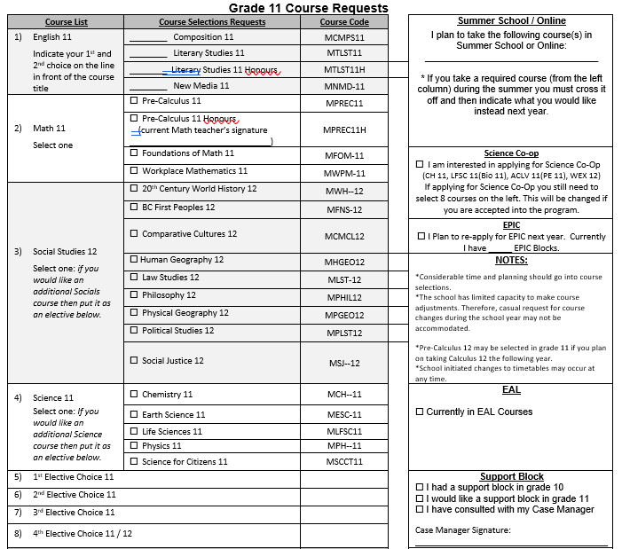
Course Request Form (gr 11 example)
English 11 preference
If choosing more than one option in a category, don’t check it, put it under electives
Electives:
Put in order of preference! Double check that name and code match
Fill out if applicable

Slide 23
Course Request Form
Fill it out completely…. DON’T FORGET to put your elective choices in order of preference.
Elective codes are on the reverse side of sheet
You MUST include two ALTERNATIVES…these are just as important
Pay attention to P1, L, PM or # as these courses are “ADDITIONAL ELECTIVES” and do NOT count as your 8 courses that you must take!
The choices you make now DETERMINE the courses we have

Slide 24
Course Selection Forms are DUE: THURSDAY Feb 13^{h}
Hand in to Blk 4 Teacher

