Slide 1
Grade 9 Parent Information Night
Welcome
Notes:
Heather

Slide 3
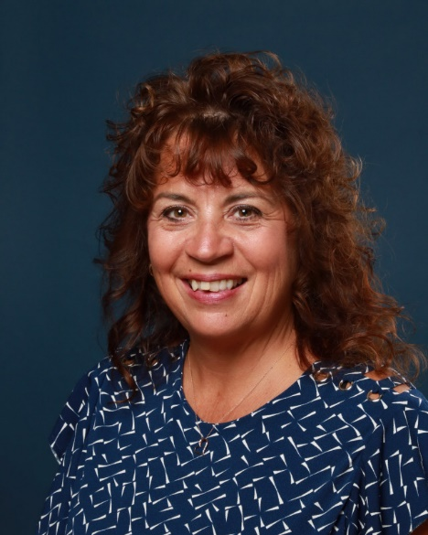
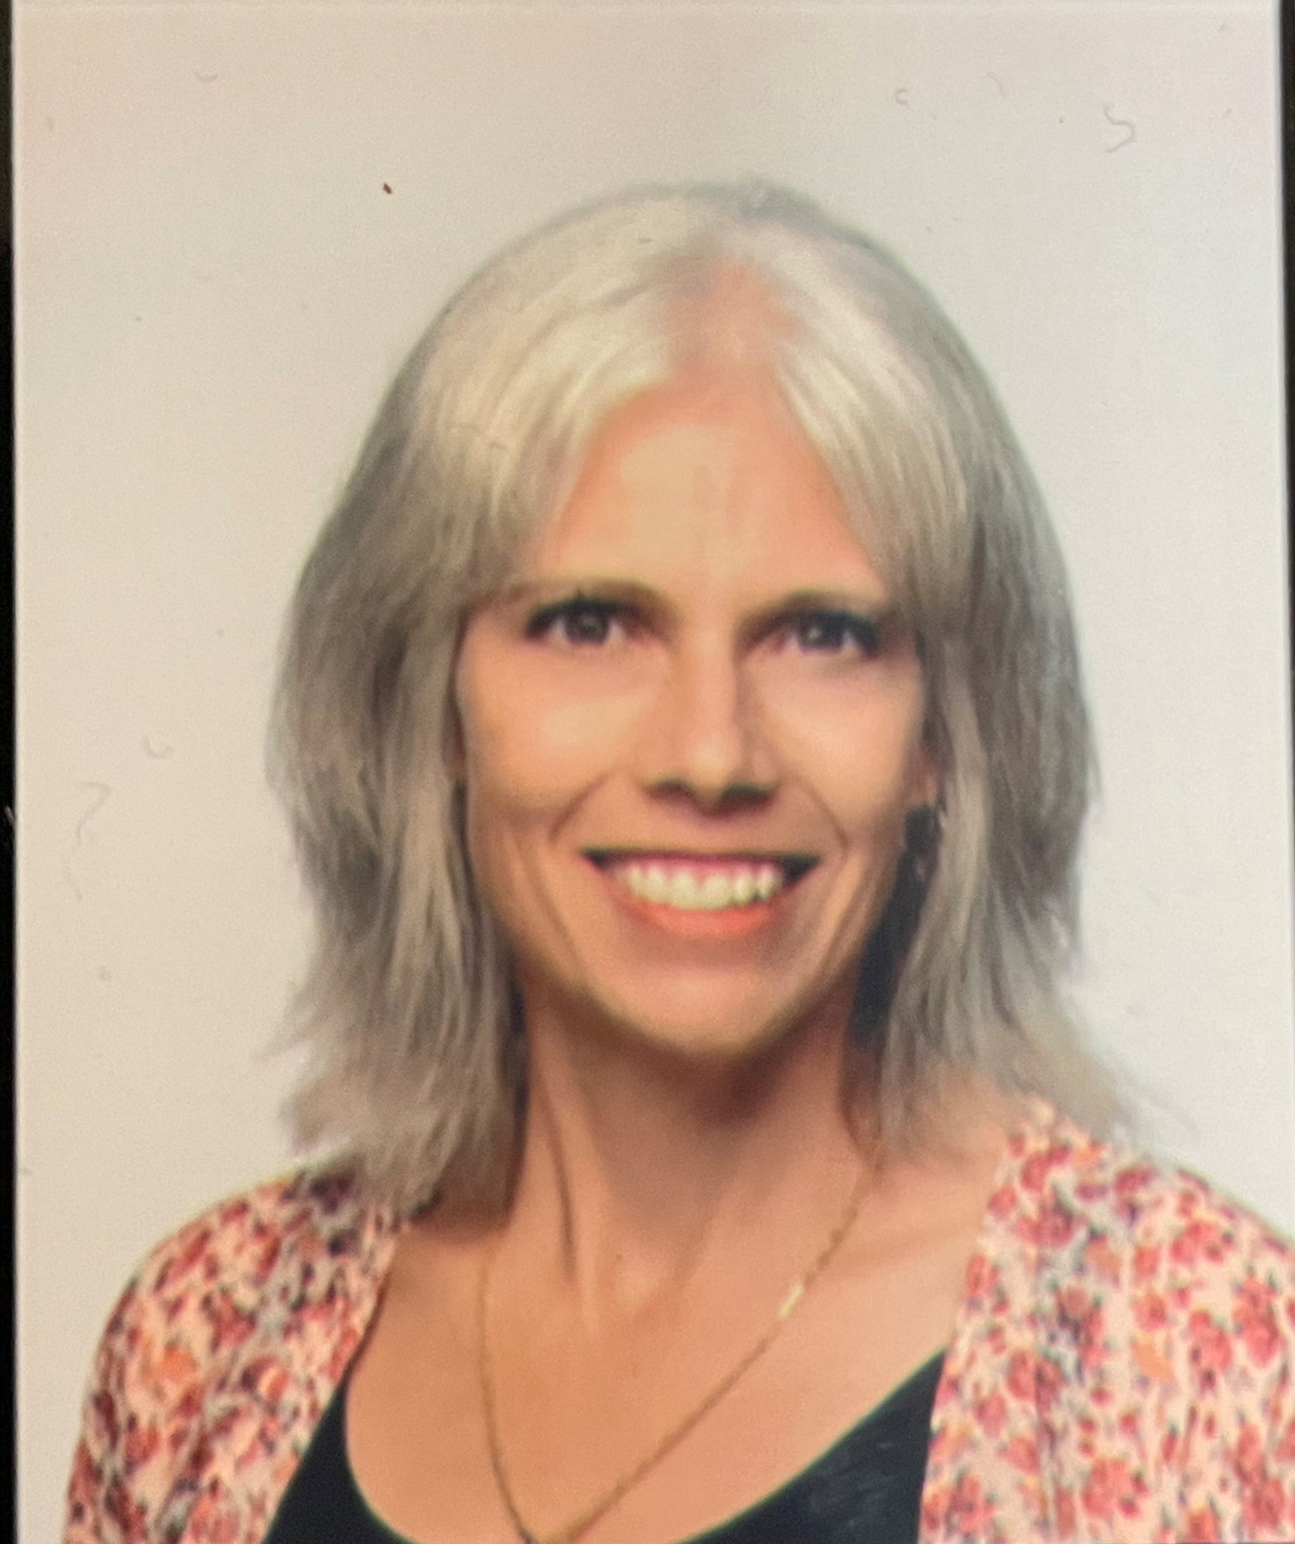
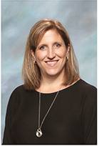
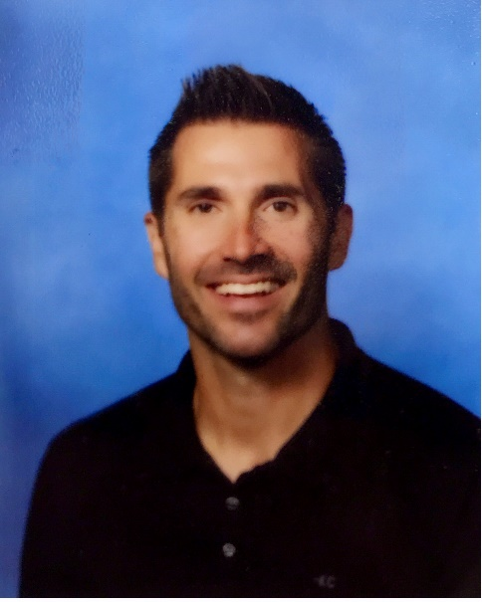
Administration
Principal
Ms. Murphy
Vice-Principal
Ms. Ciolfitto
(A – G)– L)
Vice-Principal
Ms. Fridge
(H - O)
Vice-Principal
Mr. Nelson
(P - Z)
Notes:
Heather

Slide 4
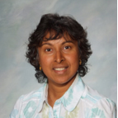
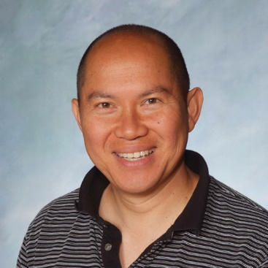
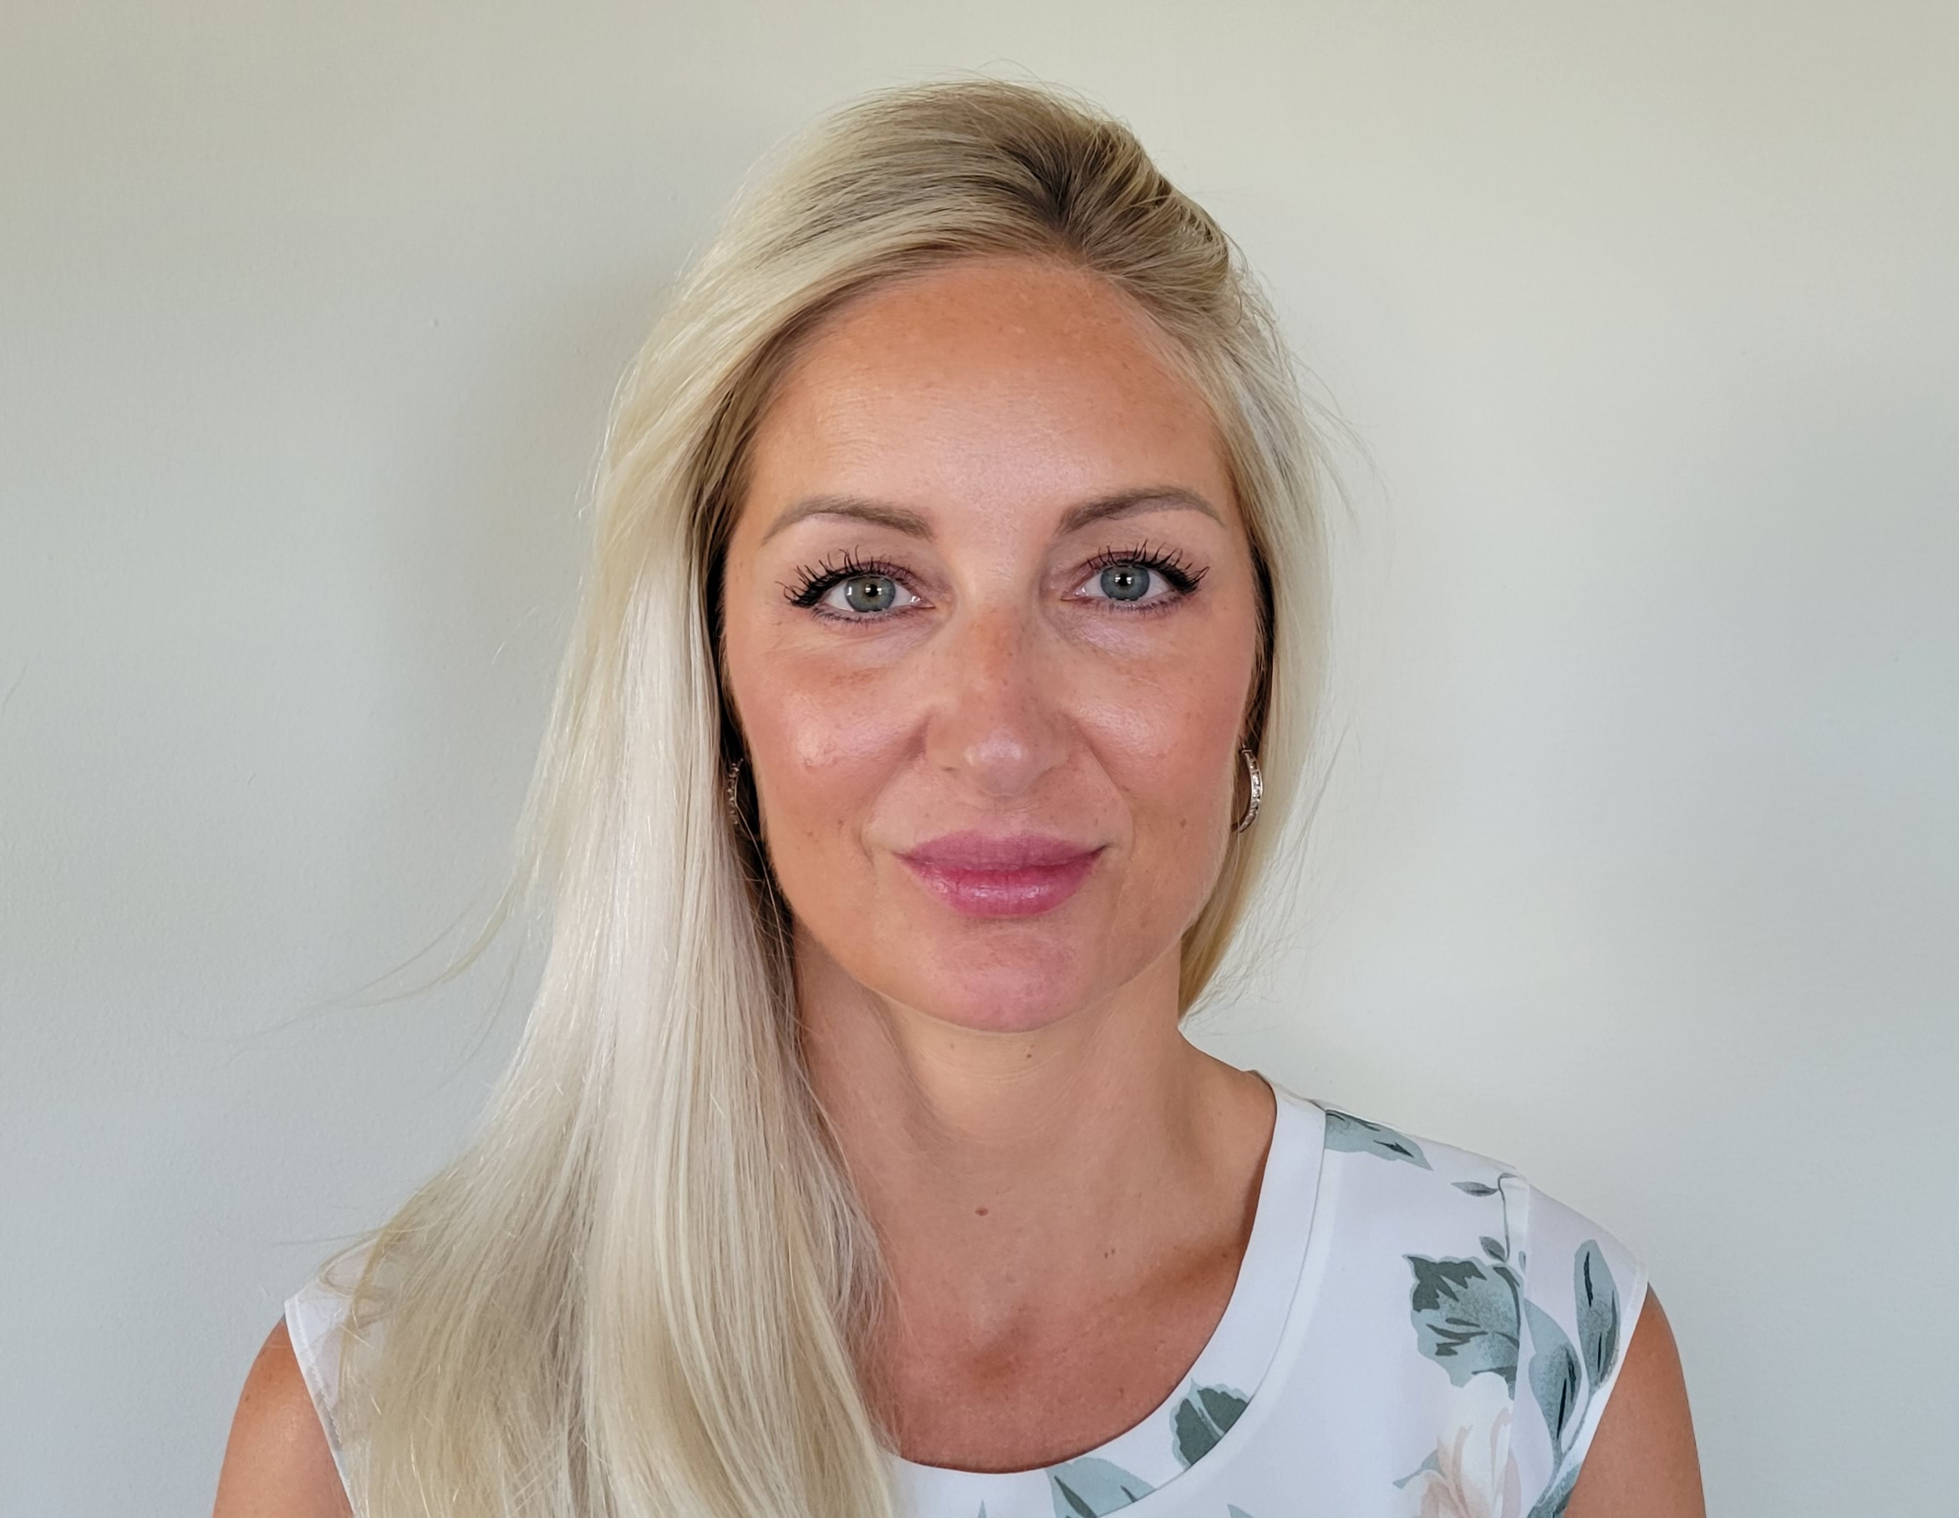
Counsellors
Ms John Mr Chang Ms Birsan
A-G H-O P-Z
Notes:
Warren

Slide 5
Charles Best PAC
Insta: @charlesbestpac
Email: bestpacchair@gmail.com
PAC Chairperson : Graehem Illman
Home | Dr. Charles Best Secondary PAC (bestpaccomms.wixsite.com)
Oct 3
Nov 6
Jan 8
Mar 4
May 6
7 pm in the library

Slide 6
YMCA

Slide 7
Student Council

Slide 8
Things students love about high school
More freedom and also MORE responsibility
Variety of elective classes
Learning more targeted to personal and career interests
Cafeteria that has lots and lots of food
80 minute lunch break
Clubs and teams for every interest and ability
Notes:
Couns.

Slide 9
Some of the Challenges
Responsibility – effectively managing the greater freedom
Rigorous course load and pacing
Semester system (5 months of the same classes each day)
Staying organized
Homework completion
More tests and quizzes
Performance anxiety
Peer relationships
Notes:
Couns

Slide 10
What students can do to help themselves
Attend every class, every day
Use a system to keep their binder and school supplies organized
Use a planner
Learn and use strategies to manage their time and resources
Check in regularly with the teacher, tutor or another person for help
Implement the Healthy Mind Platter (Dan Siegel, more later)
Notes:
Couns

Slide 11
 | Monday | Tuesday | Wednesday | Thursday | Friday | Saturday | Sunday
5:00am
6:00am
7:00am
8:00am | S | C | H | OO | L
9:00am | Due: | Due: | Due: | Due: | Due:
10:00am |  |  | Sc 10 p 24 #1-10 | Socials test | Math test:
11:00am |  |  | (need 1 hr) | WW2 | fractions
12:00pm |  |  |  | (need 1.5 h) | (need 2h) | Job
1:00pm |  |  |  |  | English essay | Job
2:00pm |  |  |  |  | (need2.5h) | Job
3:00pm |  |  |  |  |  | Job
4:00pm | snack | snack | snack | snack | snack | Job | H/W
5:00pm | Volleyball |  | Volleyball | Violin practice |  | Job | H/W
6:00pm | Volleyball | Dinner | Volleyball | Dinner
7:00pm | Dinner | Soccer | Dinner | H/W
8:00pm | H/W | Soccer | H/W | H/W
9:00pm | H/W | H/W | H/W
10:00pm |  | H/W |  |  |  |  | Bedtime
11:00pm | Bedtime | Bedtime | Bedtime | Bedtime
12:00am |  |  |  |  |  | Bedtime
1:00am |  |  |  |  | Bedtime
 | -Science questions (1h) - Start English essay (1h) | - Study for Math (1h) -Complete any extra science questions | -Study for Socials test (1.5h) -English essay (0.5h) | -Study for math (1h) -Finish English essay (1h)
Homework:
Notes:
Assignments due
How long to complete assignments
Assign 2 hours of study time every night (5x weekly should be enough)
Put in homework in study time
What about perfectionists? Focus on “Excellence” instead of “Perfection” . No one is perfect. Excellence= doing the best you can under the given circumstances. For me: getting 52% in English 100.

Slide 12
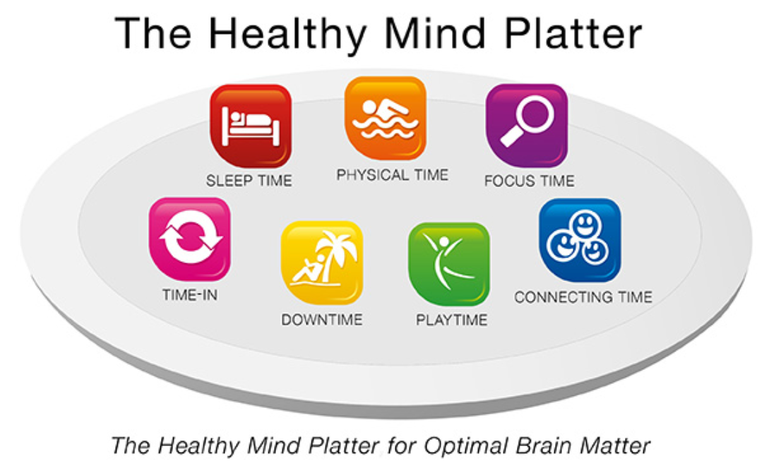
Notes:
Couns.Consider how your child might portion out a representation of how much of their day is spent on each element of the platter. How might you help balance things?

Slide 13
How parents can help
During times of change and transition, there is a need to support our kids more
Help with organization- model processes and strategies
Show interest in homework
Become familiar with Teams sites
Reach out to teachers
Balance Co-regulation and self-regulation
Encourage, encourage
Keep lines of communication open
Monitor for behaviour changes
Notes:
Couns

Slide 14
Informative Books
Why We Sleep by Matthew Walker
The Confidence Gap by Russ Harris
Grit – The Power of Passion and Perseverance by Angela Duckworth
Hold Onto Your Kids by Dr. Gabor Mate & Dr. Gordon Neufeld
Atomic Habits James Clear

Slide 15
Contact teachers: (first initial)(lastname)@sd43.bc.ca e.g. fsmith@sd43.bc.ca
Attendance
Process: charlesbestattendance@sd43.bc.ca
include in email child’s full name, grade, absence reason, specific dates student is away and returning
Semester 1 closed campus
Notes:
Kelly

Slide 16
Athletics-Autumn Options
Soccer (boys)
Mr. Karmali
Swimming
Mr. Choi
Field Hockey
Ms. Jenkins
Volleyball
Mr. Chang/Mr. Raabe
Cross Country
Mr. Gant
Notes:
Kelly

Slide 17
Athletics-Winter Options
Soccer (Girls)
Mr. Karmali
Basketball
Mr. Percevault
Rugby
Mr. Startin
Badminton
Mr. Chang
Track & Field
Mr. Gant
Notes:
Kelly

Slide 18
Get Involved - Clubs
Club Day Wednesday, September 20th was a success!
38 Clubs offered this year
Club List posted in the front foyer. Contact sponsor teacher to get involved.
Notes:
Kelly

Slide 19
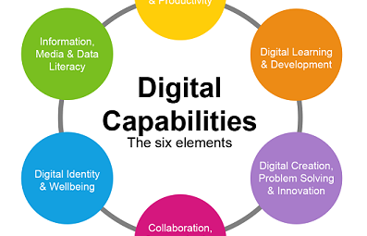
Digital Learning 10 A Grade 9 course for success at Best
Prepare students for the digital world
Develop Positive Digital Citizens
Ensure that students are safe online
Build community, participation, and belonging
Notes:
Joel

Slide 20
Digital Learning 10
Please encourage your child to check Teams regularly for Monthly assignments.
Parents will receive regular updates through email
Students will receive support on their lunch in the Tech Center.
Notes:
Joel

Slide 21
Nov. 1 Take Our Kids to Work Day
There will be no grade 9 classes at Charles Best on Nov. 1
Grade 9 students are responsible for making arrangements with a parent, guardian, aunt, uncle, neighbour, family-friend to attend a workplace on Nov. 1
Grade 9 students will complete an assignment in their DL10 Team during or after their experience on Nov. 1 – reflecting on the physical work environment (ex. would they rather work in a library, in a park, or in a hospital emergency room?)
Career Education begins Nov. 1 and continues throughout high school with Career Life Education 10 and Career Life Connections 12.
Notes:
Michelle

Slide 22
Reporting- some changes
Everyone will receive a Learning Update in mid-October
Greater focus on Competencies
Proficiency Scale instead of % or LG
Extending
Proficient
Developing
Emerging
Report will have comments that describe what ‘s working, what’s next for you and include a comment about your work habits/ engagement in class

Slide 23
New Reporting Order

Slide 24
Same Timeline
NOV 2023
Sem 1 Midterm Report
Oct 2023
Sem 1 Learning Update
JAN 2023
Sem 1 Final Report
MAR 2024
Sem 2 Learning Update
Apr 2023
Sem 2 Midterm Report
June 2024
deploy strategic networks with compelling e-business needs

Slide 25
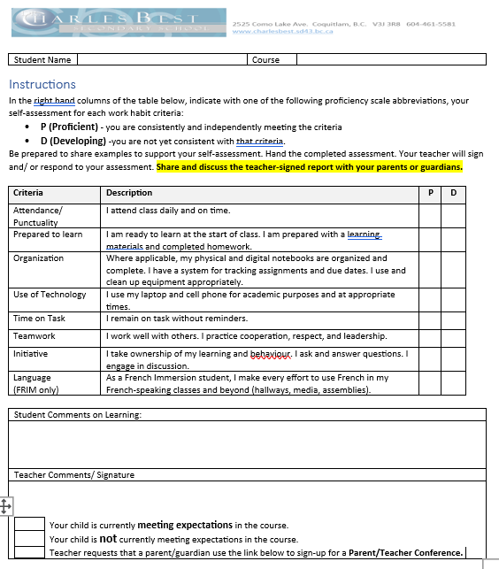
Oct 11-First Learning Update
Describes learning behaviours in each class.
No details about “marks” or progress yet.
Teacher may request Parent – Teacher conference. Link to book embedded in report.

Slide 26
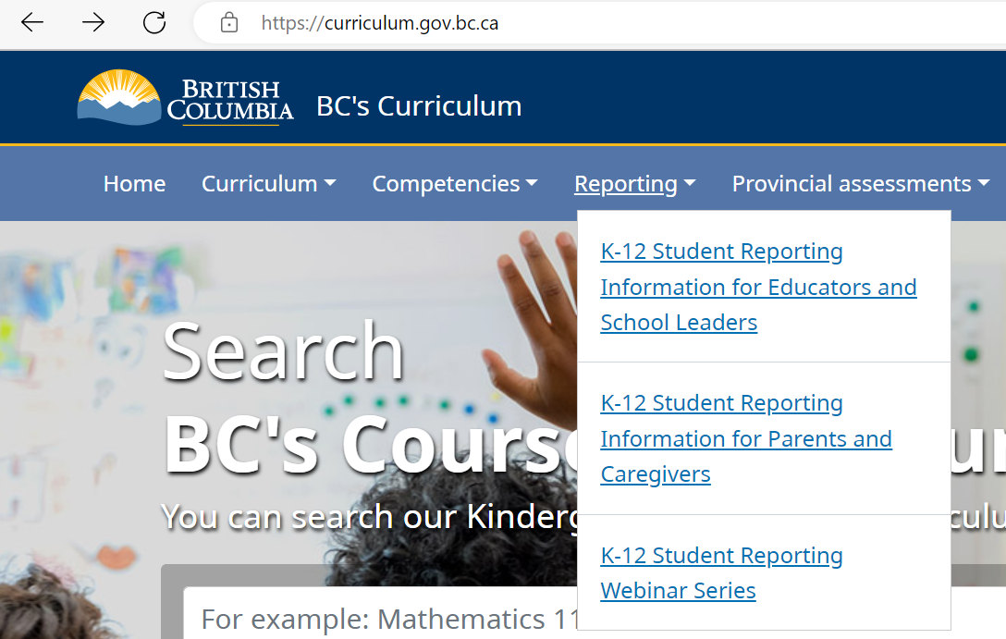
Where to find more information
Shifts in Student Reporting (gov.bc.ca)
Notes:
Addressed slides 12-18 in Ministry slides (information for Parents and Caregivers link)

Slide 27
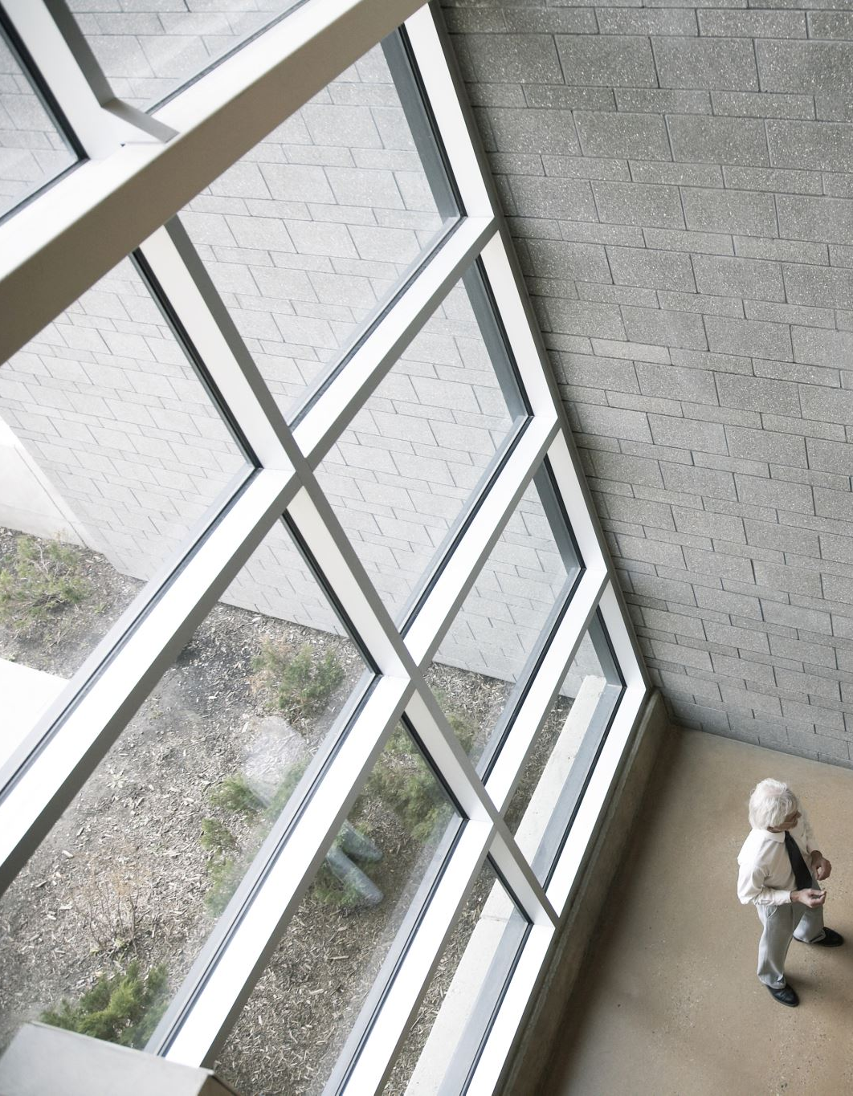
FRIM stream – Please stay here
English stream - Campus Walkabout
Admin / Counsellors/ Student Leadership will be around to answer questions on each floor
Notes:
Heather/ Pierre Henri

Slide 28
Campus Walkabout Some Points of Interest
First Floor
Foods Room / Math Tutorial Room
Main Floor
Gyms / Cafeteria/LRC
Third Floor
Library Learning Commons
Outside
6-Plex / Outdoor classroom / Turf Fields
Notes:
Heather

