Slide 1
TRAIN in Trades Programs
Amazing opportunity for any grade 11 or 12 student to take one of 22+ “Train in Trades” programs:
Tuition Free – saves $1,000s
Post Secondary level training
Level 1 Certification
Dual /Triple Credits:
high school
post secondary and/or
industry

Slide 2
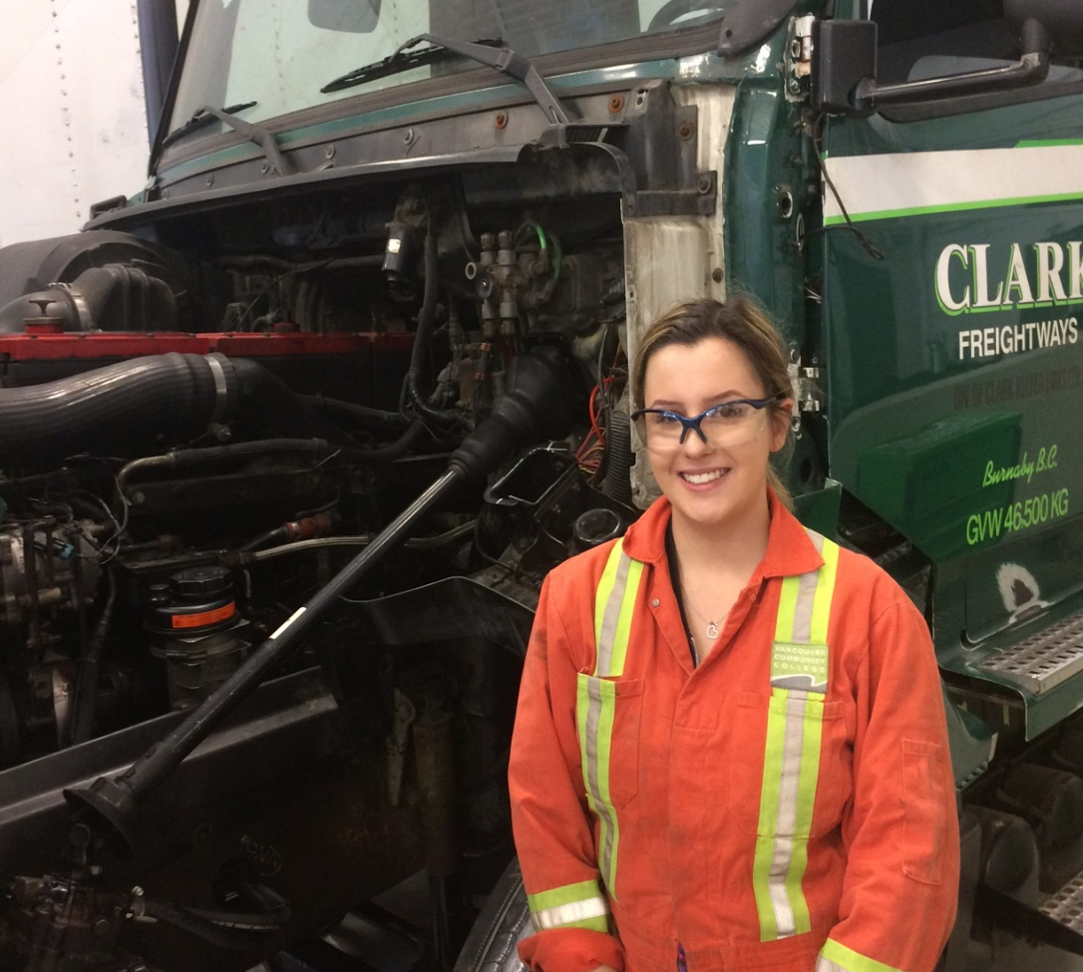
Aircraft Maintenance Engineer
Appliance Service Tech
Auto Collision + Refinishing Tech
Automotive Service Tech
Baker
Bricklayer
Cabinet Maker (Joiner)
Carpenter
CNC-Machinist
(Professional) Cook
Electrician
TRAIN in Trades Programs

Slide 3
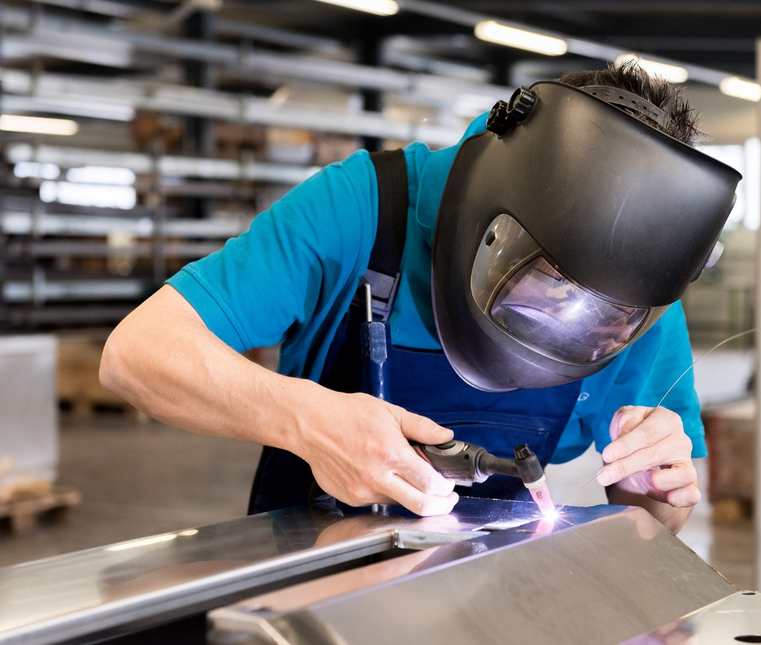
Hairstylist
Heavy Duty Mechanic
Ironworker
Metal Fabricator
Millwright
Motorcycle Mechanic
(Commercial) Painter
Plumber
Refrigeration Mechanic
Sheet Metal Worker
Welder
TRAIN in Trades Programs

Slide 4
WORK in Trades Program
popular student jobs
carpenter
cook
landscaper
mechanic
floorlayer
Regardless of your career aspirations… if you have/get a paying job in a trade you can receive credits toward high school graduation:
120 hrs working = 4 credits (up to 16 credits)
900+ hrs worked (before age of 20) could qualify student for a $1,000 award… gave out 30+ scholarships last year
if you later pursue that trade career, those hours count towards certification

Slide 5
TRAIN contact
WORK contact
More Info
www.43Careers.com
Doug MacLean
e: DMaclean@sd43.bc.ca
c: 604-341-8977
Joanna Horvath
e: JHorvath@sd43.bc.ca
c: 604-312-7739
Parent-Student Info Session
Wed., Feb. 16 at 6.00pm
Contact Doug or Joanna for more information and the Teams meeting link

